Slide 1
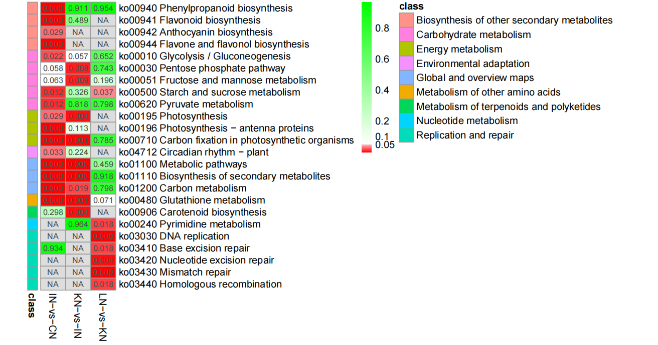
Fig. S1. The root samples were respectively collected at 0 h (CN), 6 h (IN), 12 h (KN) and 24 h (LN) after GXS16 inoculation, and the KEGG pathway enrichment of DEGs in the comparison of IN vs CN, KN vs IN, and LN vs KN.

