Slide 1
A new microfluidic concept for successful in vitro culture of mouse embryos
V. Mancini and P.J McKeegan, A.C. Rutledge, S.G. Codreanu, S.D. Sherrod, J.A. McLean, H.M Picton, V. Pensabene

Slide 2
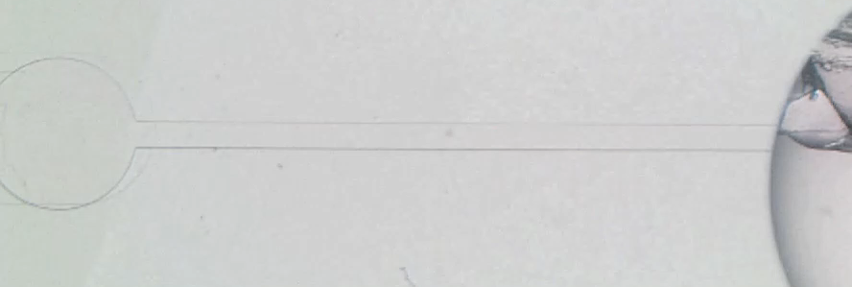
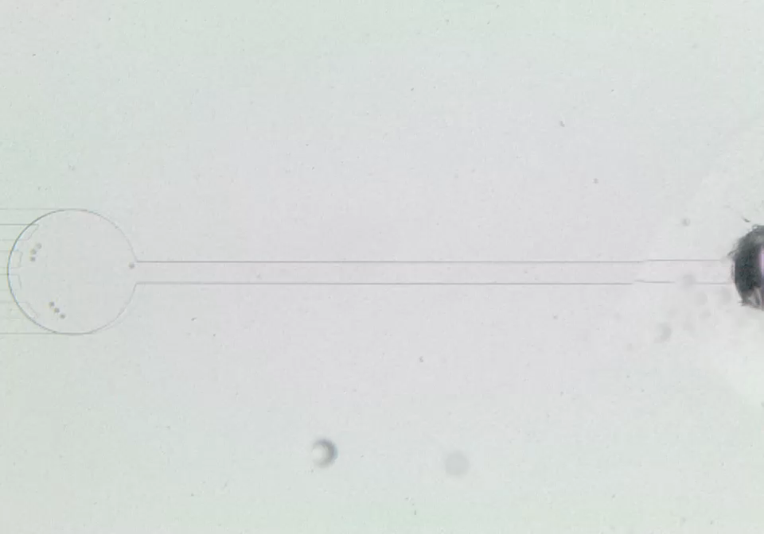
Supplementary videos
Video 1 Loading
Chamber
Microfluidic Channel
Access port
Video 2 Retrieval
Notes:
HP feedback- good slide

