Slide 1
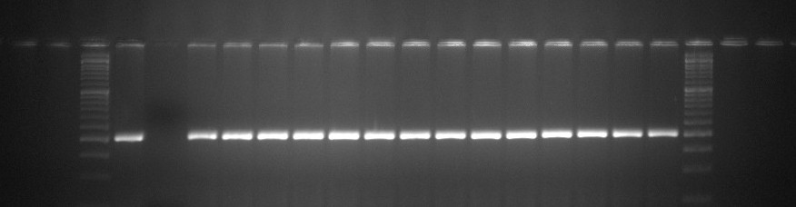
L
Positive parent
Negative parent
MSS-8
MSS-9
MSS-28
MSS-31
MSS-37
MSS-52
MSS-76
MSS-84
MSS-88
MSS-93
MSS-101
MSS-103
MSS-122
MSS-128
L
S M
Supplementary Figure 1A: PCR amplification of Sub1 QTL controlling submergence tolerance using Sub1-A203 marker in
BC1F1 progenies

Slide 2
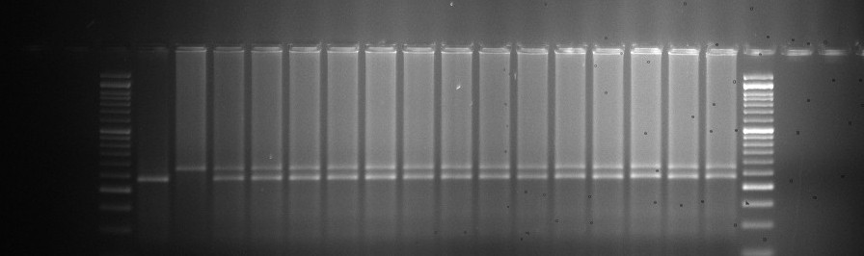
L
Positive parent
Negative parent
MSS-8
MSS-9
MSS-28
MSS-31
MSS-37
MSS-52
MSS-76
MSS-84
MSS-88
MSS-93
MSS-101
MSS-103
MSS-122
MSS-128
L
S M
Supplementary Figure 1B: PCR amplification of Sub1 QTL controlling submergence tolerance using Sub1-BC2 marker in BC1F1 progenies

Slide 3
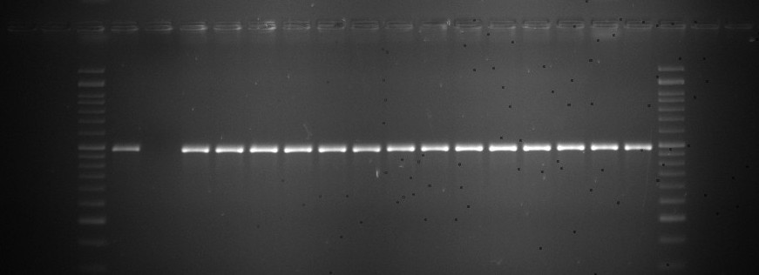
L
Positive parent
Negative parent
MSS-8
MSS-9
MSS-28
MSS-31
MSS-37
MSS-52
MSS-76
MSS-84
MSS-88
MSS-93
MSS-101
MSS-103
MSS-122
MSS-128
L
M S
Supplementary Figure 1C: PCR amplification of markers for yield component QTL, OsSPL14 in
BC1F1 generation

Slide 4
L
Positive parent
Negative parent
MSS-8
MSS-9
MSS-28
MSS-31
MSS-37
MSS-52
MSS-76
MSS-84
MSS-88
MSS-93
MSS-101
MSS-103
MSS-122
MSS-128
L
S M
Supplementary Figure 1D: PCR amplification of markers for yield component QTL, GW5 in
BC1F1 generation

Slide 5
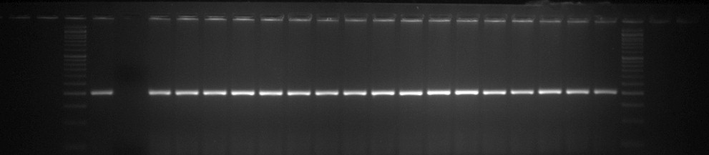
L
Positive parent
Negative parent
MSS-84-3
MSS-84-7
MSS-84-9
MSS-84-10
MSS-84-22
MSS-84-29
MSS-84-42
MSS-128-69
MSS-128-73
MSS-128-82
MSS-128-102
MSS-128-109
MSS-128-111
MSS-128-138
MSS-128-153
MSS-128-157
MSS-128-169
L
S M
Supplementary Figure 2A: PCR amplification of Sub1 QTL controlling submergence tolerance using Sub1-A203 marker in
BC2F1 progenies

Slide 6
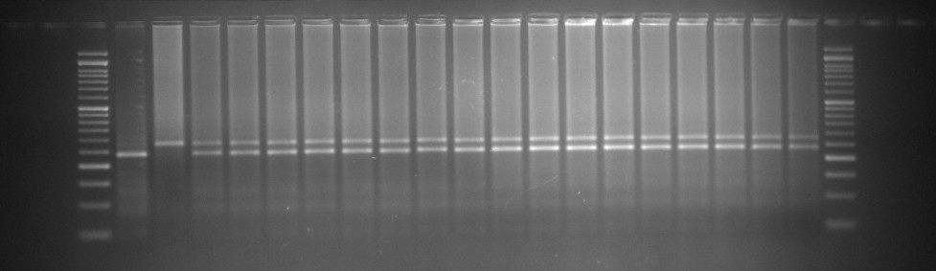
L
Positive parent
Negative parent
MSS-84-3
MSS-84-7
MSS-84-9
MSS-84-10
MSS-84-22
MSS-84-29
MSS-84-42
MSS-128-69
MSS-128-73
MSS-128-82
MSS-128-102
MSS-128-109
MSS-128-111
MSS-128-138
MSS-128-153
MSS-128-157
MSS-128-169
L
S M
Supplementary Figure 2B: PCR amplification of markers for submergence tolerance, Sub1 in
BC2F1 generation deploying marker, Sub1-BC2

Slide 7
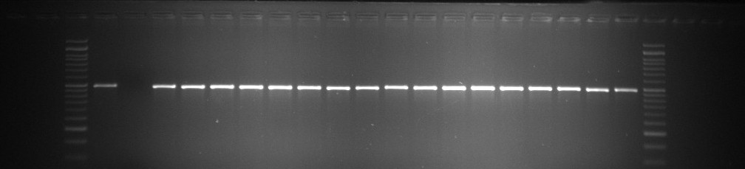
L
Positive parent
Negative parent
MSS-84-3
MSS-84-7
MSS-84-9
MSS-84-10
MSS-84-22
MSS-84-29
MSS-84-42
MSS-128-69
MSS-128-73
MSS-128-82
MSS-128-102
MSS-128-109
MSS-128-111
MSS-128-138
MSS-128-153
MSS-128-157
MSS-128-169
L
M S
Supplementary Figure 2C: PCR amplification of markers for yield component QTL, OsSPL14 in
BC2F1 generation

Slide 8
L
Positive parent
Negative parent
MSS-84-3
MSS-84-7
MSS-84-9
MSS-84-10
MSS-84-22
MSS-84-29
MSS-84-42
MSS-128-69
MSS-128-73
MSS-128-82
MSS-128-102
MSS-128-109
MSS-128-111
MSS-128-138
MSS-128-153
MSS-128-157
MSS-128-169
L
S M
Supplementary Figure 2D:PCR amplification of markers for yield component QTL, GW5 in
BC2F1 generation

Slide 9
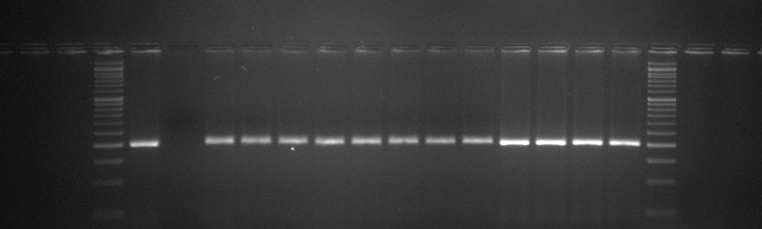
L
Positive parent
Negative parent
MSS-128-102-21
MSS-128-102-22
MSS-128-102-47
MSS-128-102-58
MSS-128-102-60
MSS-128-102-63
MSS-128-102-78
MSS-128-102-82
MSS-128-102-97
MSS-128-102-129
MSS-128-102-133
MSS-128-102-138
L
S M
Supplementary Figure 3A: PCR amplification of Sub1 QTL controlling submergence tolerance using Sub1-A203 marker in
BC3F1 progenies

Slide 10
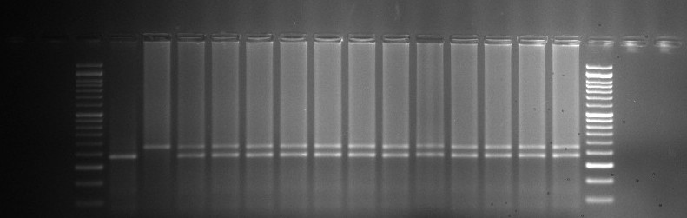
L
Positive parent
Negative parent
MSS-128-102-21
MSS-128-102-22
MSS-128-102-47
MSS-128-102-58
MSS-128-102-60
MSS-128-102-63
MSS-128-102-78
MSS-128-102-82
MSS-128-102-97
MSS-128-102-129
MSS-128-102-133
MSS-128-102-138
L
S M
Supplementary Figure 3B:PCR amplification of Sub1 QTL controlling submergence tolerance using Sub1-BC2 marker in
BC3F1 progenies

Slide 11
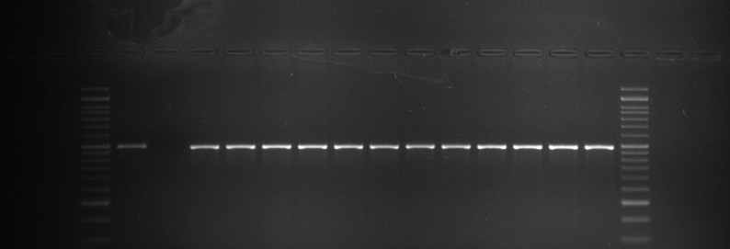
L
Positive parent
Negative parent
MSS-128-102-21
MSS-128-102-22
MSS-128-102-47
MSS-128-102-58
MSS-128-102-60
MSS-128-102-63
MSS-128-102-78
MSS-128-102-82
MSS-128-102-97
MSS-128-102-129
MSS-128-102-133
MSS-128-102-138
L
M S
Supplementary Figure 3C: PCR amplification of markers for yield component QTL, OsSPL14 in
BC3F1 generation

Slide 12
L
Positive parent
Negative parent
MSS-128-102-21
MSS-128-102-22
MSS-128-102-47
MSS-128-102-58
MSS-128-102-60
MSS-128-102-63
MSS-128-102-78
MSS-128-102-82
MSS-128-102-97
MSS-128-102-129
MSS-128-102-133
MSS-128-102-138
L
S M
Supplementary Figure 3D: PCR amplification of markers for yield component QTL, GW5 in
BC3F1 generation

Slide 13
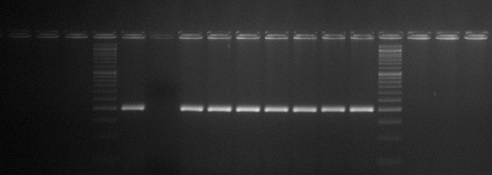
L
Parent
Parent
MSS-128-102-97-68
MSS-128-102-97-117
MSS-128-102-97-335
MSS-128-102-97-436
MSS-128-102-97-601
MSS-128-102-97-613
MSS-128-102-97-617
L
S M
Supplementary Figure 4A: Generation: PCR amplification of Sub1 QTL controlling submergence tolerance using Sub1-A203 marker in BC3F2 progenies

Slide 14
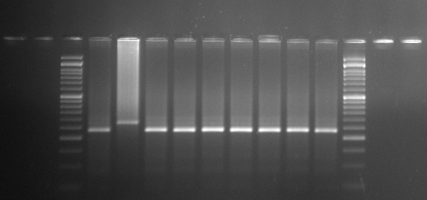
L
Parent
Parent
MSS-128-102-97-68
MSS-128-102-97-117
MSS-128-102-97-335
MSS-128-102-97-436
MSS-128-102-97-601
MSS-128-102-97-613
MSS-128-102-97-617
L
S M
Supplementary Figure 4B:PCR amplification of Sub1 QTL controlling submergence tolerance using Sub1-BC2 marker in
BC3F2 progenies

Slide 15
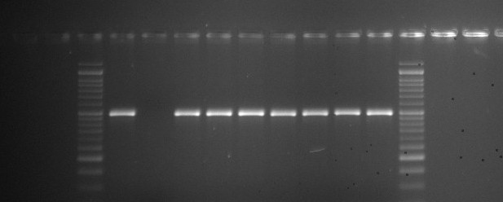
L
Parent
Parent
MSS-128-102-97-68
MSS-128-102-97-117
MSS-128-102-97-335
MSS-128-102-97-436
MSS-128-102-97-601
MSS-128-102-97-613
MSS-128-102-97-617
L
M S
Supplementary Figure 4C:PCR amplification of markers for yield component QTL, OsSPL14 in
BC3F2 generation

Slide 16
L
Parent
Parent
MSS-128-102-97-68
MSS-128-102-97-117
MSS-128-102-97-335
MSS-128-102-97-436
MSS-128-102-97-601
MSS-128-102-97-613
MSS-128-102-97-617
L
S M
Supplementary Figure 4D: PCR amplification of markers for yield component QTL, GW5 in
BC3F2 generation

Slide 17
L
Parent
Parent
MSS-128-102-97-68
MSS-128-102-97-117
MSS-128-102-97-335
MSS-128-102-97-436
MSS-128-102-97-601
MSS-128-102-97-613
MSS-128-102-97-617
L
S M
Supplementary Figure 4E: PCR amplification of markers for yield component QTL, SCM2 in
BC3F2 generation

Slide 18
L
Parent
Parent
MSS-128-102-97-68
MSS-128-102-97-117
MSS-128-102-97-335
MSS-128-102-97-436
MSS-128-102-97-601
MSS-128-102-97-613
MSS-128-102-97-617
L
S M
Supplementary Figure 4F:PCR amplification of markers for yield component QTL, Gn1a in
BC3F2 generation

