Slide 1
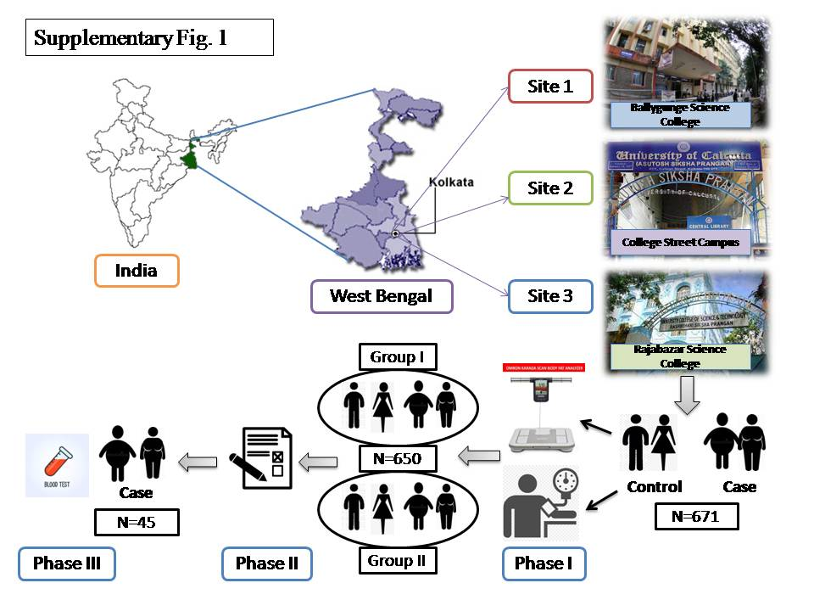
Study method involving data collection from the study site

Slide 2
Supplementary Table 1a: Study group age and frequency
Grouping criteria of the study population
Age | Sex |  | Frequency n (%) | Mean Age ± SD | Mean BMI ± SD
<35 years (n= 232) | Male | Case | 51 (7.8%) | 26.44±4.04 | 28.04±2.44
 |  | Control | 56 (8.6%) |  | 22.61±1.82
 | Female | Case | 65 (10%) | 24.44±3.22 | 28.63±2.65
 |  | Control | 60 (9.2%) |  | 22.39±1.84
>=35 years (n= 418) | Male | Case | 190 (29.2%) | 48.38±7.27 | 27.75±2.24
 |  | Control | 159 (24.4%) |  | 22.83±1.49
 | Female | Case | 50 (7.7%) | 46±6.58 | 29.24±3.13
 |  | Control | 19 (2.9%) |  | 22.78±1.51

Slide 3
Supplementary Table 1b: Socio-demographic details of the study population (n=650)
Socio-demographic characteristics | Sub categories |  | Frequency n (%)
Addiction | Smoking | Male | 139 (21.41%)
 |  | Female | 1 (0.15%)
 | Chewing | Male | 12 (1.8%)
 |  | Female | 0 (0)
 | Alcohol | Male | 79 (12.17%)
 |  | Female | 1 (0.15%)
Food Preference |  | Non-Vegetarian | 627 (96.31%)
 |  | Vegetarian | 19 (2.9%)
 |  |  | Mean ± SD
Daily Water Consumption(L) |  |  | 3.17± 1.18
Working Hours | Age <35 years |  | 10.11± 1.73
 | Age >=35 years |  | 7.65± 1.89
Sleeping Hours | Age <35 years |  | 6.13± 1.46
 | Age >=35 years |  | 6.49± 1.18

Slide 4
Supplementary Table 2: Regression Analyses Results
Parameter 1 | Sex | Parameter 2 | Linear Regression (R² ) | Std Beta | P Value
WbSb% | Male | VF% | 0.54 | 0.73 | <0.001
 |  | BMI | 0.49 | 0.7 | <0.001
 | Female | VF% | 0.51 | 0.71 | <0.001
 |  | BMI | 0.63 | 0.79 | <0.001
WbSk% | Male | VF% | 0.32 | -0.57 | <0.001
 |  | BMI | 0.16 | -0.4 | <0.001
 | Female | VF% | 0.25 | -0.5 | <0.001
 |  | BMI | 0.23 | -0.48 | <0.001
SBP | Male | VF% | 0.009 | 0.09 | 0.048
 |  | BMI | 0.002 | 0.04 | 0.29
 | Female | VF% | 0.13 | 0.36 | <0.001
 |  | BMI | 0.06 | 0.26 | <0.001
DBP | Male | VF% | 0.02 | 0.16 | <0.001
 |  | BMI | 0.02 | 0.14 | <0.005
 | Female | VF% | 0.14 | 0.37 | <0.001
 |  | BMI | 0.11 | 0.33 | <0.001
MAP | Male | VF% | 0.02 | 0.14 | <0.005
 |  | BMI | 0.01 | 0.11 | <0.05
 | Female | VF% | 0.16 | 0.4 | <0.001
 |  | BMI | 0.1 | 0.32 | <0.001
PA | Male | VF% | 0.008 | -0.089 | 0.075
 |  | BMI | 0.007 | -0.081 | 0.1
 | Female | VF% | 0.02 | -0.16 | 0.047
 |  | BMI | 0.03 | -0.18 | <0.05

Slide 5
Supplementary Table 3: Biochemical Parameters Analyzed from Blood
 | Sl. No. | Name of Test | Reference Range
Glucose Profile | 1 2 3 | Fasting Blood Sugar Average Blood Sugar HbA1C | 70-105 mg/dl 90-180 mg/dl <6-<8%
Ion Profile | 4 5 6 7 8 9 | Vitamin D Vitamin B Calcium (Ca) Iron (Fe) Fe binding Transferrin % | <20 ng/ml 211-911 pg/ml 8.8- 10.6 mg/dl Male= 65-175, Female= 50-170 µg/dl Male= 225- 535, Female= 215- 535 µg/dl 13-45
Lipid Profile | 10 11 12 13 14 | Total Cholesterol HDL LDL Triglycerides VLDL | 125- 200 md/dl 35-80 mg/dl 85- 130 mg/dl 25- 200 mg/dl 5- 40 mg/dl
Renal Profile | 15 16 17 18 19 | Uric Acid Serum Creatinine Protein Serum Albumin Serum Globulin | 3.1- 7.8 mg/dl 0.5- 0.8 mg/dl 5.7- 8.2 gm/dl 3.2- 4.8 gm/dl 2.5- 3.4 gm/dl
Thyroid Profile | 20 21 22 | T3 T4 TSH | 60-180 ng/dl or 0.9-2.8 nmol/L 4.5- 12 µg/dl 0.3- 5.5 µIU/ml
Liver Profile | 23 24 25 26 27 | Alkaline phosphatase Billirubin GGT SGOT SGPT | 42-98 U/L 0.3- 1.2 mg/dl <38 U/L <40 U/L 13-40 U/L
Complete Blood Count | 28 29 30 31 32 33 34 35 36 37 38 39 40 41 42 43 44 45 46 47 48 | Total Leukocytes Neutrophils Lymphocytes Monocytes Eosinophils Basophils Absolute Neutrophil Absolute Lymphocytes Absolute Monocytes Absolute Eosilophils Absolute Basophils Total RBC Heamoglobin PCV MCV MCH MCHC RDW-CV PDW MPV Platelet Count | 4-10 X 10³ / μL 40-80% 20-40% 0-10% 0-6% <2% 2-7 X 10³ / μL 1-3 X 10³ / μL 1-2 X 10³ / μL 0.02-0.5 X 10³ / μL 0.02-0.1 X 10³ / μL Male=4.7- 6.1, Female=4.2-5.4 X 10^6/μL 12-17 gm/dl 36-46% 80-101fL 27-32pQ 31.5-34.5 g/dl 11.6-14% 9.6-15.2fL 6.5-12fL 150-400x 10³ / μL

Slide 6
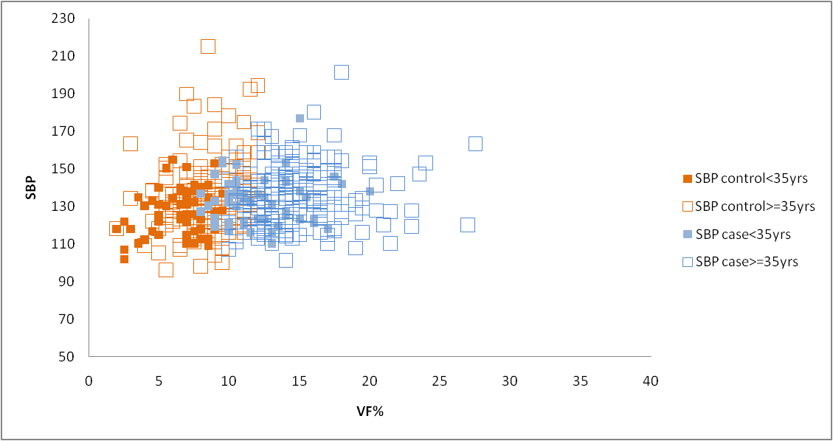
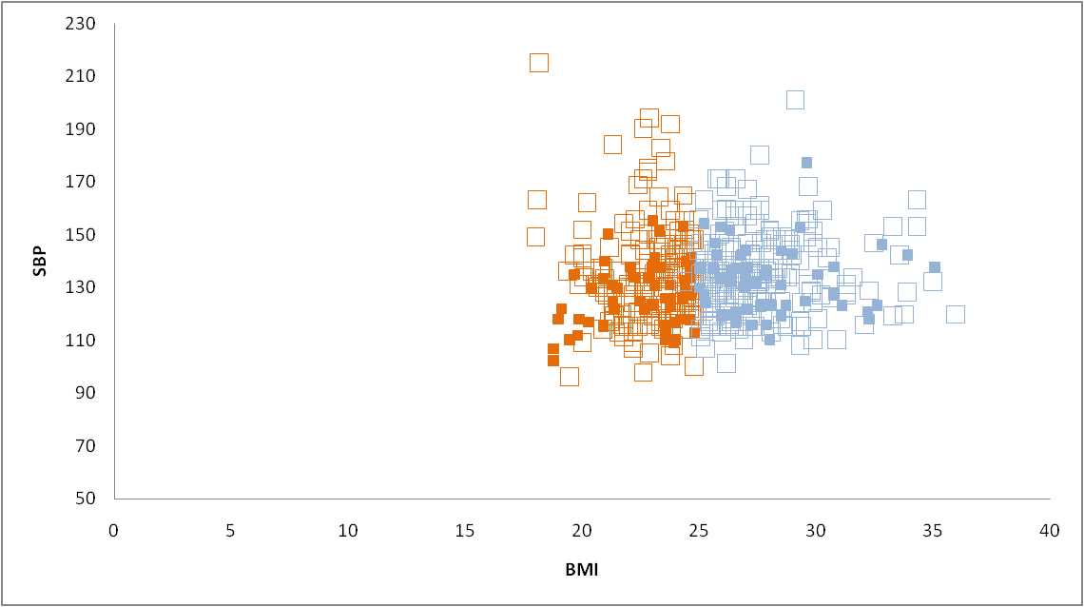
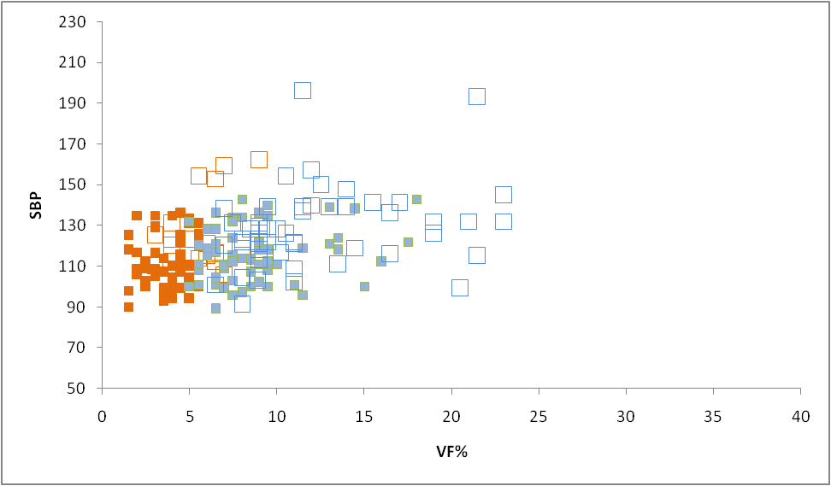
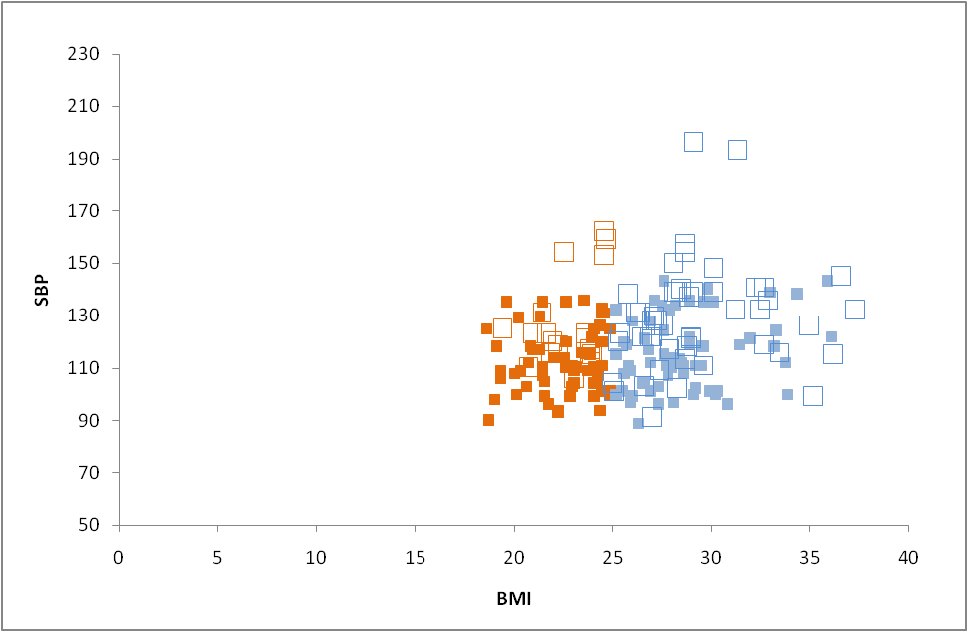
Supplementary Fig. 2
a
b
c
d
Association between VF% and SBP in the total male population (a) and female population (c)
Association between BMI and SBP in the total male population (b) and female population (d)

Slide 7
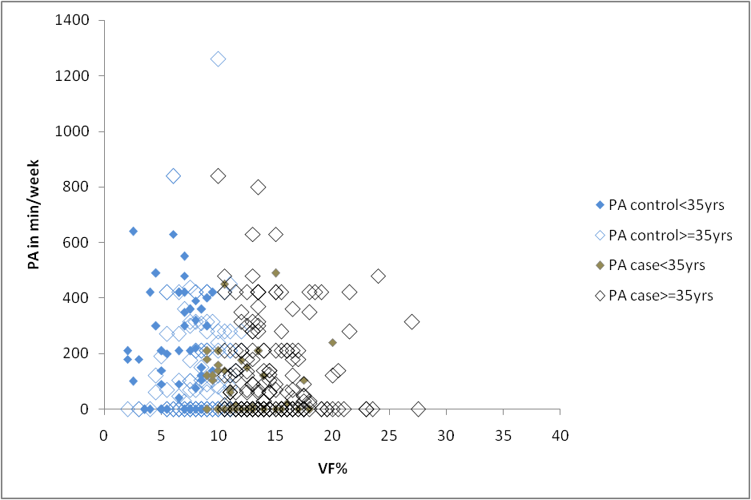
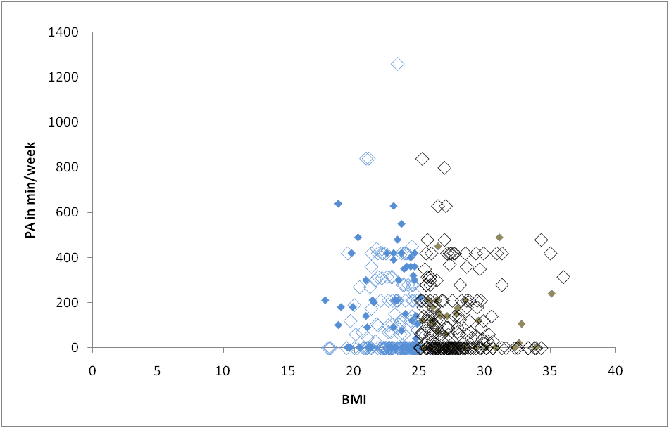
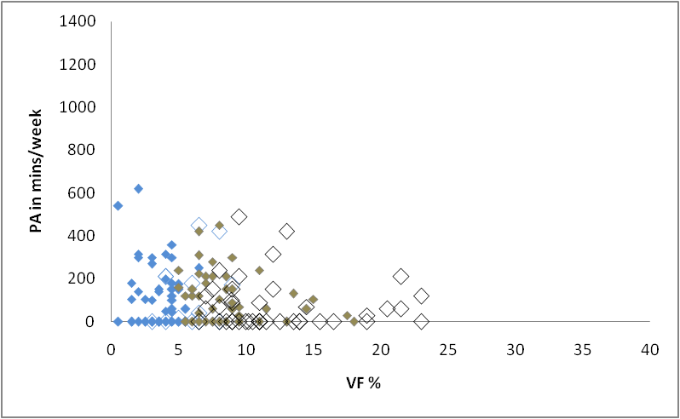
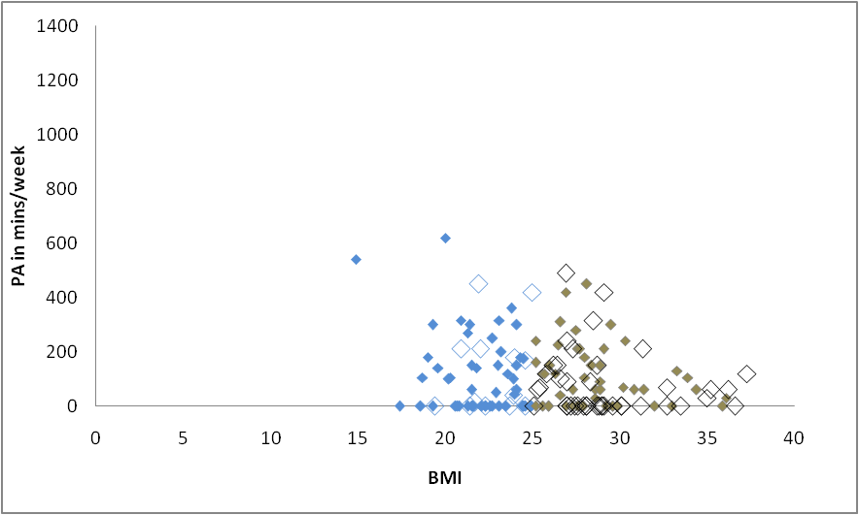
Supplementary Fig. 3
a
b
c
d
Association between VF% and PA in the total male population (a) and female population (c)
Association between BMI and PA in the total male population (b) and female population (d)

Slide 8
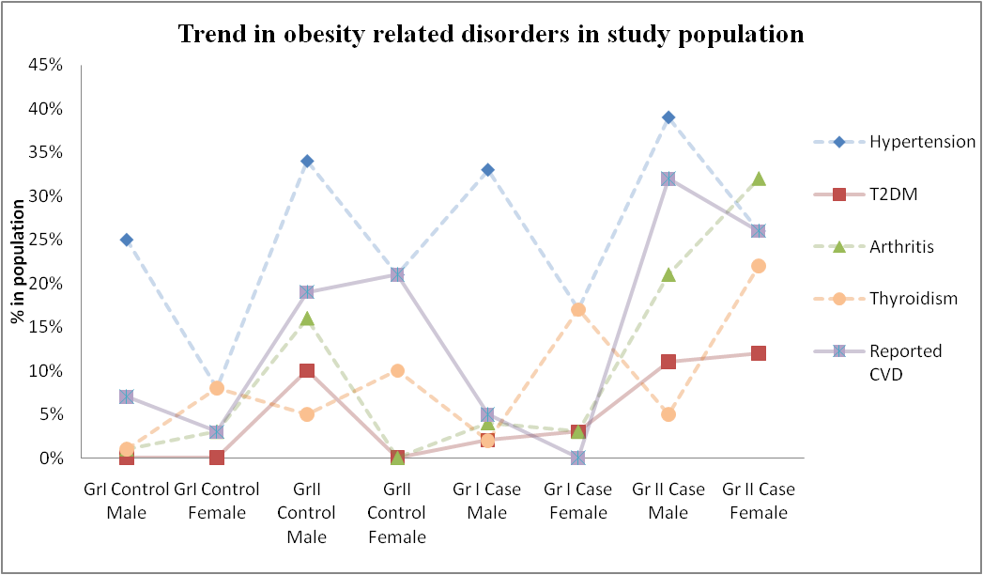
Supplementary Fig. 4
Trend in obesity associated co-morbidities among all the subgroups of the study population.

Slide 9
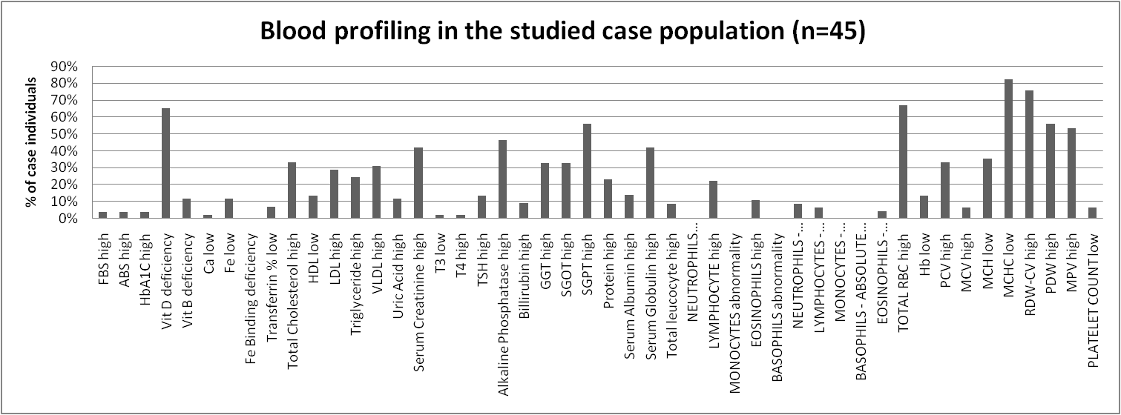
Supplementary Fig. 5
Blood profile parameters in the studied population (n=45)

