Slide 1
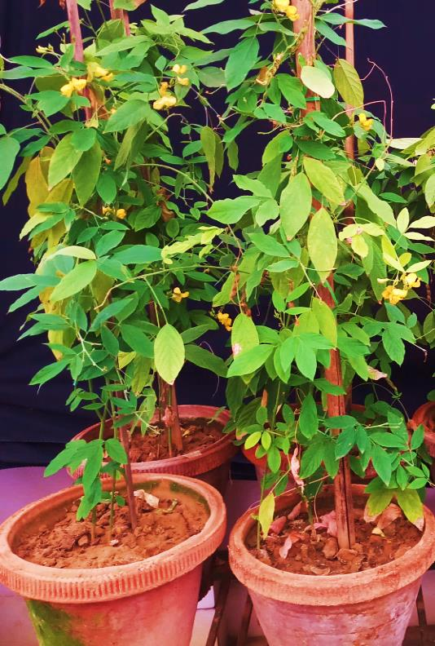
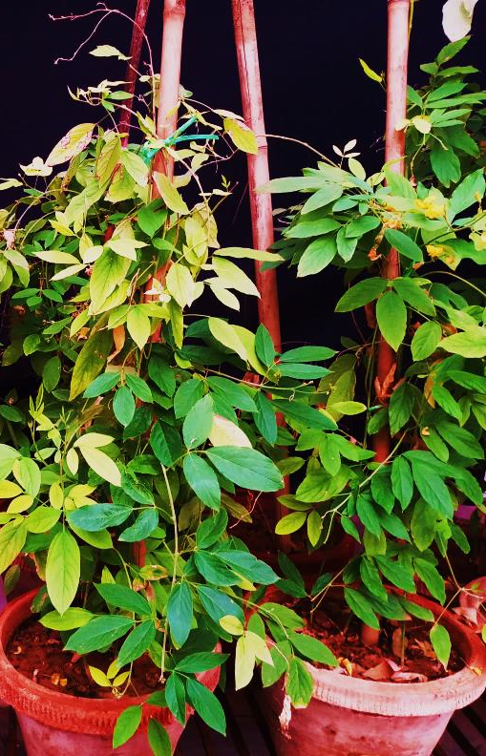
A
B
Additional file 5: Fig. S1. Comparative morphological features of mature WT and T0 plants generated in-vitro in the glass house. They clearly displayed normal morphological features and growth habit when compared with WT. Pot A, wild type (WT) pigeon pea plants obtained without bar selection. Pot B, T₁ transgenic plants obtained with bar selection

