Slide 1
Supplementary Figures

Slide 2
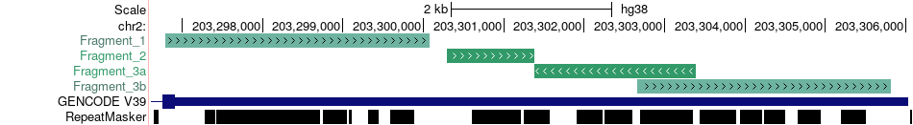

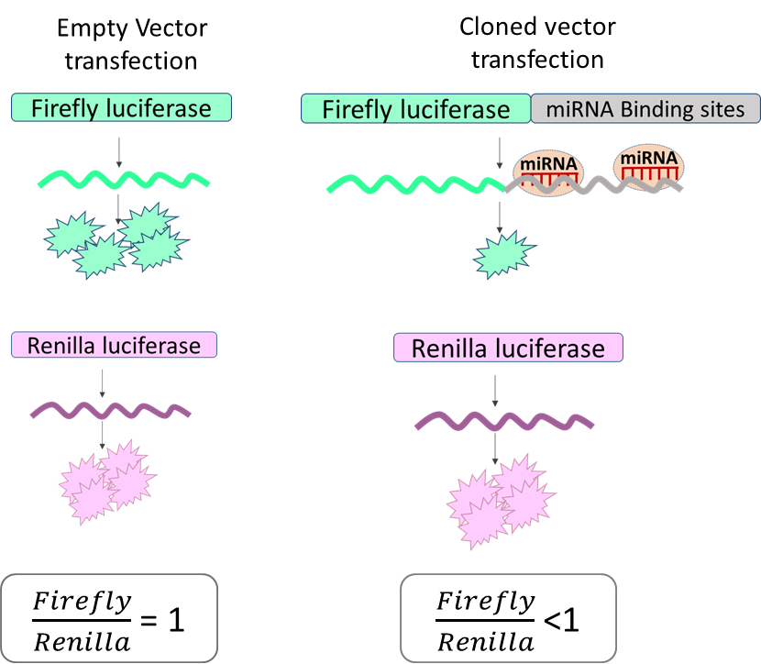
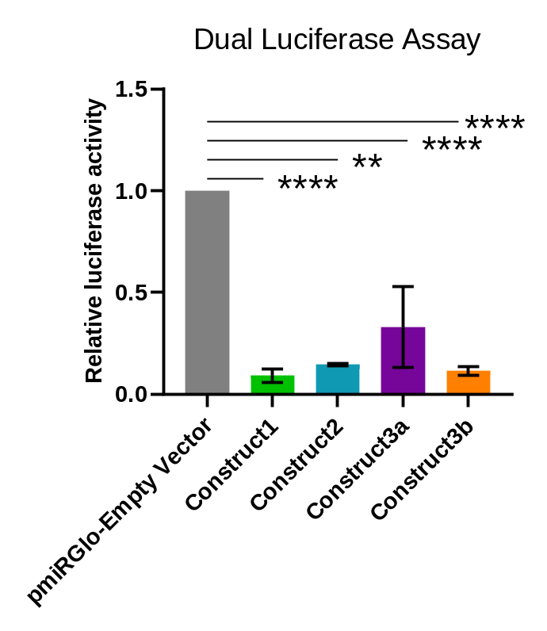
Figure S1 a) Different segments of CYP20A1 cloned in the pmiRGlo vector b) The schematic represents the principle of Dual-Luciferase assay. c)The graph shows the assay results for all the clones of CYP20A1
a
~3.2Kb
~1Kb
~3.1Kb
~2Kb
b
c
N= 4 and n= 5

Slide 3
Figure S2: RNA seq values of selected genes in primary neurons after Tat treatment and Heat-shock treatment.
Gene | Log2 FC – UP (Pr. Neurons_Tat treated) | Log2 FC- Down (Pr. Neurons_Heat Shock treated)
GAP43 | 1.2 | 2.92
SLC20A2 | 1.62 | 1.32
MCAM | 1.2 | 1.62
EIF4H | 1.26 | 1.39
URB1 | 1.62 | 1.11
NEIL2 | 1.14 | 1.10
ORAI2 | 1.23 | 0.80

Slide 4
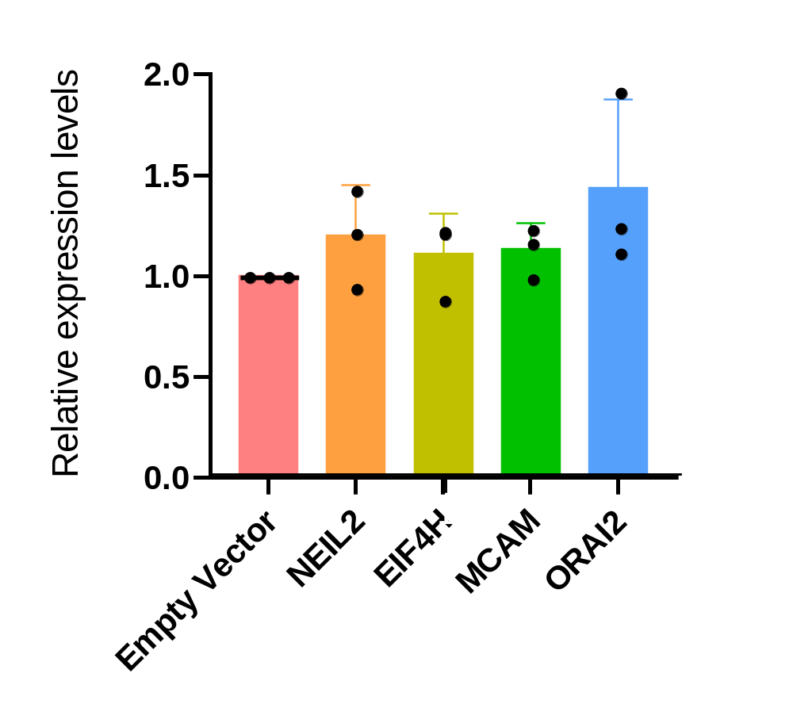
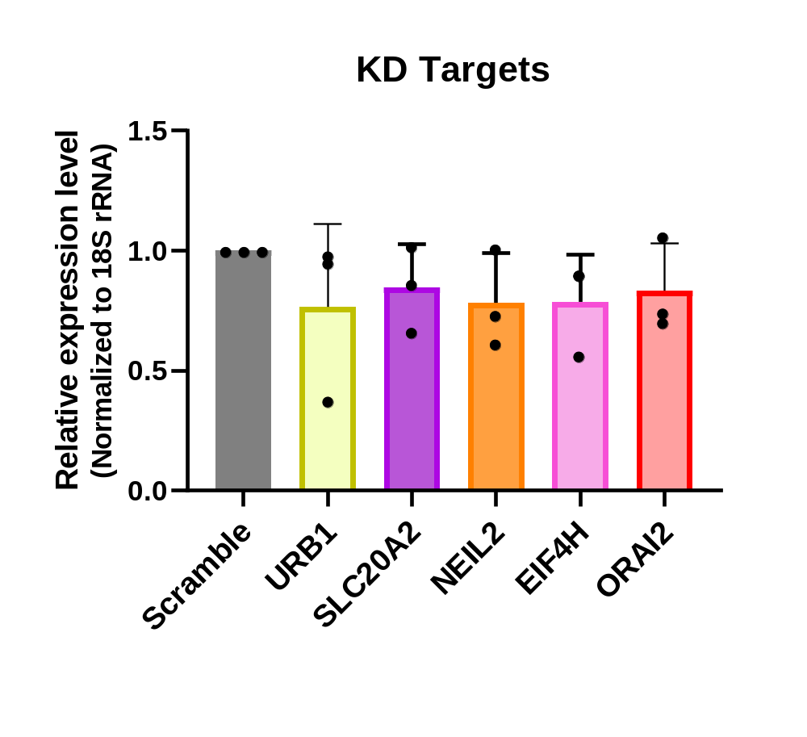
Figure S3 a) Overexpression of the NEIL2, EIF4H, MCAM, and ORAI2 after overexpression of CYP20A1 b) Decreased expression of the URB1, SLC20A2, NEIL2, EIF4H, and ORAI2 after knockdown of CYP20A1.
a
b

Slide 5
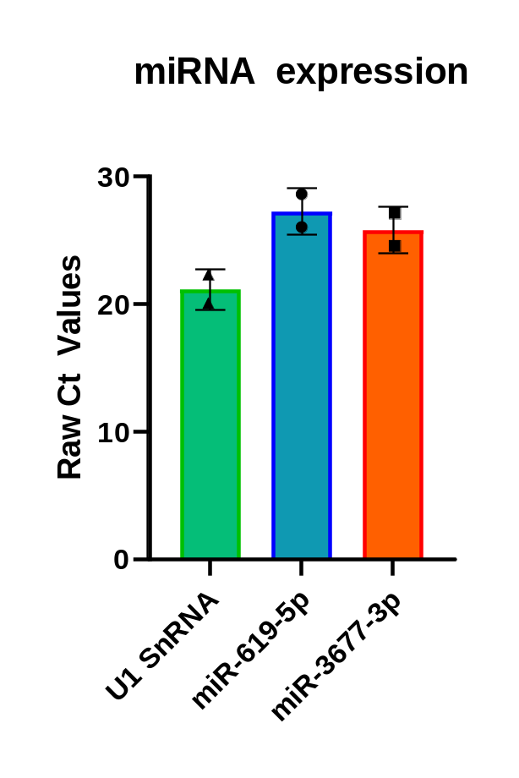
Figure S4: Ct values of miRNA expression checked in SK-N-SH cell line by qRT-PCR

