Slide 1
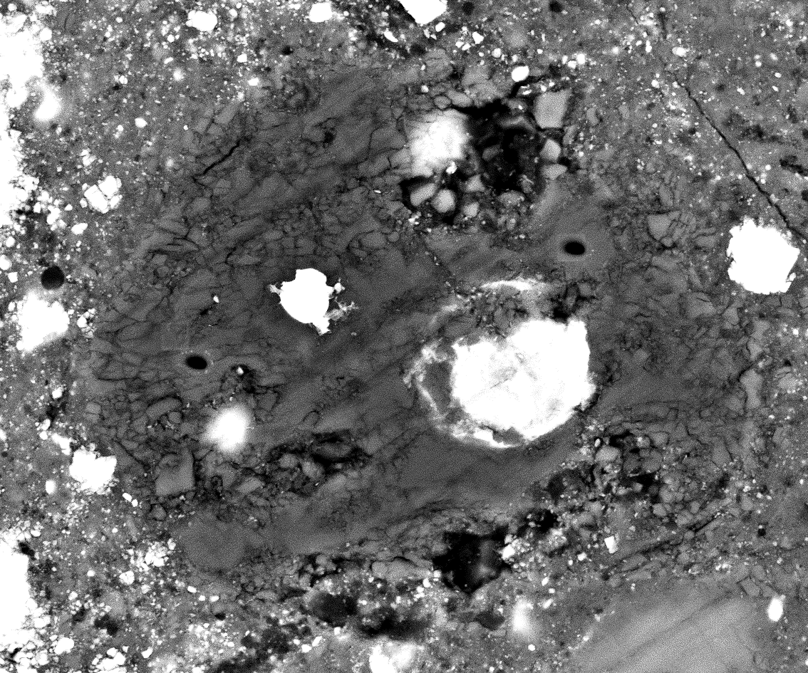
Fig. A1: C0002-P5-C1-Chd
1501
Sul
Mt
Ol
1
2
1500
2
PCM
CCAM
δ¹⁷O_{VSMOW} (‰)
Δ¹⁷O (‰)
1
TF
Ox
1499
1µm
δ¹⁸O_{VSMOW} (‰)
4-digit numbers correspond to analysis# of FE-EPMA (Supplementary table A1).

Slide 2
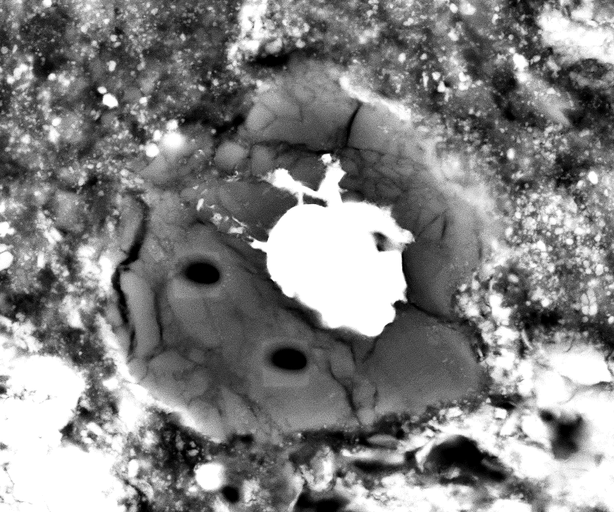
Fig. A2: C0002-P5-C2-Chd
Mt
PCM
CCAM
1
2
δ¹⁷O_{VSMOW} (‰)
Δ¹⁷O (‰)
1
TF
1477
2
Ol
1476
1µm
δ¹⁸O_{VSMOW} (‰)

Slide 3
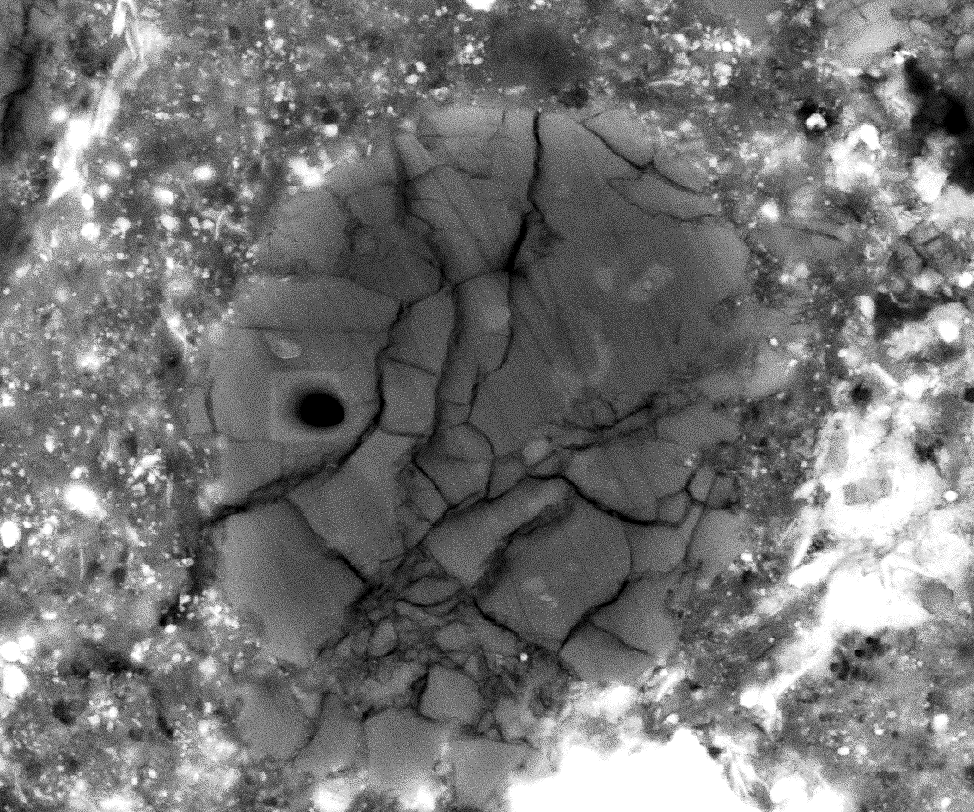
Fig. A3: C0040-02-Chd
2496
Ol
Diop
PCM
CCAM
δ¹⁷O_{VSMOW} (‰)
Δ¹⁷O (‰)
TF
1µm
δ¹⁸O_{VSMOW} (‰)

Slide 4
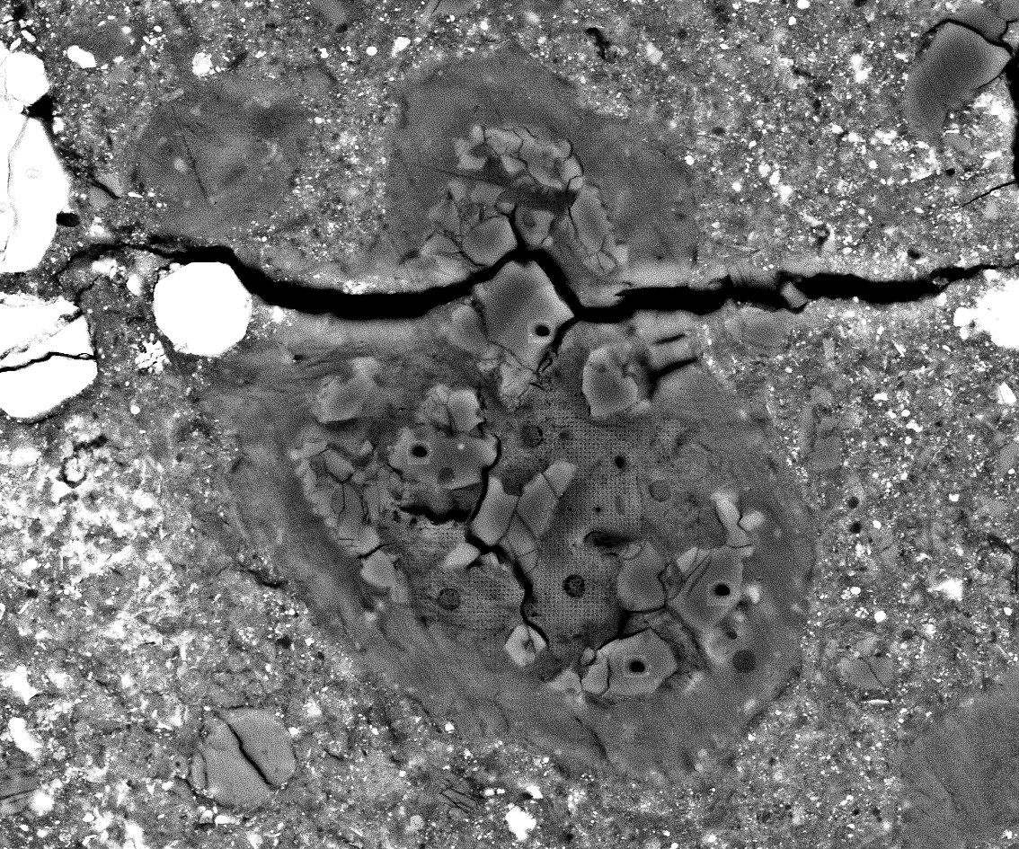
Fig. A4: C0040-02-CAI
2482
2484
2483
2485
Pv
Hib
PCM
1
2814
CCAM
Phyl
δ¹⁷O_{VSMOW} (‰)
2
Δ¹⁷O (‰)
TF
3
4
2
2811
1
3
Sp
2486
4
2815
2813
2812
1µm
δ¹⁸O_{VSMOW} (‰)
2487

Slide 5
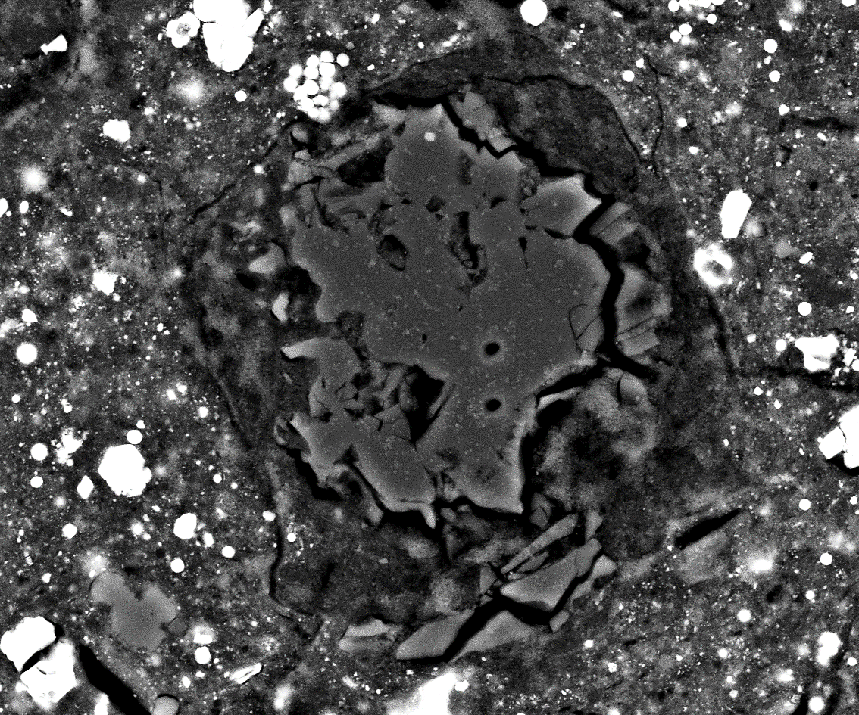
Fig. A5: C0076-10-CAI
Pv
5845
Sp
6000
5995
PCM
CCAM
5846
1
δ¹⁷O_{VSMOW} (‰)
Δ¹⁷O (‰)
TF
1
2
5996
2
5999
Phyl
5997
5998
5848
5847
1µm
δ¹⁸O_{VSMOW} (‰)

