Slide 1
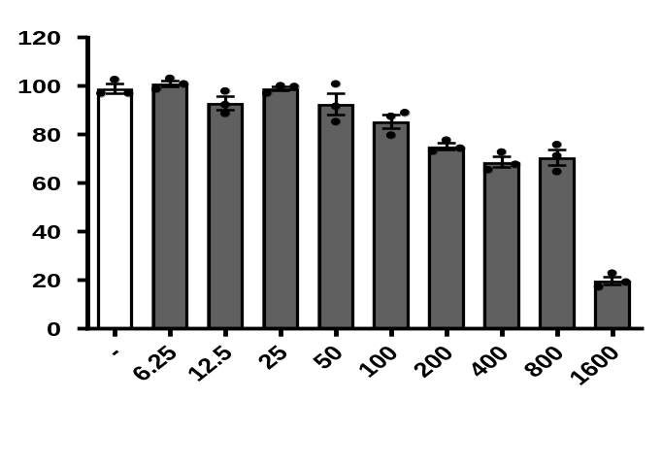


Supplementary Fig1
120
80
40
0
ns
ns
ns
ns
0.0072
Cell viability
<0.0001
<0.0001
<0.0001
<0.0001
Ethanol (mM) :
-
6.25
12.5
25
50
100
200
400
800
1600
Supplementary Figure 1: The most suitable concentration of Ethanol for in vitro model.
Cell viability detected by MTT assay after aml-12 cells seeded in 96-well plate treated by ethanol (0, 6.25, 12.5, 25, 50, 100, 200, 400, 800, 1600mM) for 24h. (n=3).
Results are the mean ± SEM with dots representing individual values of independent experiments. Values noted in the graph are shown as means ± SEM. NS means no significance.

Slide 2
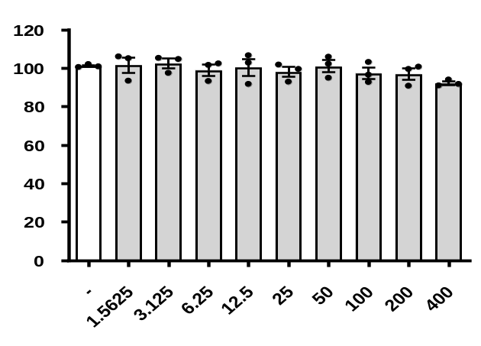




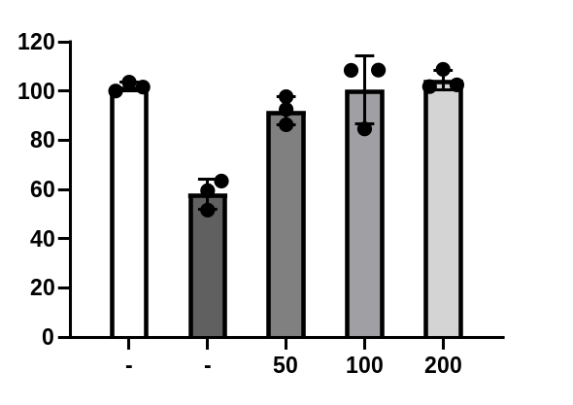


Supplementary Fig2
A
120
80
40
0
ns
Cell viability
PHI (μg/ml):
-
3.125
6.25
12.5
25
50
100
200
>200
1.5625
B
120
80
40
0
P=0.0004
P=0.0003
P=0.0006
P=0.0026
Cell viability
PHI (μg/ml):
Ethanol(200mM):
- - 50 100 200
- + + + +
Supplementary Figure 2: Cytotoxicity and efficacy of Philyrin.
A. The Cell viability detected by MTT assay after aml-12 cells seeded in 96-well plate treated by a series concentrations of Phillyrin(0, 1.5625, 3.125, 6.25, 12.5, 25, 50, 100, 200, >200μg/ml, Phillyrin precipitates at higher concentration, n=3).
B. The effectiveness of Phillyrin(50, 100 200μg/ml) was tested under the stable stimulated by 200mM ethanol. (n=3).
Results are the mean ± SEM with dots representing individual values of independent experiments. Values noted in the graph are shown as means ± SEM. NS means no significance.

Slide 3
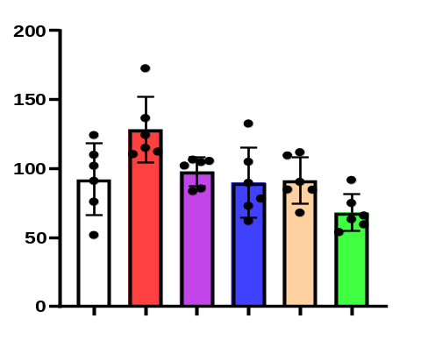
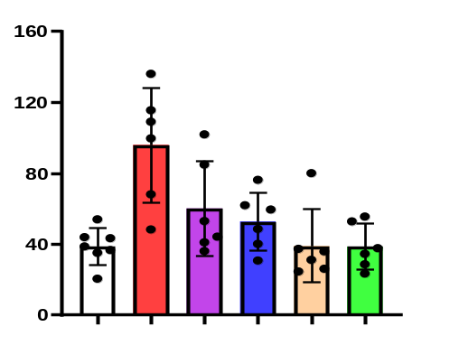

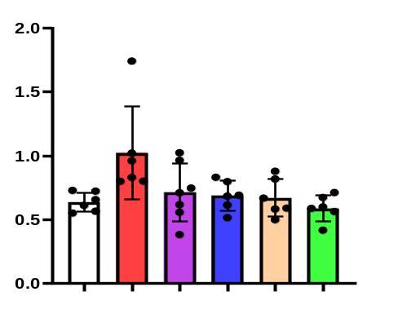
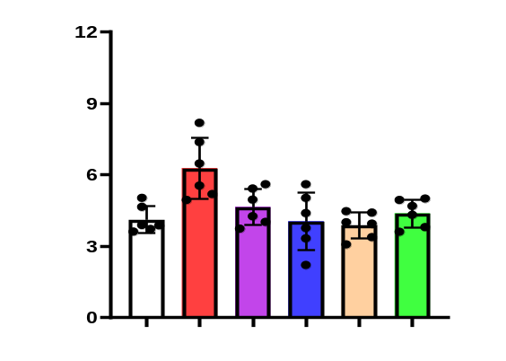
Supplementary Fig3
A
B
ns
200
150
100
50
0
ns
160
120
80
40
0
P=0.0021
P=0.0118
P=0.0180
P=0.0089
P=0.0010
P=0.0532
Serum AST(U/L)
P=0.0303
P=0.0397
Serum ALT(U/L)
2.0
1.5
1.0
0.5
0
ns
12
9
6
3
0
C
P=0.0407
D
ns
ns
Serum T-CHO(mg/dl)
P=0.0015
ns
P=0.0029
Serum TG(mg/dl)
P=0.0286
P=0.0039
P-0.0302
Ethanol-fed:
PHI(mg/kg):
-
-
+
-
+
5
+
15
+
45
-
45
Ethanol-fed:
PHI(mg/kg):
-
-
+
-
+
5
+
15
+
45
-
45
Supplementary Figure 3: Serum index in ASH mice.
Serum ALT, AST, TG, T-CHO levels (n=6).
Results are the mean ± SEM with dots representing individual values of independent experiments. Values noted in the graph are shown as means ± SEM. NS means no significance.

