Slide 1
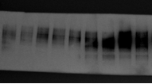
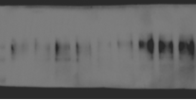
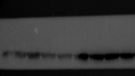
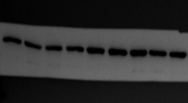
Figure 1D
Fibronectin
Collagen I
α-SMA
GAPDH

Slide 2
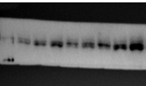
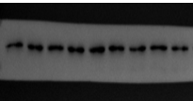
Figure 1J
IL33
GAPDH

Slide 3









Figure 2A
Fibronectin
Collagen I
α-SMA

Slide 4



Figure 2A
GAPDH

Slide 5









Figure 2B
Fibronectin
Collagen I
α-SMA

Slide 6
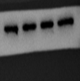


Figure 2B
GAPDH

Slide 7









Figure 2D
Fibronectin
Collagen I
α-SMA

Slide 8



Figure 2D
GAPDH

Slide 9









Figure 2E
Fibronectin
Collagen I
α-SMA

Slide 10

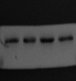

Figure 2E
GAPDH

Slide 11









Figure 3G
ERK
p-c-Jun
p-ERK

Slide 12






Figure 3G
GAPDH
c-Jun

Slide 13









Figure 3H
ERK
p-c-Jun
p-ERK

Slide 14






Figure 3H
c-Jun
GAPDH

Slide 15









Figure 3K
Fibronectin
Collagen I
α-SMA

Slide 16



Figure 3K
GAPDH

Slide 17






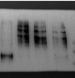


Figure 3L
Fibronectin
Collagen I
α-SMA

Slide 18
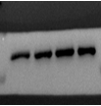


Figure 3L
GAPDH

Slide 19


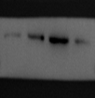
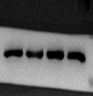


Figure 4F
NPM1
GAPDH

Slide 20




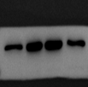

Figure 4G
NPM1
GAPDH

Slide 21






Figure 4J
NPM1
GAPDH

Slide 22









Figure 5A
Fibronectin
Collagen I
α-SMA

Slide 23





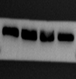
Figure 5A
c-Jun
GAPDH

Slide 24









Figure 5B
Fibronectin
Collagen I
α-SMA

Slide 25



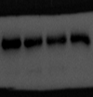


Figure 5B
c-Jun
GAPDH

Slide 26
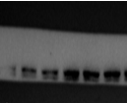
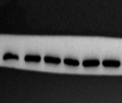
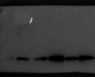
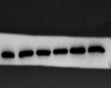
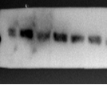
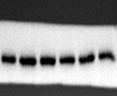
Figure 6B
IL33
GAPDH

Slide 27








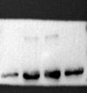
Figure 6C
Fibronectin
Collagen I
α-SMA

Slide 28



Figure 6C
GAPDH

Slide 29



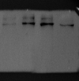





Figure 6D
Fibronectin
Collagen I
α-SMA

Slide 30



Figure 6D
GAPDH

Slide 31
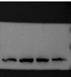
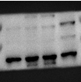







Figure 6E
ERK
p-c-Jun
p-ERK

Slide 32

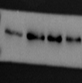



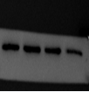

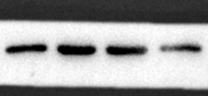

Figure 6E
c-Jun
NPM1
GAPDH

Slide 33









Figure 6F
ERK
p-c-Jun
p-ERK

Slide 34





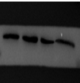



Figure 6F
c-Jun
NPM1
GAPDH

Slide 35
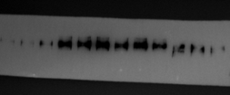
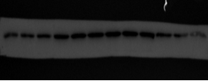
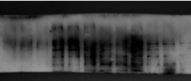
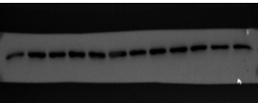
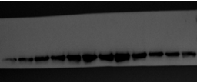
Figure 7H
Fibronectin
NPM1
Collagen I
GAPDH
α-SMA

Slide 36
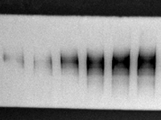
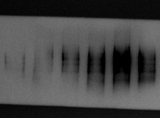
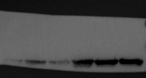

Supplemental Figure
Fibronectin
Collagen I
α-SMA
GAPDH

