Slide 1

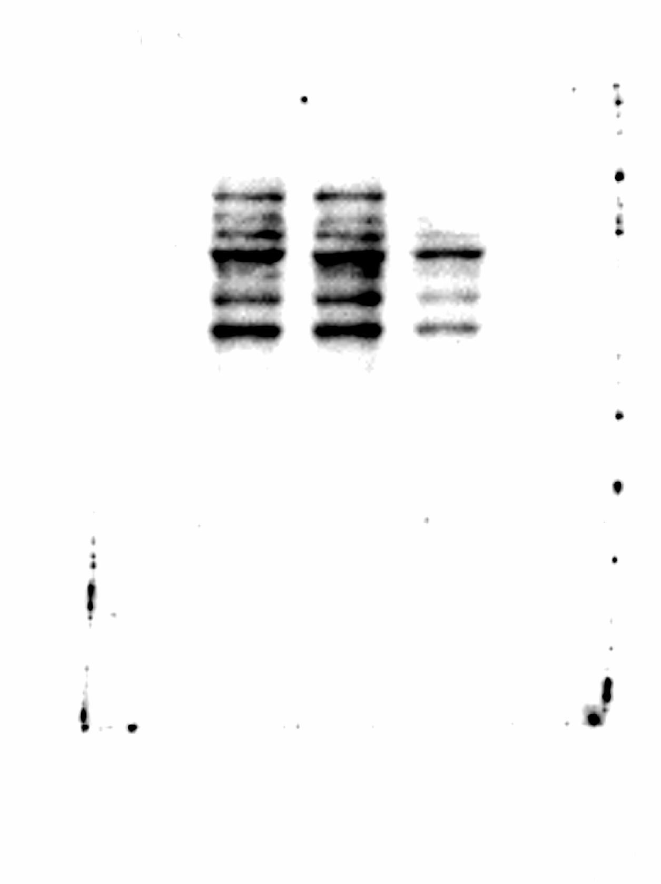
β-ACTIN TROPONIN I
0 5 10
0 5 10
42 KDa
28 KDa
Fig. 1S. ZnO NPs effect on troponin I expression. Cells (1 × 10⁶) were exposed to 5 and 10 μg/cm² over 48 h and the expression of troponin I was determined by western blot. This is a representative experiment of three performed in an independent way. Membrane was first incubated with anti- troponin I antibody, stripped and after incubated with an anti-β-actin antibody. These images correspond to the membranesanalyzed in the ChemiDocTM MP Imaging System (Bio-Rad).

Slide 2

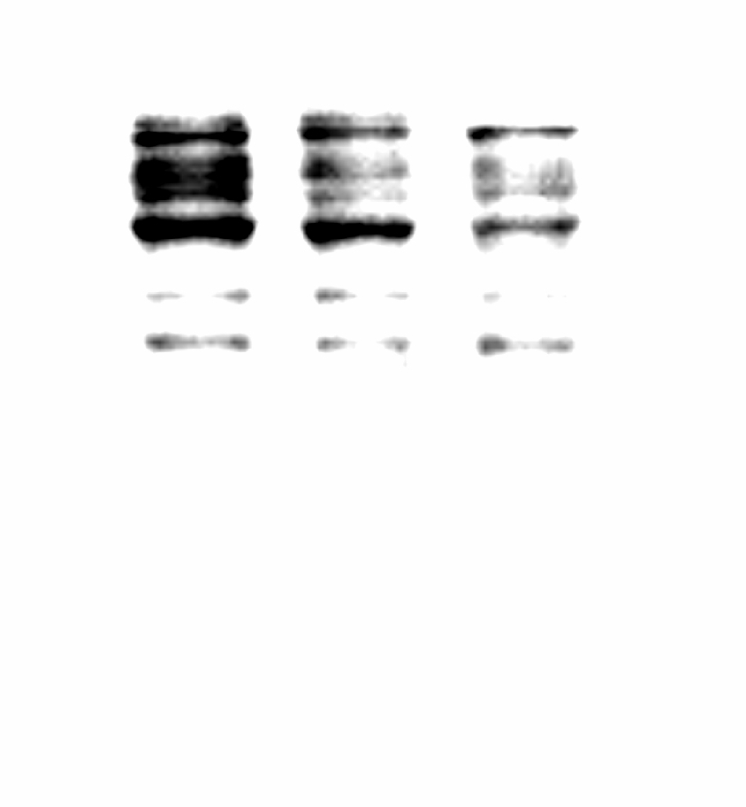
β-ACTIN ATRIAL NATRIURETIC PEPTIDE
0 5 10
0 5 10
42 KDa
16 KDa
Fig. 2S. ZnO NPs effect on atrial natriuretic peptide expression. Cells (1 × 10⁶) were exposed to 5 and 10 μg/cm² over 48 h and the expression of atrial natriuretic peptide was determined by western blot. This is a representative experiment of three performed in an independent way. Membrane was first incubated with anti-atrial natriuretic peptide antibody, stripped, and after incubated with an anti-β-actin antibody. These images correspond to the membrane analyzed in the ChemiDocTM MP Imaging System (Bio-Rad).

