Slide 1

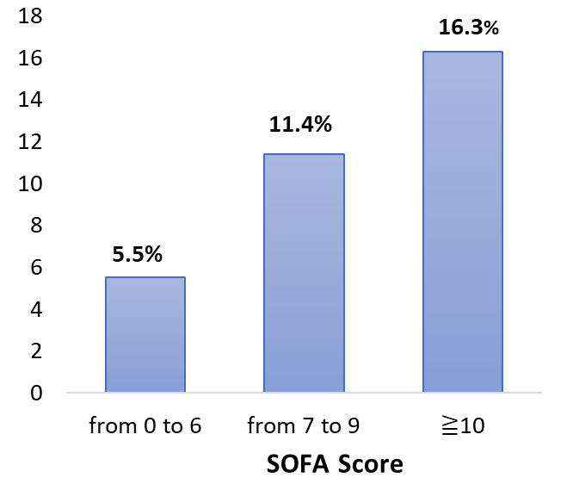
ENTERAL
Nutrition Therapy
+ PARENTERAL Needed
ASSOCIATED FACTORS on ICU ADMISSION
↑ SOFA Score
↑Trygliceride
↓ Albumin
Severity Disease
Inflammatory Response
*
Higher need of Parenteral Nutrition after initiation of Enteral Nutrition with higher organ failure on ICU admission
Gastro-intestinal failure
* Average of patients needing Parenteral Nutrition after the start of enteral nutrition

