Slide 1
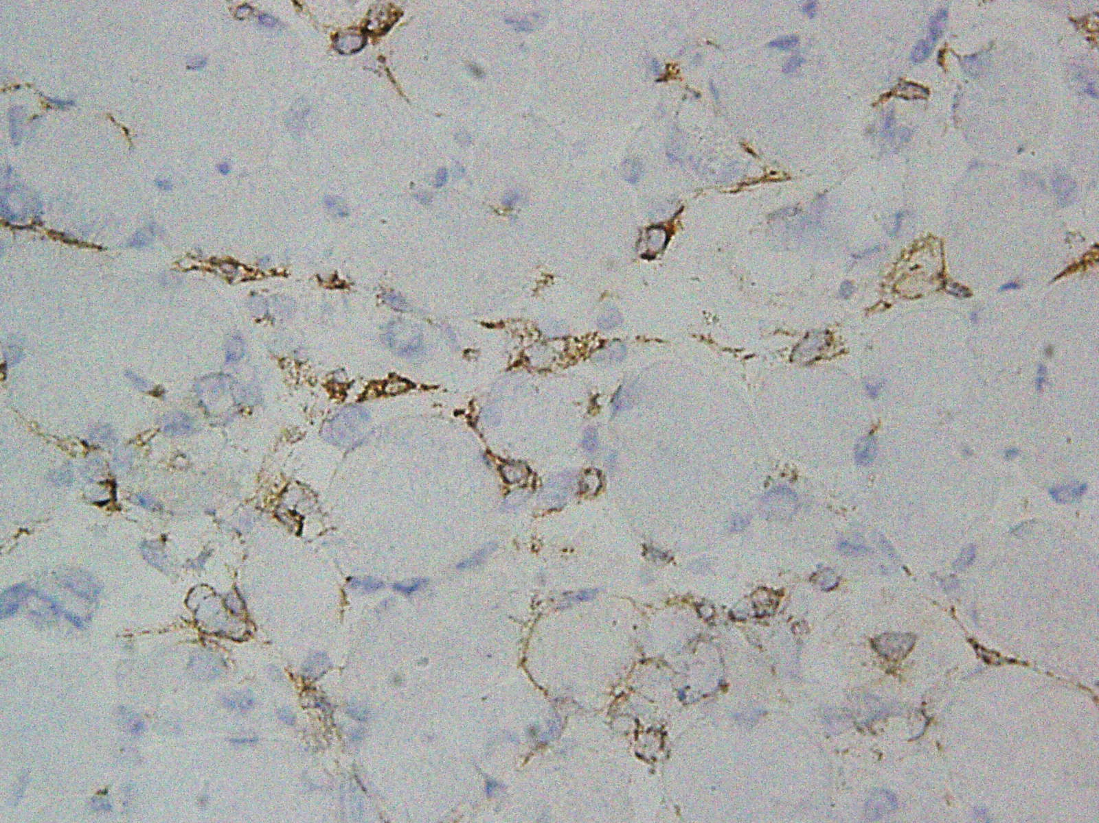
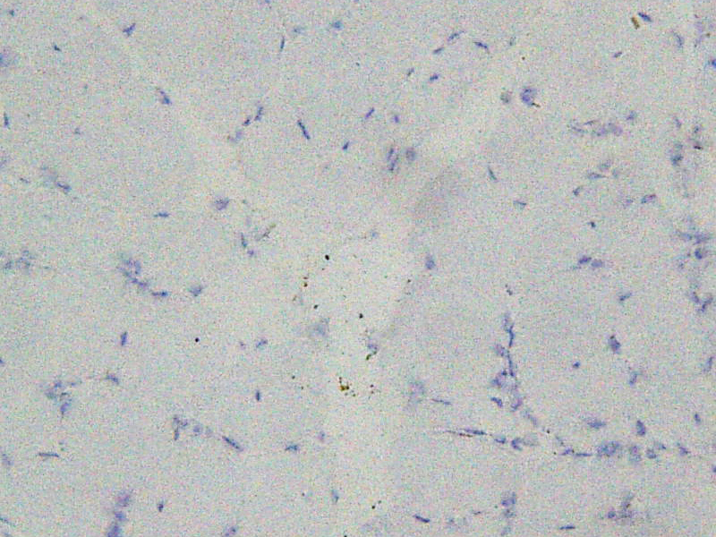
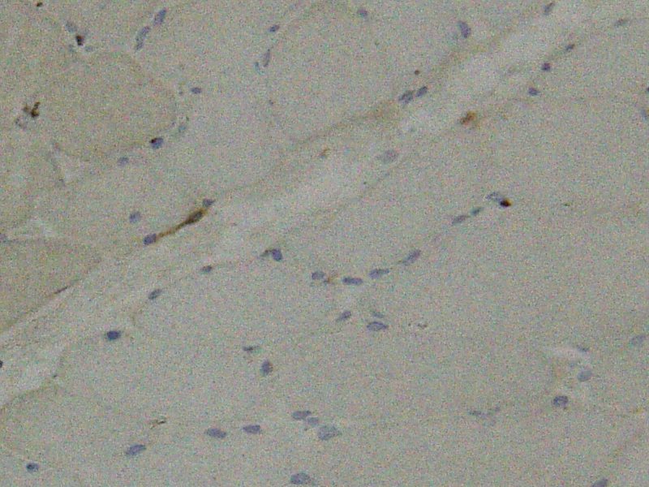
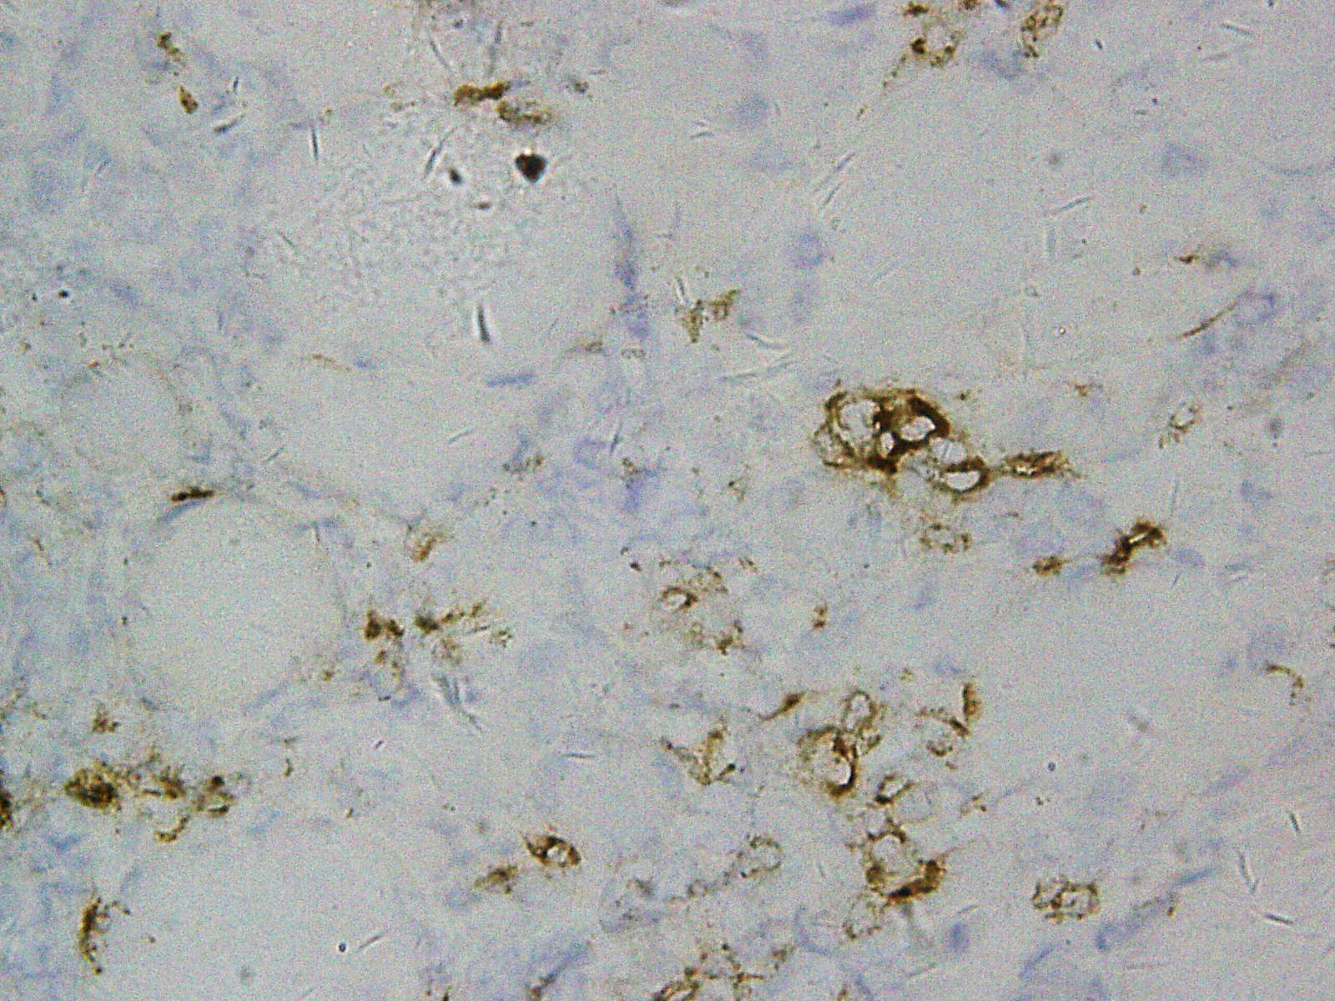
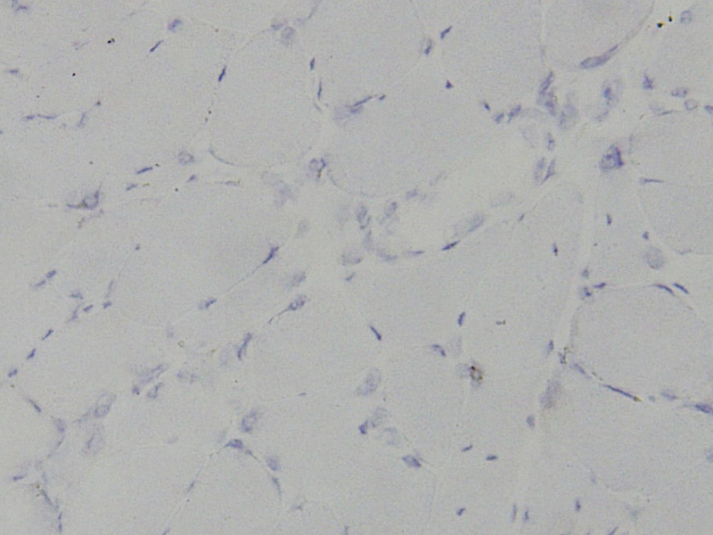
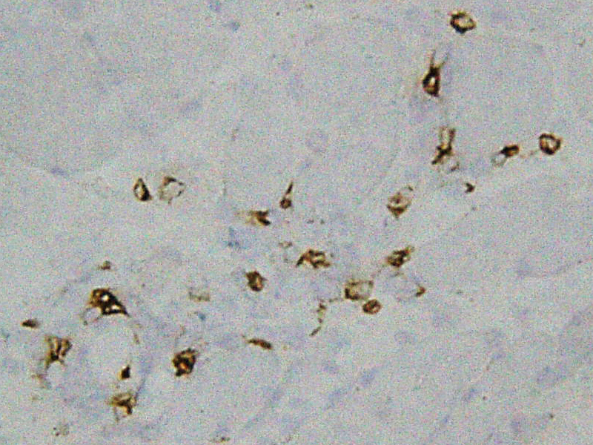
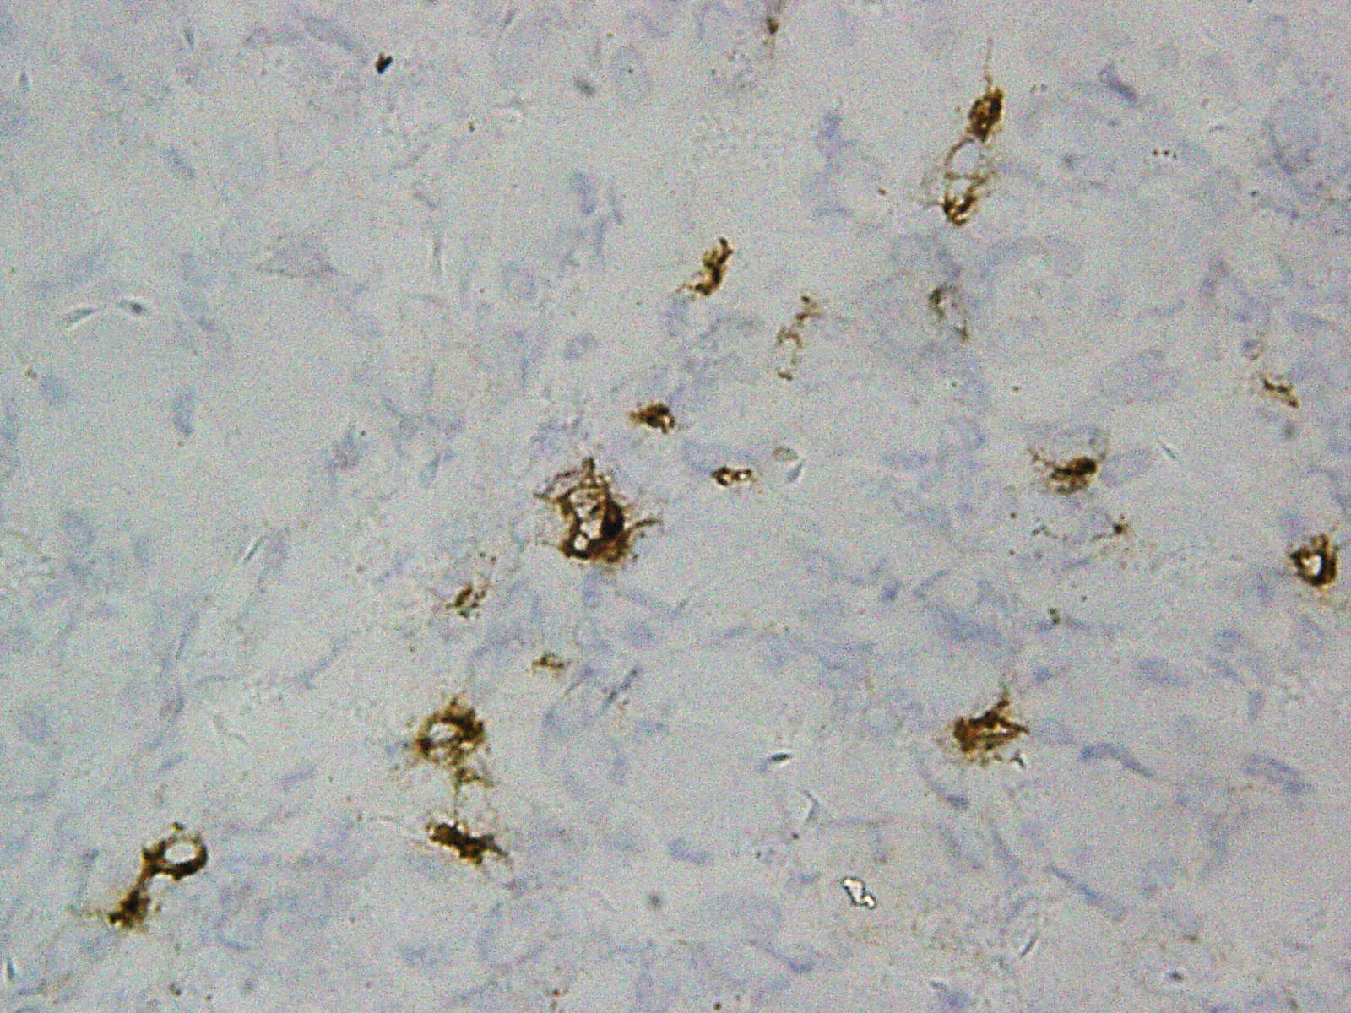
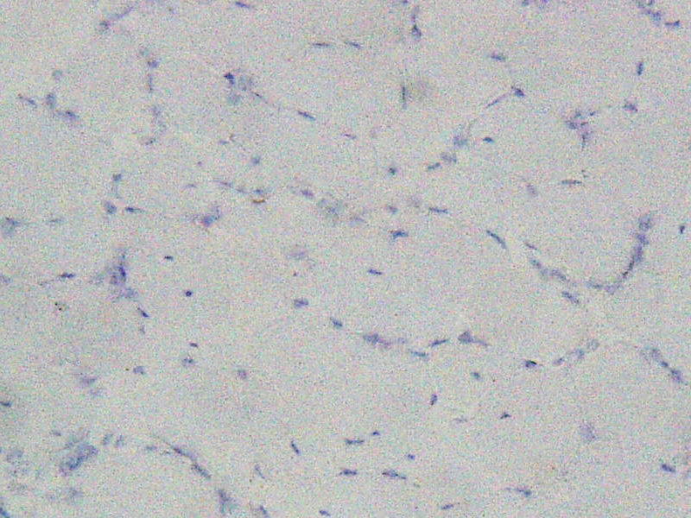
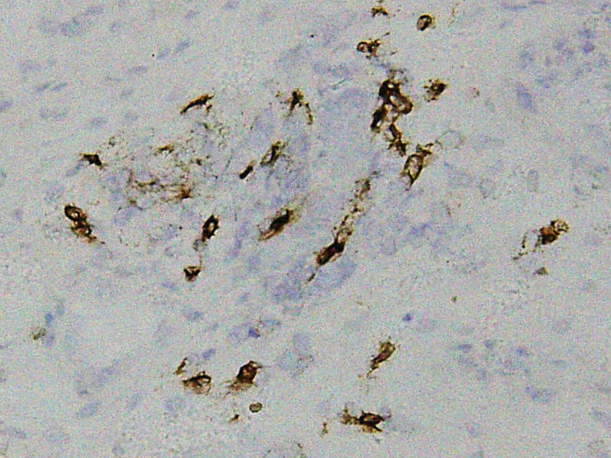
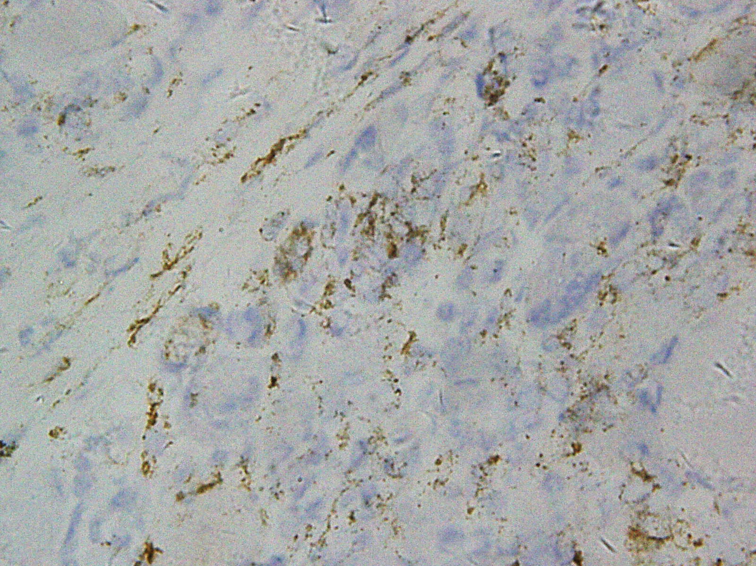
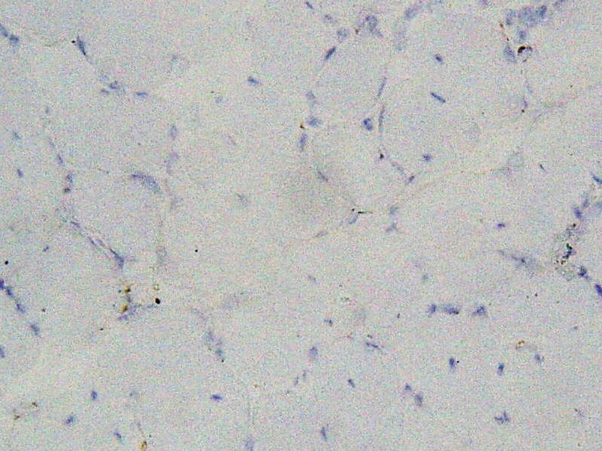
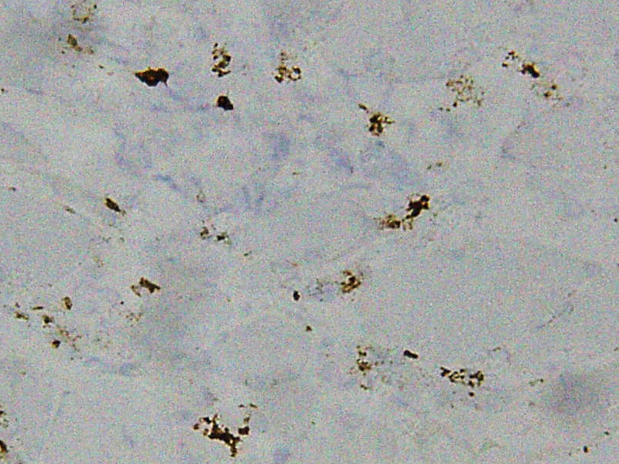
Deep Pathological Phenotyping of Dermatomyositis with Different Autoantibodies
Li Zeng^{1*}, Xue Ma^{2*}, Jun Lu³, Ming-shi Gao⁴, Zhang-yang Wang³, Chong Sun³, Jian-ying Xi³, Su-shan Luo³, Jie Lin³, Kai Qiao³, Chong-bo Zhao³, Jia-hong Lu³, Bi-tao Bu², Wen-hua Zhu^{3,#}
Supplementary Fig 2
Mi-2
MDA5
SAE
CD4
200x
a
b
c
CD8
200x
d
e
f
CD20
200x
g
h
i
CD68
200x
j
k
l

