Slide 1
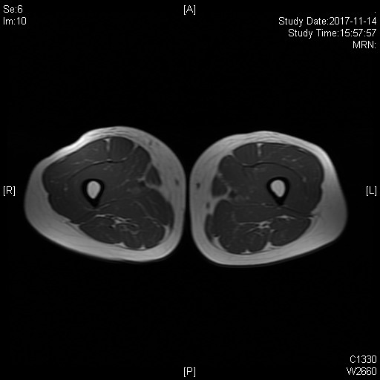
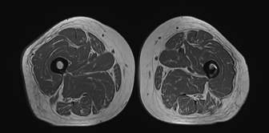
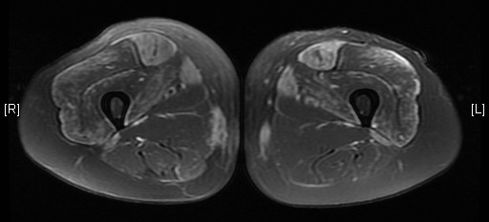
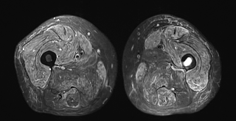
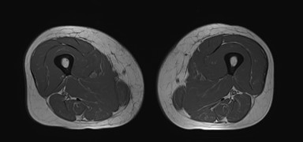
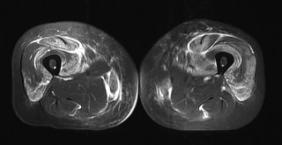
Deep Pathological Phenotyping of Dermatomyositis with Different Autoantibodies
Li Zeng^{1*}, Xue Ma^{2*}, Jun Lu³, Ming-shi Gao⁴, Zhang-yang Wang³, Chong Sun³, Jian-ying Xi³, Su-shan Luo³, Jie Lin³, Kai Qiao³, Chong-bo Zhao³, Jia-hong Lu³, Bi-tao Bu², Wen-hua Zhu^{3,#}
Supplementary Fig 1
Mild
Moderate
Severe
T1W
STIR
Tif1-γ
Mild
Moderate
Severe
T1W
STIR
NXP2

