Slide 1
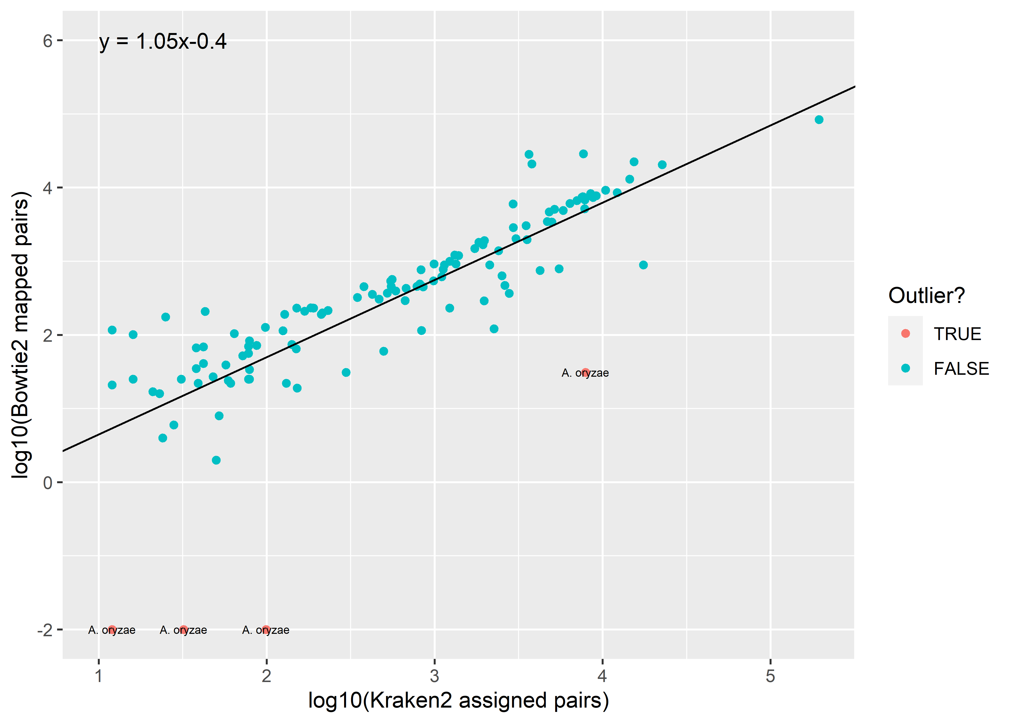
Supplementary Figure 1: Strong linear relationship between the number of Bowtie2 mapped and Kraken2 assigned reads on the log10 scale. All data points (n=120) are shown on the scatter plot. The linear regression line and associated parameter estimates annotated here were computed after removing 4 outlier data points. These outliers had studentised residuals >2 as computed from an initial linear regression including all data points.

Slide 2
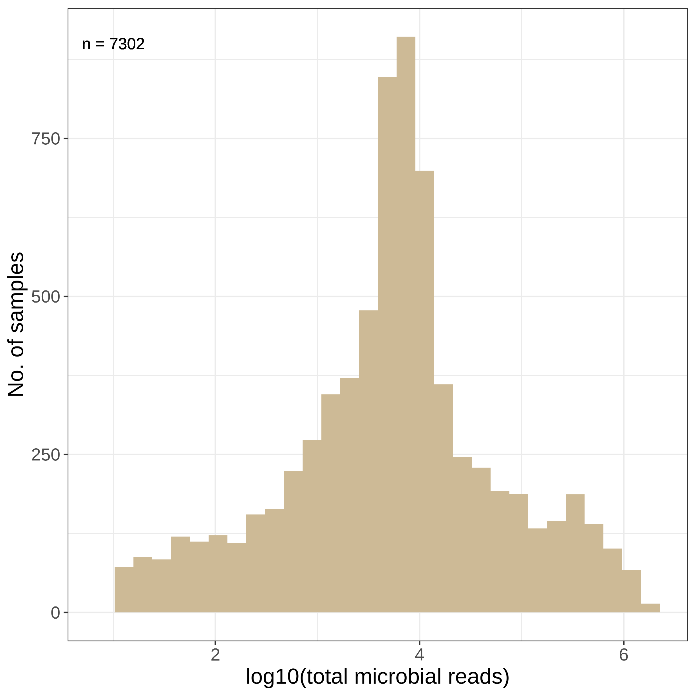
n=7,487
No. of samples
log₁₀(total microbial read pairs)
Supplementary Figure 2: Distribution of total microbial reads for samples with no detected non-contaminant taxa. Total microbial read counts are equivalent to the number of reads classified as microbial after applying the abundance filter but before decontamination (see Methods, Figure 1a).

Slide 3
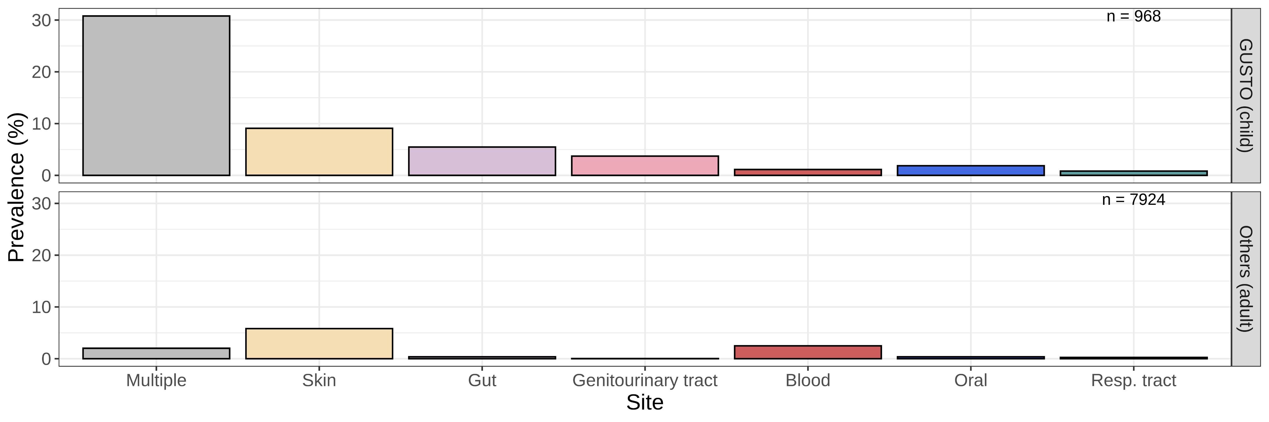


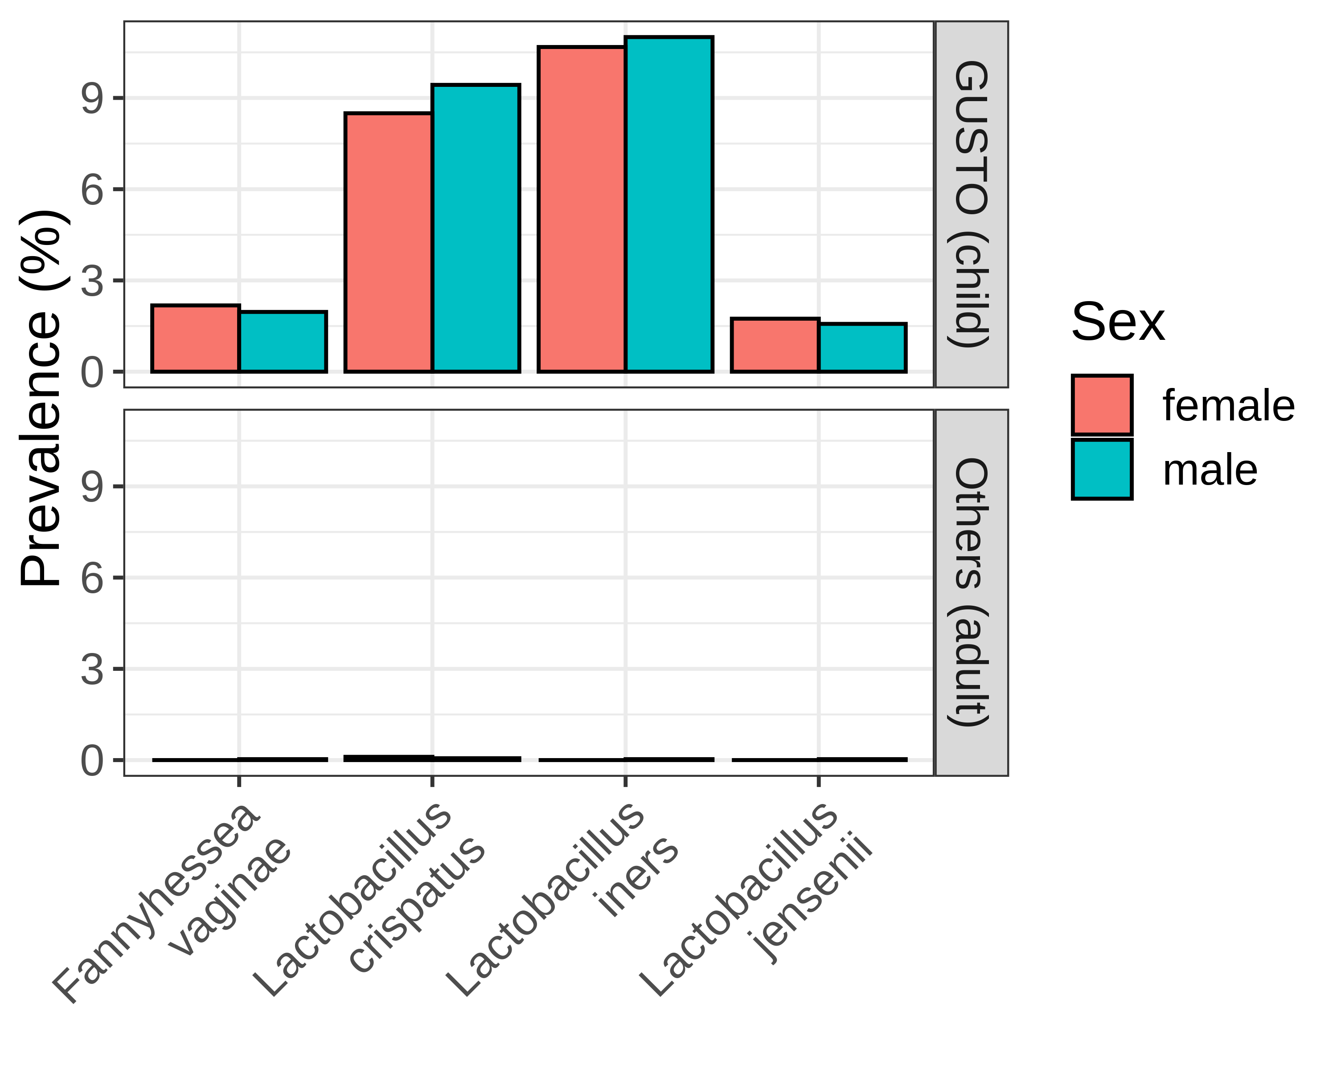
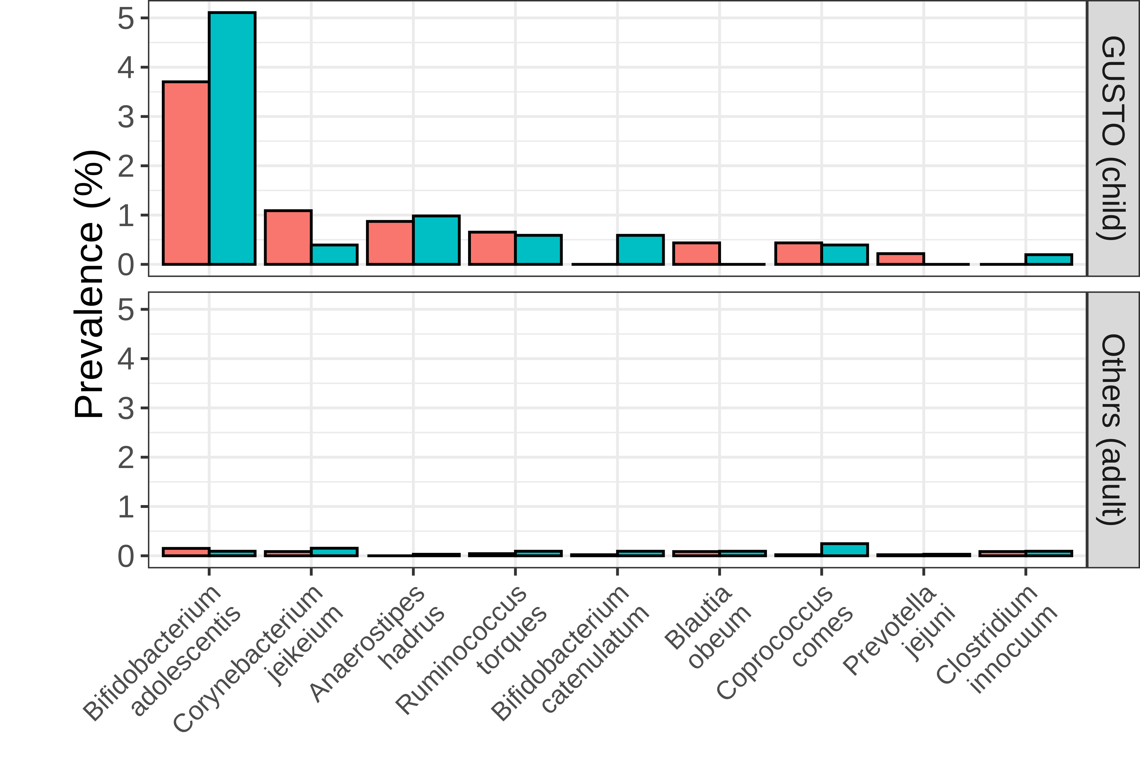
a
n=968
Children
n=7924
Adults
Multiple
Skin
Gut
Genitourinary tract
Blood
Oral
Respiratory tract
b
c
Children
Children
Sex
Female
Male
Adults
Adults
Fannyhessea vaginae
Lactobacillus crispatus
Lactobacillus iners
Lactobacillus jensenii
Blautia obeum
Prevotella jejuni
Bifidobacterium adolescentis
Anaerostipes hadrus
Bifidobacterium catenulatum
Coprococcus comes
Corynebacterium jeikeium
Ruminococcus torques
Clostridium innocuum
Genitourinary tract microbes
Gut microbes
Gut microbes
Supplementary Figure 3: Higher prevalence of microbes in the blood of healthy children. (a) The disproportionately high prevalence of microbes in the children’s cohort GUSTO relative to the other adult cohorts. Prevalence of (b) genitourinary tract-associated and (c) gut-associated microbes in children’s and adult cohorts, stratified by sex. Body site classifications were determined using the Disbiome database.

Slide 4
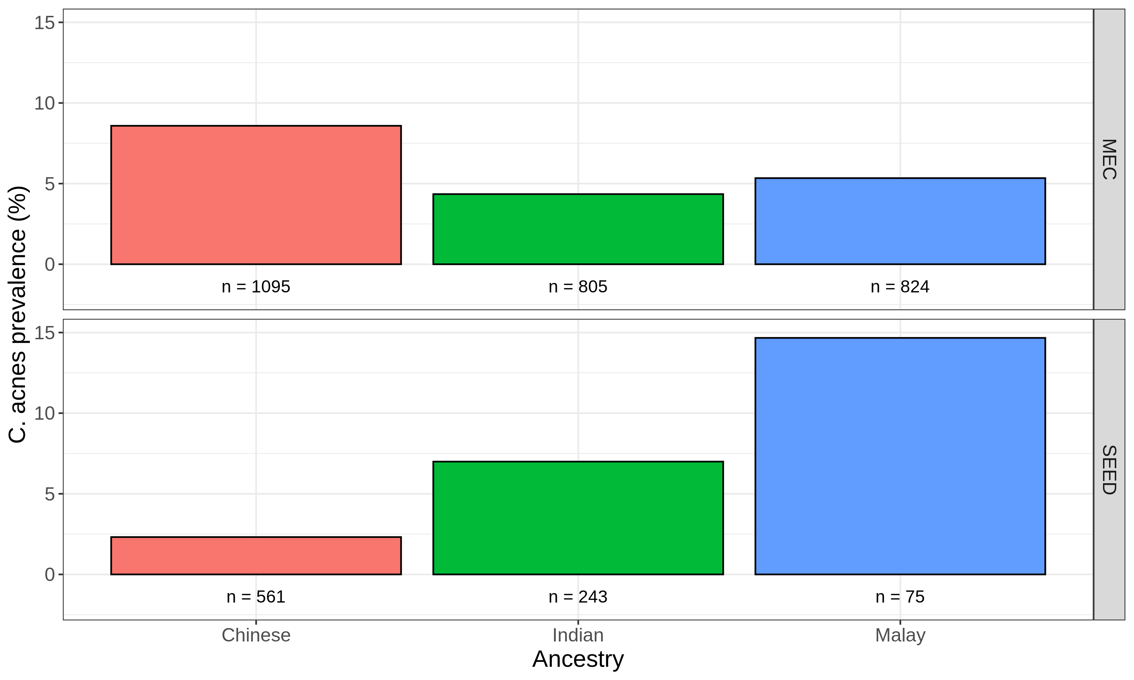
C. acnes prevalence (%)
Supplementary Figure 4: Inconsistent associations between C. acnes and genetic ancestry. Samples were stratified by source cohort and genetic ancestry to calculate C. acnes prevalence. Only the cohorts where a significant (p<0.05) association between the presence of C. acnes and genetic ancestry was found are shown (i.e., MEC and SEED). The number of samples used as the denominator when calculating prevalence is annotated.

Slide 5
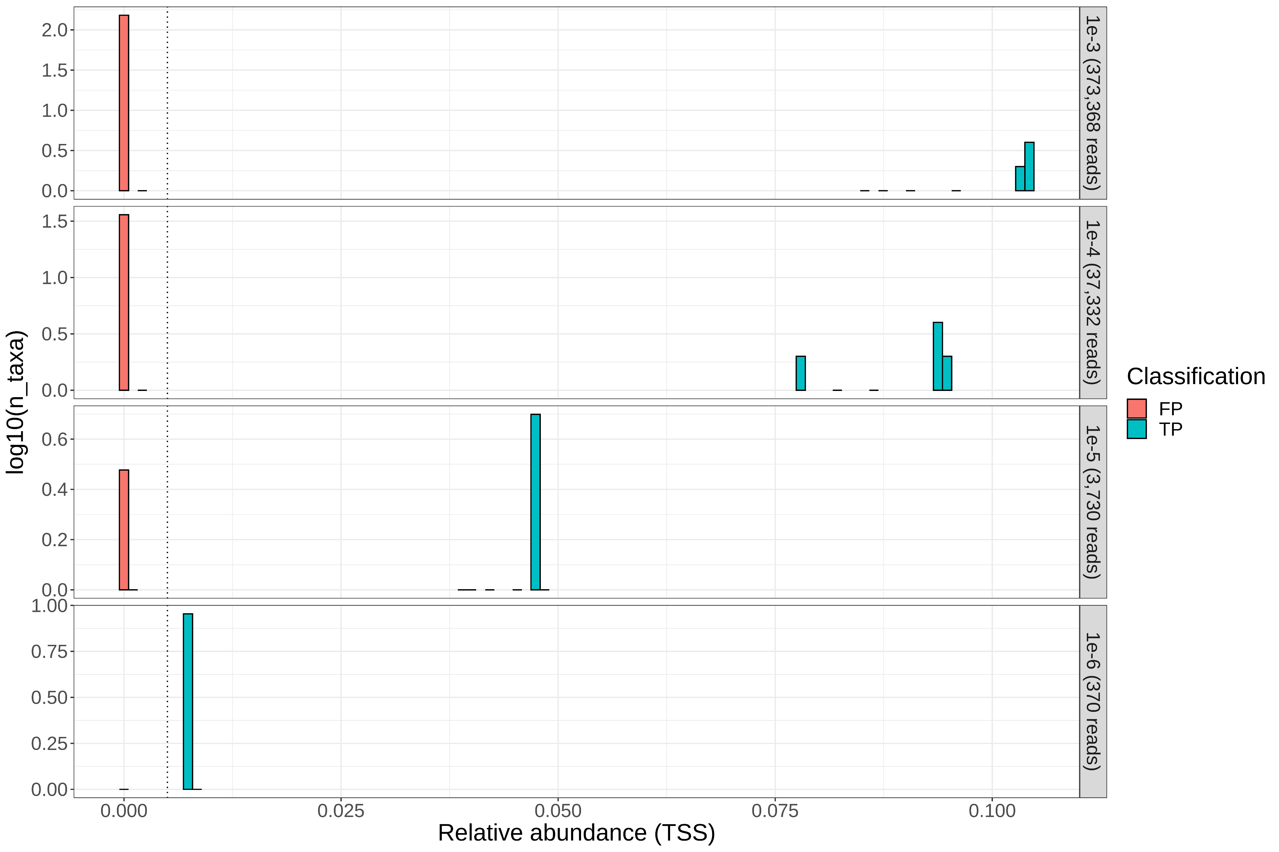
False-positive assignments to exclude
True-positive read assignments to retain
Microbial read fraction (no. of reads)
log₁₀(no. of species)
False-positive
True-positive
Relative abundance=0.005
Relative abundance
Supplementary Figure 5: Simulation experiments to determine the abundance cutoff for reducing false-positive species assignments. Approximately 373 million total reads were generated from human (GRCh38) and 10 microbial reference genomes at various microbial read fractions using InSillicoSeq. An abundance cutoff delineating the false-positive (FP) from true was selected (relative abundance=0.005) that retains and excludes all true-positive and false-positive Kraken2 species assignments, respectively.

Slide 6
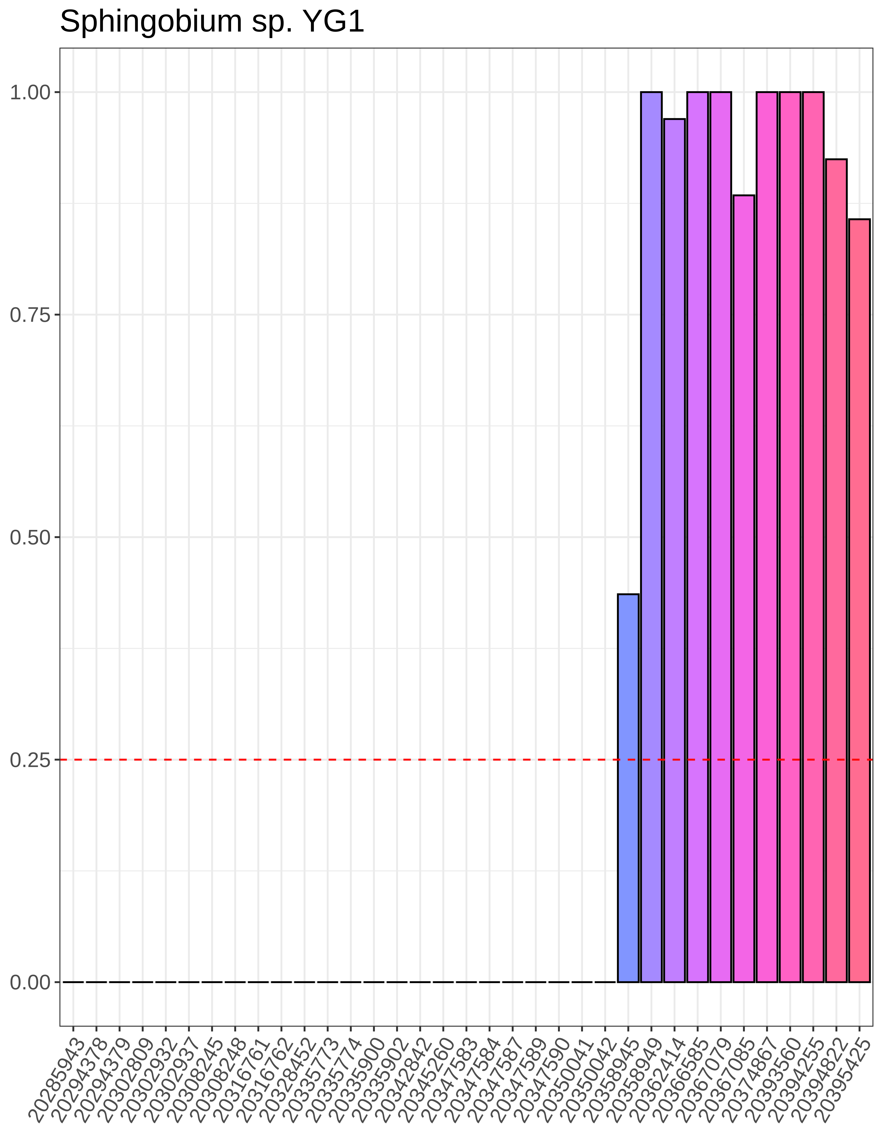
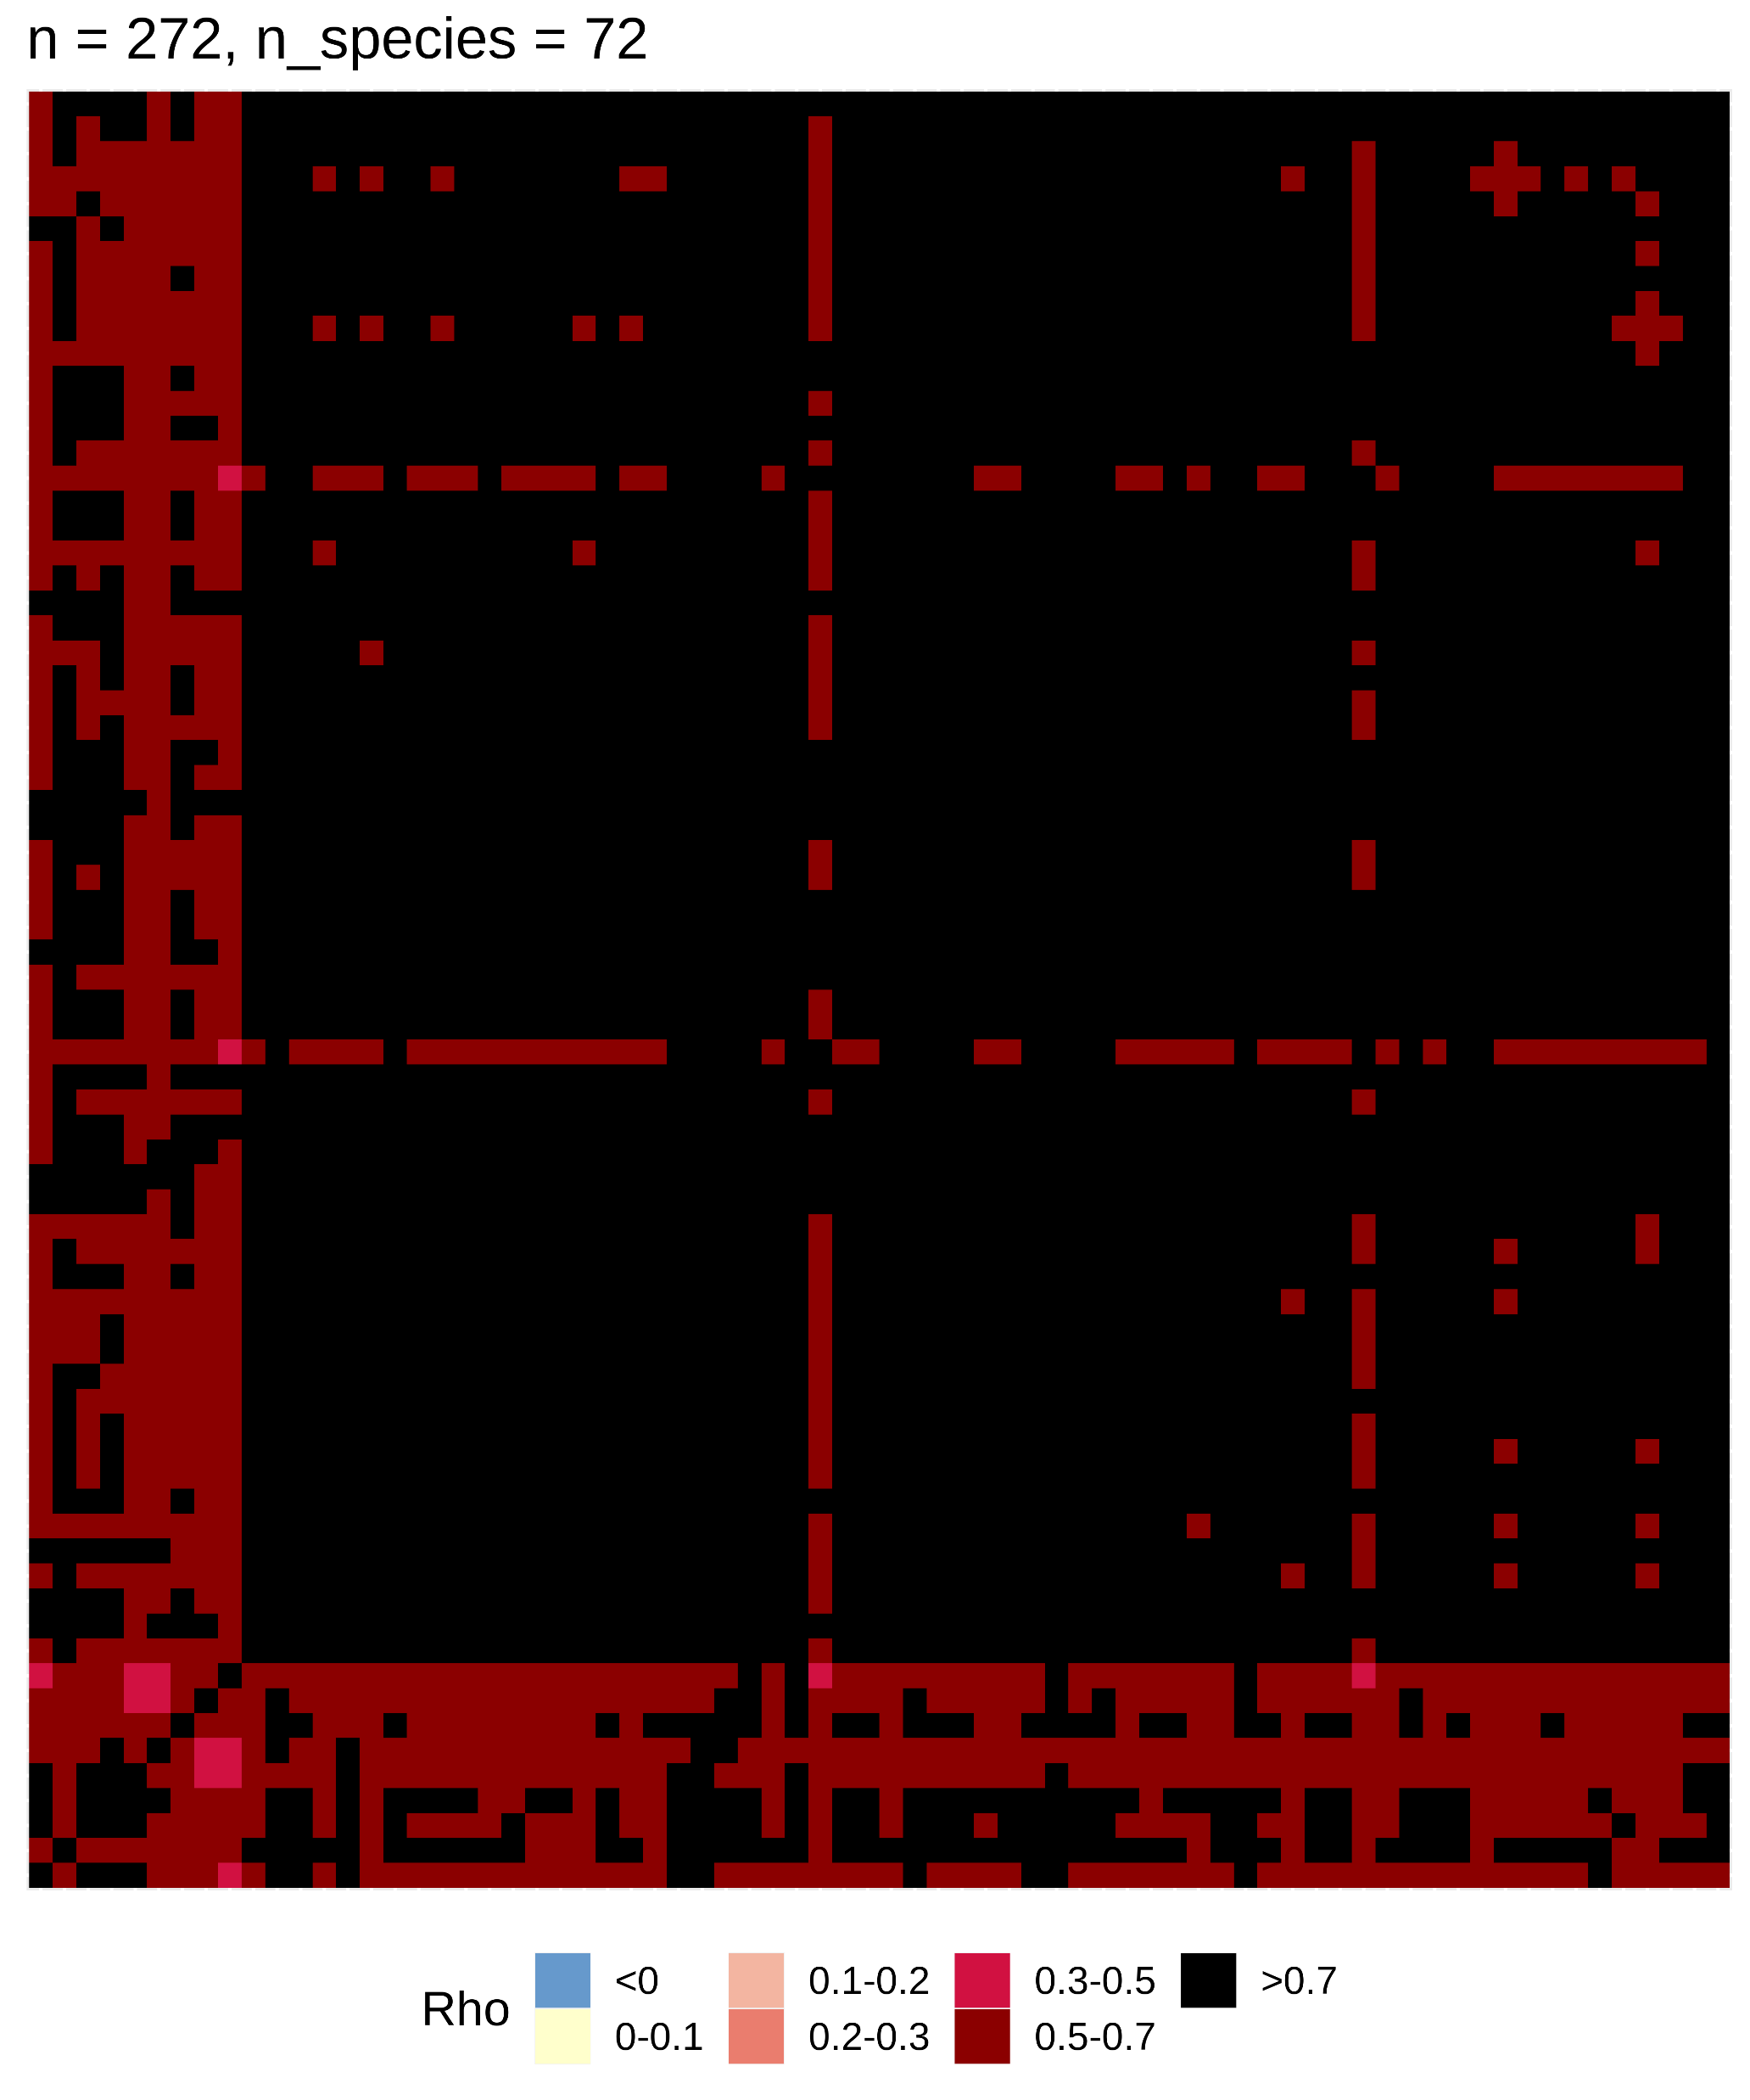
a
Sphingobium sp. YG1
b
Contaminants in flow cell lot 20367079
Prevalence
Contaminants (n=72)
Spearman’s ρ
Flow cell lot number
Contaminants (n=72)
Supplementary Figure 6: Illustration of decontamination filters used. (a) The prevalence filter flagged Sphingobium sp. YG1 as a contaminant because its prevalence in at least one batch (i.e., flow cell lot used) is greater than 25% (threshold indicated by dotted red line) and more than two-fold higher than the prevalence in at least one other batch. (b) Heatmap of pairwise Spearman’s Rho (i.e., correlation) between the 72 contaminant species identified by the correlation filter for flow cell batch 20367079. The highly correlated nature of these species indicates that they are indeed likely contaminants specific to batch 20367079.

