Slide 1
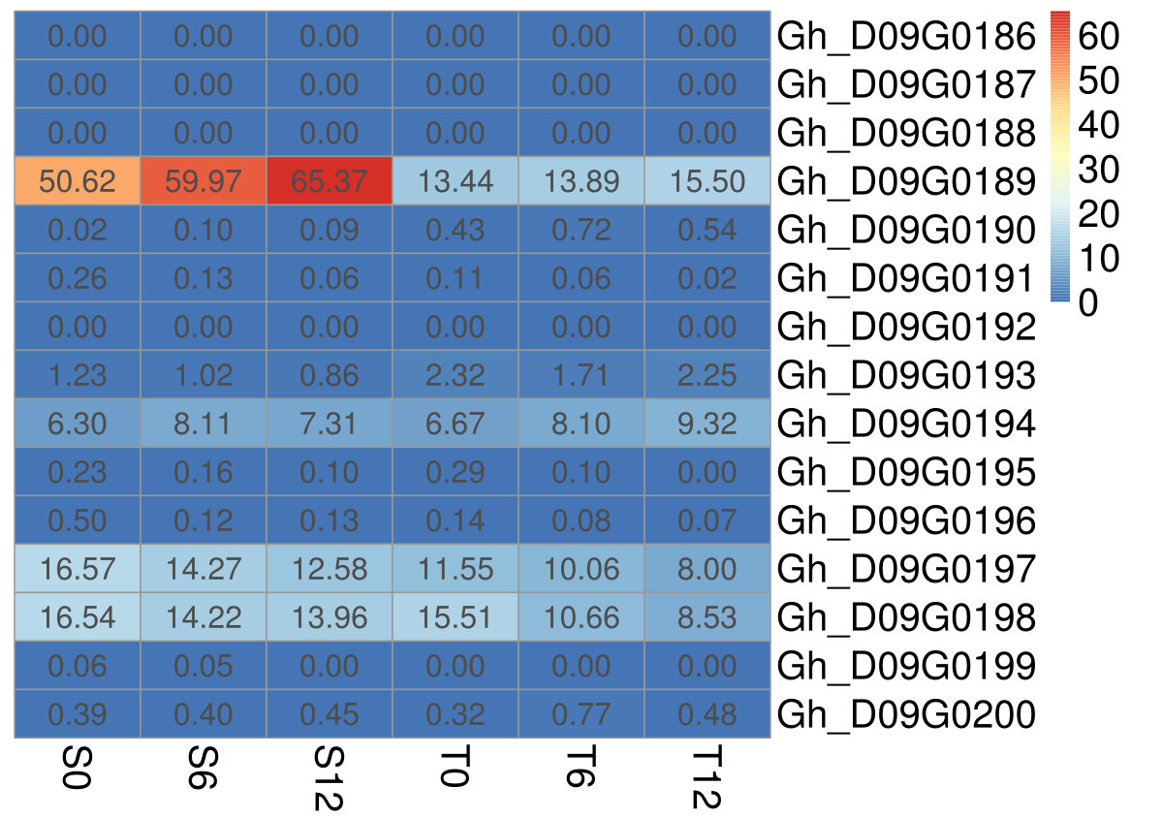
Fig. S1 Expression abundance of 15 genes located on Chr D09 between HapA (XLZ84) and HapB (XLZ16). Redder markers have higher FPKM value, blueer markers have lower density

Slide 2
Fig. S2 Daily temperature variation curve in the cotton area of Anyang 2009-2019 (4/1-4/30)

Slide 3
Fig. S3 Daily temperature variation curve in the cotton area of Shihezi 2009-2019 (4/1-4/30)

Slide 4
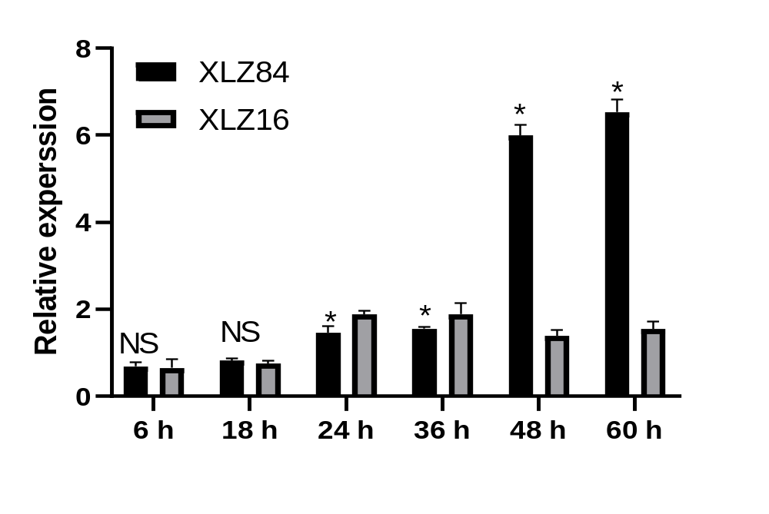
Fig. S4 Relative expression of Gh_D09G0189 during germination

Slide 5
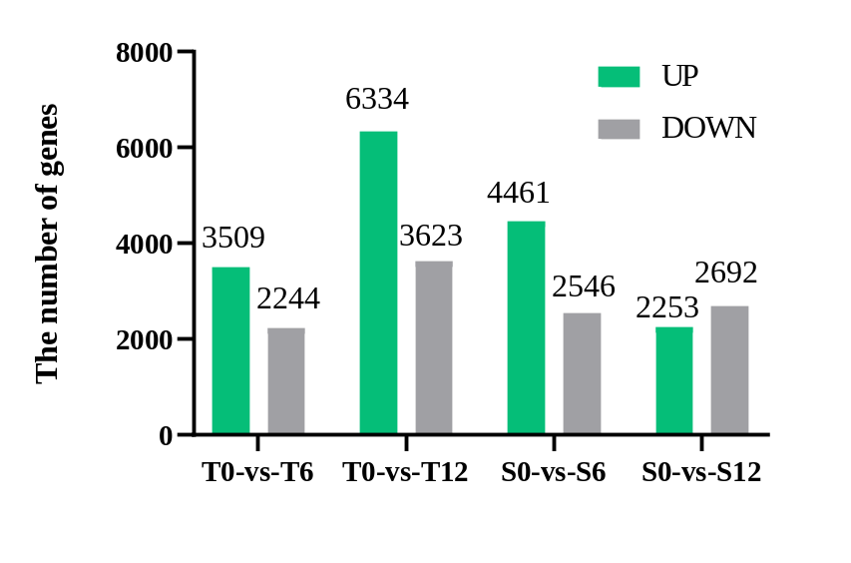
Fig. S5 The statistics of up-regulated and down-regulated DEGs between XLZ84 and XLZ16 under SC conditions. S0-vs-S6, comparison between 0 h and 6 h of XLZ84; S0-vs-S12, comparison between 0 h and 12 h of XLZ84; T0-vs-T6, comparison between 0 h and 6 h of XLZ16; T0-vs-T12, comparison between 0 h and 12 h of XLZ16; 0, 6, and 12 represent the sampling hours before cold treatment, 6 h and 12 h after cold treatment.

Slide 6
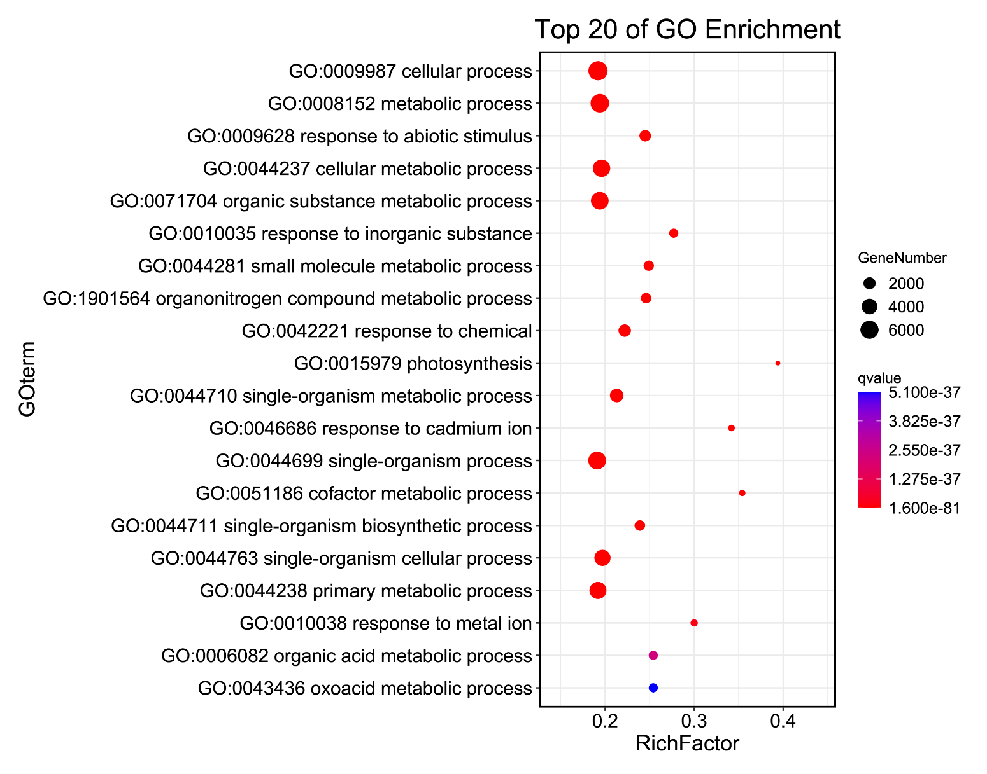
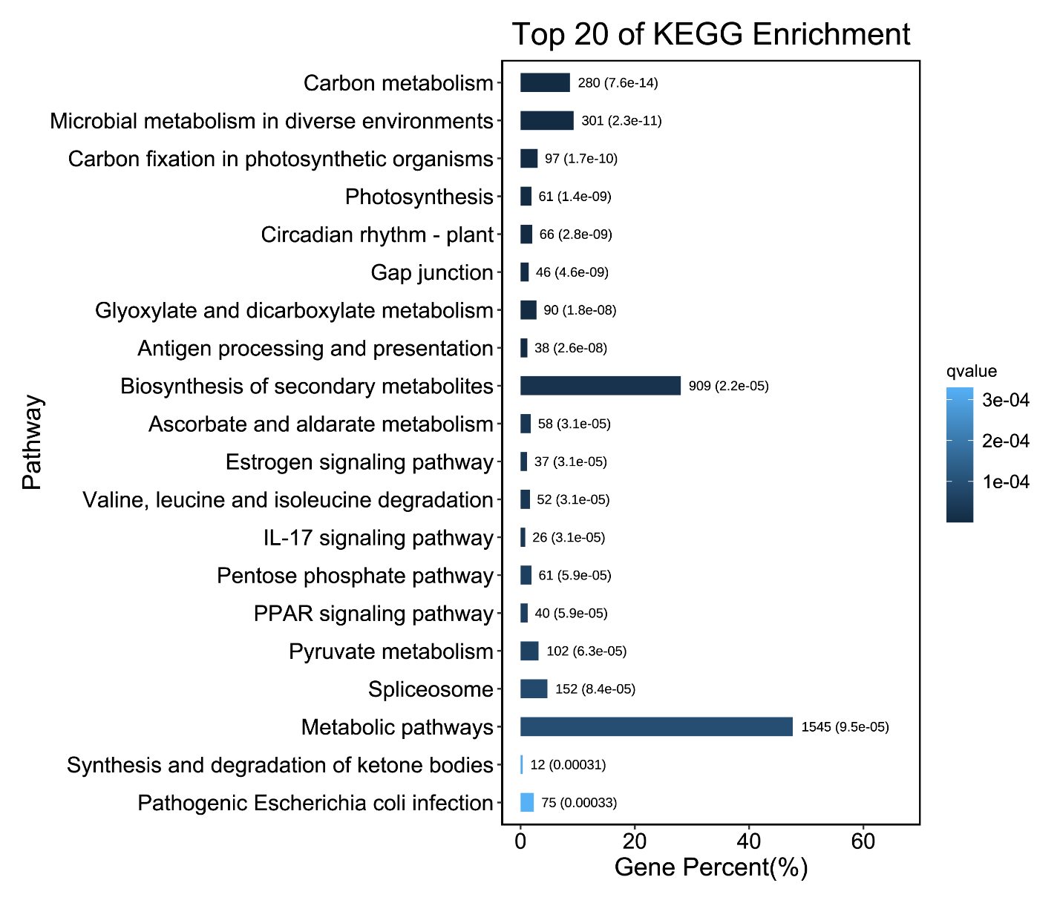
a
b
Fig. S6 Biological process (a) and KEGG pathway (b) enrichment analysis of DEGs

