Slide 1
Supplementary Figures

Slide 2
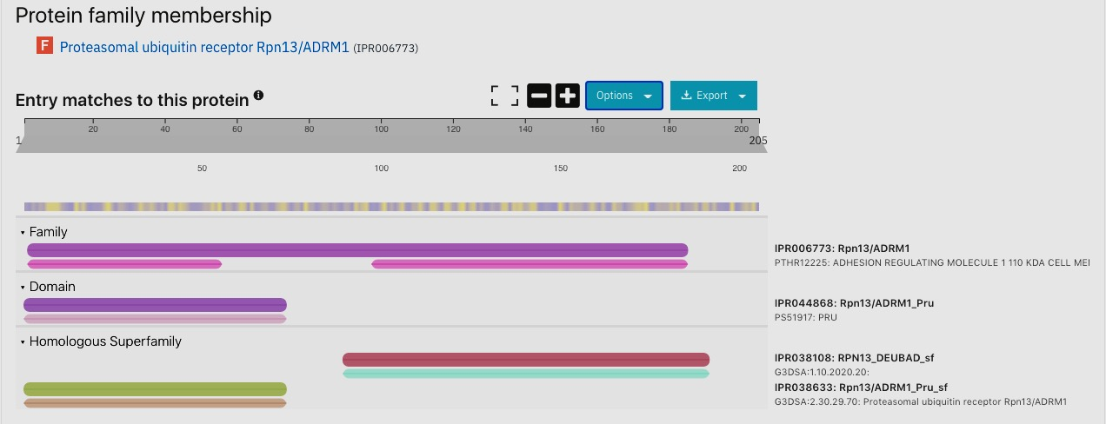
Parasitol. Res.
The 26S proteasome in Entamoeba histolytica: Functional Annotation and modelling to investigate differences from the host proteasomes
Nidhi Joshi^{1,a}, SK Yasir Hosen^{1,b}, Anil Raj Narooka^{c}, S. Gourinath^{d*}, Swati Tiwari^{c,*}
^{c}Molecular Cell Biology Laboratory, School of Biotechnology, Jawaharlal Nehru University, New Delhi -110067, India; swati_tiwari@mail.jnu.ac.in
^{d}School of Life Sciences, Jawaharlal Nehru University, New Delhi -110067, India; sgourinath@mail.jnu.ac.in
Supp. Fig. S1
Supplementary Fig. S1 Domain analysis of the putative Rpn13 ortholog from E. histolytica by InterProScan

Slide 3
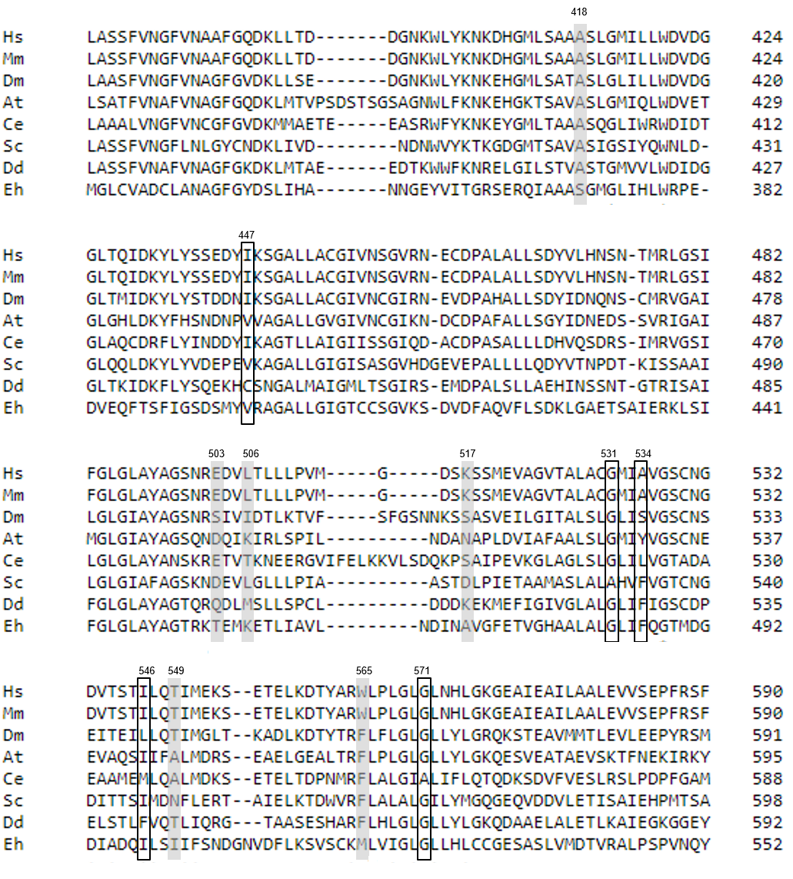
Parasitol. Res.
The 26S proteasome in Entamoeba histolytica: Functional Annotation and modelling to investigate differences from the host proteasomes
Nidhi Joshi^{1,a}, SK Yasir Hosen^{1,b}, Anil Raj Narooka^{c}, S. Gourinath^{d*}, Swati Tiwari^{c,*}
^{c}Molecular Cell Biology Laboratory, School of Biotechnology, Jawaharlal Nehru University, New Delhi -110067, India; swati_tiwari@mail.jnu.ac.in
^{d}School of Life Sciences, Jawaharlal Nehru University, New Delhi -110067, India; sgourinath@mail.jnu.ac.in
a
Supp. Fig. S2

Slide 4
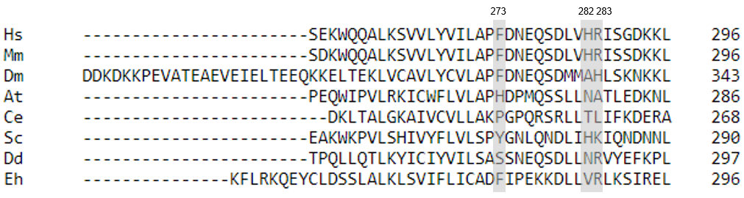
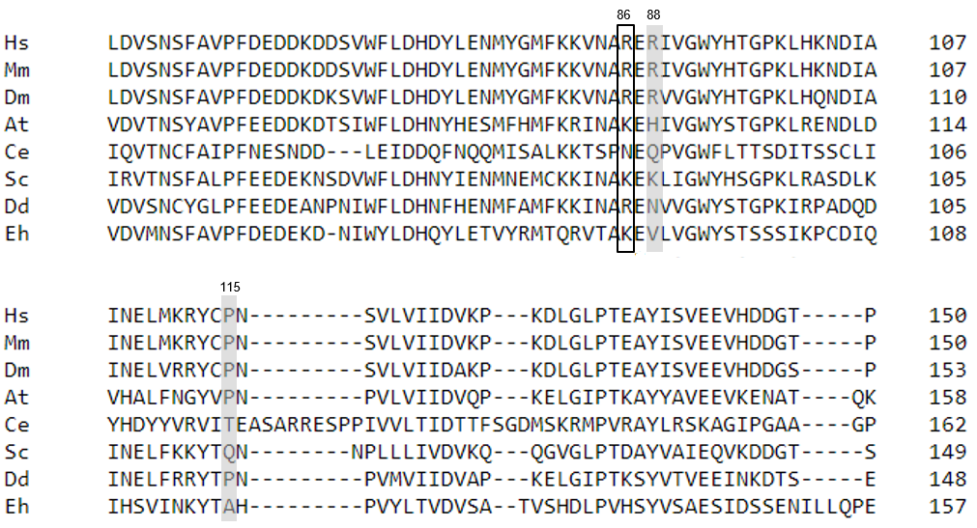
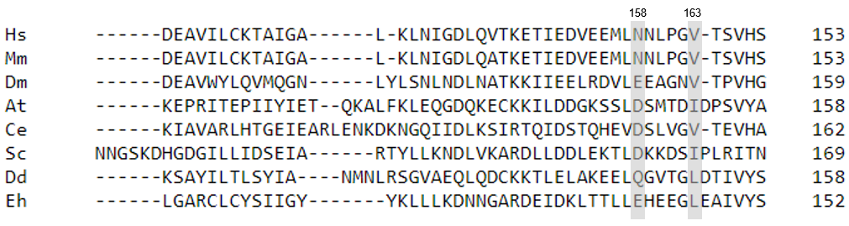
Parasitol. Res.
The 26S proteasome in Entamoeba histolytica: Functional Annotation and modelling to investigate differences from the host proteasomes
Nidhi Joshi^{1,a}, SK Yasir Hosen^{1,b}, Anil Raj Narooka^{c}, S. Gourinath^{d*}, Swati Tiwari^{c,*}
^{c}Molecular Cell Biology Laboratory, School of Biotechnology, Jawaharlal Nehru University, New Delhi -110067, India; swati_tiwari@mail.jnu.ac.in
^{d}School of Life Sciences, Jawaharlal Nehru University, New Delhi -110067, India; sgourinath@mail.jnu.ac.in
b
Supp. Fig. S2
c
d

Slide 5
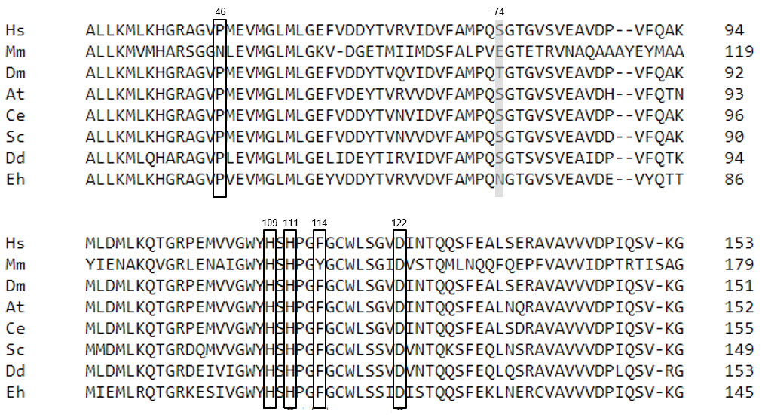
Parasitol. Res.
The 26S proteasome in Entamoeba histolytica: Functional Annotation and modelling to investigate differences from the host proteasomes
Nidhi Joshi^{1,a}, SK Yasir Hosen^{1,b}, Anil Raj Narooka^{c}, S. Gourinath^{d*}, Swati Tiwari^{c,*}
^{c}Molecular Cell Biology Laboratory, School of Biotechnology, Jawaharlal Nehru University, New Delhi -110067, India; swati_tiwari@mail.jnu.ac.in
^{d}School of Life Sciences, Jawaharlal Nehru University, New Delhi -110067, India; sgourinath@mail.jnu.ac.in
Supp. Fig. S2
e
f
418 447
Eh GRSERQIAAASGMGLIHLWRPEDVEQFTSFIGSDSMYVRAGALLGIGTCCSGVKSDVDFA
Ei ARSELQVAAAAGMGLLHLWRPQEIEQFTTFTQSDSMYVRAGALLGIGTCCSGVKSDVDFA
Ed GRSERQVAAASGMGLIHLWRPEDVEQFTSFIGSDSMYVRAGALLGIGTCCSGVQSDVDFA
Eh QVFLSDKLGAETSAIERKLSIFGLGLAYAGTRKTEMKETLIAVLNDINAVGFETVGHAAL
Ei QVFLADKLTASTSAIERKLSIFGLGLSHAGSRNAELKEQLIAVLNDITAVGFETAGHAAI
Ed QVFLSDKLGAETSAIERKLSIFGLGLAYAGTRKIEMKETLIAVLNDINAVGFETVGHAAL
Eh ALGLIFQGTMDGDIADQILSIIFSNDGNVDFLKSVSCKMLVIGLGLLHLCCGESASLVMD
Ei ALGMIYEGSMDGEIADQILSIIFSNDGNEEFLKSISCKMLVIGLGLLHLCCGDASTLVMD
Ed SLGLIFEGTMDGDIADQILSIIFSNDGNDDFLKSISCKMLVIGLGLLHLCCGESASLVMD
420
420
420
503 506 517
480
480
480
531 534 546 565 571
540
540
540
g
273 282 283
Eh LSSELKMEISENKFLRKQEYCLDSSLALKLSVIFLICADFIPEKKDLLVRLKSIRELENF 299
Ei LKPEVKFEISENEFLRTQKFCIDESVALKLAVMYLICAEFIPEKKDLLTKLKGIRMLENF 300
Ed LSSELKMEISENKFLRKQEYCLDSSLALKLSVIFLICADFIPEKKDLLVRLKSIRELENF 299

Slide 6
Parasitol. Res.
The 26S proteasome in Entamoeba histolytica: Functional Annotation and modelling to investigate differences from the host proteasomes
Nidhi Joshi^{1,a}, SK Yasir Hosen^{1,b}, Anil Raj Narooka^{c}, S. Gourinath^{d*}, Swati Tiwari^{c,*}
^{c}Molecular Cell Biology Laboratory, School of Biotechnology, Jawaharlal Nehru University, New Delhi -110067, India; swati_tiwari@mail.jnu.ac.in
^{d}School of Life Sciences, Jawaharlal Nehru University, New Delhi -110067, India; sgourinath@mail.jnu.ac.in
Supp. Fig. S2
h
86 88 115
Eh DEDEKDNIWYLDHQYLETVYRMTQRVTAKEVLVGWYSTSSSIKPCDIQIHSVINKYTAHP 120
Ei DEDEKDQIWYLDHQYLETLYRMTQRVTAKEVLVGWYSTSDKIKQCDIQIHTVIQKYTAHP 120
Ed DEDEKDNIWYLDHQYLETVYRMTQRVTAKEVLVGWYSTSSSIKPCDIQIHSVINKYTAHP 120
i
158 163
Eh LLLKDNNGARDEIDKLTTLLEHEEGLEAIVYSQYHYLCTCYYESKNDANEYFISGVKYLK 180
Ei LLAHNVPLARDEIDKVDKLLEHEEGLEAVVYSQYHLLCTRFYEAKNDANEFFISGVKYLK 180
Ed LLLNDNNGARDEIDKLTRLLEHEEGLEAIVYSQYHYLCTCYYESKNDANEYFISGVKYLK 180
j
46
Eh MFSFGGRRPISGDMPLPDTSETVYISSLALLKMLKHGRAGVPVEVMGLMLGEYVDDYTVR 60
Ei MFGMGGRKPISGDVPLPDTSETVHISSLALLKMLKHGRAGVPVEVMGLMLGEYVDQYTVR 60
Ed MFSFGGRRPISGDMPLPDTSETVHISSLALLKMLKHGRAGVPVEVMGLMLGEYVDDYTVR 60
Eh VVDVFAMPQNGTGVSVEAVDEVYQTTMIEMLRQTGRKESIVGWYHSHPGFGCWLSSIDIS 120
Ei VVDVFAMPQNGTGVSVEAVDEVYQTTMTDMLKQTGRKETIVGWYHSHPGFGCWLSSIDIS 120
Ed VVDVFAMPQNGTGVSVEAVDEVYQTTMIEMLRQTGRKESIVGWYHSHPGFGCWLSSIDIS 120
74 109 111 114 122
Supplementary Fig. S2 Multiple sequence alignment (MSA) of Rpn-subunits of 19S lid. (a-e) MSA shows parts of Rpn subunits Rpn1, 5, 8, 9 and 11 of E. histolytica (Eh), D. discoidium (Dd), S. cerevisiae (Sc), C. elegans (Ce), A. thaliana (At), D. melanogaster (Dm), Mus musculus (Mm) and Homo sapiens (Hs). Vertical lines separate different parts of the sequence patched in the image. Critical residues described in results are boxed. (f-j) MSA of parts of Rpn1, 5, 8, 9 and 11 subunits of E. histolytica (Eh), E. invadens (Ei) and E. dispar (Ed). Boxes with black outlines, conserved residues; grey highlight, non-conserved residues. Numbers of top indicate residue positions according to corresponding subunits in S. cerevisiae

Slide 7
Parasitol. Res.
The 26S proteasome in Entamoeba histolytica: Functional Annotation and modelling to investigate differences from the host proteasomes
Nidhi Joshi^{1,a}, SK Yasir Hosen^{1,b}, Anil Raj Narooka^{c}, S. Gourinath^{d*}, Swati Tiwari^{c,*}
^{c}Molecular Cell Biology Laboratory, School of Biotechnology, Jawaharlal Nehru University, New Delhi -110067, India; swati_tiwari@mail.jnu.ac.in
^{d}School of Life Sciences, Jawaharlal Nehru University, New Delhi -110067, India; sgourinath@mail.jnu.ac.in
a
Supp. Fig. S3
117 118 147 249 250 292 294
b
259 260 295 302 304
c
107 111
235 238 240 276
d
75 79 207 208 243

Slide 8
Parasitol. Res.
The 26S proteasome in Entamoeba histolytica: Functional Annotation and modelling to investigate differences from the host proteasomes
Nidhi Joshi^{1,a}, SK Yasir Hosen^{1,b}, Anil Raj Narooka^{c}, S. Gourinath^{d*}, Swati Tiwari^{c,*}
^{c}Molecular Cell Biology Laboratory, School of Biotechnology, Jawaharlal Nehru University, New Delhi -110067, India; swati_tiwari@mail.jnu.ac.in
^{d}School of Life Sciences, Jawaharlal Nehru University, New Delhi -110067, India; sgourinath@mail.jnu.ac.in
Supp. Fig. S3
e
128 158 260 261 297 299 303 305
f
72 92 121
g
117 118
Eh PVSQWDLNADKKLMEEQPLLVSRCIKAMPDEREPRYVISIKEYAKFVVGKSNRVEKDAVQ 120
Ei PVSQWDLNGDKRLMEEQPLLVSRCVKAMPEAREPRYVISIKEYARFVAGKSAKVDKDSIQ 120
Ed PVSQWDLNADKKLMEEQPLLVCRCIKAMPDEREPRYVISIKEFARFVVGKSNRVEKNAVQ 120
Eh DGTRVGVDRARYEIKMALPPKIDPSVSVMQVEEKPDVTYKDIGGCKEQIERIREVVELPM 180
Ei DGTRIGVDRGRYEIKMALPPKIDPSVSVMQVEEKPDVTYKDIGGCKEQIERIREVVELPM 180
Ed DGTRVGVDRARYEIKMALPPKIDPSVSVMQVEEKPDVTYKDIGGCKEQIERIKEVVELPM 180
Eh VQKYVGEGAK DTGESEVQRT
Ei VQKYVGEGAK DTGESEVQRT
Ed VQKYVGEGAK DTGESEVQRT
147
249 250 292 294
h
259 260
Eh YEEIGIKPPKGVILYGPPGTGKTLLAKAVANETSATFLRIVGSELIQKYLGDGPKLVREL 240
Ei YEEIGIKPPKGVILYGPPGTGKTLLAKAVANETSATFLRIVGSELIQKYLGDGPKLVREL 240
Ed YEEIGIKPPKGVILYGPPGTGKTLLAKAVANETSATFLRIVGSELIQKYLGDGPKLVREL 240
Eh FQAAKDSAPSIVFIDEIDAVGTKRYDAHSGGEKEIQRTMLELLNQLDGFDTRGEVKVIIA 300
Ei FQAAKDSAPSIVFIDEIDAVGTKRYDAQSGGEKEIQRTMLELLNQLDGFDTRGEVKVIIA 300
Ed FQAAKDSAPSIVFIDEIDAVGTKRYDAHSGGEKEIQRTMLELLNQLDGFDTRGEVKVIIA 300
295 302 304

Slide 9







Parasitol. Res.
The 26S proteasome in Entamoeba histolytica: Functional Annotation and modelling to investigate differences from the host proteasomes
Nidhi Joshi^{1,a}, SK Yasir Hosen^{1,b}, Anil Raj Narooka^{c}, S. Gourinath^{d*}, Swati Tiwari^{c,*}
^{c}Molecular Cell Biology Laboratory, School of Biotechnology, Jawaharlal Nehru University, New Delhi -110067, India; swati_tiwari@mail.jnu.ac.in
^{d}School of Life Sciences, Jawaharlal Nehru University, New Delhi -110067, India; sgourinath@mail.jnu.ac.in
i
Supp. Fig. S3
107 111
Eh GQFVEMVDKDTAVVTLSSGTTQFVRILSTINRELLKPGTSVAHHKQSNALVDVLPPEADS 120
Ei GQFVEMVDKDTAVVTLSSGTTQNLSCAPQAIQ----------------RTCRCTPTRGRF 84
Ed GQFVEMVDKDTAVVTLSSGTTQFVRILSTINRELLKPGTSVAHHKQSNALVDVLPPEADS 120
235 238 240 276
Eh TGKTMLAKAVAHHTSASFIQIVGSEFAQQYLGE IATKRHDAQ
Ei TGKTMLAKAVAHHTSAAFIQIVGSEFAQQYLGE IATKRHDAQ
Ed TGKTMLAKAVAHHTSASFIQIVGSEFAQQYLGE IATKRHDAQ
j
75 79 207 208 243
Eh YIVKVSLGPHYVV IVDKYL GKRIAEG
Ei VLVKSAQEGKYIV LVQKYI STRVEGN
Ed YIVKVSLGPHYVV IVDKYL GKRIAEG
k
128 158 260 261 297 299 303 305
l
72 92 121
Supplementary Fig. S3 Multiple sequence alignment (MSA) of Rpt-subunits of 19S base. (a-f) MSA of parts of Rpt subunits Rp1-6 of E. histolytica (Eh), D. discoidium (Dd), S. cerevisiae (Sc), C. elegans (Ce), A. thaliana (At), D. melanogaster (Dm), Mus musculus (Mm) and Homo sapiens (Hs). Vertical lines separate different parts of the sequence patched in the image. Critical residues described in results are boxed. (g-l) MSA of parts of Rpt subunits Rpt1-6 of E. histolytica (Eh), E. invadens (Ei) and E. dispar (Ed). Vertical lines separate different parts of the sequence patched in the image. Boxes with black outlines, conserved residues; grey highlight, non-conserved residues. Numbers on top show residue positions according to corresponding subunits in human proteins

Slide 10
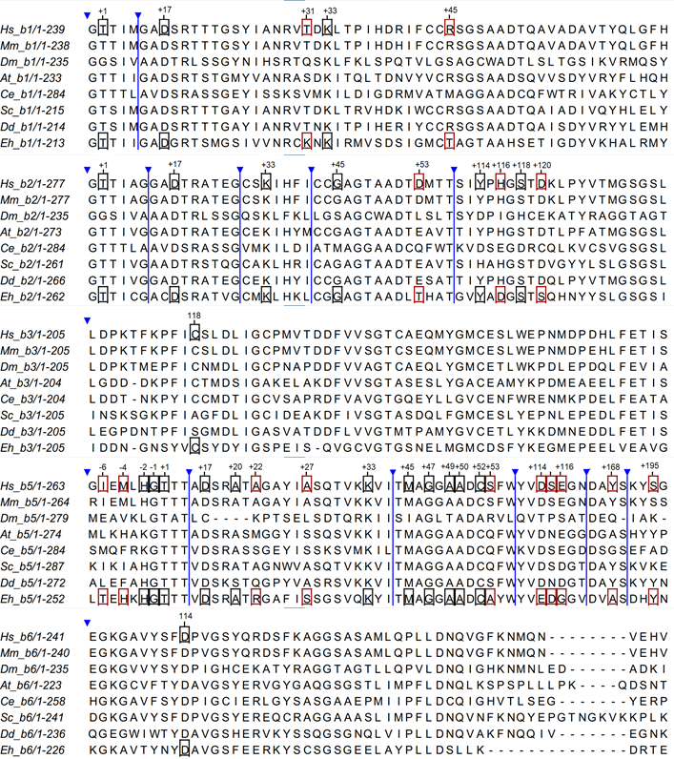
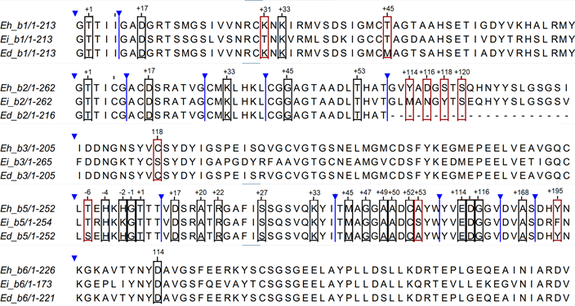
Parasitol. Res.
The 26S proteasome in Entamoeba histolytica: Functional Annotation and modelling to investigate differences from the host proteasomes
Nidhi Joshi^{1,a}, SK Yasir Hosen^{1,b}, Anil Raj Narooka^{c}, S. Gourinath^{d*}, Swati Tiwari^{c,*}
^{c}Molecular Cell Biology Laboratory, School of Biotechnology, Jawaharlal Nehru University, New Delhi -110067, India; swati_tiwari@mail.jnu.ac.in
^{d}School of Life Sciences, Jawaharlal Nehru University, New Delhi -110067, India; sgourinath@mail.jnu.ac.in
a
Supp. Fig. S4
b
Supplementary Fig. S4 Multiple sequence alignment (MSA) of constitutive β1, β2, and β5 subunits. (a-c) MSA of β1, β2, and β5 subunits from E. histolytica (Eh), D. discoidium (Dd), S. cerevisiae (Sc), C. elegans (Ce), A. thaliana (At), D. melanogaster (Dm), Mus musculus (Mm) and Homo sapiens (Hs). Vertical lines separate different parts of the sequence patched in the image. (d-f) MSA of β1, β2, and β5 subunits of E. histolytica (Eh), E. invadens (Ei) and E. dispar (Ed). Numbers on top show the residue numbers of human ortholog. Boxes with black outlines, conserved residues; grey highlights, non-conserved residues. Vertical lines separate different parts of the sequence patched in the image

Slide 11
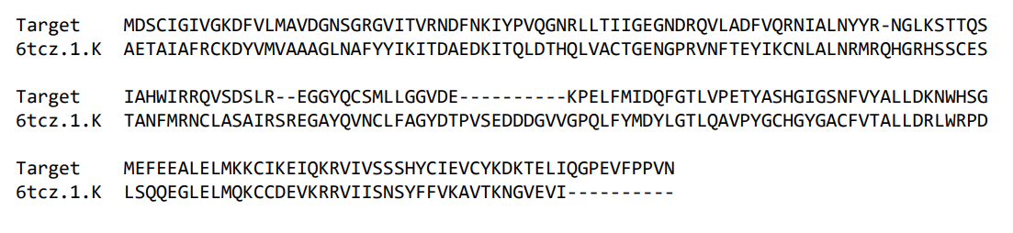
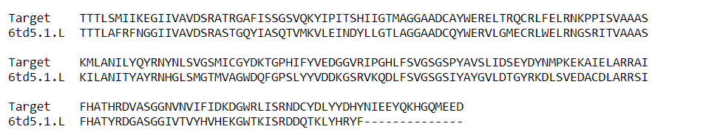
Parasitol. Res.
The 26S proteasome in Entamoeba histolytica: Functional Annotation and modelling to investigate differences from the host proteasomes
Nidhi Joshi^{1,a}, SK Yasir Hosen^{1,b}, Anil Raj Narooka^{c}, S. Gourinath^{d*}, Swati Tiwari^{c,*}
^{c}Molecular Cell Biology Laboratory, School of Biotechnology, Jawaharlal Nehru University, New Delhi -110067, India; swati_tiwari@mail.jnu.ac.in
^{d}School of Life Sciences, Jawaharlal Nehru University, New Delhi -110067, India; sgourinath@mail.jnu.ac.in
Supp Fig S5
a
β4 Subunit
b
β5 Subunit
c
Eh_β5
Hs_β5
Supplementary Fig. S5 SWISS-MODEL generated multiple sequence alignment of (a) β4 and β5 (b) of E. histolytica (target) with 6TCZ and 6TD5. (c) Conservation of residues between E. histolytica and human β5 subunits that interact with compound 8. The interacting residues are marked in blue. Conservative substitution is underlined

Slide 12
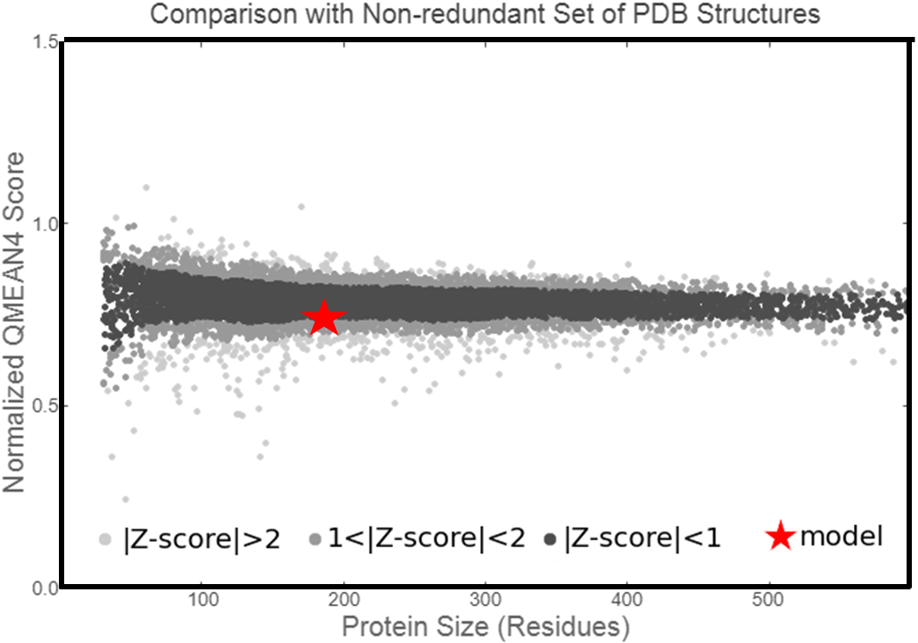
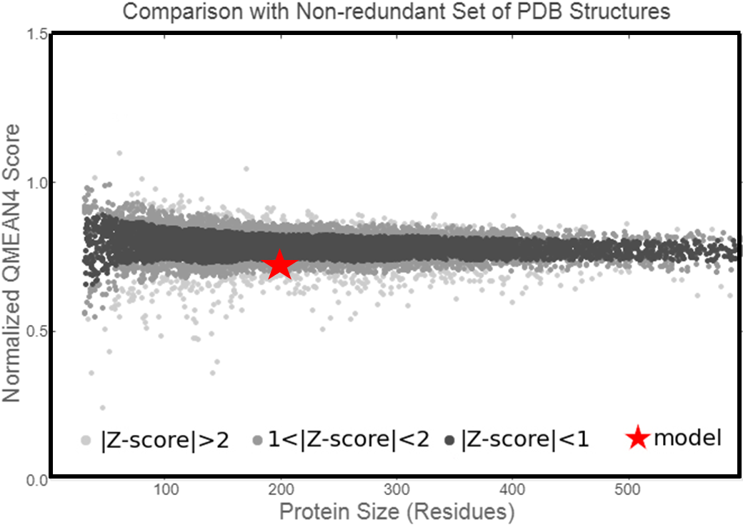
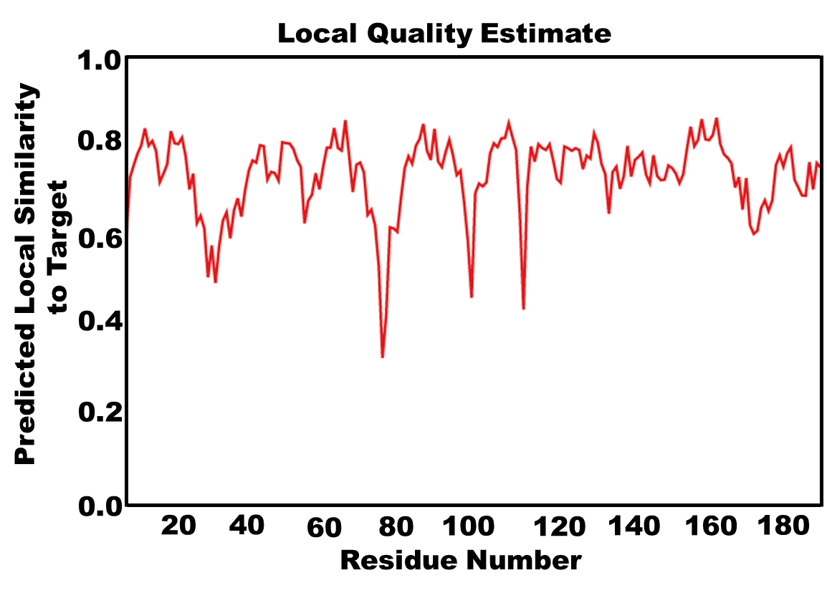
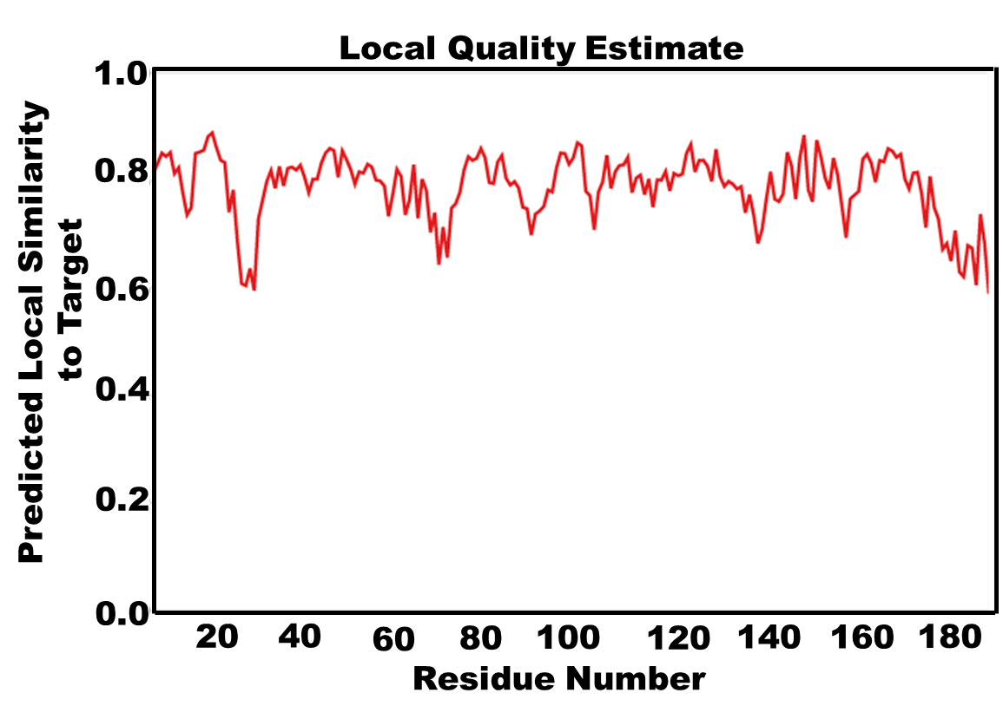
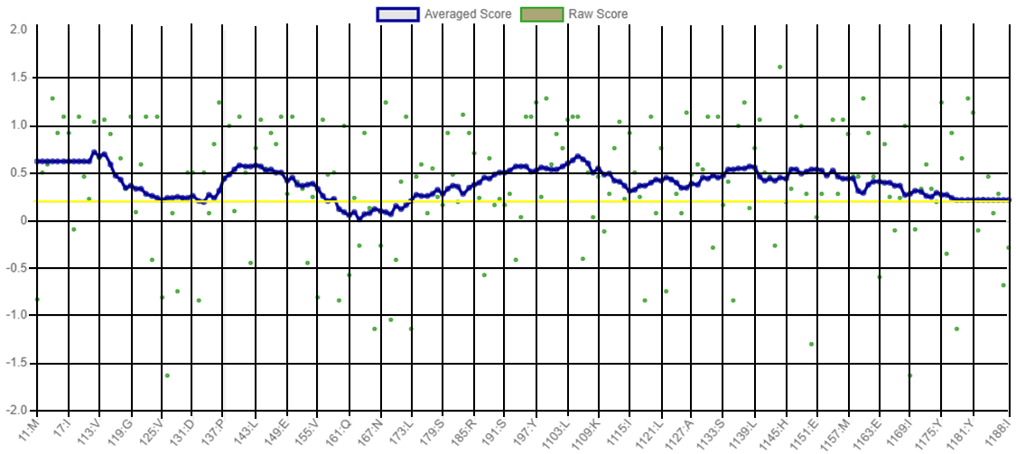
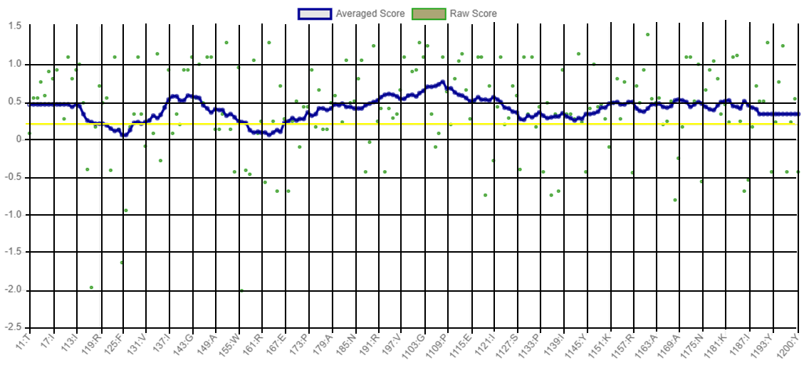
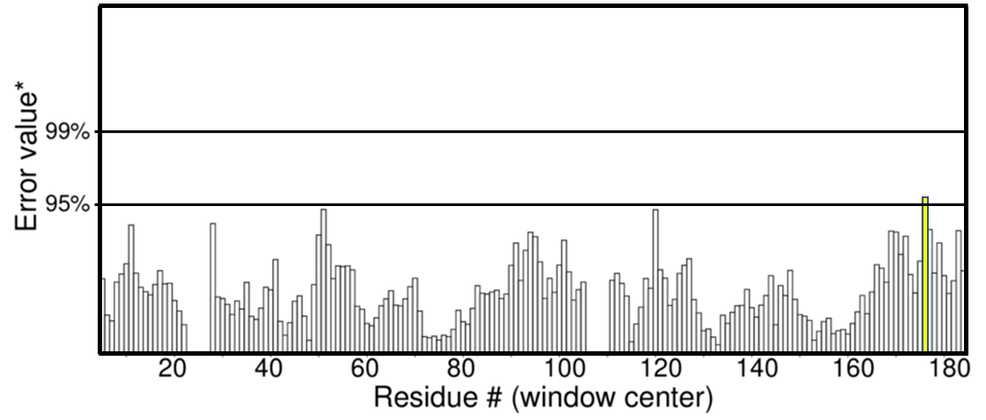
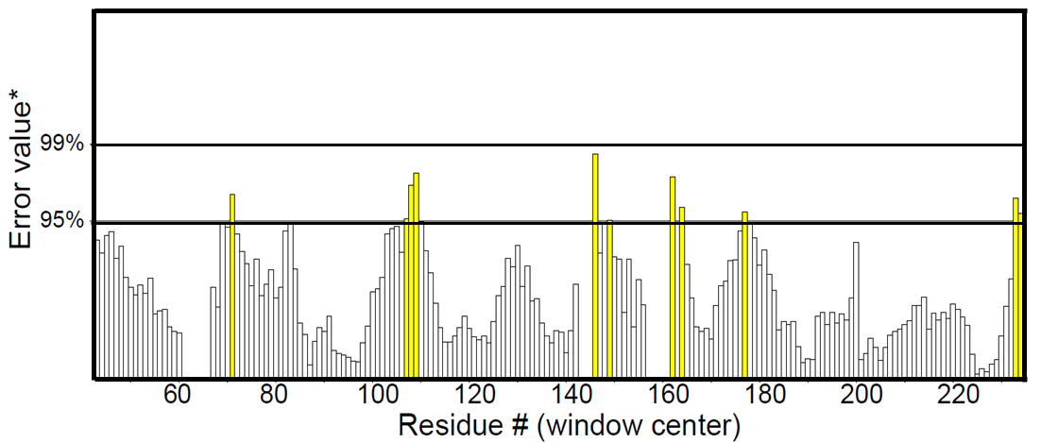
Parasitol. Res.
The 26S proteasome in Entamoeba histolytica: Functional Annotation and modelling to investigate differences from the host proteasomes
Nidhi Joshi^{1,a}, SK Yasir Hosen^{1,b}, Anil Raj Narooka^{c}, S. Gourinath^{d*}, Swati Tiwari^{c,*}
^{c}Molecular Cell Biology Laboratory, School of Biotechnology, Jawaharlal Nehru University, New Delhi -110067, India; swati_tiwari@mail.jnu.ac.in
^{d}School of Life Sciences, Jawaharlal Nehru University, New Delhi -110067, India; sgourinath@mail.jnu.ac.in
Supp. Fig. S6
β4 Subunit
β5 Subunit
a
c
b
d
e
f
g
h
Supplementary Fig. S6 Comparative quality estimation analysis of the computational models of β4 and β5 subunits of E. histolytica. (A, C) QMEAN Z-scores, (B, D) Local Quality Estimate, (E, F) VARIFY-3D and (G, H) ERRAT plots for models of β4 (A, B, E, G) and β5 (C, D, F, H) subunits of E. histolytica

Slide 13
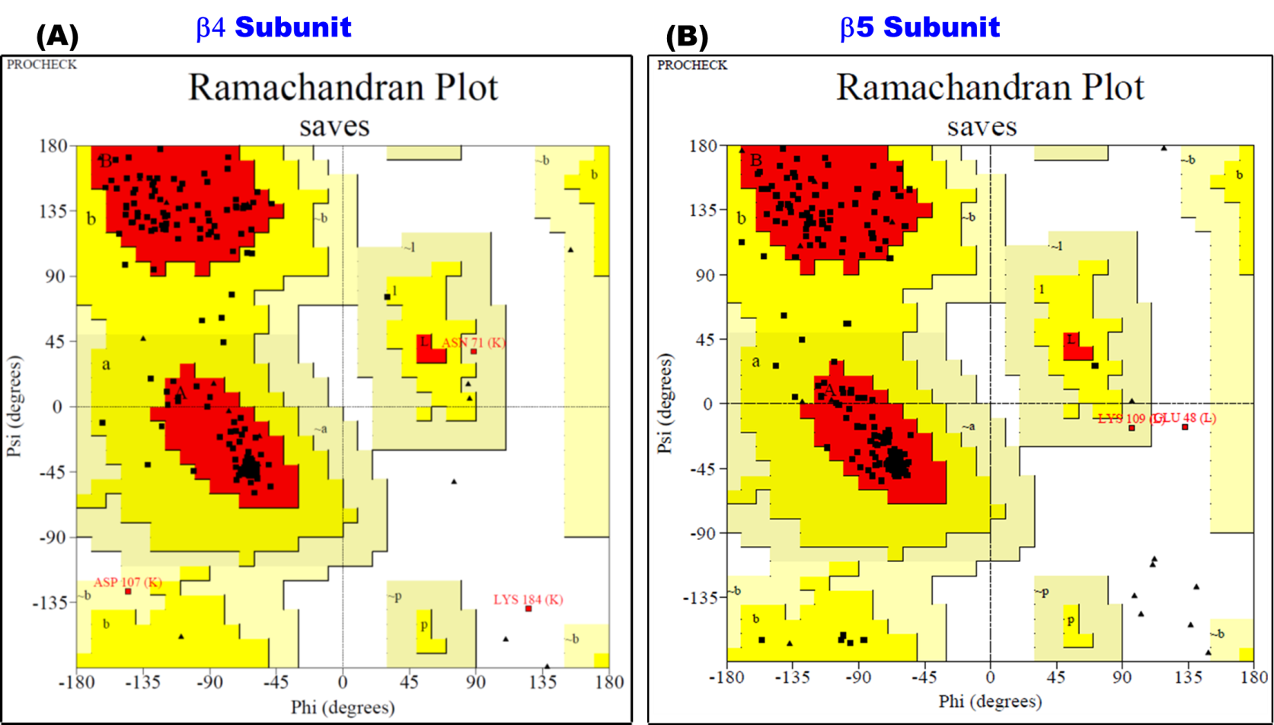
Parasitol. Res.
The 26S proteasome in Entamoeba histolytica: Functional Annotation and modelling to investigate differences from the host proteasomes
Nidhi Joshi^{1,a}, SK Yasir Hosen^{1,b}, Anil Raj Narooka^{c}, S. Gourinath^{d*}, Swati Tiwari^{c,*}
^{c}Molecular Cell Biology Laboratory, School of Biotechnology, Jawaharlal Nehru University, New Delhi -110067, India; swati_tiwari@mail.jnu.ac.in
^{d}School of Life Sciences, Jawaharlal Nehru University, New Delhi -110067, India; sgourinath@mail.jnu.ac.in
Supp. Fig. S7
Supplementary Fig. S7 Stereochemical analysis of the modeled structure. Ramachandran plots for (a) β4 and (b) β5 subunits of E. histolytica

Slide 14
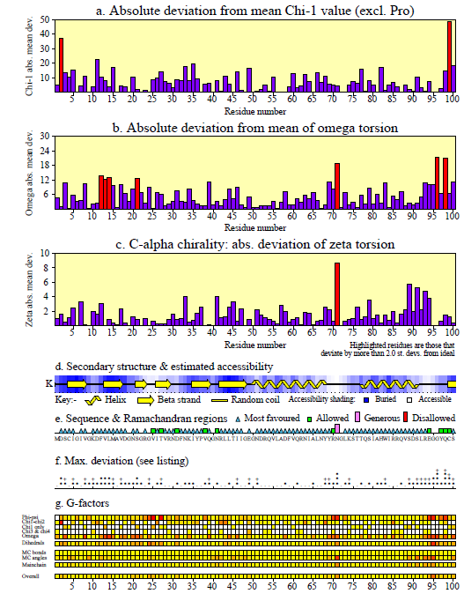
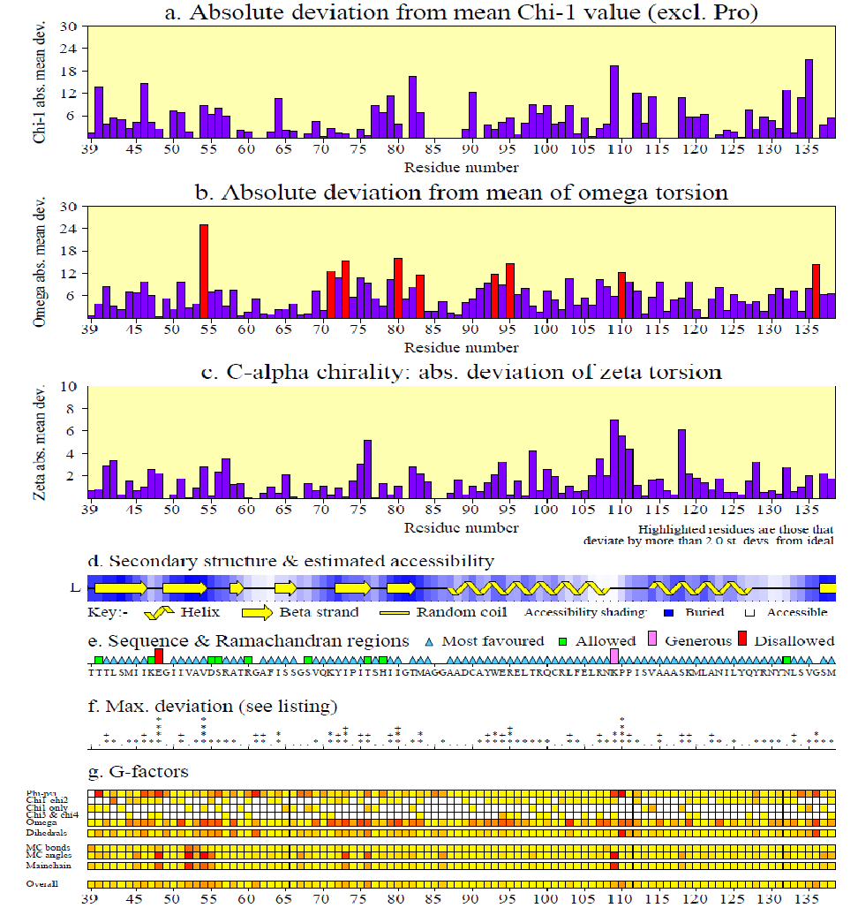
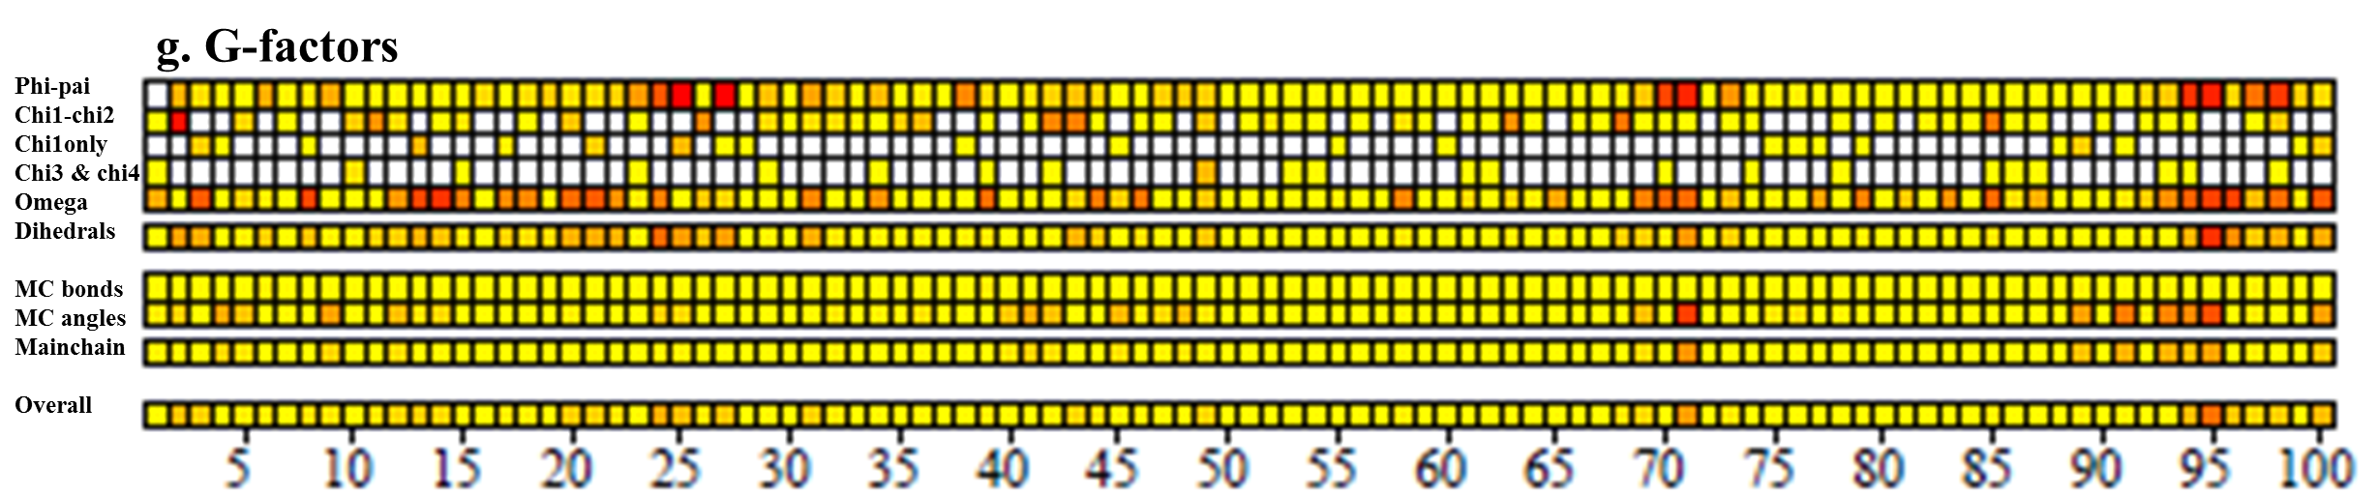
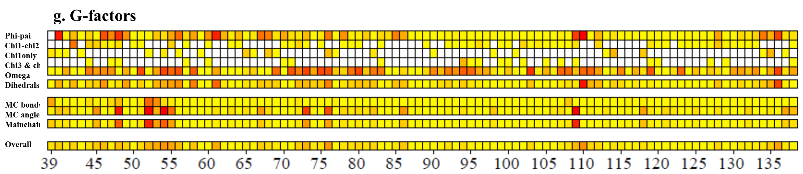
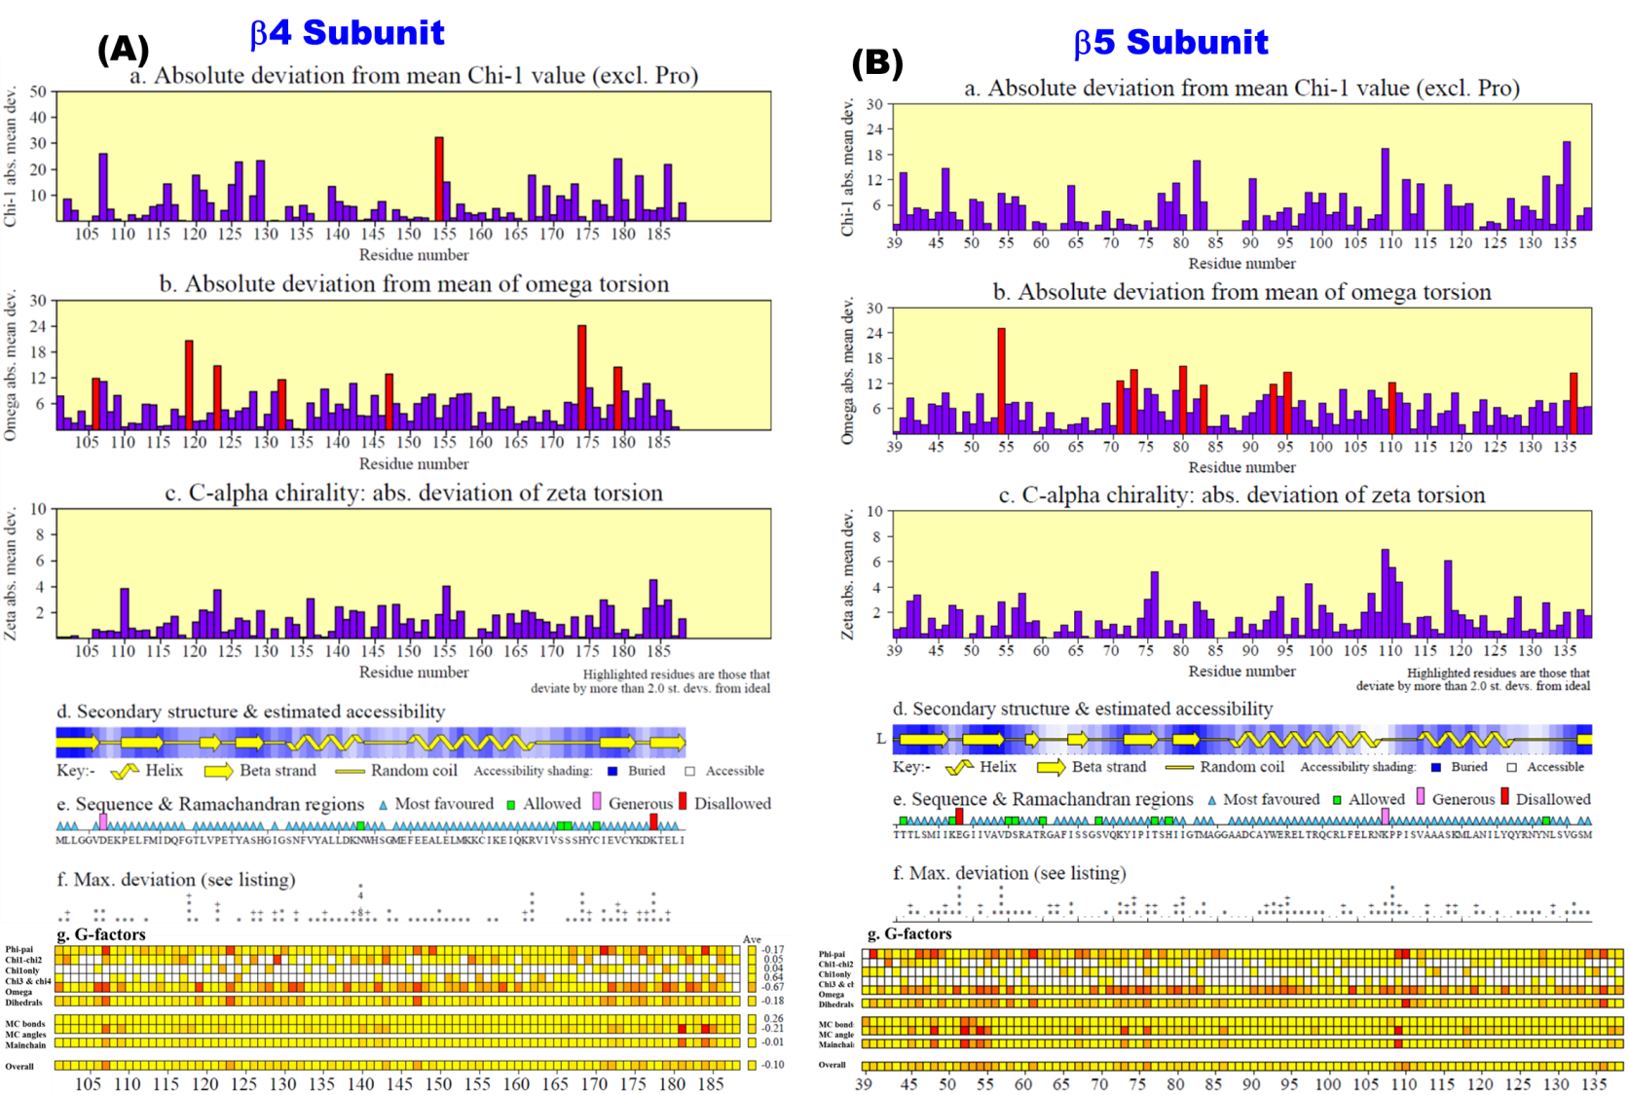
Parasitol. Res.
The 26S proteasome in Entamoeba histolytica: Functional Annotation and modelling to investigate differences from the host proteasomes
Nidhi Joshi^{1,a}, SK Yasir Hosen^{1,b}, Anil Raj Narooka^{c}, S. Gourinath^{d*}, Swati Tiwari^{c,*}
^{c}Molecular Cell Biology Laboratory, School of Biotechnology, Jawaharlal Nehru University, New Delhi -110067, India; swati_tiwari@mail.jnu.ac.in
^{d}School of Life Sciences, Jawaharlal Nehru University, New Delhi -110067, India; sgourinath@mail.jnu.ac.in
Supp. Fig. S8
a
b
c
d
Supplementary Fig. S8 Validation of models by SAVES 6.0 server. (a, b) VARIFY3D parameter plots and (c, d) ERRAT-plots for β4 (left panel) and β5 (right panel) subunits of E. histolytica

Slide 15
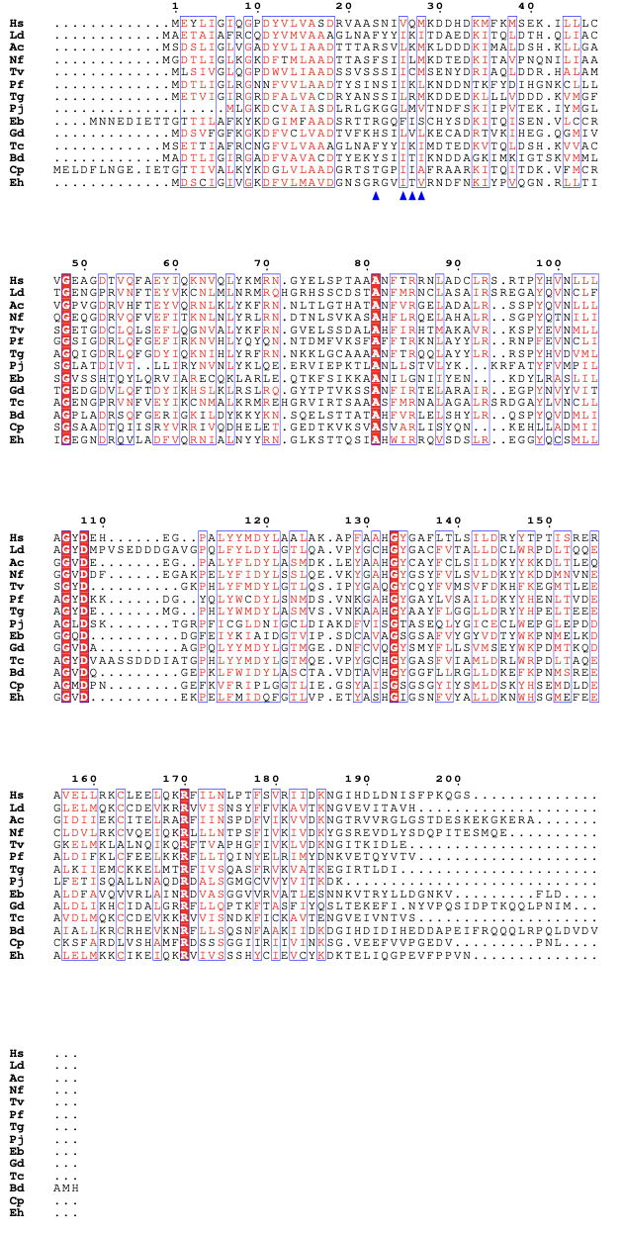
Parasitol. Res.
The 26S proteasome in Entamoeba histolytica: Functional Annotation and modelling to investigate differences from the host proteasomes
Nidhi Joshi^{1,a}, SK Yasir Hosen^{1,b}, Anil Raj Narooka^{c}, S. Gourinath^{d*}, Swati Tiwari^{c,*}
^{c}Molecular Cell Biology Laboratory, School of Biotechnology, Jawaharlal Nehru University, New Delhi -110067, India; swati_tiwari@mail.jnu.ac.in
^{d}School of Life Sciences, Jawaharlal Nehru University, New Delhi -110067, India; sgourinath@mail.jnu.ac.in
Supp. Fig. S9a

Slide 16
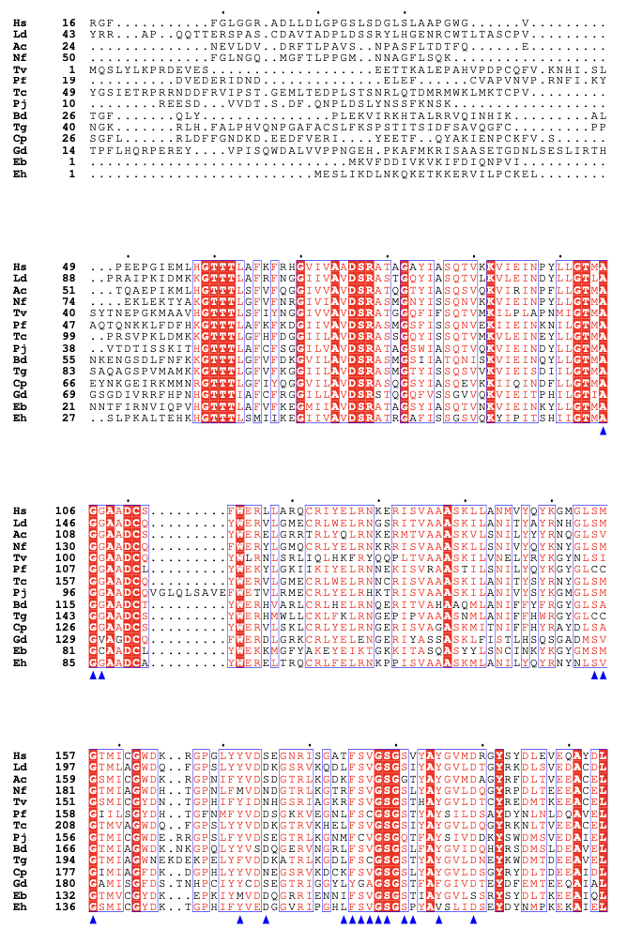
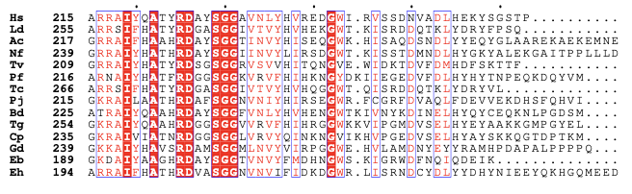
Supp. Fig. S9b
Parasitol. Res.
The 26S proteasome in Entamoeba histolytica: Functional Annotation and modelling to investigate differences from the host proteasomes
Nidhi Joshi^{1,a}, SK Yasir Hosen^{1,b}, Anil Raj Narooka^{c}, S. Gourinath^{d*}, Swati Tiwari^{c,*}
^{c}Molecular Cell Biology Laboratory, School of Biotechnology, Jawaharlal Nehru University, New Delhi -110067, India; swati_tiwari@mail.jnu.ac.in
^{d}School of Life Sciences, Jawaharlal Nehru University, New Delhi -110067, India; sgourinath@mail.jnu.ac.in
Supplementary Fig S9 Protein sequence alignment of b4 and b5 subunits of various human pathogens. Proteasome subunits (a) β4 and (b) β5 are aligned from different pathogens Leishmania donovani (tax id 5661), Trypanosoma cruzi (tax id 5693), Giardia duodenalis (tax id 5741), Trichomonas vaginalis (tax id 412133), Naegleria fowleri (tax id 5763), Acanthamoeba castellanii (tax id 1257118), Babesia divergens (tax id 32595), Plasmodium falciparum (tax id 36329), Cryptosporidium parvum (tax id 353152), Toxoplasma gondii (tax id 5811), Enterocytozoon bieneusi (tax id 31281), Pneumocystis jirovecii (tax id 42068), Entamoeba histolytica (tax id 294381) and Homo sapiens (tax 9606) in (a) beta 4 subunit and (b) beta 5 subunit . The conserved residues are colored red. The residues in the protein subunit of E. histolytica which are within 5Å of the compound 8 in the model are marked by a blue arrowhead. Blue stars show the residues that are variable in protozoa/changed in immunoproteasomes

Slide 17
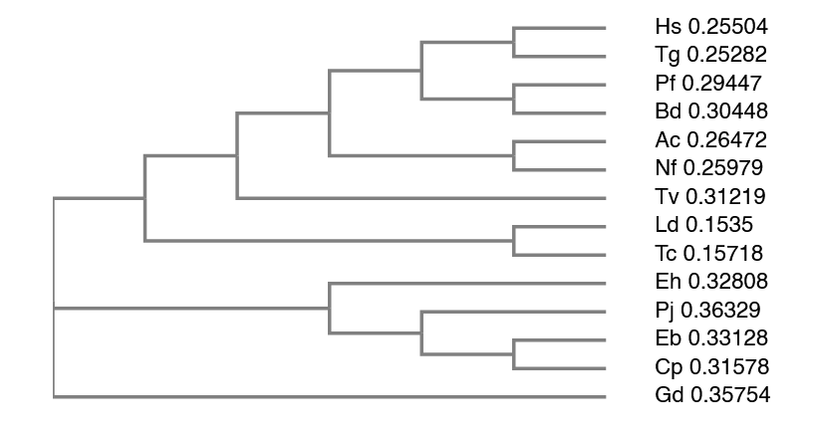
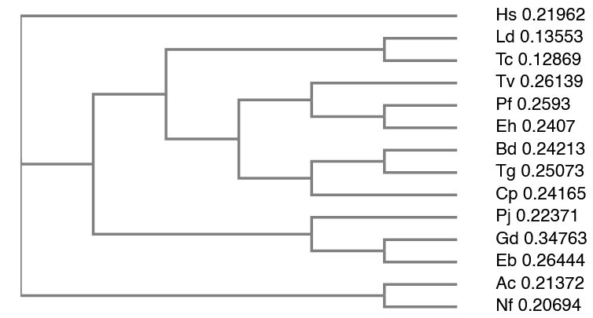
Parasitol. Res.
The 26S proteasome in Entamoeba histolytica: Functional Annotation and modelling to investigate differences from the host proteasomes
Nidhi Joshi^{1,a}, SK Yasir Hosen^{1,b}, Anil Raj Narooka^{c}, S. Gourinath^{d*}, Swati Tiwari^{c,*}
^{c}Molecular Cell Biology Laboratory, School of Biotechnology, Jawaharlal Nehru University, New Delhi -110067, India; swati_tiwari@mail.jnu.ac.in
^{d}School of Life Sciences, Jawaharlal Nehru University, New Delhi -110067, India; sgourinath@mail.jnu.ac.in
Supp. Fig. S10
a
b
Supplementary Fig. S10 Cladogram of β4 and β5 subunits of various human pathogens. Cladogram of (a) β4 and (b) β5 subunits of Leishmania donovani (tax id 5661), Trypanosoma cruzi (tax id 5693), Giardia duodenalis (tax id 5741), Trichomonas vaginalis (tax id 412133), Naegleria fowleri (tax id 5763), Acanthamoeba castellanii (tax id 1257118), Babesia divergens (tax id 32595), Plasmodium falciparum (tax id 36329), Cryptosporidium parvum (tax id 353152), Toxoplasma gondii (tax id 5811), Enterocytozoon bieneusi (tax id 31281), Pneumocystis jirovecii (tax id 42068), Entamoeba histolytica (tax id 294381) and Homo sapiens (tax 9606)

