Slide 1
a)
b)
ΔG7048
G9376
kDa
250
150
100
75
50
37
25
20
15
kDa
250
150
100
75
50
37
25
20
15
MM
30 60 µg
MM
3,5 7 µg
-
-
-
-
-
-
-
-
-
-
-
-
-
-
-
-
-
-
Supplementary Figure S1. Purification of recombinant G9376 and ΔG7048 from P. pastoris. SDS-page/Comassie blu staining analysis of a) G9376 and b) ΔG7048 as eluted from the IMAC chromatography. Different amounts (µg) were evaluated for each protein. Molecular weight marker (MM) is also reported.

Slide 2
a)
b)
c)
d)
e)
f)
Supplementary Figure S2. Far-UV CD analysis of G9376 and ΔG7048. a) CD spectra of G9376 (0.3 mg/ml) at 20°C; b) CD spectra of G9376 collected at different temperatures (from 25°C to 75°C); c) thermal denaturation profile of G9376 as obtained by monitoring the variation in CD signal at 217 nm. d) CD spectra of ΔG7048 (0.1 mg/ml) at 20°C; e) CD spectra of ΔG7048 collected at different temperatures (from 25°C to 75°C); f) thermal denaturation profile of ΔG7048 obtained by monitoring the variation in CD signal at 225 nm. Experiments were carried out in 30 mM sodium acetate pH 5.5 and 50 mM NaCl.

Slide 3
LAM2
LAM4
LAM5
LAM3
Glc
1,3-β-D-LAM5P
Intensity (uRIU)
*
Supplementary Figure S3. Analysis of degradation products obtained from two different 1,3-β-glucan pentamers upon incubation with exo-1,3-β-glucanase G9376. Chromatographic analysis of equal amounts of (upper panel) different 1,3-β-glucan oligomers and (lower panel) of degradation products as obtained from 1,3-β-glucan pentamer (LAM5) and 1,3-β-D-Laminaripentaitol borohydride (1,3-β-D-LAM5P) upon 3-h incubation with exo-1,3-β-glucanase G9376. * indicates an intermediate-product as detected during the reaction. In the upper panel, glucose is also analysed. [Glc, D-Glucose; LAM2, Laminaribiose; LAM3, Laminaritriose; LAM4, Laminaritetraose; LAM5, Laminaripentaose; 1,3-β-D-LAM5P, 1,3-β-D-Laminaripentaitol borohydride].

Slide 4
LAM6
LAM2
LAM4
LAM5
LAM3
Intensity (uRIU)
Supplementary Figure S4. Production kinetic of the hybrid oligosaccharide generated by 1,3-β-transglucanase ΔG7048 using LAM5 as substrate. Chromatographic analysis of (upper panel) different 1,3-β-glucan oligomers (LAM2-6) and of (lower panel) enzymatic products obtained from LAM5 upon different incubation times with 1,3-β-transglucanase ΔG7048. [LAM2, Laminaribiose; LAM3, Laminaritriose; LAM4, Laminaritetraose; LAM5, Laminaripentaose; LAM6, Laminarihexaose].

Slide 5
x10
5
LAM5
5
1337.5
LAM8
4
LAM8 + H8
851.4
x10
x10
1337.5
5
1.0
3
LAM5
4
0.8
851.5
2
3
0.6
H11
Intens. [a.u.]
Intens. [a.u.]
Intens. [a.u.]
1823.6
2
LAM9
0.4
1
LAM7
LAM7
1499.5
LAM6
LAM4
LAM4
H14
LAM6
1175.5
LAM6
1
LAM7
0.2
689,3
1013.5
H9
H12
689.3
1013.5
LAM8
LAM5
1175.5
LAM10
1499.6
1985.6
2309.7
1175.5
1337.6
851.5
1013.5
1661.5
0
1000
1500
2000
2500
3000
0
0.0
m/z
1000
1500
2000
2500
3000
m/z
1000
1500
2000
2500
3000
m/z
Supplementary Figure S5. Mass spectrometry analysis of the hybrid oligosaccharides generated by the activity of 1,3-β-transglucanase ΔG7048 on LAM5. MALDI-TOF mass spectrum of the commercial left panel) LAM5 (m/z = 851,4, [M + Na]⁺) and middle panel) LAM8 (m/z = 1337,5, [M + Na]⁺). Right panel) Products of the 24-hour incubation of LAM5 with the 1,3-β-transglucanase ΔG7048. Hybrid oligosaccharides are indicated as HX where X is the calculated degree of polymerization (DP). Green and turquoise arrows indicate two different +DP3-series. [HX, hybrid oligosaccharide with DPX; LAM4, Laminaritetraose; LAM5, Laminaripentaose; LAM6, Laminarihexaose; LAM7, Laminariheptaose; LAM8, Laminarioctaose; LAM9, Laminarinonaose; LAM10, Laminarin-decamer].

Slide 6
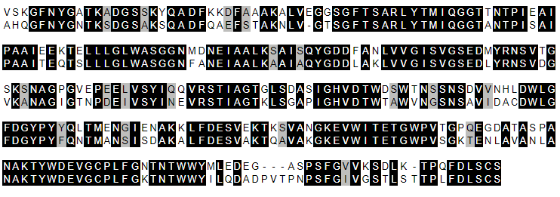
ΔG7048
60
Bgt2p
59
ΔG7048
120
Bgt2p
119
ΔG7048
180
Bgt2p
179
ΔG7048
240
Bgt2p
239
ΔG7048
290
Bgt2p
293
Supplementary Figure S6. Amino acid alignment between the catalytic domains of 1,3-β-transglucanase ΔG7048 from P. sumatraense AQ67100 and Bgt2p from A. fumigatus. Identical amino acids are in black background, whereas amino acid in grey background refers to amino acids with similar chemical properties. Numbering is from the first amino acid of each mature protein. The amino acid identity between the two proteins is 68.37%. The alignment was performed by excluding the non-catalytic C-terminal region of each protein, i.e., last 189 and 135 amino acids in ΔG7048 and Bgt2p, respectively. [ΔG7048, 1,3-β-transglucanase ΔG7048 from P. sumatraense AQ67100; Bgt2p, 1,3-β-glucanosyltransferase 2 from Aspergillus fumigatus].

