Slide 1
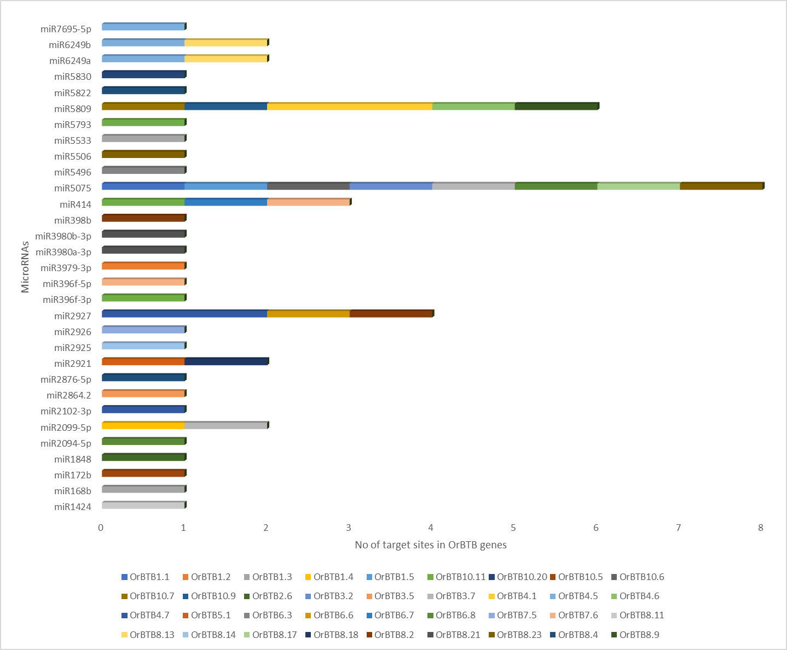
Supplementary Fig. S6: Distribution of putative miRNA target sites on OrBTB genes.

