Slide 1
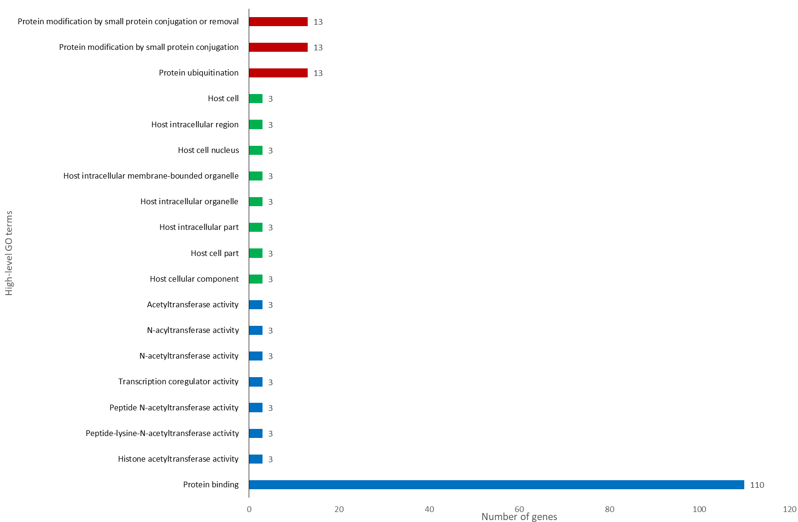
Supplementary Fig. S7: Functional annotations and categorization of the OrBTB genes.

