Slide 1
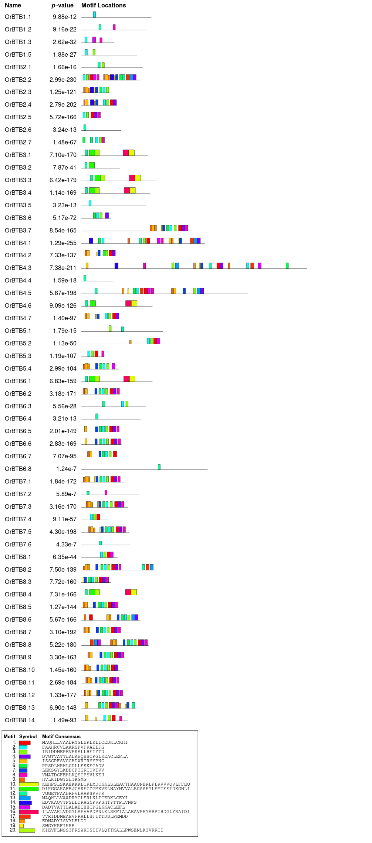
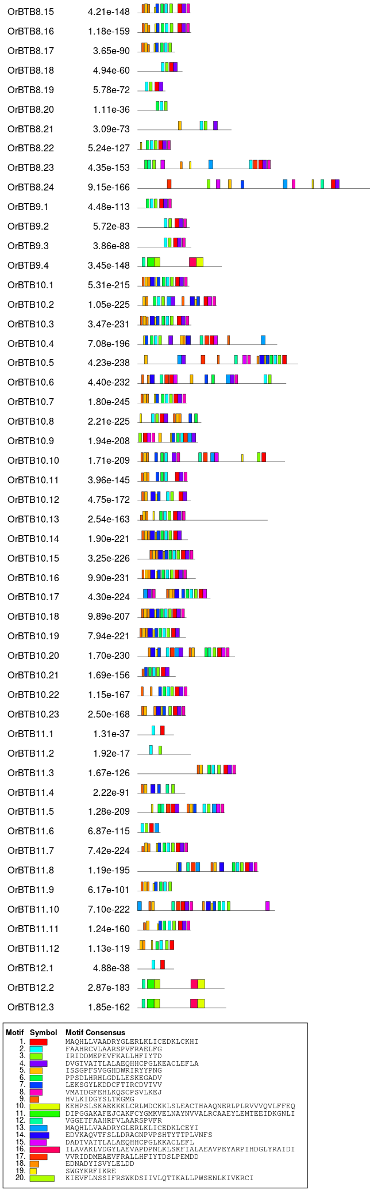
Supplementary Fig. S2. The conserved motif of OrBTB genes was identified by the MEME tool. Colored rectangular boxes represent conserved motifs. Sequences of the 10 conserved motifs are shown in the figure legend.

