Slide 1
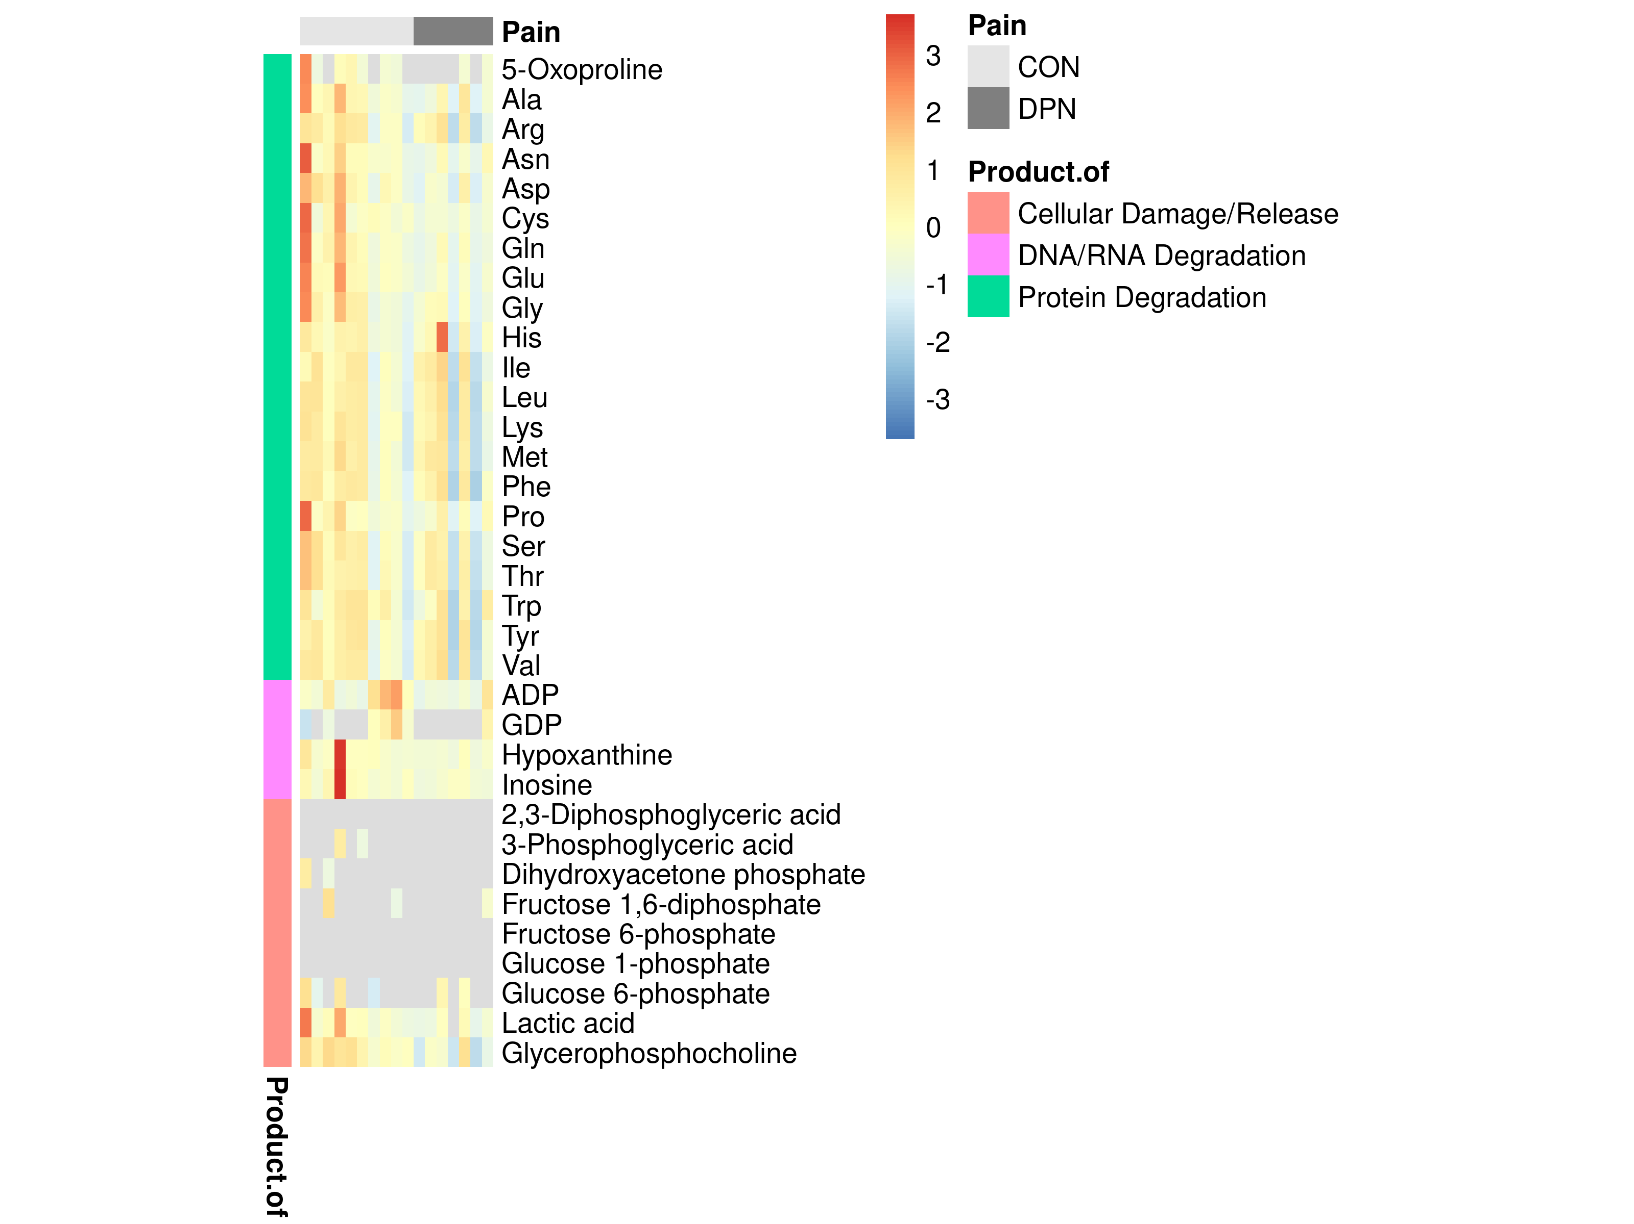
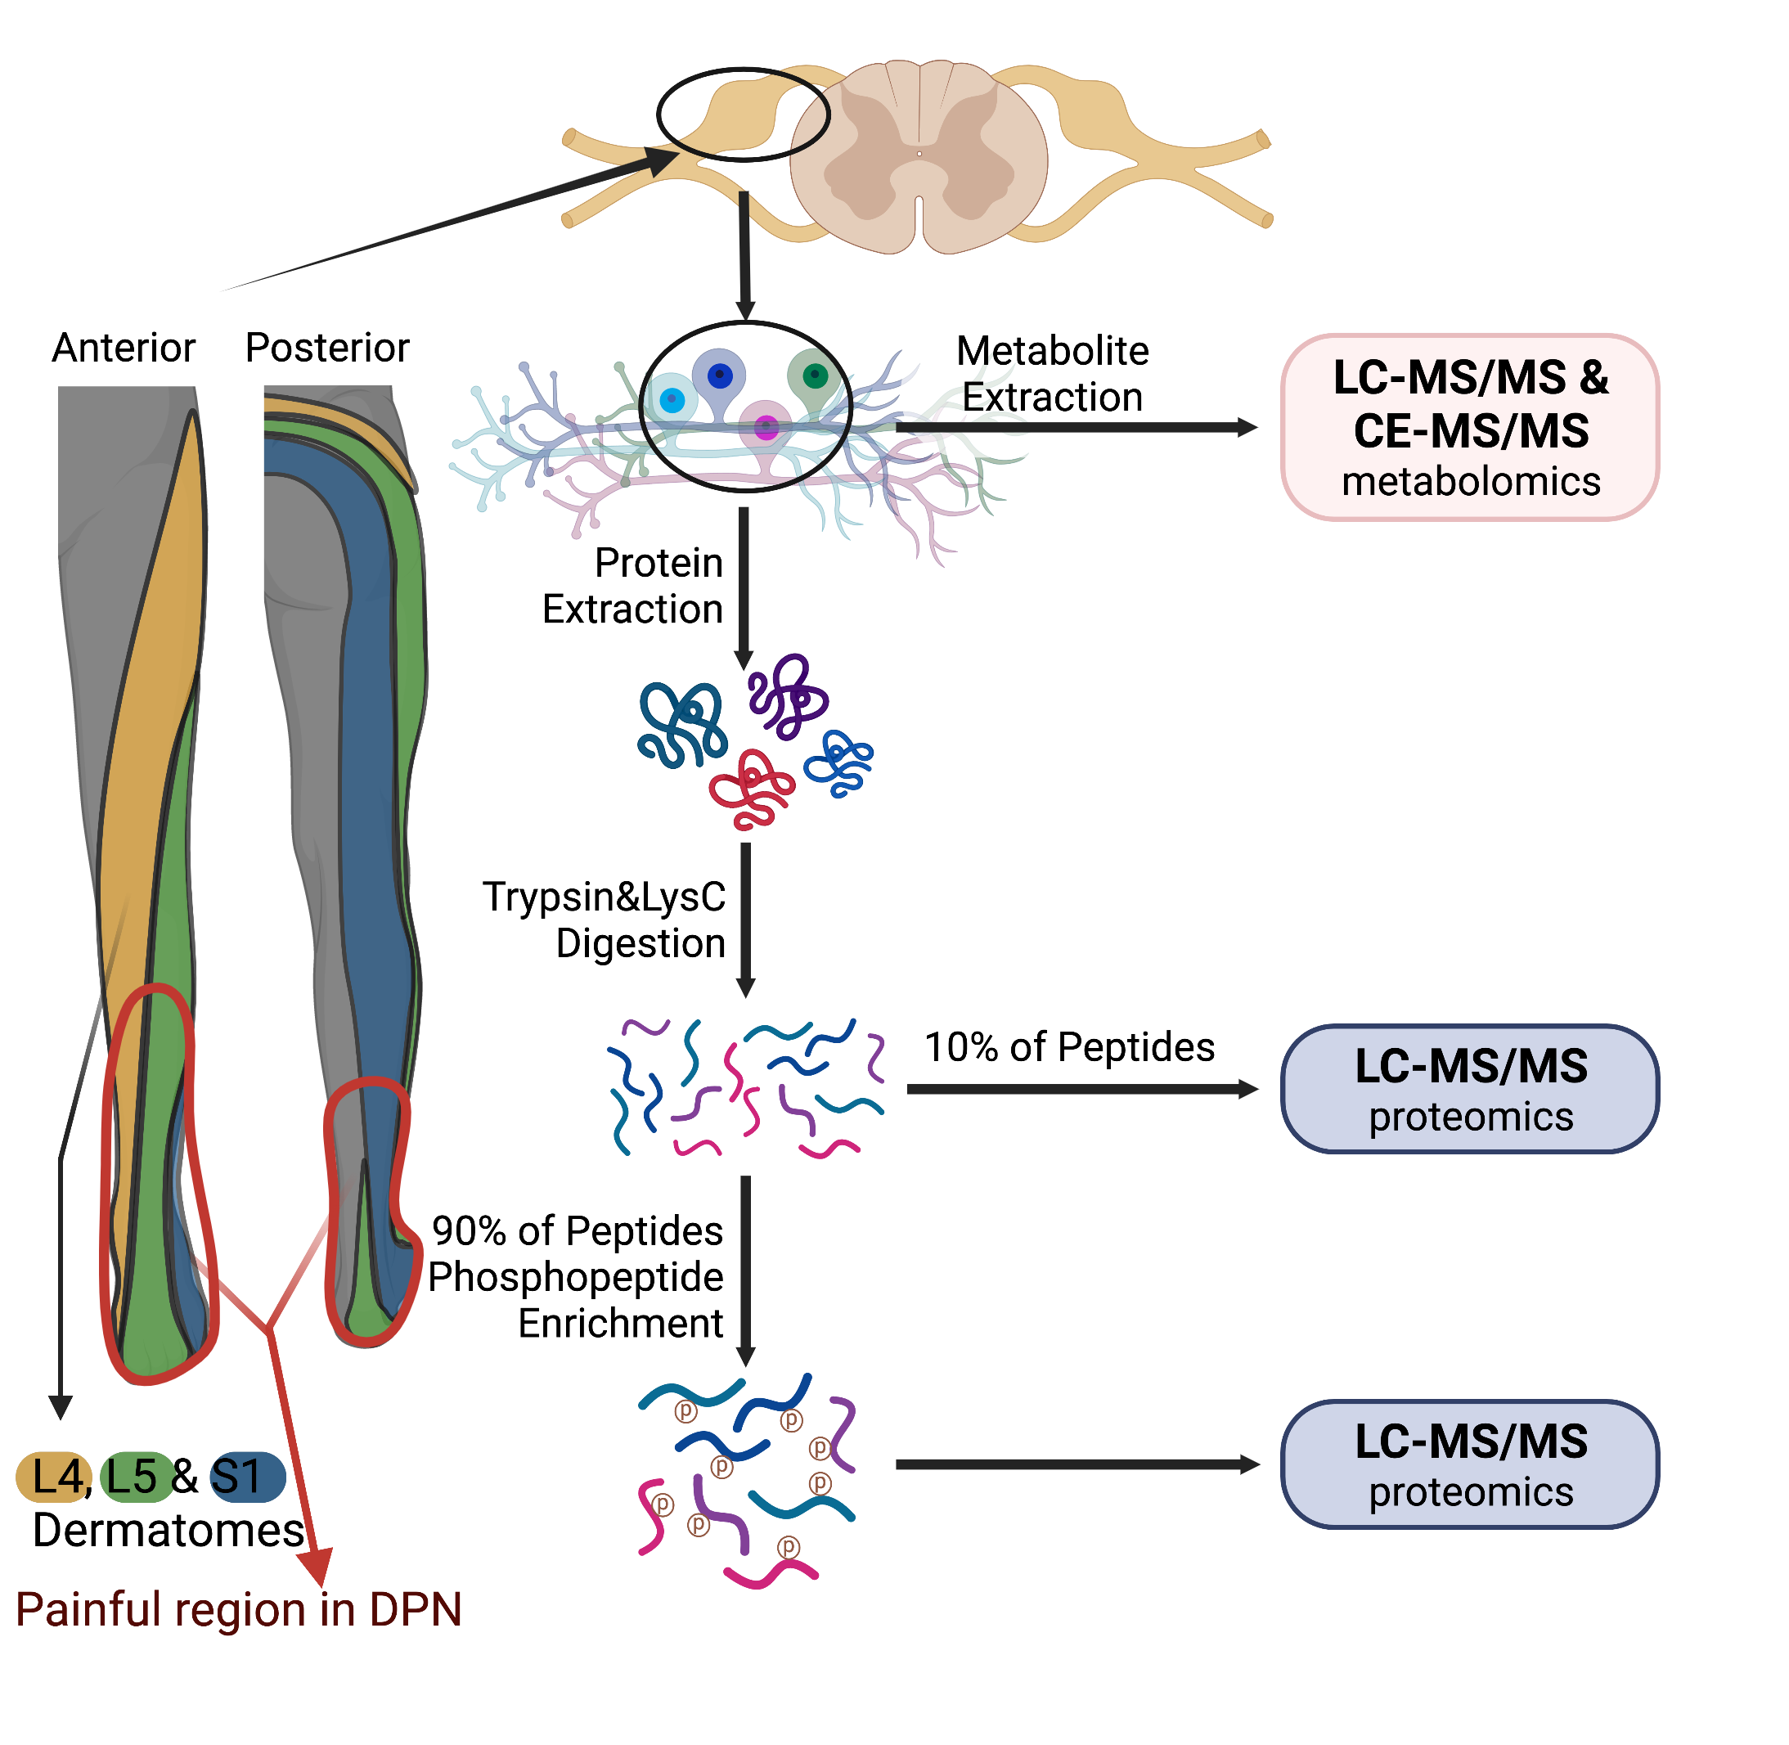
a.
b.
CON
DPN
Metabolite is a product of:
Supplementary Figure S1. A) Schematic representation of study design. Innervation pattern for L4, L5, and S1 DRG used in analyses overlap with painful region in DPN. Created with BioRender. B) Heat map showing scaled and centered relative abundance data for select metabolites. Abnormally high profiles of all metabolites here would be indicative of tissue degradation. Two samples show higher abundance of some metabolites. However, these levels are reasonable for normal biological variation, and profiles of all noted metabolites are not observed to be consistently high. As such, DRG samples were determined to be of suitable quality for analysis. Row-wise annotations indicate degradative process which might produce indicated metabolites. CON indicates control samples, DPN indicates diabetic peripheral neuropathy.

Slide 2
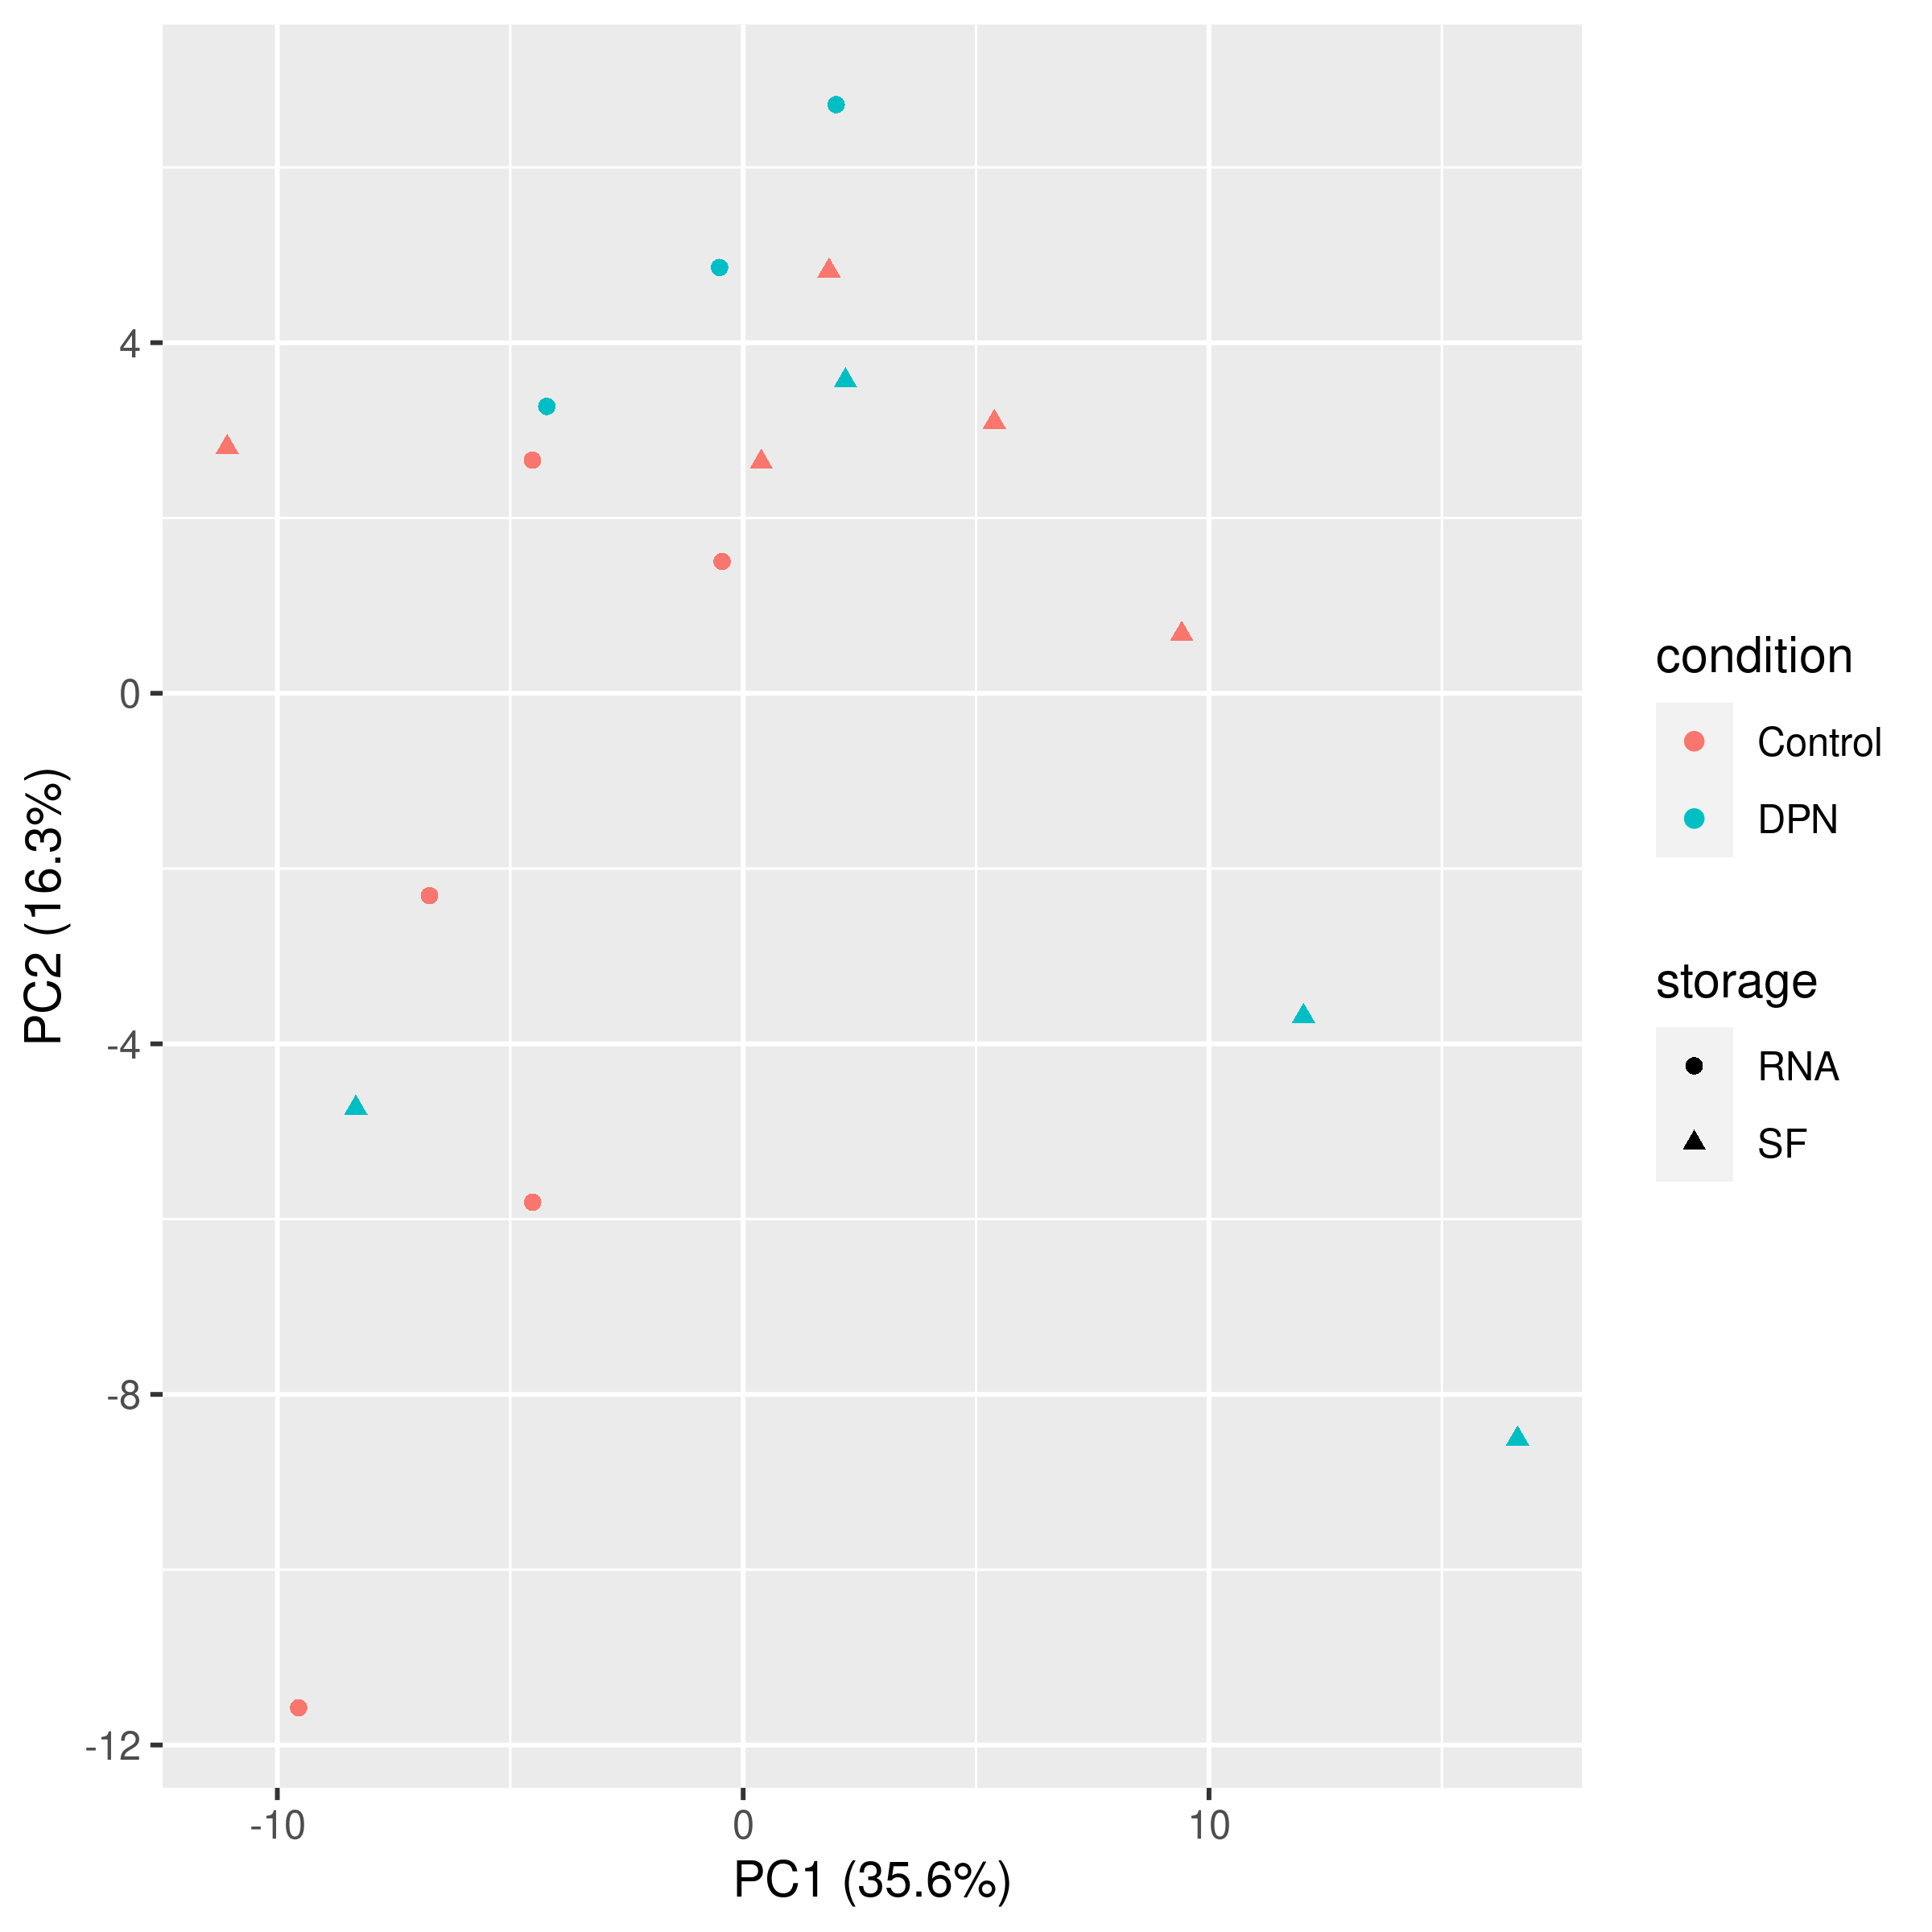
Supplementary Figure S2. Plotted results of PCA performed with metabolomic data. DRG donor condition is indicated by color and tissue storage method (snap frozen (SF) or RNAlater (RNA)) is indicated by shape of the point.

Slide 3
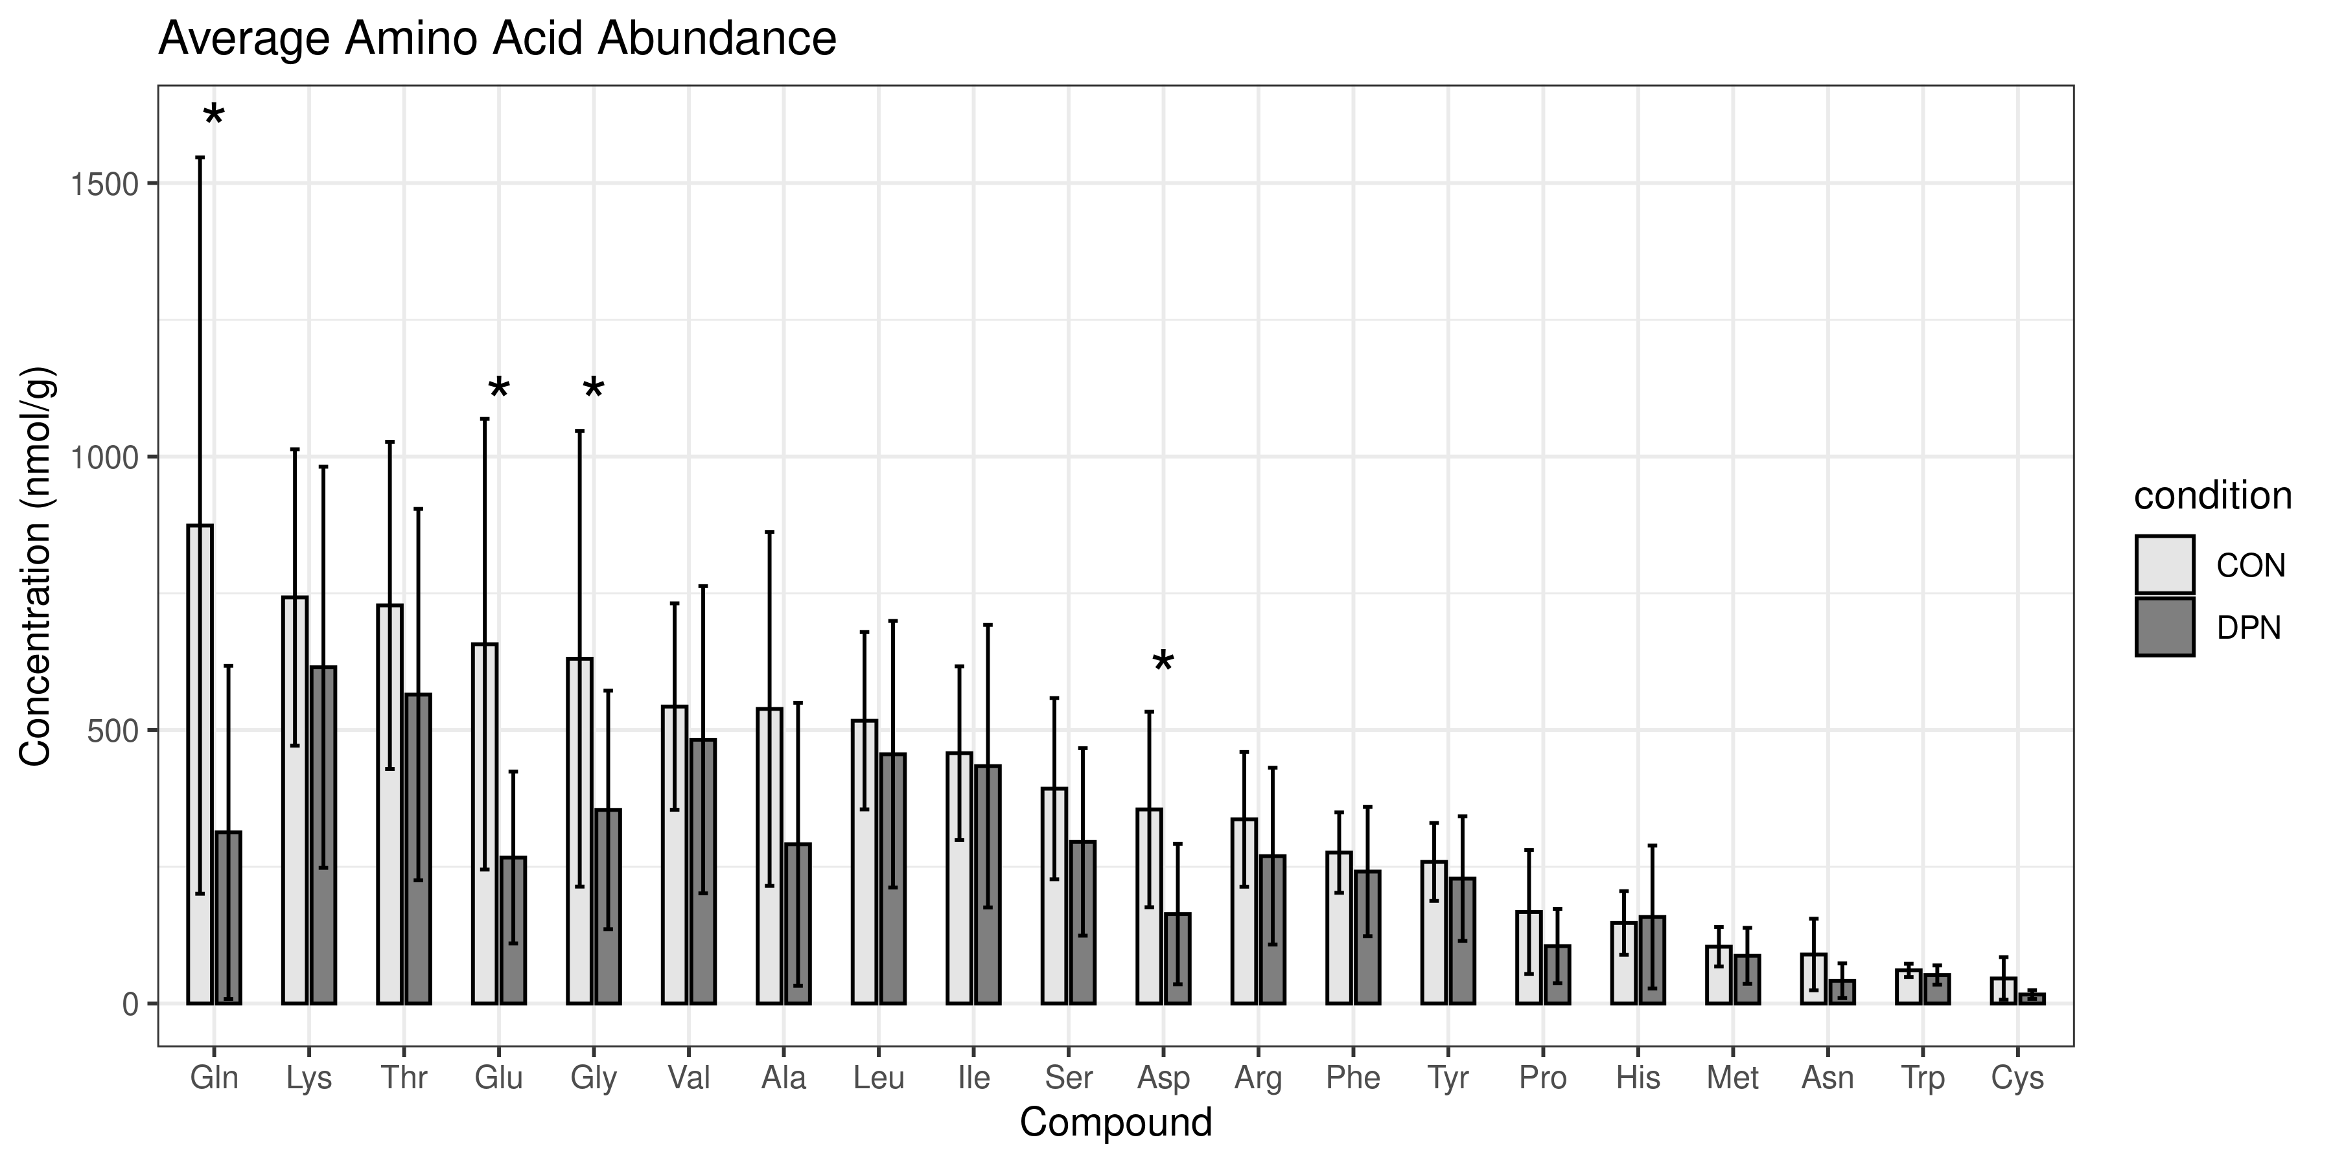
Supplementary Figure S3. Concentration of amino acids in the DRG as detected using quantitative mass spectrometry panels. Amino acids are arranged according to highest average concentration in control human DRG tissues. CON indicates control, DPN indicates Diabetic Peripheral Neuropathy. Amino acids labeled with standard 3 letter abbreviations.

Slide 4
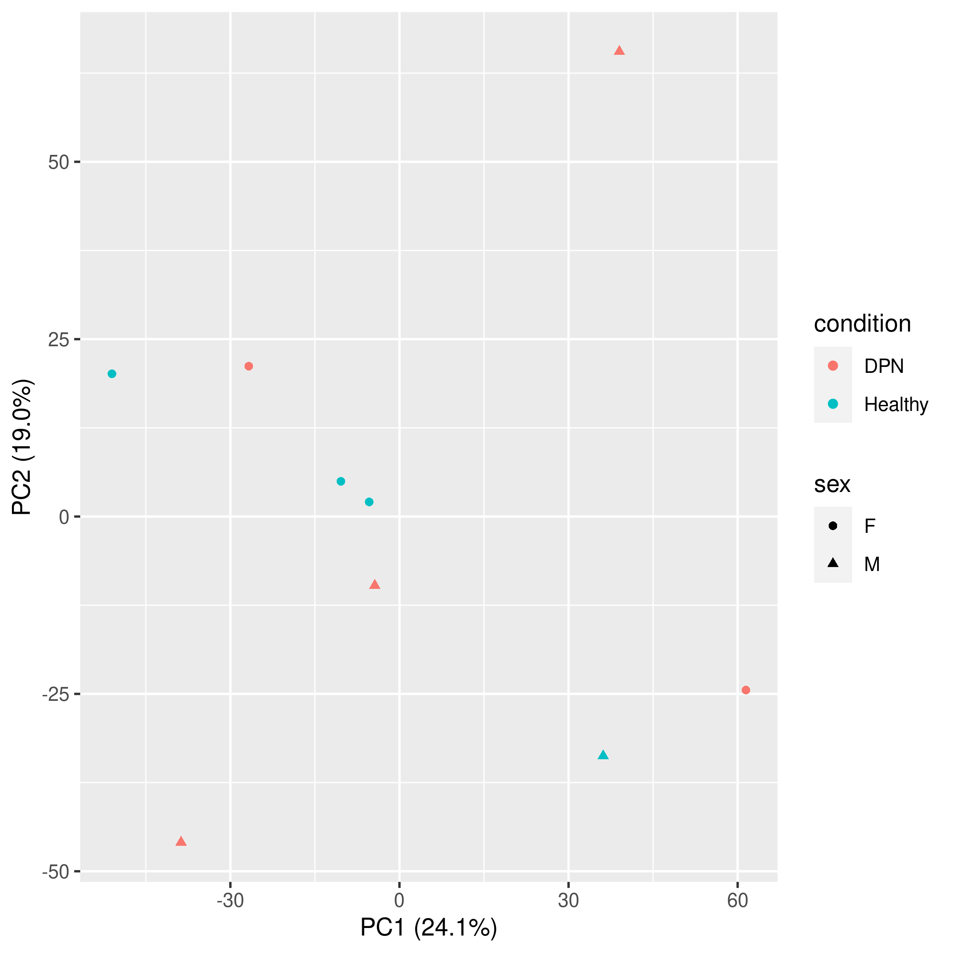
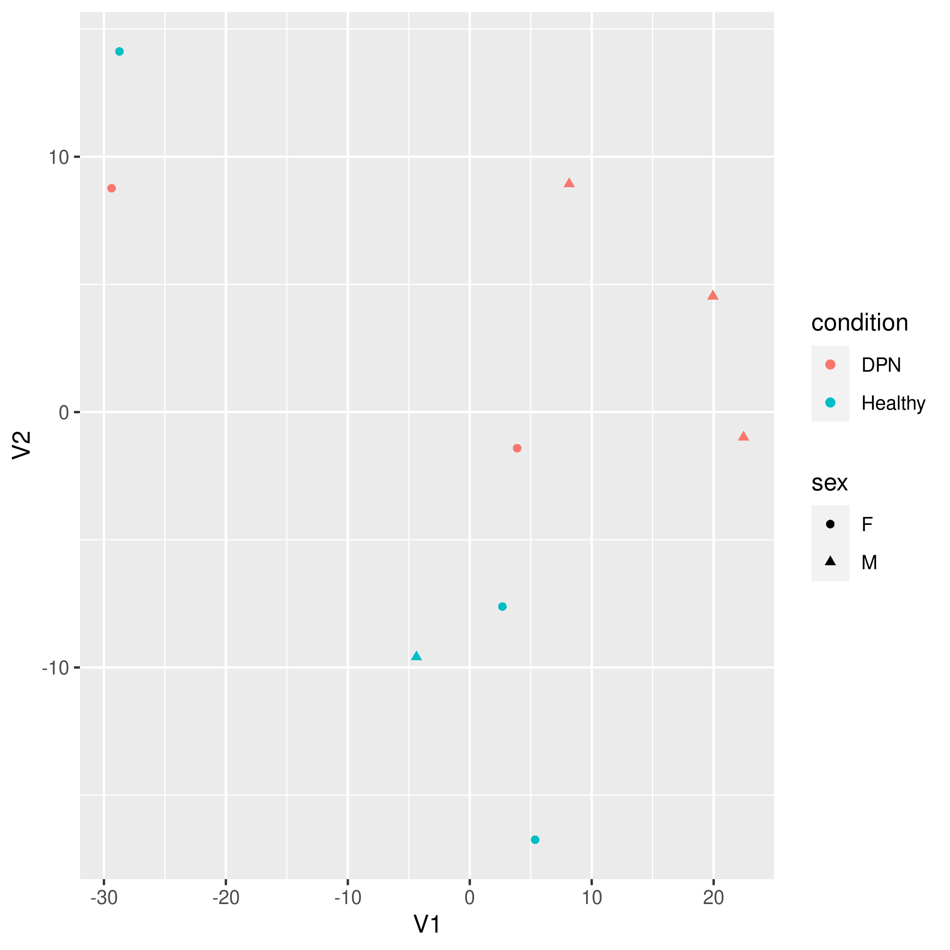
a.
b.
Supplementary Figure S4. Plotted results of (A) PCA and (B) t-SNE performed with proteomic data. For both plots, DRG donor condition is indicated by color and donor sex (female (F) or male (M)) is indicated by shape of the point.

Slide 5
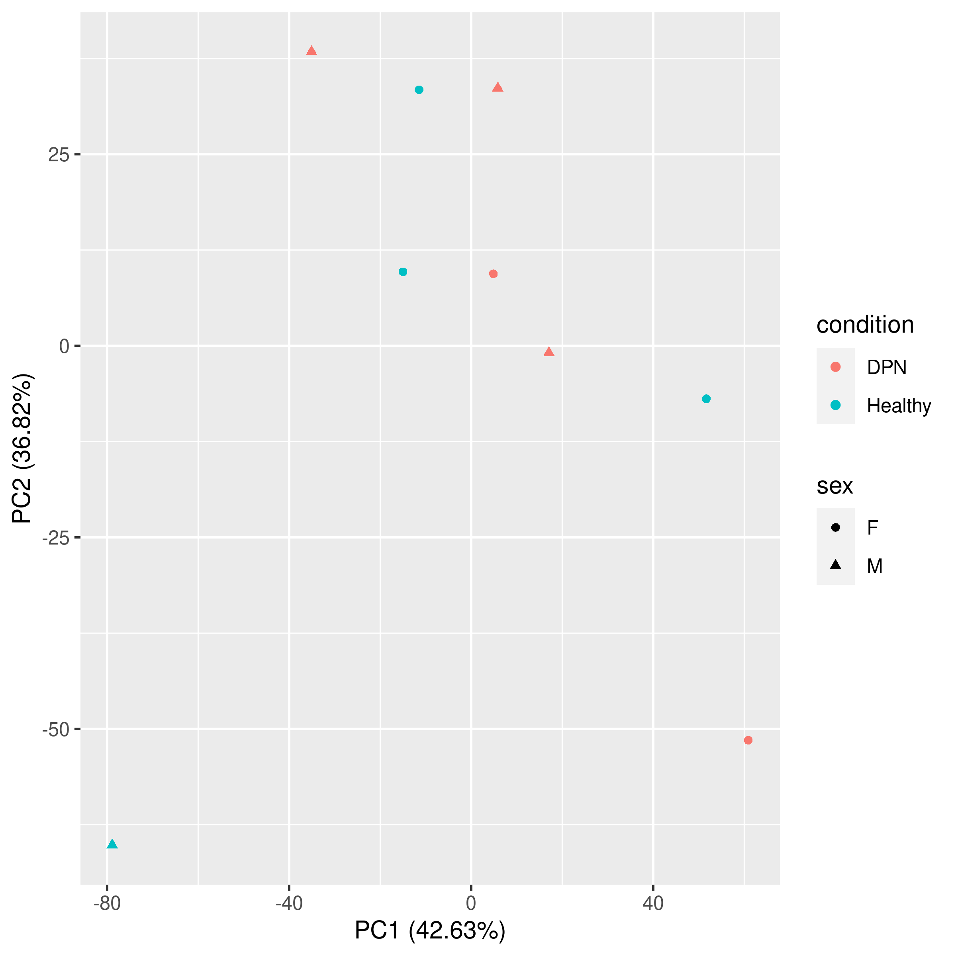
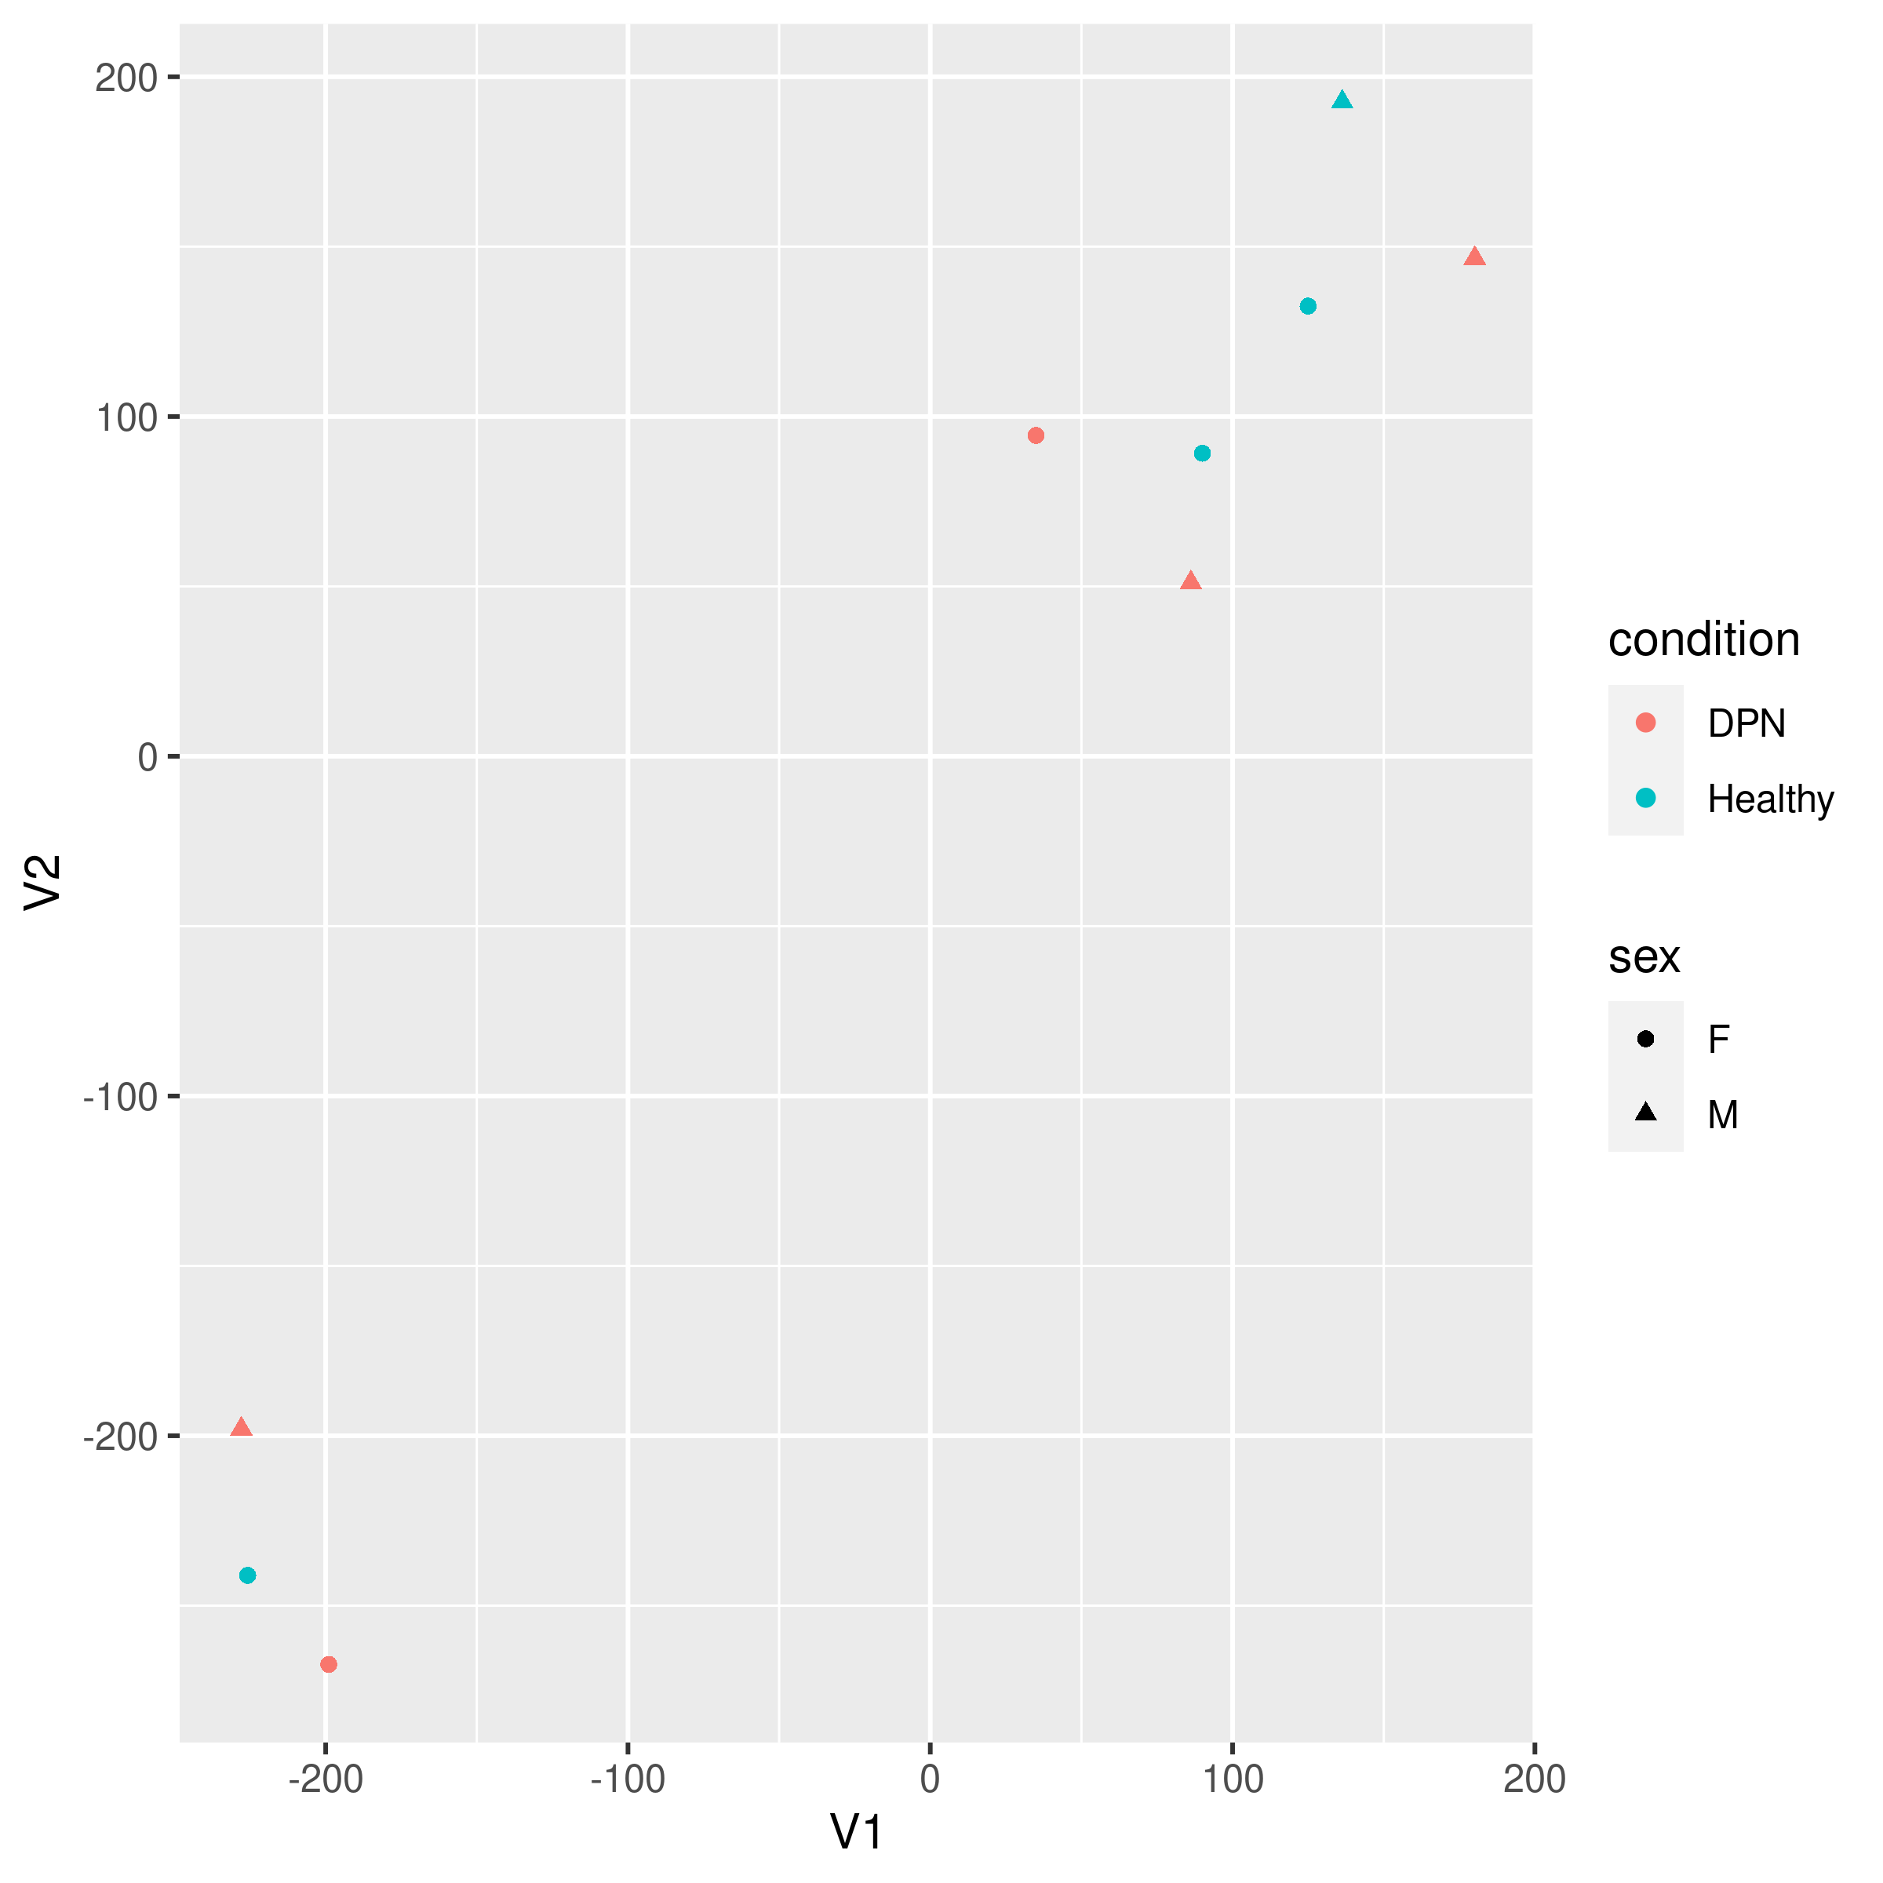
a.
b.
Supplementary Figure S5. Plotted results of (A) PCA and (B) t-SNE performed with phospho-proteomic data. For both plots, DRG donor condition is indicated by color and donor sex (female (F) or male (M)) is indicated by shape of the point.

Slide 6
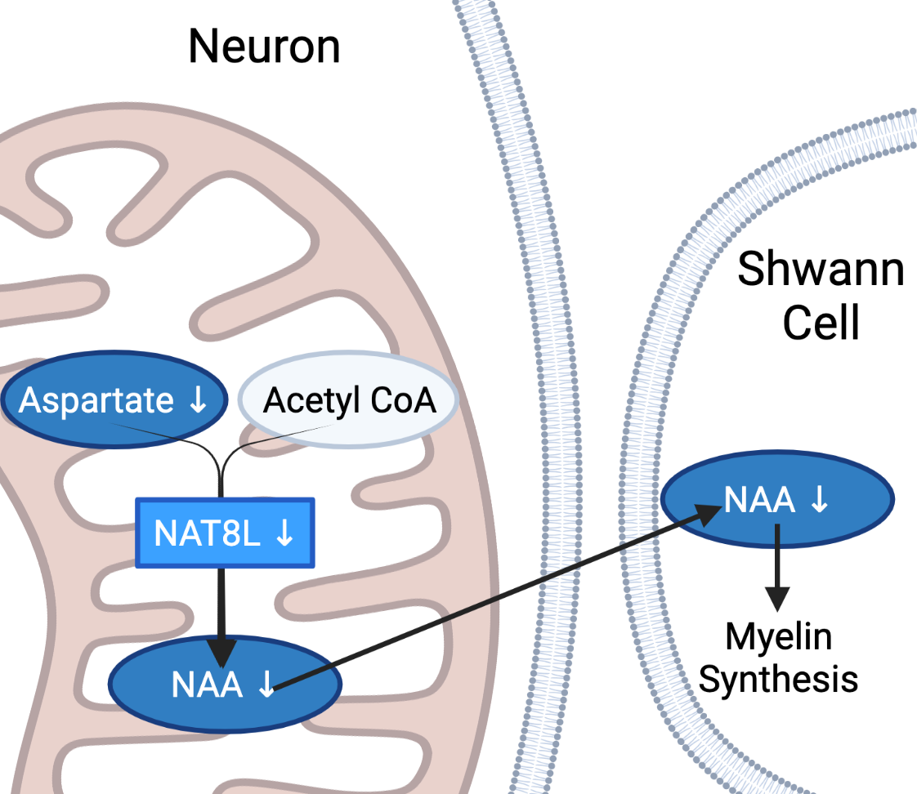
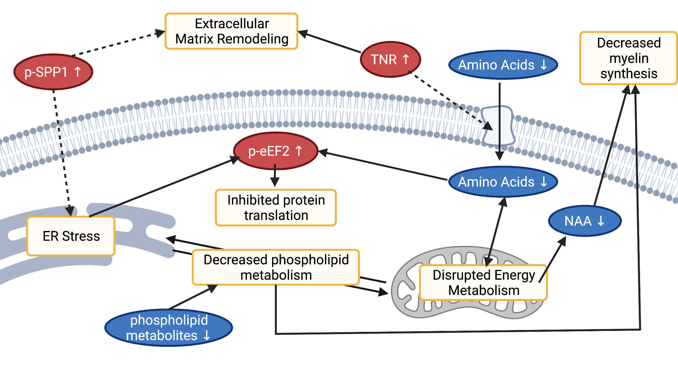
a.
b.
Supplementary Figure S6. A) Schematic depicting a direct corelation between decreased metabolite NAA and decreased gene transcript NAT8L (created with BioRender). NAA is synthesized in the mitochondria from Asp by NAT8L. NAA is then transported to Schwann cells, where it is used as a precursor for myelin lipids. B) Schematic showing suggested interplay between identified molecular changes (created with BioRender). Briefly, amino acid starvation can impair mitochondrial function as well as inhibit protein translation, resulting in ER stress. Impaired function of the mitochondria and ER can also lead to disrupted crosstalk between these organelles and thus disrupted phospholipid synthesis. Disrupted mitochondrial function can also impair NAA synthesis, impacting glial-neuronal structures. Changes to the extracellular matrix can be related to ER stress and amino acid uptake. Finally, both ER stress and amino acid depletion can induce hyperphosphorylation of eEF2, thus inhibiting protein translation.

Slide 7
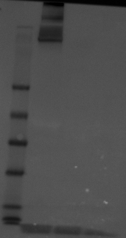
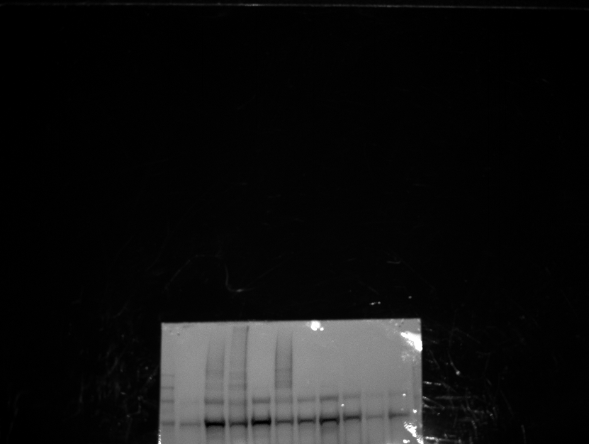
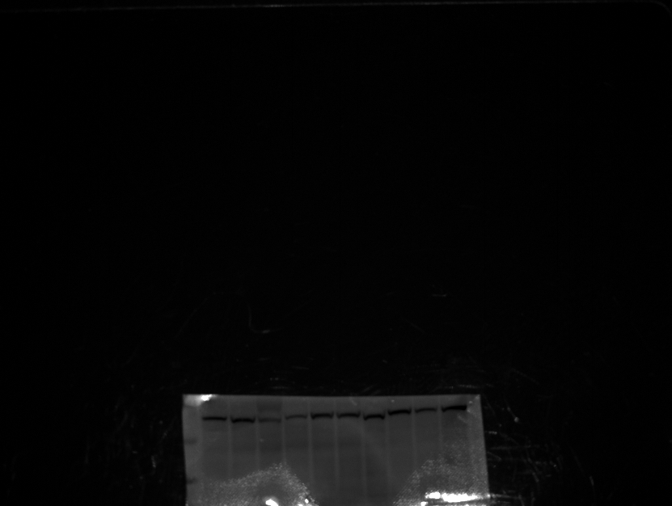
A
B
+
-
-
CON
DPN
kDa
kDa
198
245
98
180
62
135
100
C
CON
DPN
kDa
63
48
Supplementary Figure S6 A) Specificity of TNR antibody was confirmed using positive (mouse brain) and negative (mouse liver and spleen) controls. B) and C) are images from the same membrane, the membrane was cut to avoid stripping. B) displays TNR labeling. C) displays alpha-tubulin labeling. All images were acquired using auto-exposure setting on the FlourChem M imager.

Slide 8
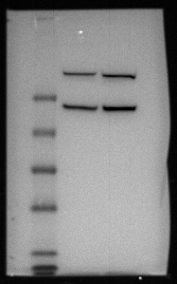
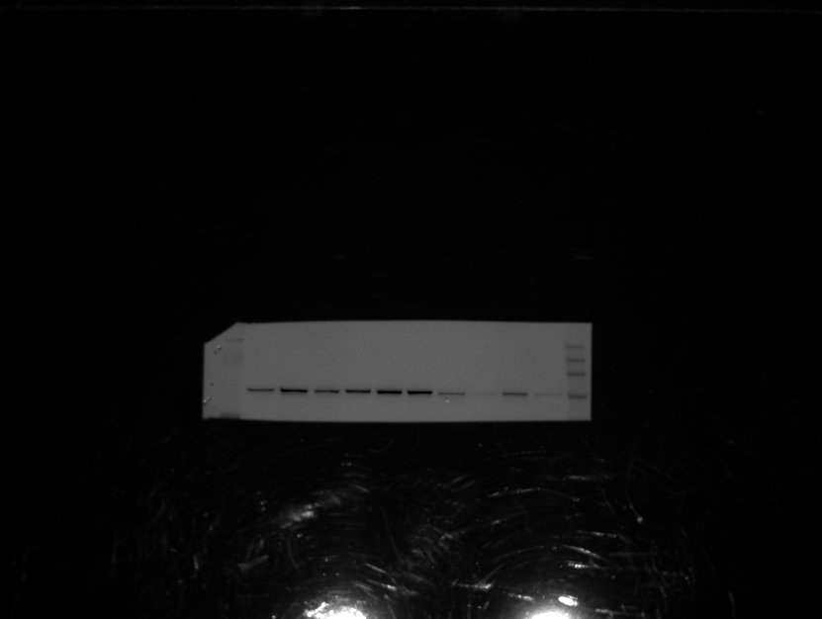
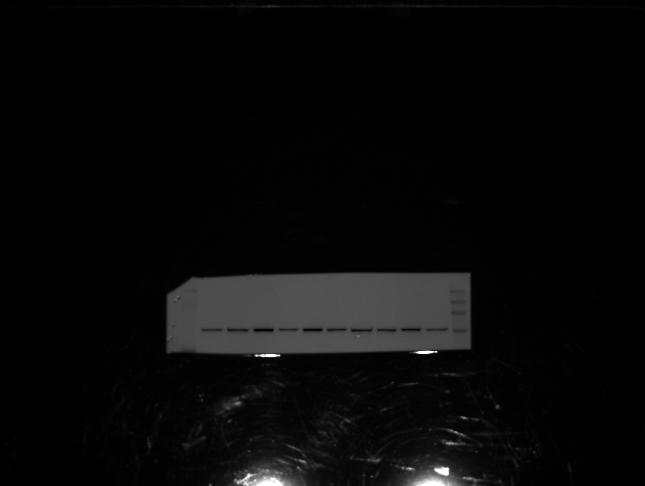
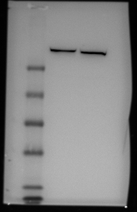
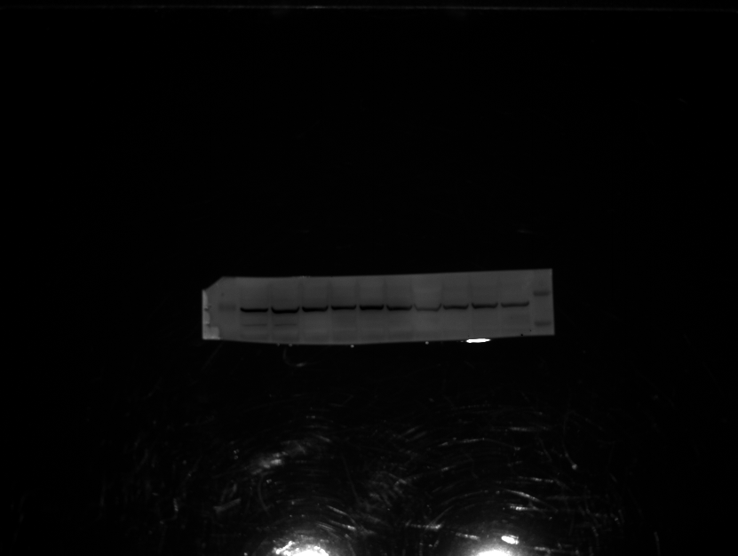
kDa
A
C
kDa
CON
DPN
kDa
191
235
191
97
170
97
64
130
51
93
64
39
28
19
14
D
kDa
CON
DPN
kDa
235
191
170
130
97
B
kDa
93
191
64
97
64
51
E
kDa
CON
DPN
kDa
39
53
28
41
51
19
14
Supplementary Figure S7 Specificity of p-eEF2 (A) and eEF2 (B) antibodies was confirmed using positive a control (mouse brain). P-eEF2 antibody reacts with a truncated p-eEF2 product. Images C), D), and E) are from the same membrane, the membrane was cut to avoid stripping when possible. C) and D) show the same higher molecular weight piece of the membrane. C) displays p-eEF2 labeling. D) displays eEF2 labeling. E) displays alpha-tubulin labeling on a lower molecular weight piece of the membrane. All images were acquired using auto-exposure setting on the FlourChem M imager.

Slide 9
kDa
kDa
kDa
DPN
*
*
*
pI
pI
pI
kDa
kDa
kDa
Control
*
*
*
pI
pI
pI
Supplementary Figure S8: Full membranes for 2D gels, labeled for SPP1 show molecular weight and pI of SPP1 in DPN and control samples. Location of a loading control was determined by overlaying developed images here with a Coomassie blue stained image of the same membrane (tropomyosin, pI = 5.2) is indicated with an asterisks (*). Images were acquired with an Amersham Imager 600 with 1 minute exposure.

