Slide 1
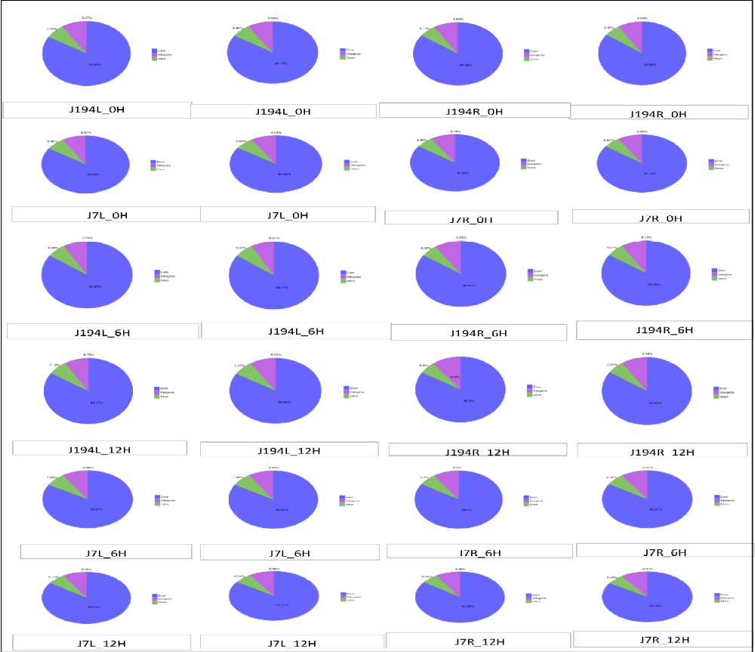
Comparative transcriptomes and genome-wide identification reveal salt stress-responsive PP2C in Jute (Corchorus capsularis)
Aminu Kurawa Ibrahim^{a,1}, Yi Xu^{a,1}, Qingyao Heª, Sylvain Niyitangaª, Muhammad Zohaib Afzalª, Lilan Zhangª, Jianmin Qiª, Liwu Zhang^{a,b*}
Additional file 1: Figure S1. Comparisons of all samples clean reads with the reference genome.
The comparisons are in different regions for J194 and J7 leaf (L) and root(R) at 0, 6, and 12hours duration of exposure to NaCl. Exon, intron, and intergenic percentages are also indicated

Slide 2
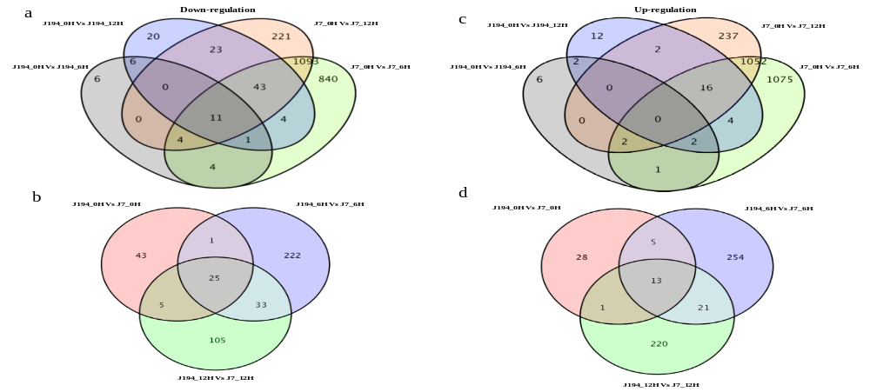
Comparative transcriptomes and genome-wide identification reveal salt stress-responsive PP2C in Jute (Corchorus capsularis)
Aminu Kurawa Ibrahim^{a,1}, Yi Xu^{a,1}, Qingyao Heª, Sylvain Niyitangaª, Muhammad Zohaib Afzalª, Lilan Zhangª, Jianmin Qiª, Liwu Zhang^{a,b*}
Additional file 2: Figure S2(i). Down and Up-regulated DEGs leaf in the same and different germplasms combination.
(a and c): are down and up-regulated DEGs Venn diagrams for J194 and J7 leaf(L) at the same pairing combinations and 0, 6 and 12-hour duration of exposure to NaCl; (b and d): are down and up-regulated DEGs Venn diagrams for J194 and J7 leaf(L) at different pairing combinations and 0, 6 and 12-hour duration of exposure to NaCl.

Slide 3
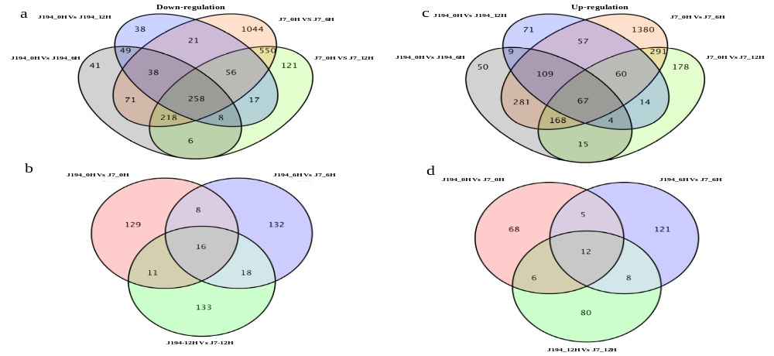
Comparative transcriptomes and genome-wide identification reveal salt stress-responsive PP2C in Jute (Corchorus capsularis)
Aminu Kurawa Ibrahim^{a,1}, Yi Xu^{a,1}, Qingyao Heª, Sylvain Niyitangaª, Muhammad Zohaib Afzalª, Lilan Zhangª, Jianmin Qiª, Liwu Zhang^{a,b*}
Additional file 3: Figure S2(ii). Down and Up-regulated DEGs root in the same and different germplasms combination.
(a and c): are down and up-regulated DEGs Venn diagrams for J194 and J7 root(R) at the same pairing combinations and 0, 6 and 12-hour duration of exposure to NaCl; (b and d): are down and up-regulated DEGs Venn diagrams for J194 and J7 root(R) at different pairing combinations and 0, 6 and 12-hour duration of exposure to NaCl

Slide 4
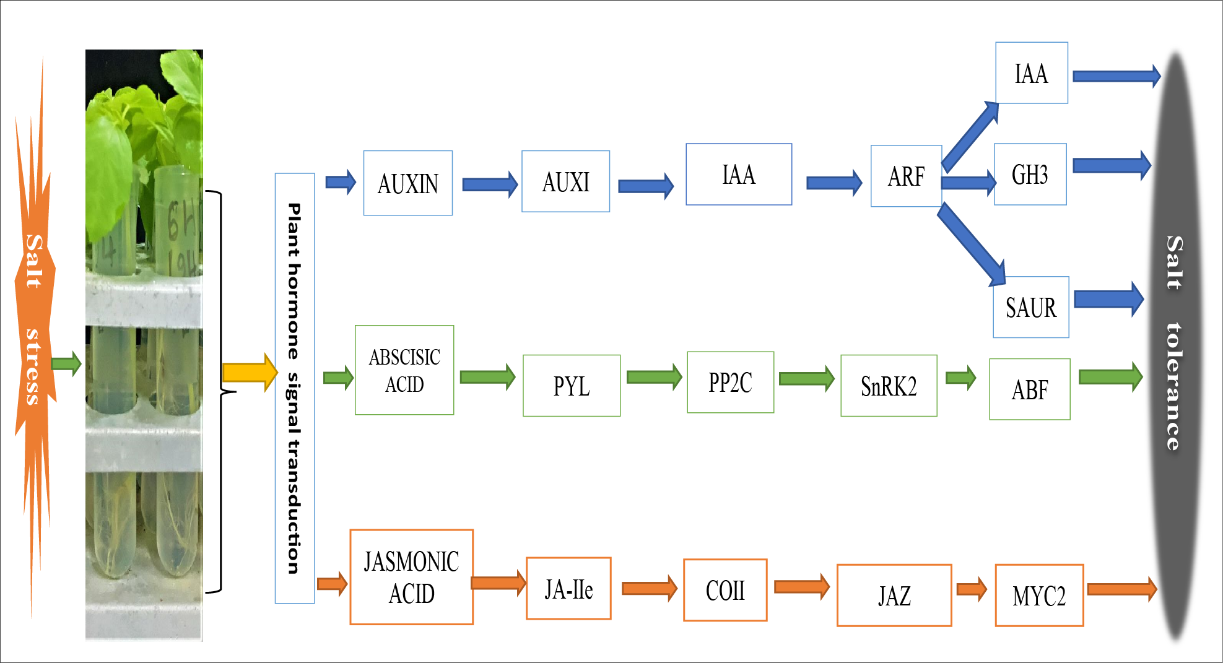
Comparative transcriptomes and genome-wide identification reveal salt stress-responsive PP2C in Jute (Corchorus capsularis)
Aminu Kurawa Ibrahim^{a,1}, Yi Xu^{a,1}, Qingyao Heª, Sylvain Niyitangaª, Muhammad Zohaib Afzalª, Lilan Zhangª, Jianmin Qiª, Liwu Zhang^{a,b*}
Additional file 4: Figure S3. A model mechanisms underlying salt tolerance enhanced pathways of J194 and J7 leaf and root tissues

Slide 5
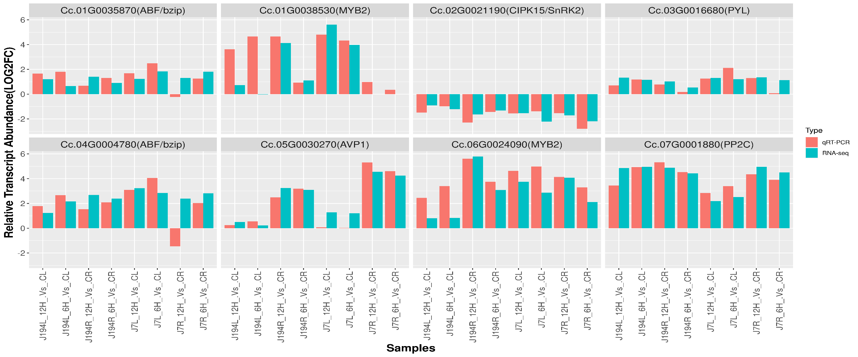
Comparative transcriptomes and genome-wide identification reveal salt stress-responsive PP2C in Jute (Corchorus capsularis)
Aminu Kurawa Ibrahim^{a,1}, Yi Xu^{a,1}, Qingyao Heª, Sylvain Niyitangaª, Muhammad Zohaib Afzalª, Lilan Zhangª, Jianmin Qiª, Liwu Zhang^{a,b*}
Additional file 5: Figure S4. qRT-PCR validation analysis of RNA-sequencing.
Eight DEGs were used on J194 and J7 root (R) and leaf(L) tissues samples at 0(C), 6, and 12hour duration of exposure to NaCl stress. Relative transcript abundance log2 (fold change) is indicated on Y-axis, samples are presented on the x-axis. The blue and the red color bars indicated the expression via qRT-PCR and RNA-seq respectively.

Slide 6
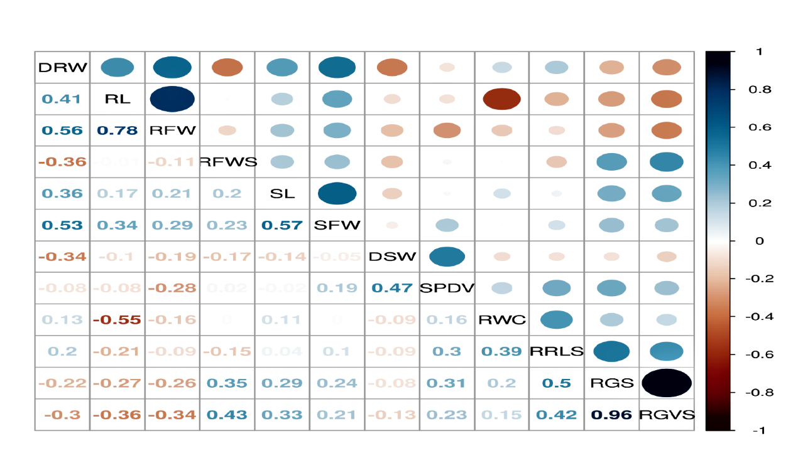
Comparative transcriptomes and genome-wide identification reveal salt stress-responsive PP2C in Jute (Corchorus capsularis)
Aminu Kurawa Ibrahim^{a,1}, Yi Xu^{a,1}, Qingyao Heª, Sylvain Niyitangaª, Muhammad Zohaib Afzalª, Lilan Zhangª, Jianmin Qiª, Liwu Zhang^{a,b*}
Additional file 6: Figure S5. Correlation analysis between germination and seedling stage-related traits.
Where:DRW(dry root weight);RL(root length); RFW(root fresh weight); SL(shoot length); SFW(shoot fresh weight); DSW(dry shoot weight); SPDV(spad value) and RWC(relative water content) are the seedling related traits while RFW(relative fresh weight under salt); RRLS(relative root length under salt); RGS(relative germination rate under salt) and RGVS(relative germination vigor under salt) are those under germination rate related trait

Slide 7
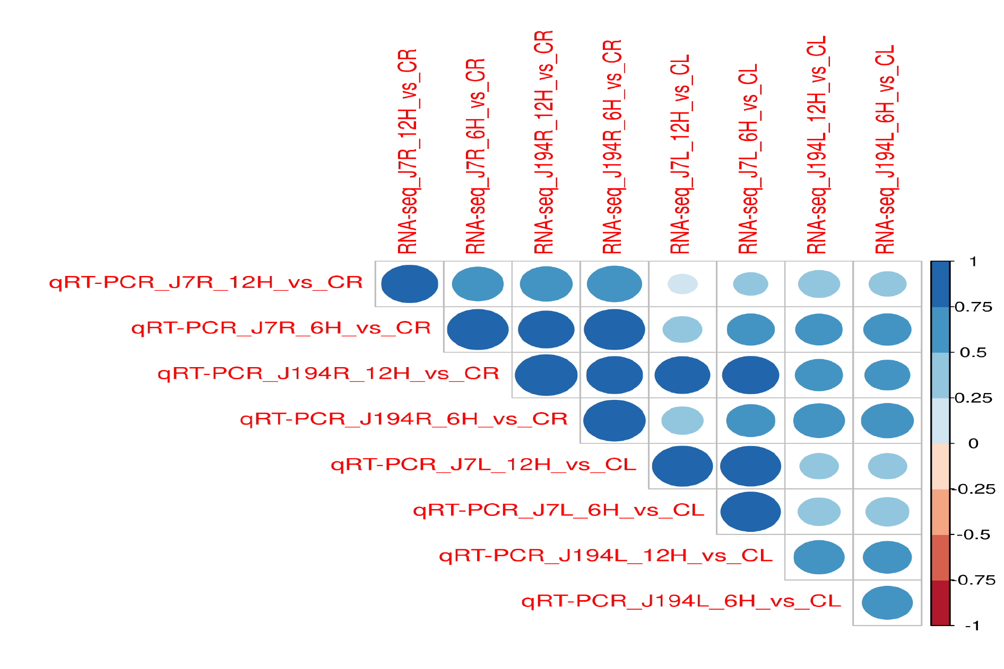
Comparative transcriptomes and genome-wide identification reveal salt stress-responsive PP2C in Jute (Corchorus capsularis)
Aminu Kurawa Ibrahim^{a,1}, Yi Xu^{a,1}, Qingyao Heª, Sylvain Niyitangaª, Muhammad Zohaib Afzalª, Lilan Zhangª, Jianmin Qiª, Liwu Zhang^{a,b*}
Additional file 7: Figure S6. Correlation analysis between qRT-PCR and RNA-Seq.
Results obtained from J194 and J7 root (R) and leaf (L) tissue samples at 0 (C), 6, and 12hour duration of exposure to NaCl stress.

Slide 8
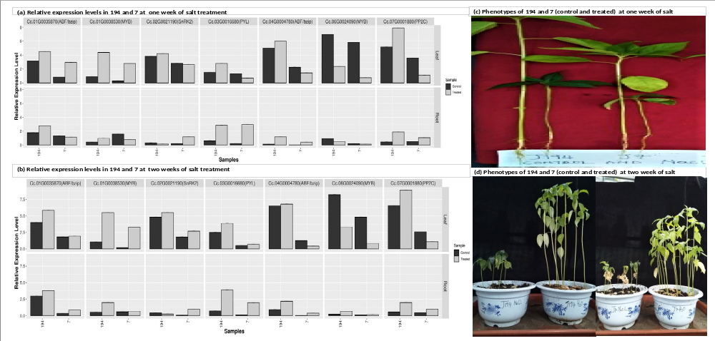
Comparative transcriptomes and genome-wide identification reveal salt stress-responsive PP2C in Jute (Corchorus capsularis)
Aminu Kurawa Ibrahim^{a,1}, Yi Xu^{a,1}, Qingyao Heª, Sylvain Niyitangaª, Muhammad Zohaib Afzalª, Lilan Zhangª, Jianmin Qiª, Liwu Zhang^{a,b*}
Additional file 8: Figure S7. Relative expression levels and the phenotypes of J194 and J7 for the control and treated (NaCl) condition.
Where: (a) Relative expression levels of seven DEGs for root and leaf tissues of J194 and J7 at one-week exposure to NaCl. (b) Relative expression levels of seven DEGs for root and leaf tissues of J194 and J7 at two-week exposure to NaCl. (c) Phenotypes of J194 and J7 (control and treated) at one-week exposure to NaCl and, (d) Phenotypes of 194 and 7 (control and treated) at two-week exposure to NaCl.

Slide 9
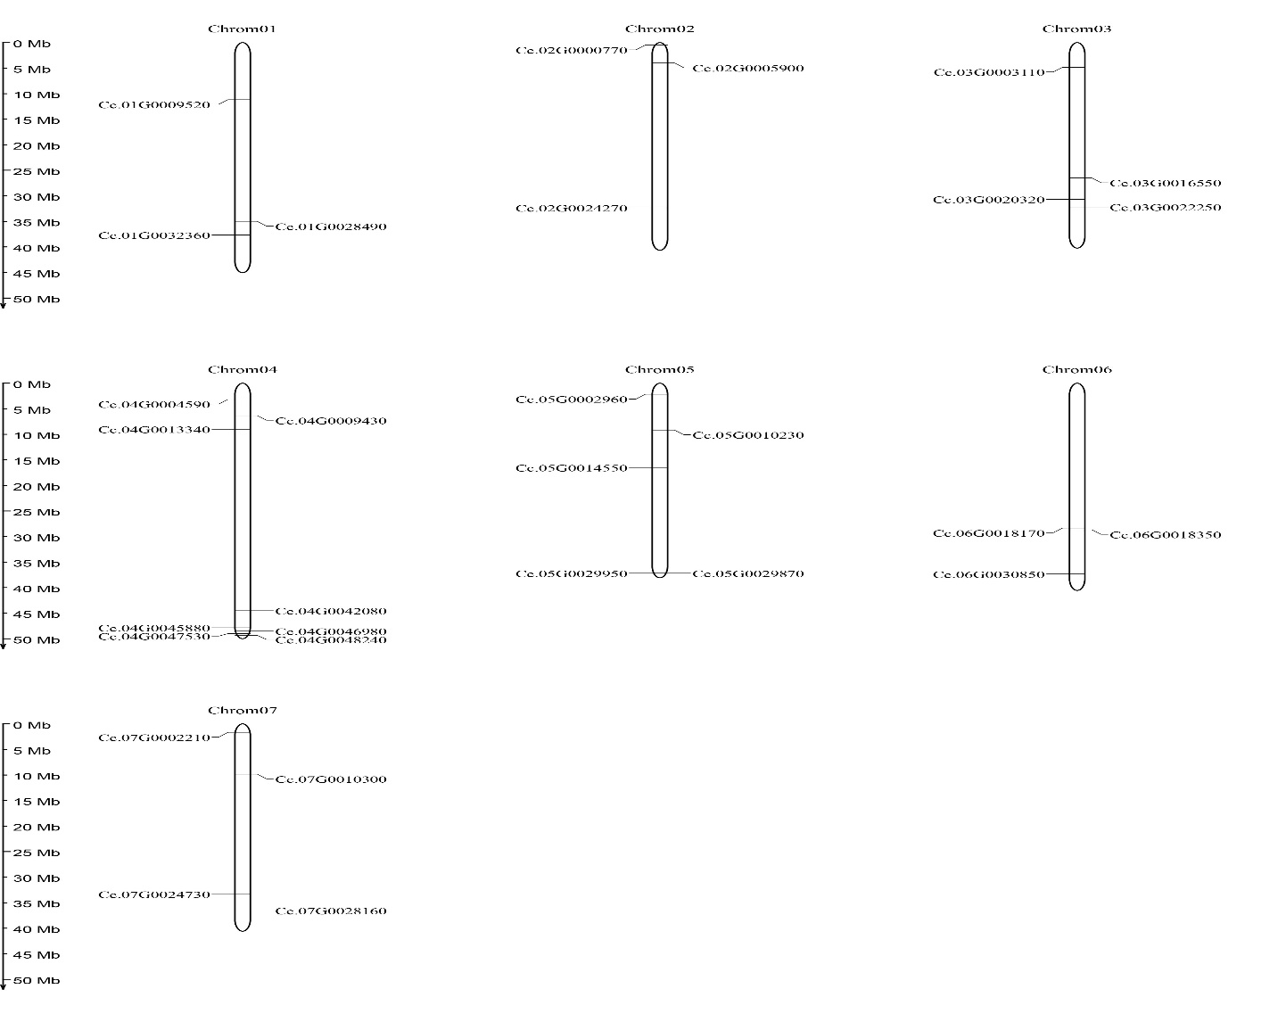
Comparative transcriptomes and genome-wide identification reveal salt stress-responsive PP2C in Jute (Corchorus capsularis)
Aminu Kurawa Ibrahim^{a,1}, Yi Xu^{a,1}, Qingyao Heª, Sylvain Niyitangaª, Muhammad Zohaib Afzalª, Lilan Zhangª, Jianmin Qiª, Liwu Zhang^{a,b*}
Additional file 9: Figure S8. Chromosome location of Corchorus capsularis PP2C genes.
There are about seven chromosomes (Chrom01-chrom07) and the distances are displayed in the left corner.

