Slide 1
Supplementary Figures

Slide 2
Supplementary Figure 1

Slide 3
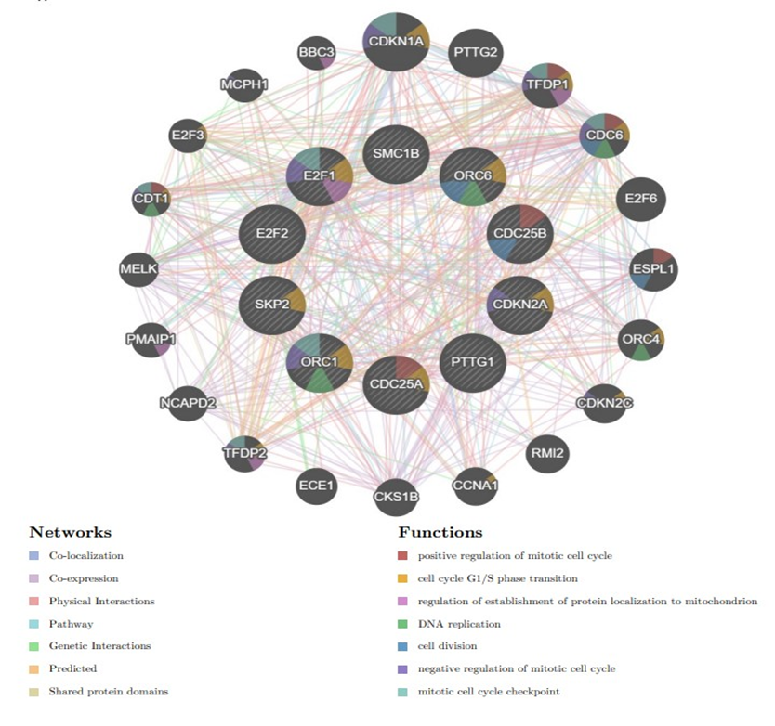

Slide 4
Supplementary Figure 1. GeneMANIA is used to identify predicted genes correlating with hub genes, 20 of the predicted genes are located in the outer circle while hub genes are drawn in the inner circle. The colour of the line illustrates different type of their relationships. The colour inside the gene dots indicates functions which these genes are involved in.

Slide 5
Supplementary Figure 2

Slide 6
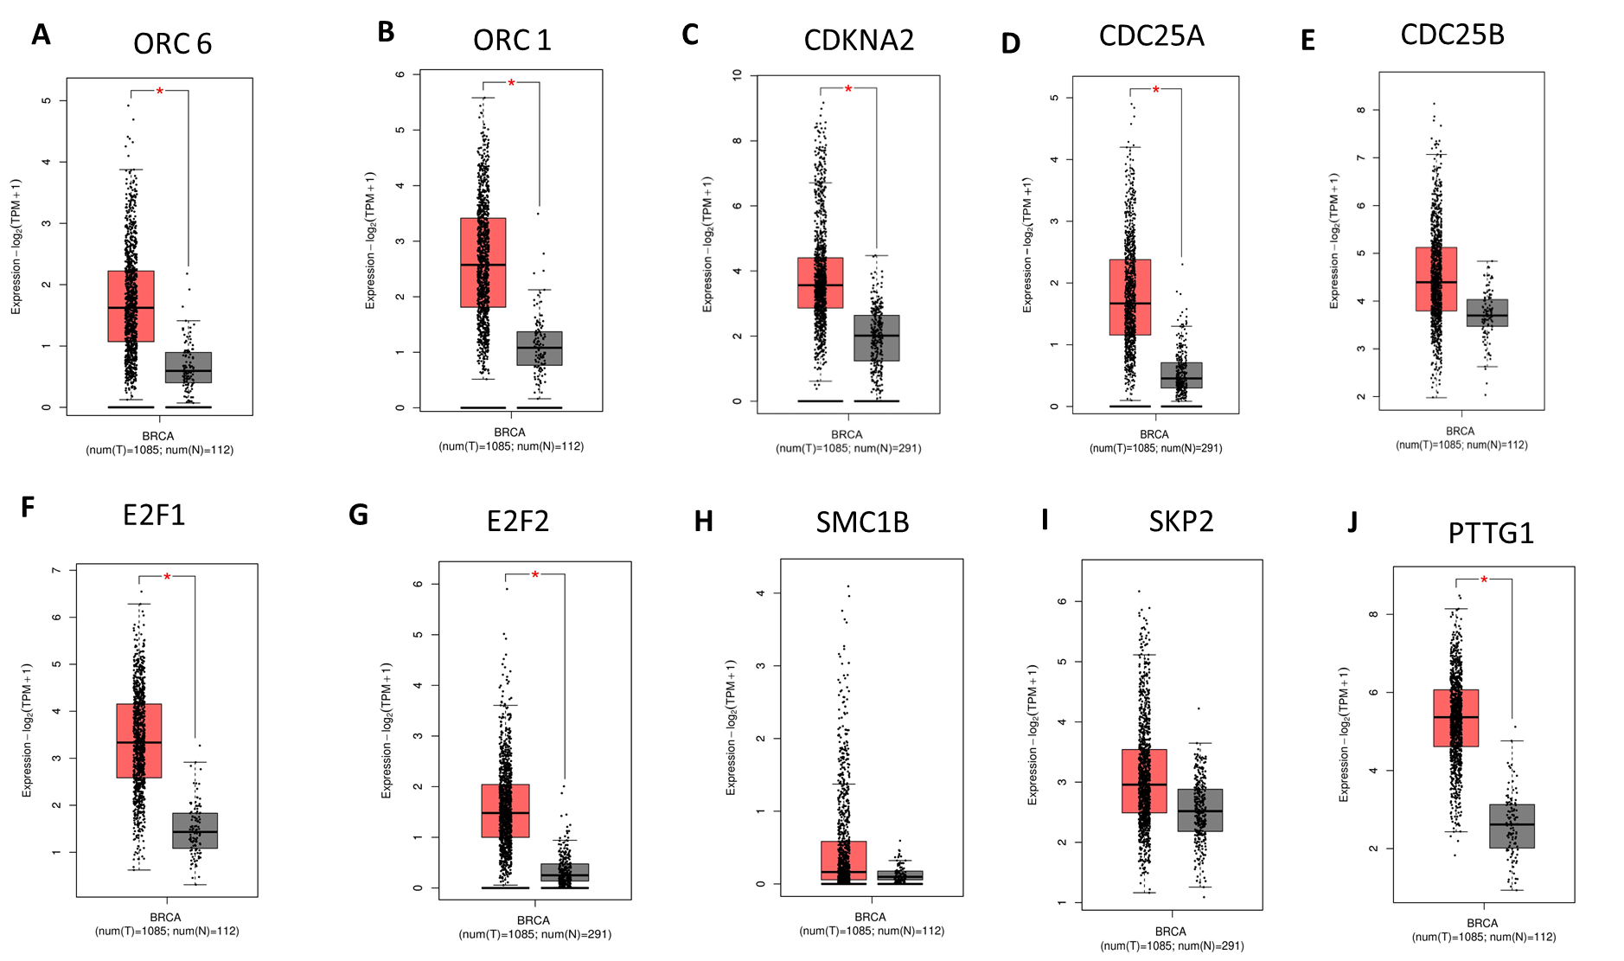

Slide 7
Supplementary Figure 2. Gene Expression Profiling Interactive Analysis demonstrated that the hub genes ORC6, ORC1,CDKN2A, E2F1, E2F2, CDC25A, PTTG1 were found to be significantly upregulated in BC compared with normal tissues. (tumour=1085; normal=112). *P<0.05.

Slide 8
Supplementary Figure 3

Slide 9
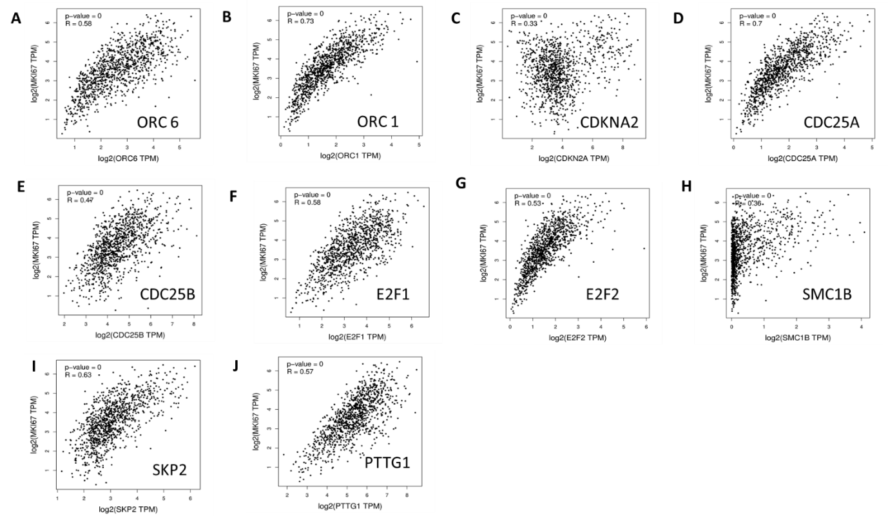

Slide 10
Supplementary Figure 3 . shows Pearson correlation between Hub genes with MKi67, the most common marker of proliferation.

Slide 11
Supplementary Figure 4

Slide 12
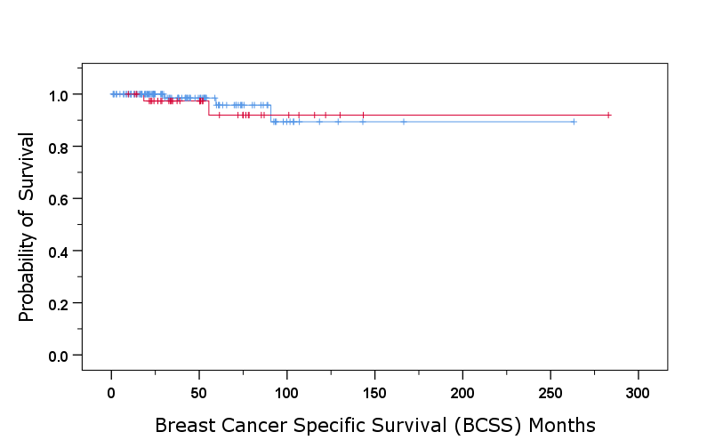
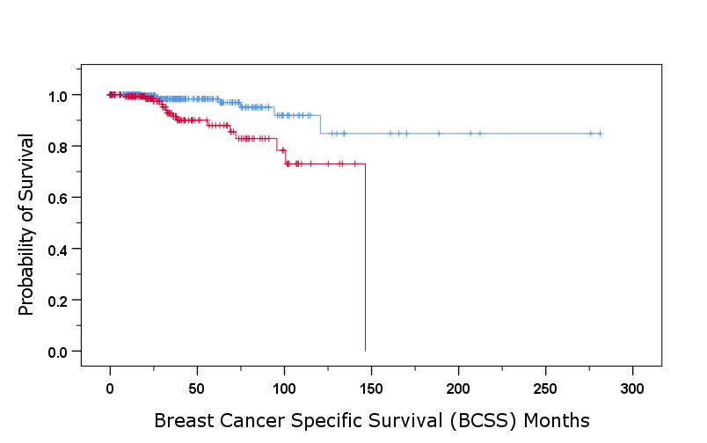
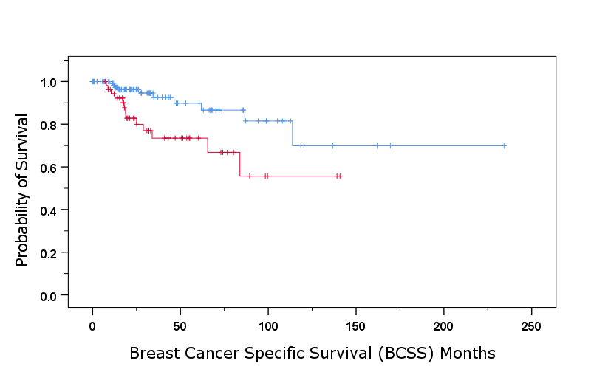
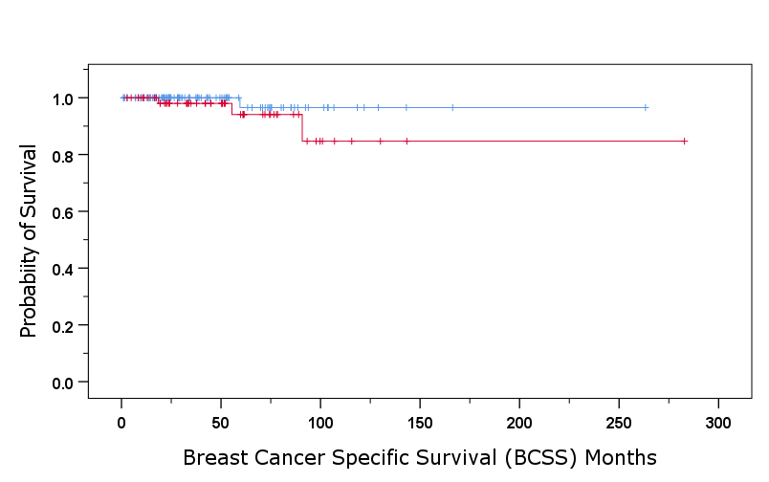
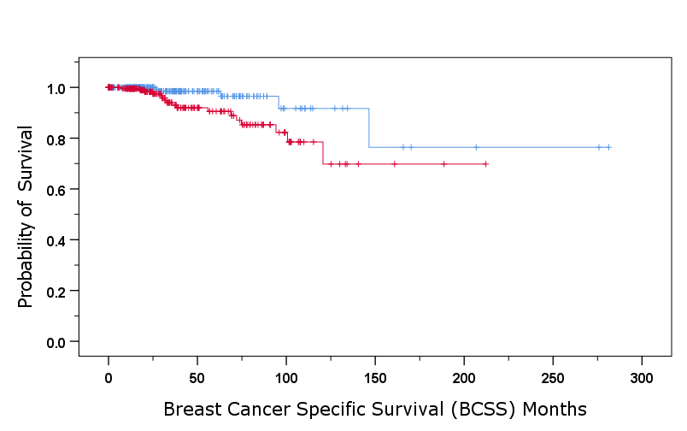
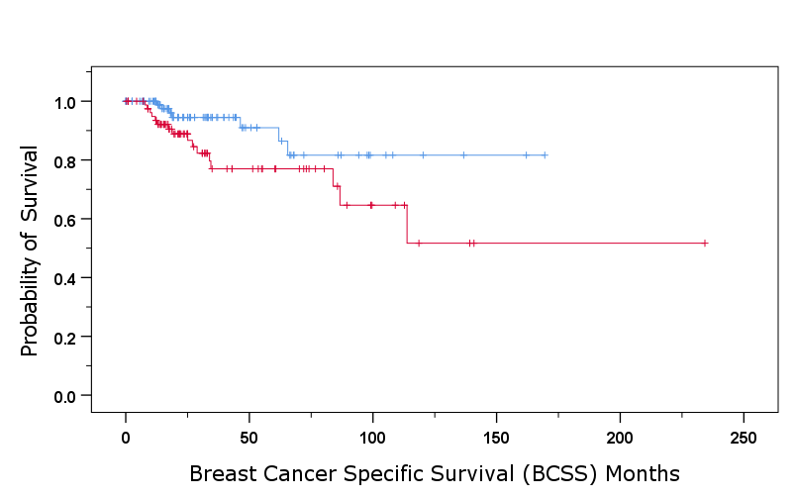
TCGA
A
B
C
ORC6 mRNA Expression
ORC6 mRNA Expression
ORC6 mRNA Expression
Low ORC6 =117
Low ORC6 =322
Low ORC6 =131
High ORC6 =41
High ORC6 =164
High ORC6 =54
Log rank= 0.174
p =0.676
Log rank= 11.22
p =0.001
Log rank= 7.59
p =0.006
Stage 1
Stage 2
Stage 3
F
D
E
SKP2 mRNA Expression
SKP2 mRNA Expression
SKP2 mRNA Expression
Low SKP2=97
Low SKP2=102
Low SKP2=257
High SKP2 =60
High SKP2 =229
High SKP2 =83
Log rank= 1.56
p =0.21
Log rank= 6.52
p =0.01
Log rank= 4.7
p =0.03
Stage 1
Stage 2
Stage 3

Slide 13
Association between ORC6 and SKP2 mRNA expression and BCSS of different stages of invasive BC patients in the TCGA cohort
A. ORC6 mRNA Expression in Sage 1 BC Patients
B. ORC6 mRNA Expression in Sage 2 BC Patients.
C. ORC6 mRNA Expression in Sage 3 BC Patients.
D. SKP2 mRNA Expression in Sage 1 BC Patients
E. SKP2 mRNA Expression in Sage 2 BC Patients.
F. SKP2 mRNA Expression in Sage 3 BC Patients.

Slide 14
Supplementary Figure 5

Slide 15
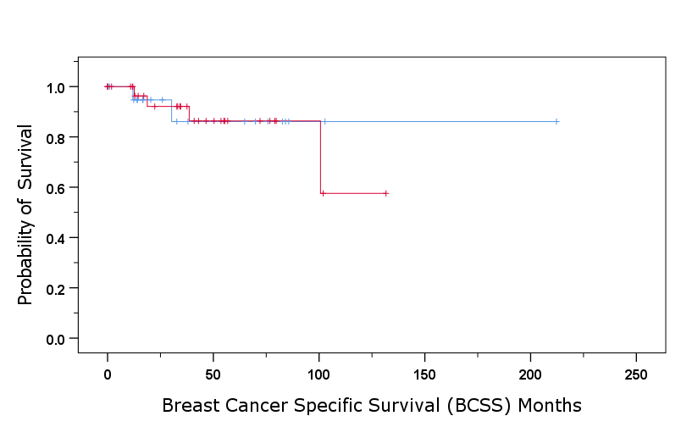
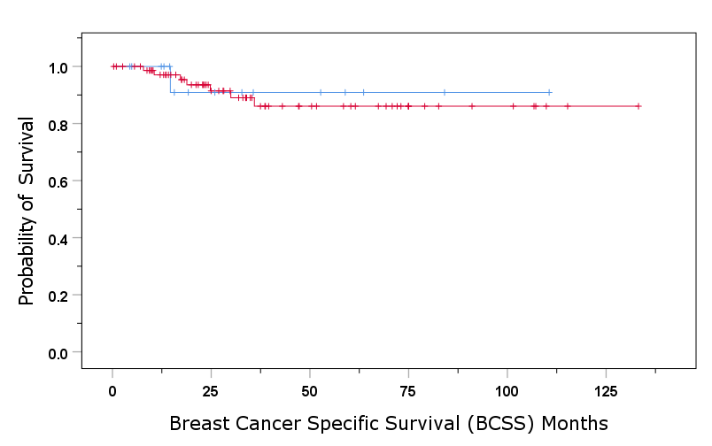
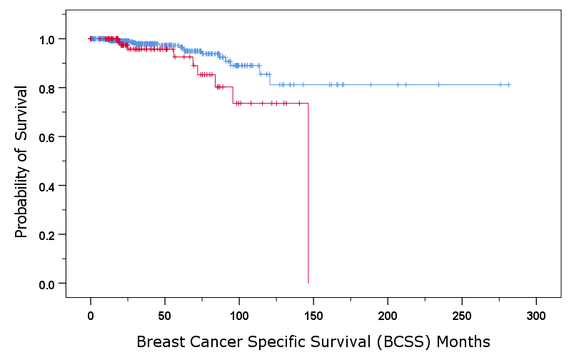
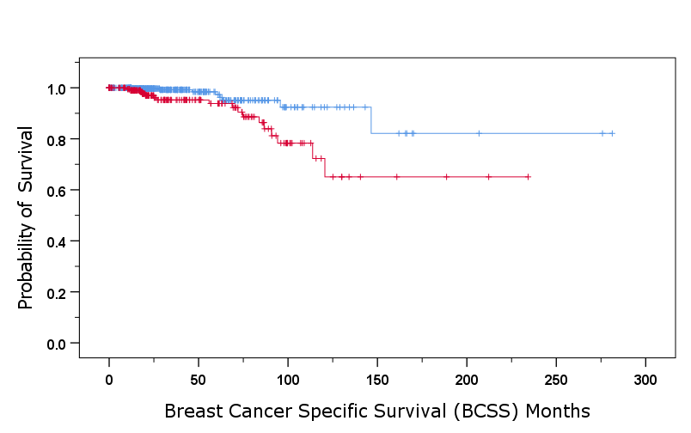
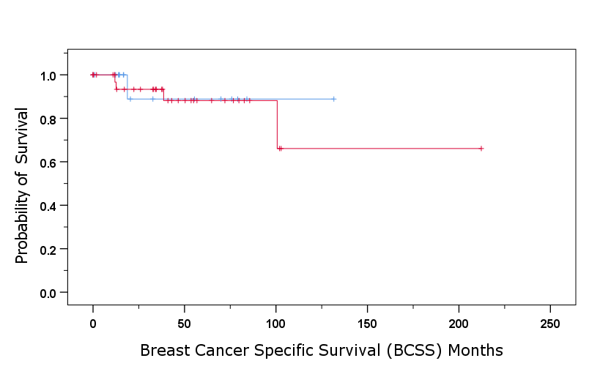
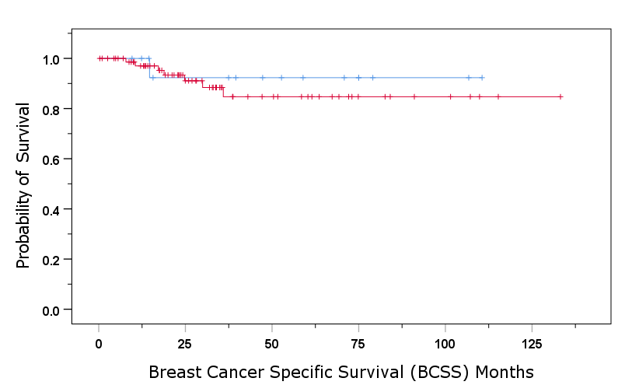
TCGA
A
B
C
ORC6 mRNA Expression
ORC6 mRNA Expression
ORC6 mRNA Expression
Low ORC6 =513
Low ORC6 =22
Low ORC6 =16
High ORC6 =108
High ORC6 =76
High ORC6 =33
Log rank= 0.04
p =0.84
Log rank= 0.052
p =0.82
Log rank= 4.56
p =0.03
Luminal BC
HER2+
TNBC
E
F
D
SKP2 mRNA Expression
SKP2 mRNA Expression
SKP2 mRNA Expression
Low SKP2=16
Low SKP2=16
Low SKP2=17
High SKP2 =76
High SKP2 =76
High SKP2 =37
Log rank= 0.137
p =0.712
Log rank= 0.35
p =0. 553
Luminal BC
Log rank= 8.732
p =0.003
HER2+
TNBC

Slide 16
Association between ORC6 and SKP2 mRNA expression and BCSS of different molecular subtypes of invasive BC patients in the TCGA cohort
A. ORC6 mRNA Expression in Luminal BC Patients
B. ORC6 mRNA Expression in Her2 enriched BC Patients.
C. ORC6 mRNA Expression in TNBC Patients.
D. SKP2 mRNA Expression in Luminal BC Patients
E. SKP2 mRNA Expression in Her2 enriched BC Patients.
F. SKP2 mRNA Expression in TNBC Patients.

Slide 17
Supplementary Figure 6.

Slide 18
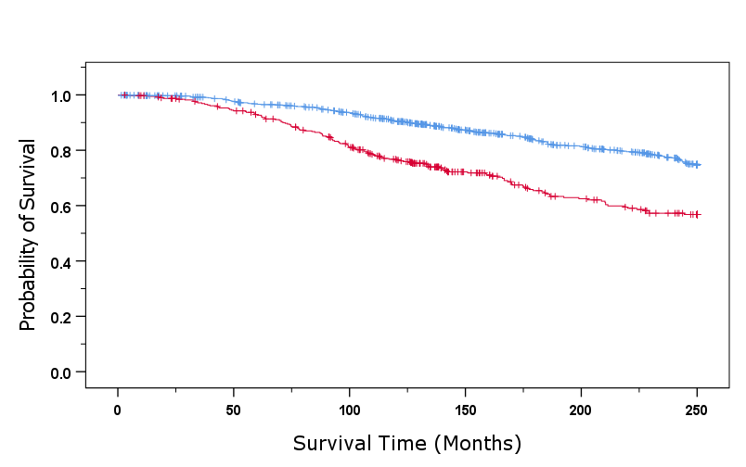
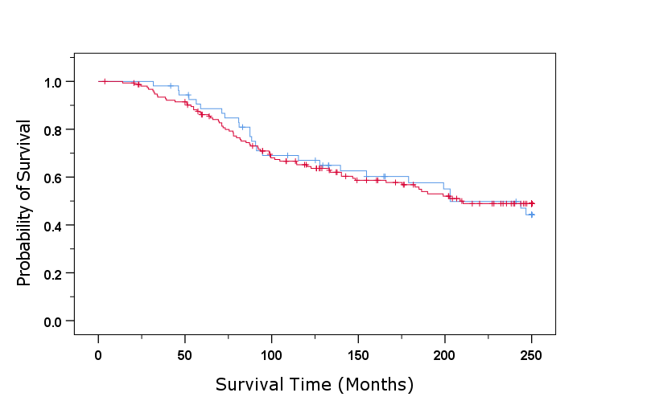
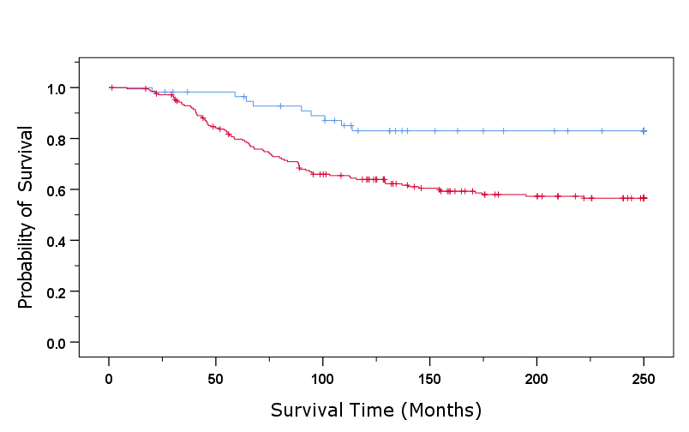
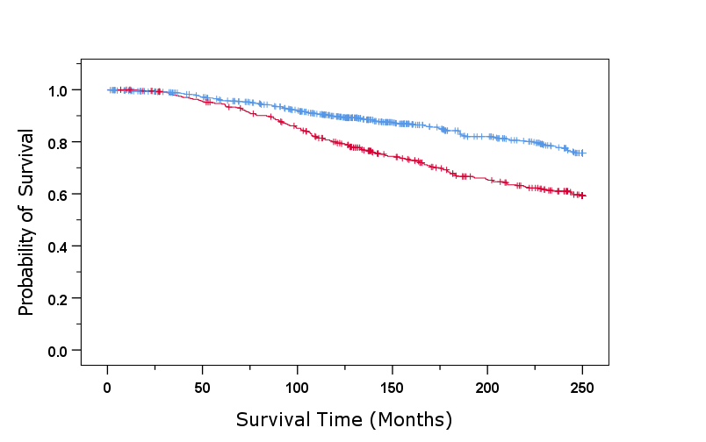
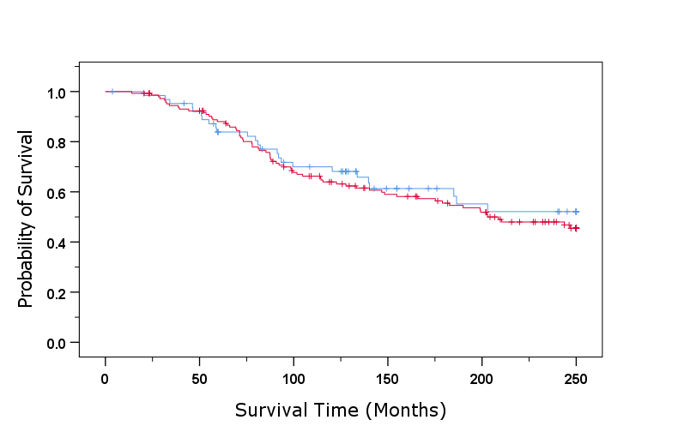
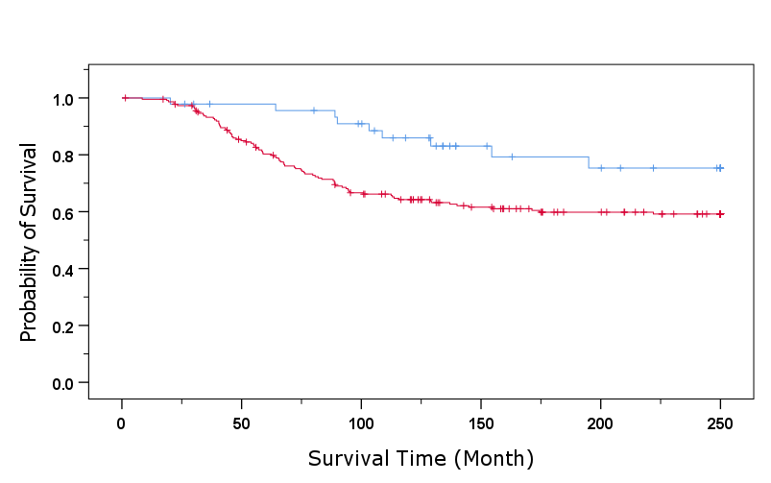
METABRIC
A
B
C
ORC6 mRNA Expression
ORC6 mRNA Expression
ORC6 mRNA Expression
Low ORC6 =778
Low ORC6 =54
Low ORC6 =58
High ORC6 =156
High ORC6 =214
High ORC6 =392
Log rank= 44.3
p <0.001
Log rank= 0.0
p =0.992
Log rank= 11.07
p =0.001
Luminal BC
HER2+
TNBC
D
SKP2 mRNA Expression
E
SKP2 mRNA Expression
F
SKP2 mRNA Expression
Low SKP2=723
Low SKP2=17
Low SKP2=47
High SKP2 =37
High SKP2 =447
High SKP2 =225
Log rank= 0.36
p =0.55
Log rank= 5.73
p =0. 017
Luminal BC
Log rank= 33.33
P<0.001
HER2+
TNBC

Slide 19
Association between ORC6 and SKP2 mRNA expression and Survival of different molecular subtypes of invasive BC patients in the METABRIC cohort
A. ORC6 mRNA Expression in Luminal BC Patients
B. ORC6 mRNA Expression in Her2 enriched BC Patients.
C. ORC6 mRNA Expression in TNBC Patients.
D. SKP2 mRNA Expression in Luminal BC Patients
E. SKP2 mRNA Expression in Her2 enriched BC Patients.
F. SKP2 mRNA Expression in TNBC Patients.

