Slide 1

Supplementary figure 1
Baseline
Follow-up either 2- or 6- or 12- month
12 – Subclinical TB
35 – Incipient TB
12+6 – Subclinical TB
29 – Incipient TB
Scatter plot for the baseline and follow-up samples.

Slide 2
Supplementary figure 2
A
B
C
Subclinical TB vs. Incipient TB
Subclinical TB vs. Household controls
Subclinical TB vs. Active TB
AUC: 0.71
AUC: 0.93
A) ROC curves for gene signature discriminate subclinical TB from incipient TB. B) ROC curve for the 8-protein signature distinguished subclinical TB from household controls. C) ROC curves for the 8-protein signature distinguished subclinical TB from active TB.

Slide 3
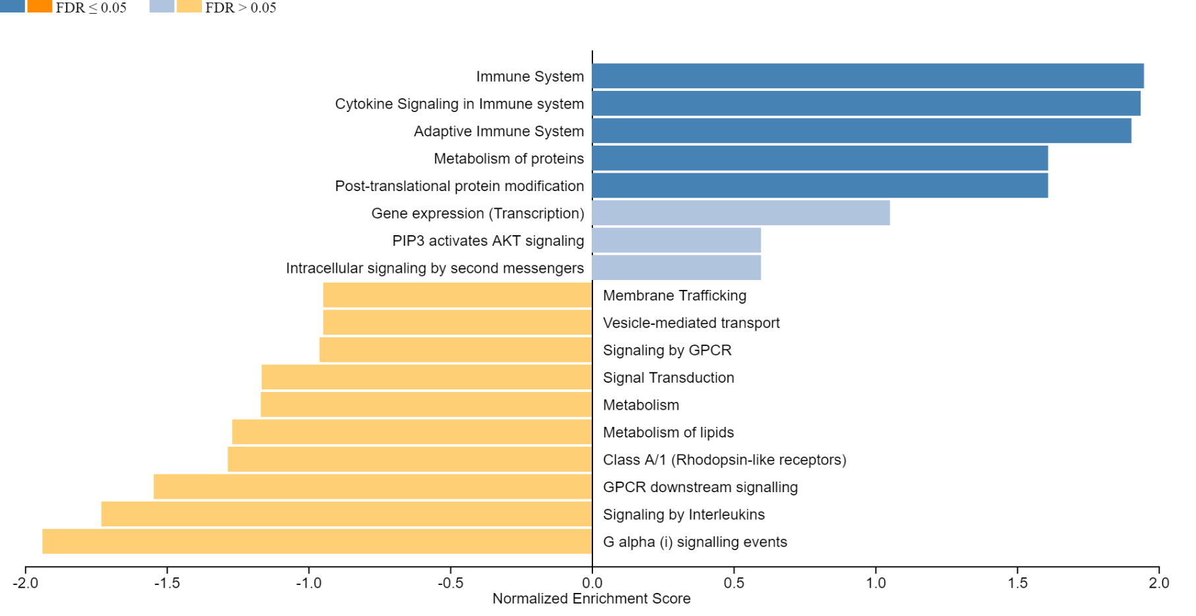
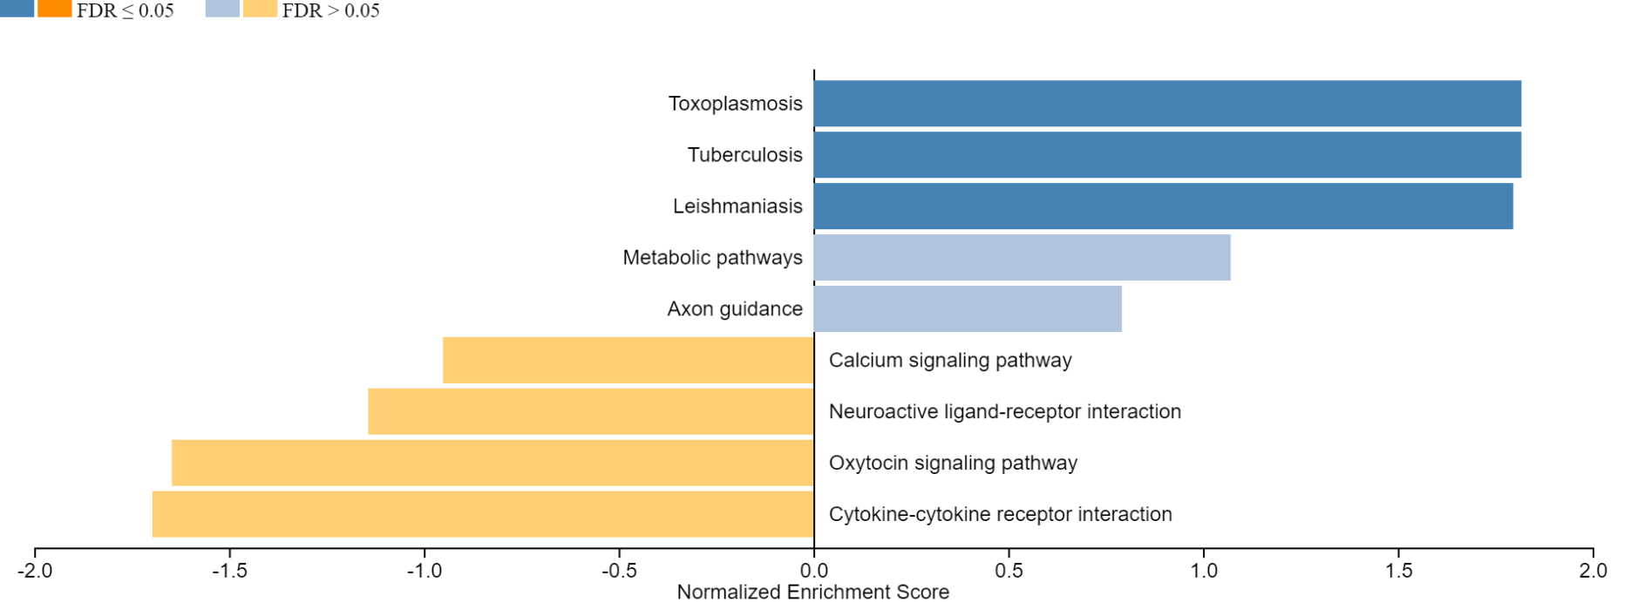
Supplementary figure 3
A
Improved visualizations on the result page of (A) WebGestalt (B) KEGG pathway enrichment analysis. The bar chart shows the enrichment ratio or normalized enrichment score of results with direction.
B

