Slide 1
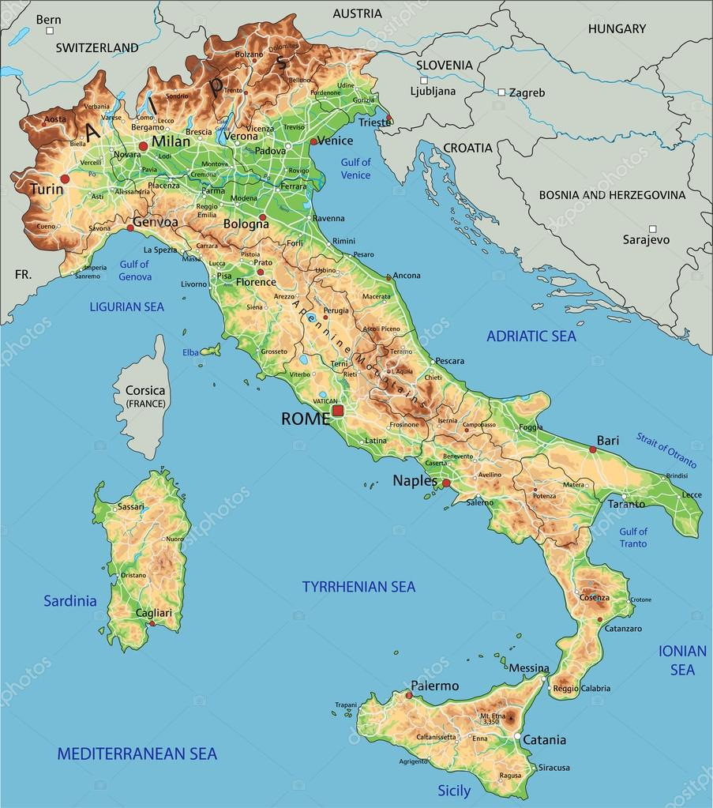
Friuli Venezia giulia Alps
Supplementary Figure 1
Veneto Alps
Lombardia Alps
Euganean Hills
© depositphotos

