Slide 1
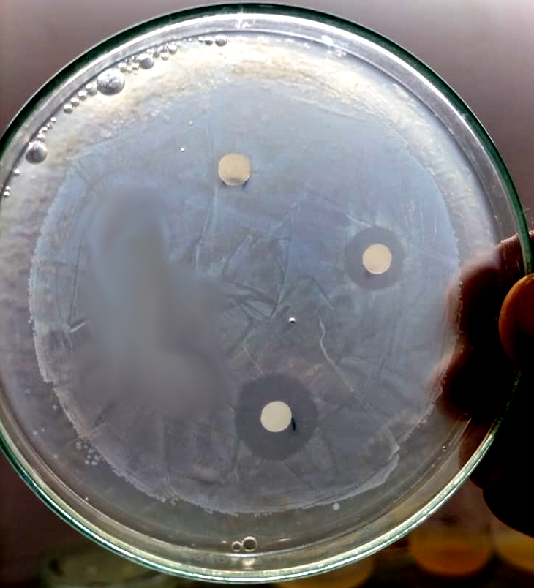
S. aureus
Control
CVM (100 µg/ml)
Gentamycin (10µg/ml)

Slide 2
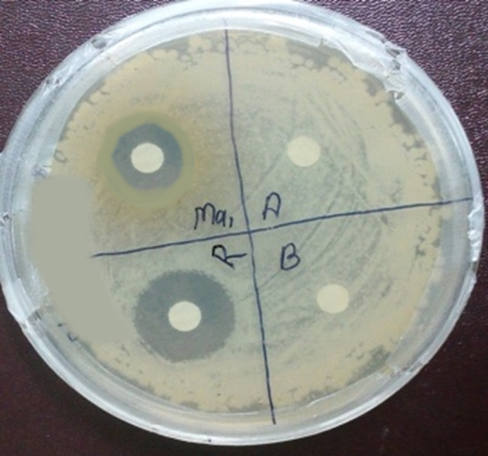
S. typhi
CVM (100 µg/ml)
Control
Gentamycin (10µg/ml)

Slide 3
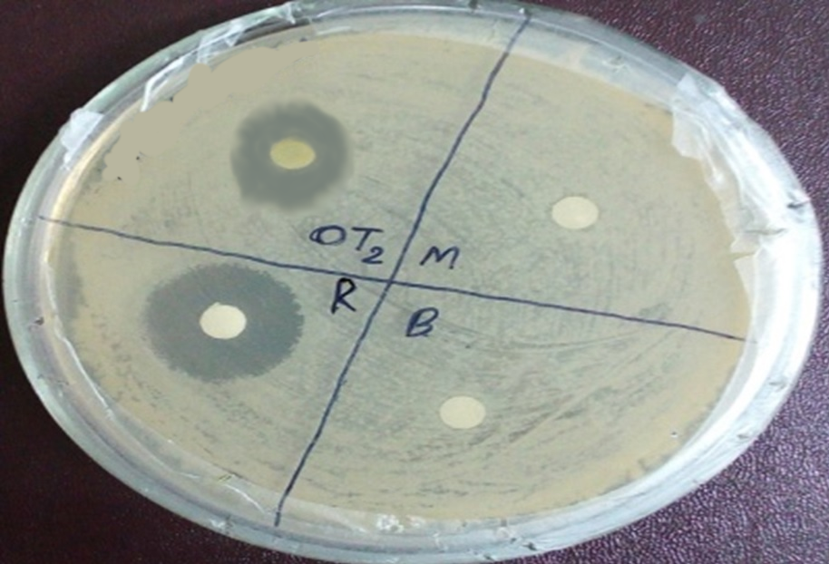
V. cholera
CVM (100 µg/ml)
Control
Gentamycin (10µg/ml)

