Slide 1
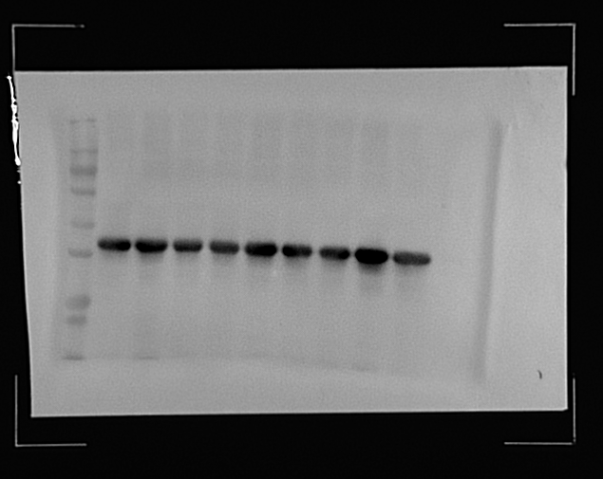
Bands shown in Figure 4E
OE-METTL3+si-ARK1B10
OE-METTL3+si-ARK1B10
OE-METTL3+si-ARK1B10
Vector
OE-METTL3
OE-METTL3
OE-METTL3
Vector
Vector
ARK1B10
36kda

Slide 2
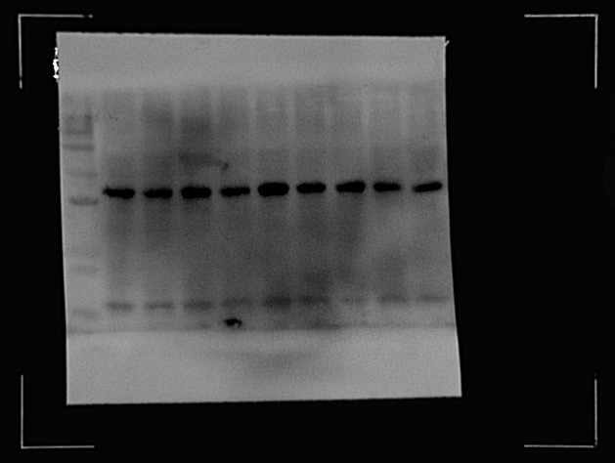
Bands shown in Figure 4E
OE-METTL3+si-ARK1B10
OE-METTL3+si-ARK1B10
OE-METTL3+si-ARK1B10
Vector
OE-METTL3
OE-METTL3
OE-METTL3
Vector
Vector
GAPDH
36kda

Slide 3
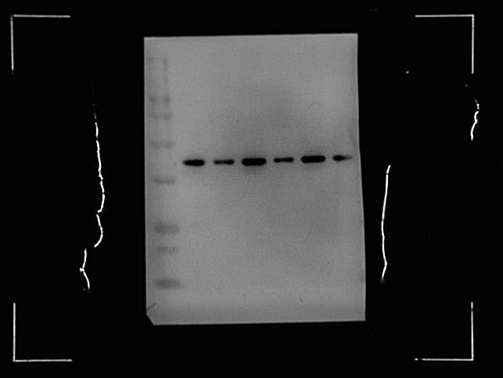
Bands shown in Figure 6B
si-ARK1B10
si-ARK1B10
si-ARK1B10
siNC
siNC
siNC
ARK1B10
36kda

Slide 4
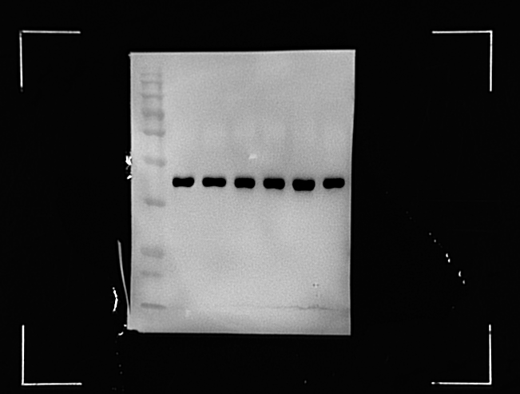
Bands shown in Figure 6B
si-ARK1B10
si-ARK1B10
si-ARK1B10
siNC
siNC
siNC
GAPDH
36kda

