Slide 1

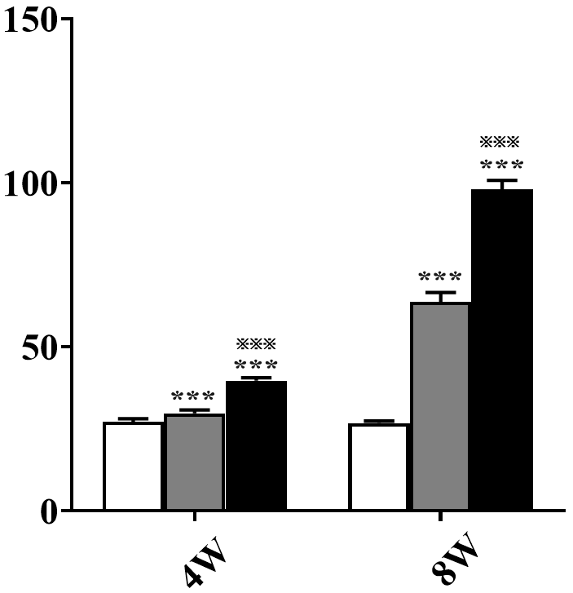
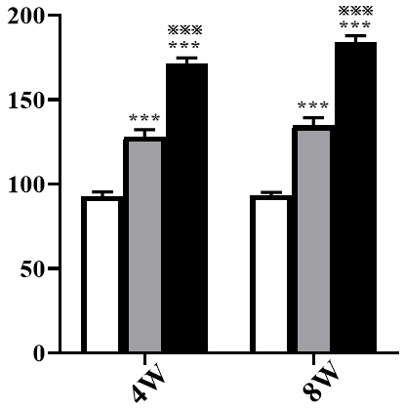
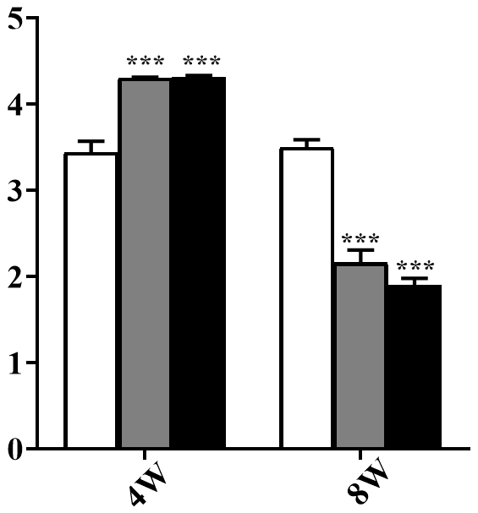
A.
ALT (U/l)
AST (U/l)
AST/ALT

Slide 2
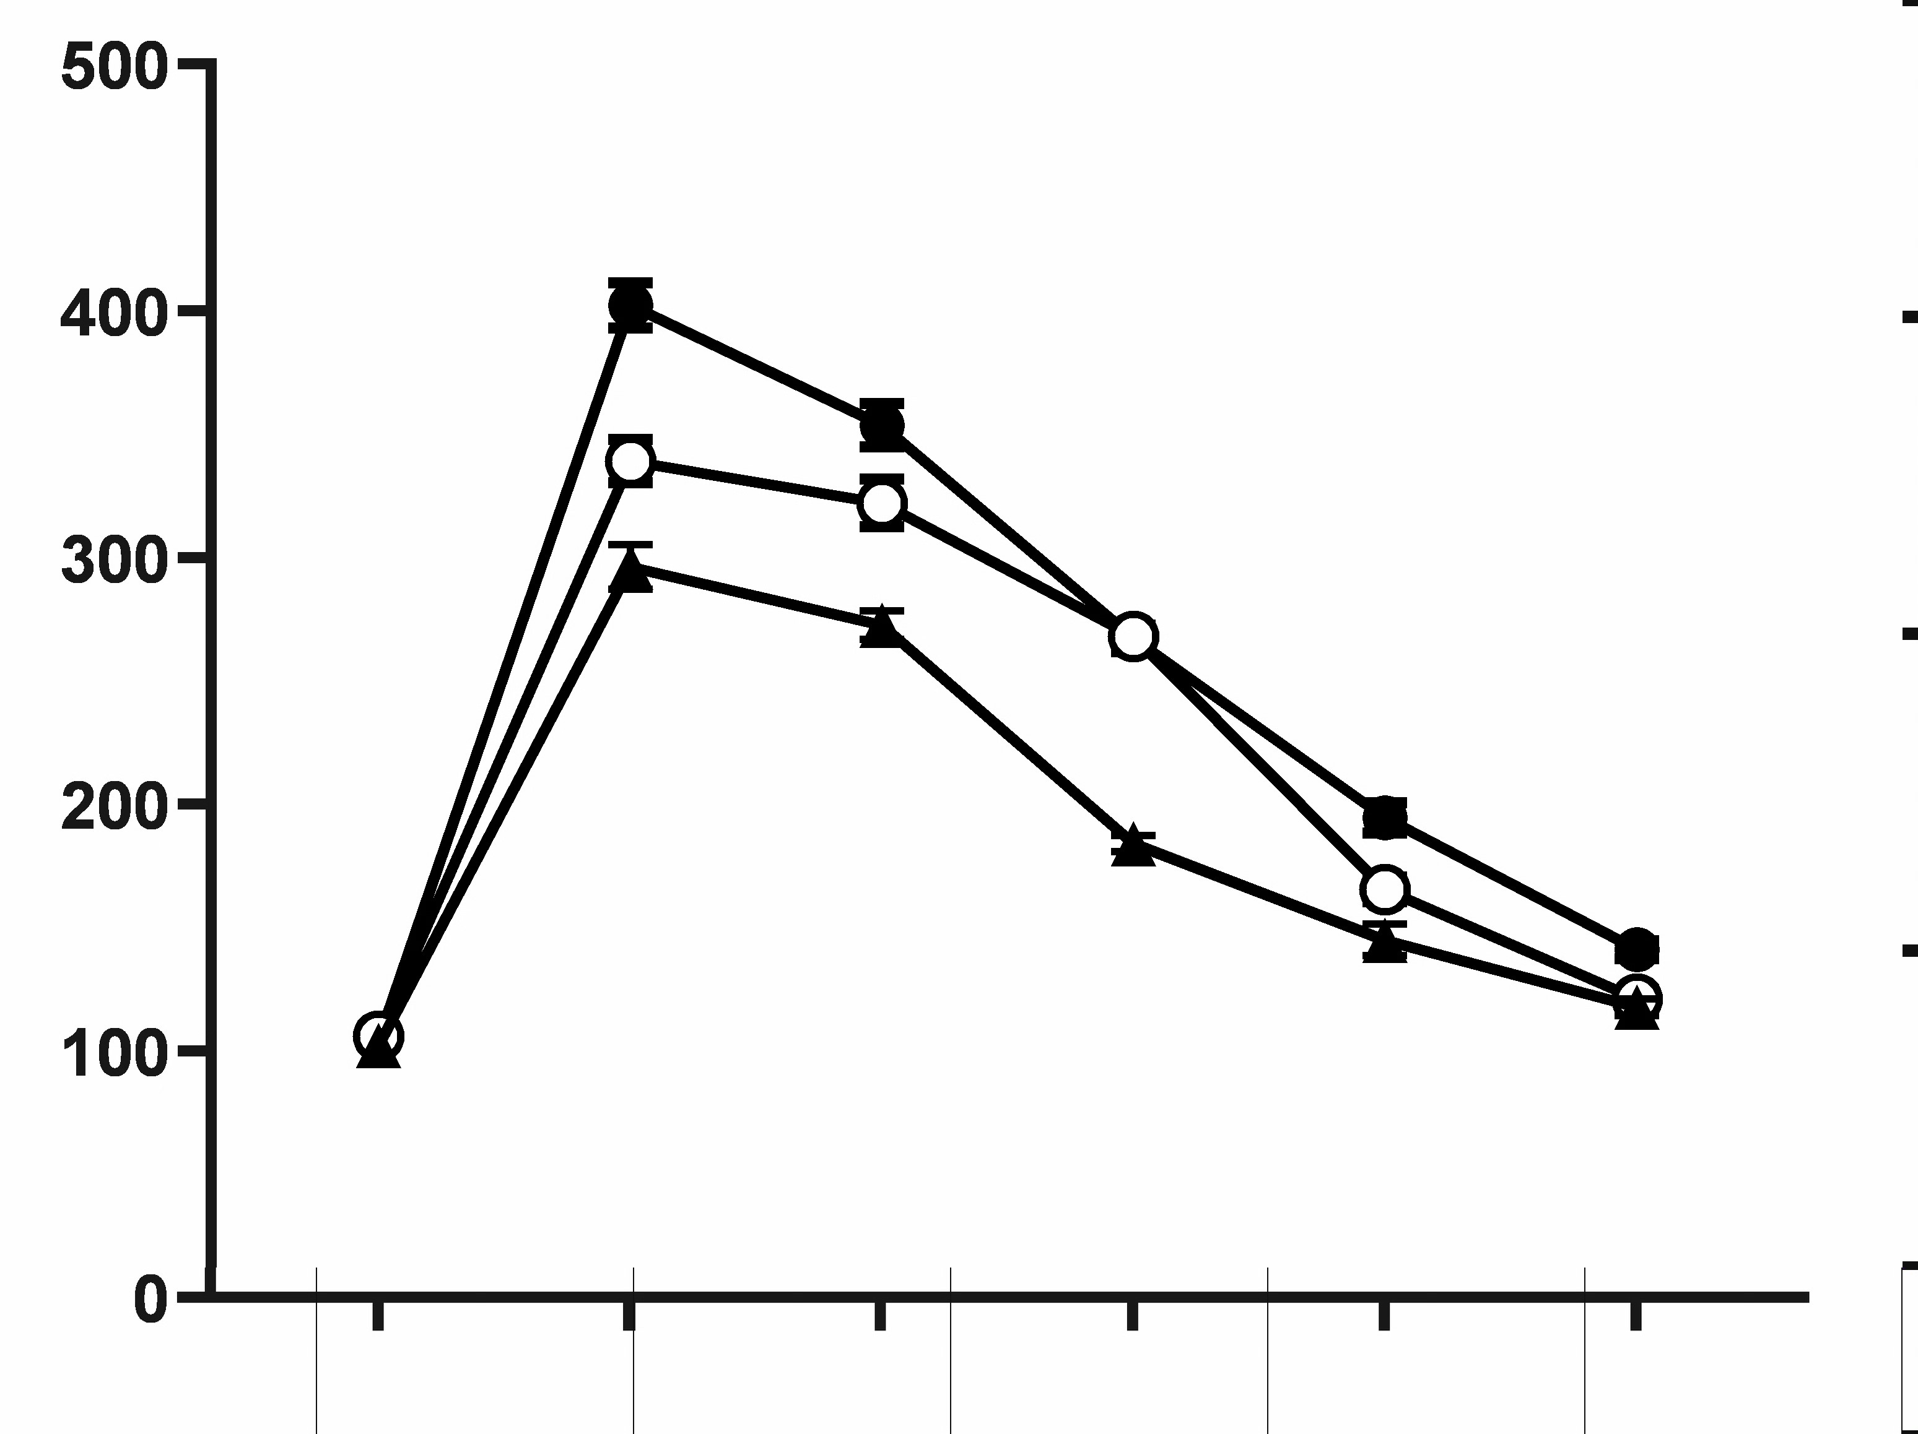
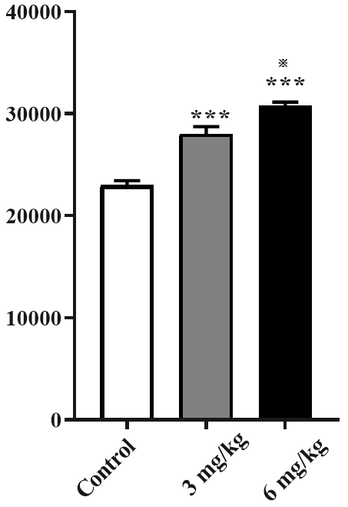
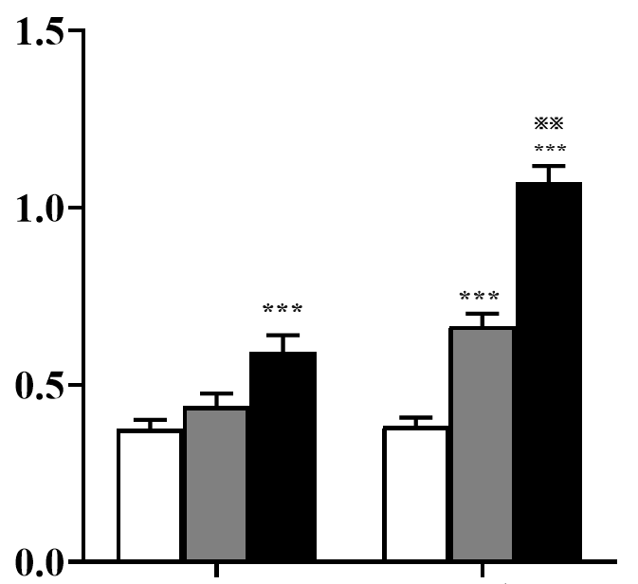




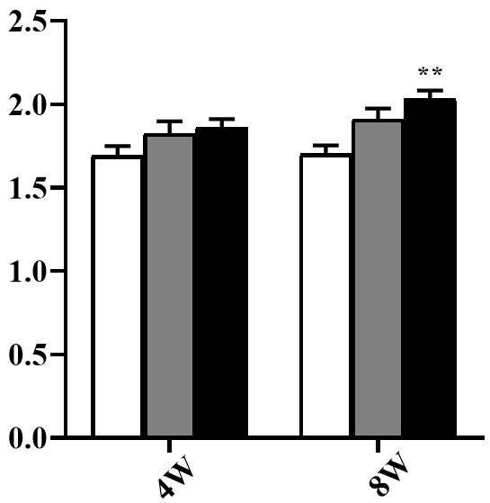
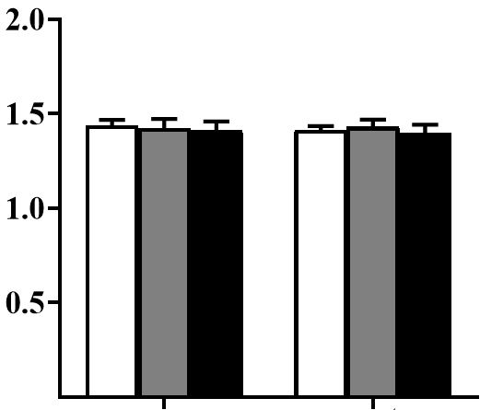
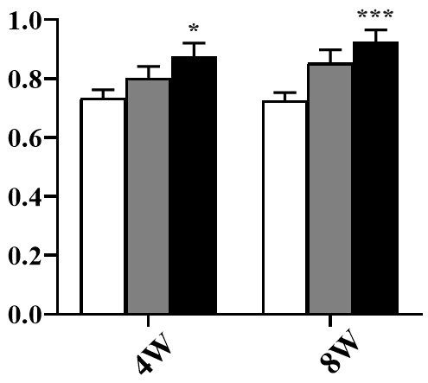
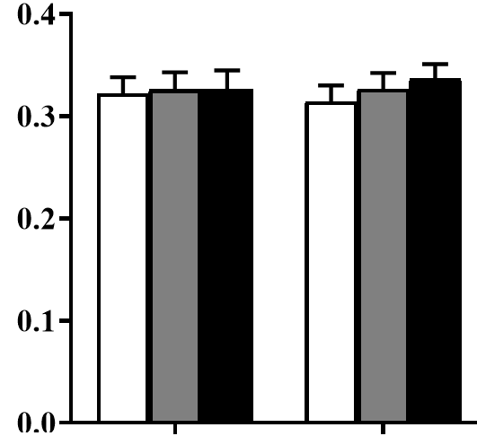
Fig. 1
B.
C.
D.
Control
Control
3mg/kg
3mg/kg
Glucose (mg/dl)
6mg/kg
6mg/kg
AUC (mg/dl/min)
Plasma triglycerides (mmol/l)
4W
8W
0
15
30
60
90
120
3mg/kg
Time (min)
Control
6mg/kg
E.
F.
G.
H.
Plasma Total cholesterol (mmol/l)
HDL-C (mmol/l)
NEFA (mmol/l)
LDL-C (mmol/l)
0.0
4W
8W
4W
8W
4W
8W
4W
8W

