Slide 1
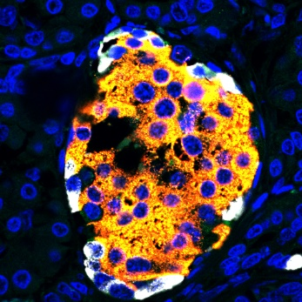
Supplementary Fig. 1
Insulin
Glucagon
ATP6AP2
Merge

