Slide 1
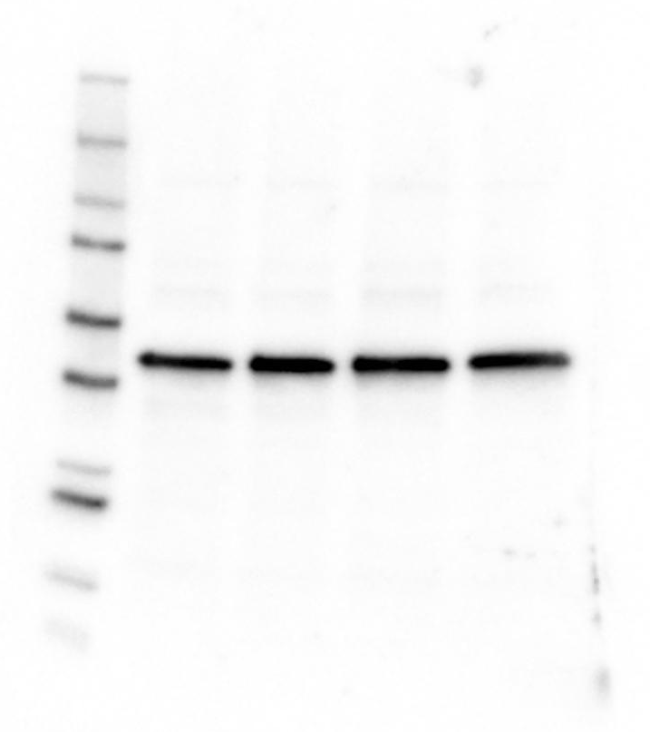
Supplementary Fig. 2
a
Scramble
Atp6ap2 siRNA-1
IB: ATP6AP2
b
Scramble
Atp6ap2 siRNA-1
IB: β Actin
Notes:
Legend:
Uncropped full-length blots of ATP6AP2 (a) and β Actin (b) are presented.

