Slide 1
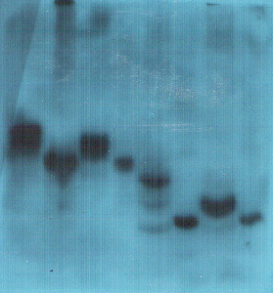
Fig. 2. Original file of Western blot result
1 2
-
+
We cut the rec-eCG lane 1 and 2 in the total western blot.
And the part was added into the Fig. 2.

