Slide 1
Movement Disorders Patients (A)

Slide 2
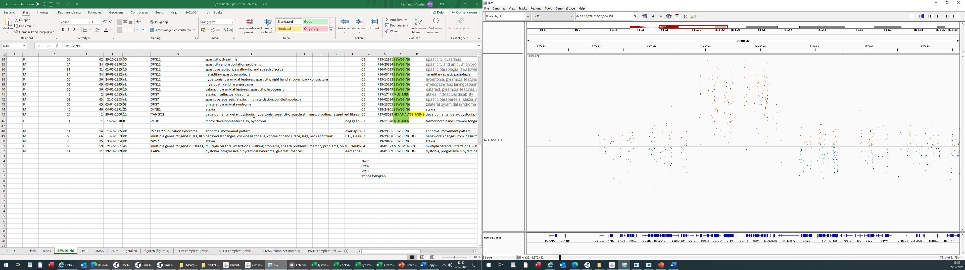
AD1; gain / 22q11.2 /~1,4 mb
22q11.2 duplication

Slide 3
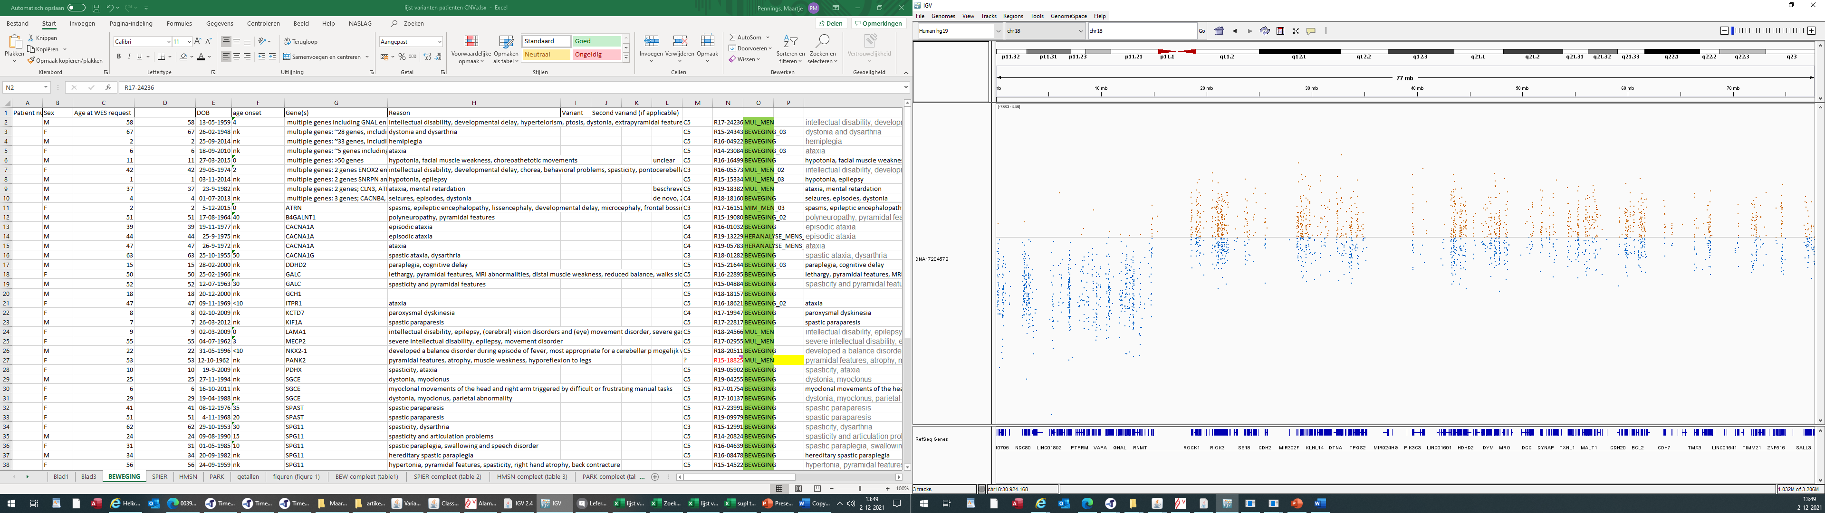
AD2; loss / 18p11 / ~13,5 mb
chromosome 18p deletion syndrome

Slide 4
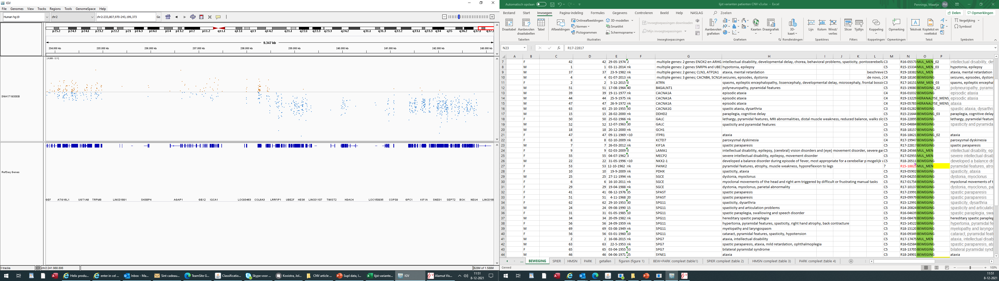
AD3; loss / 2q37 / ~4,5 mb
2q37 deletion syndrome

Slide 5
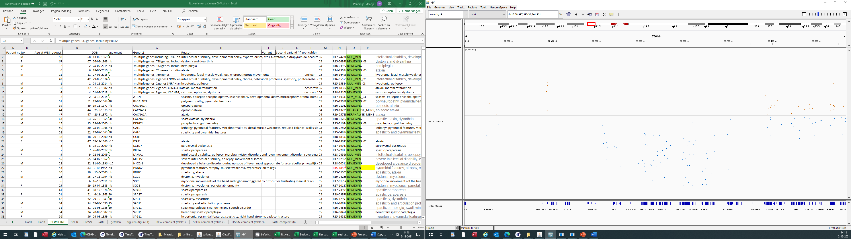
AD4; loss / 16p11.2 / ~730 kb
16p11.2 microdeletion

Slide 6
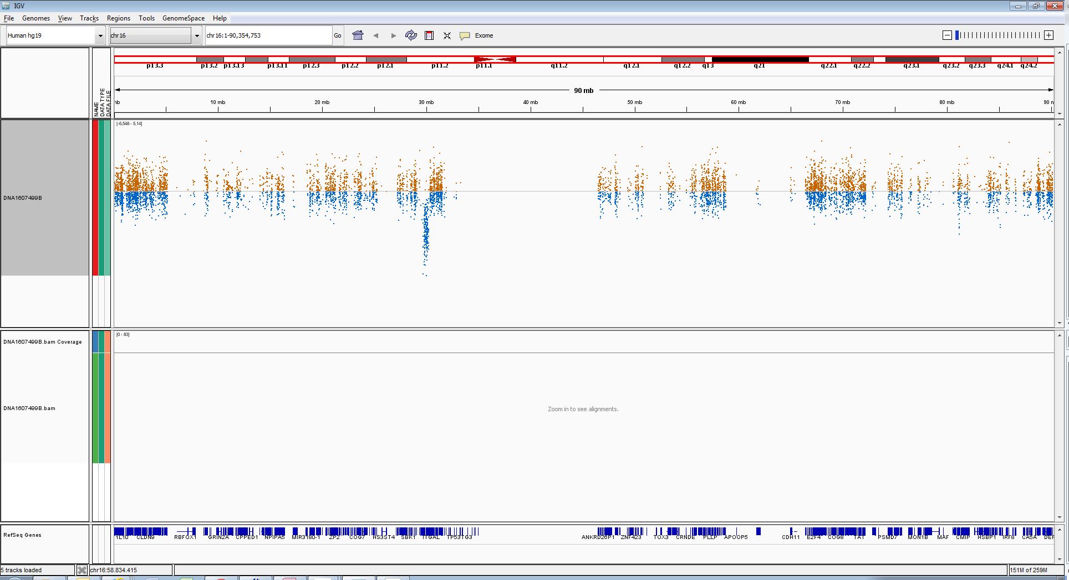
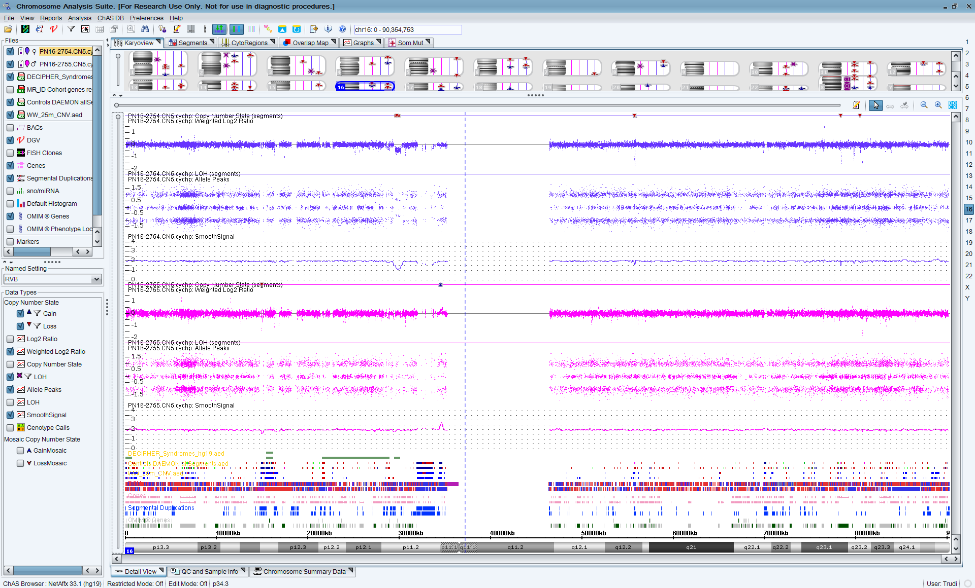
AD4;
Index
Mother
Father

Slide 7
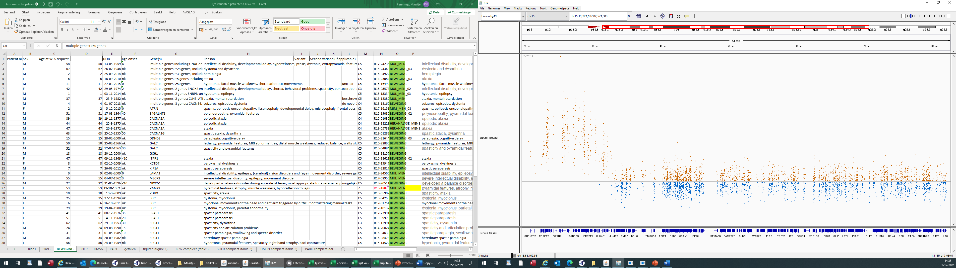
AD5; gain / 15q11-q13 / 4,8 mb
15q11-q13 duplication

Slide 8
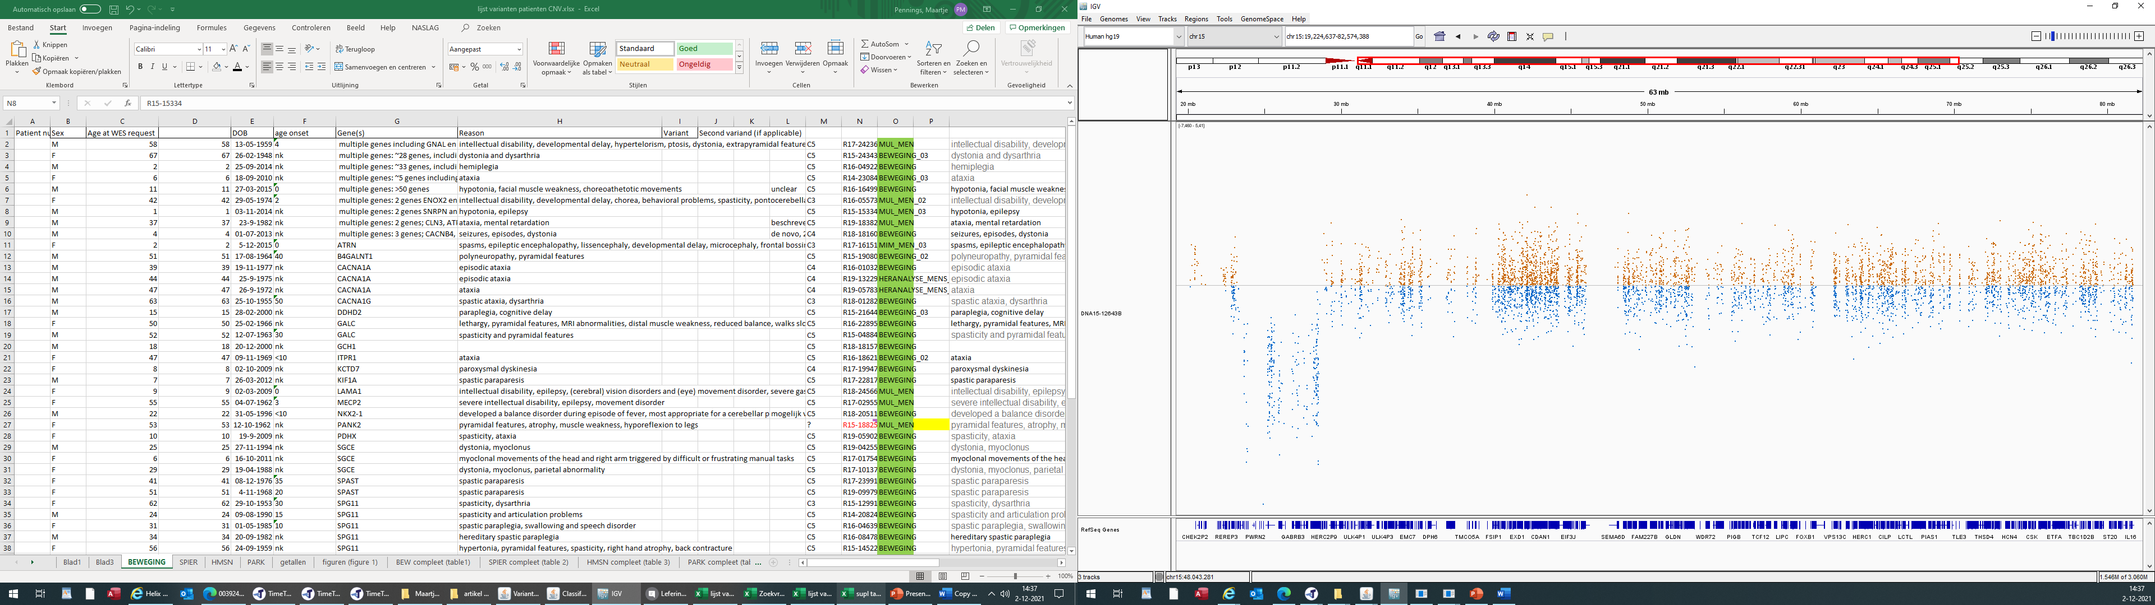
AD6; loss / 15q11q13 / 4,8 mb
15q11.2q13.1 deletion

Slide 9
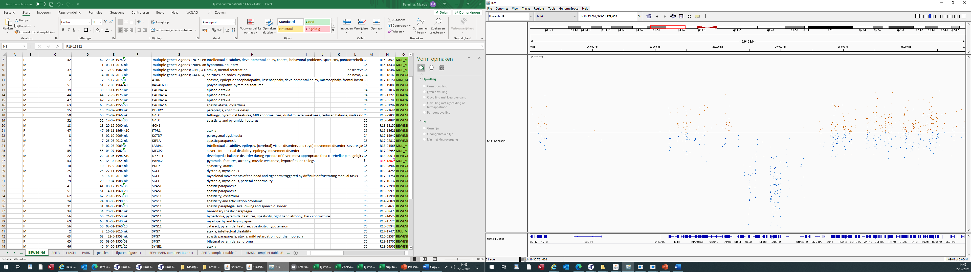
AD7; loss / 16p11.2 / 973 kb
16p11.2 microdeletion

Slide 10
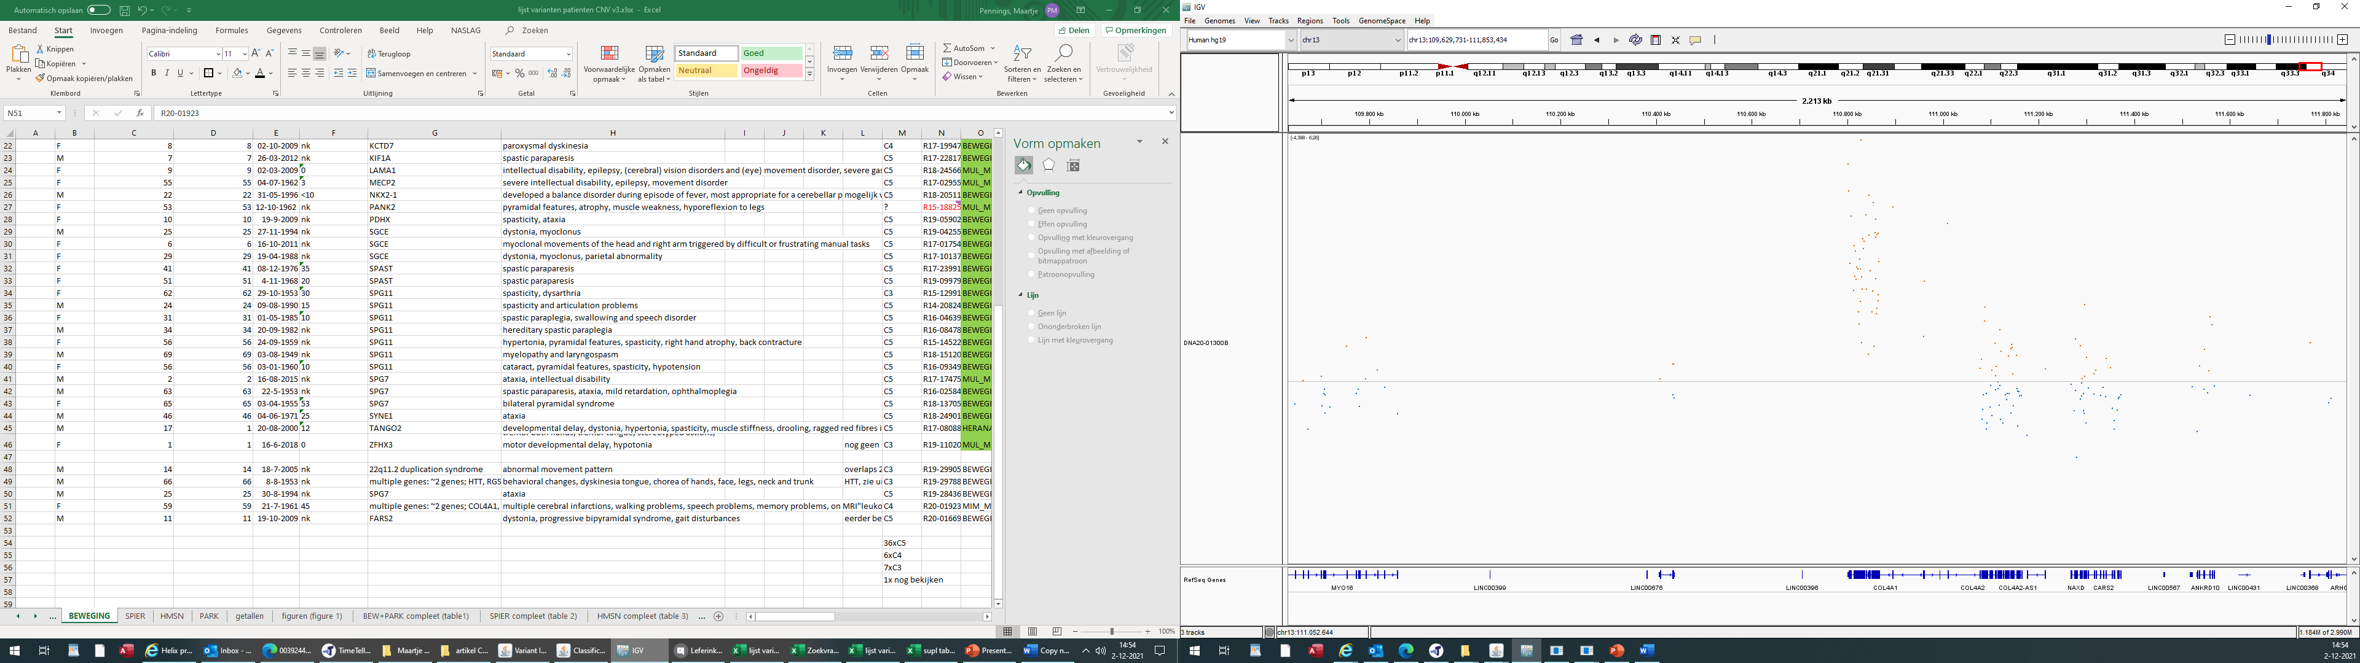
AD8; gain / 13q34 / 208,505bp kb
2 genes; COL4A1, COL4A2

Slide 11
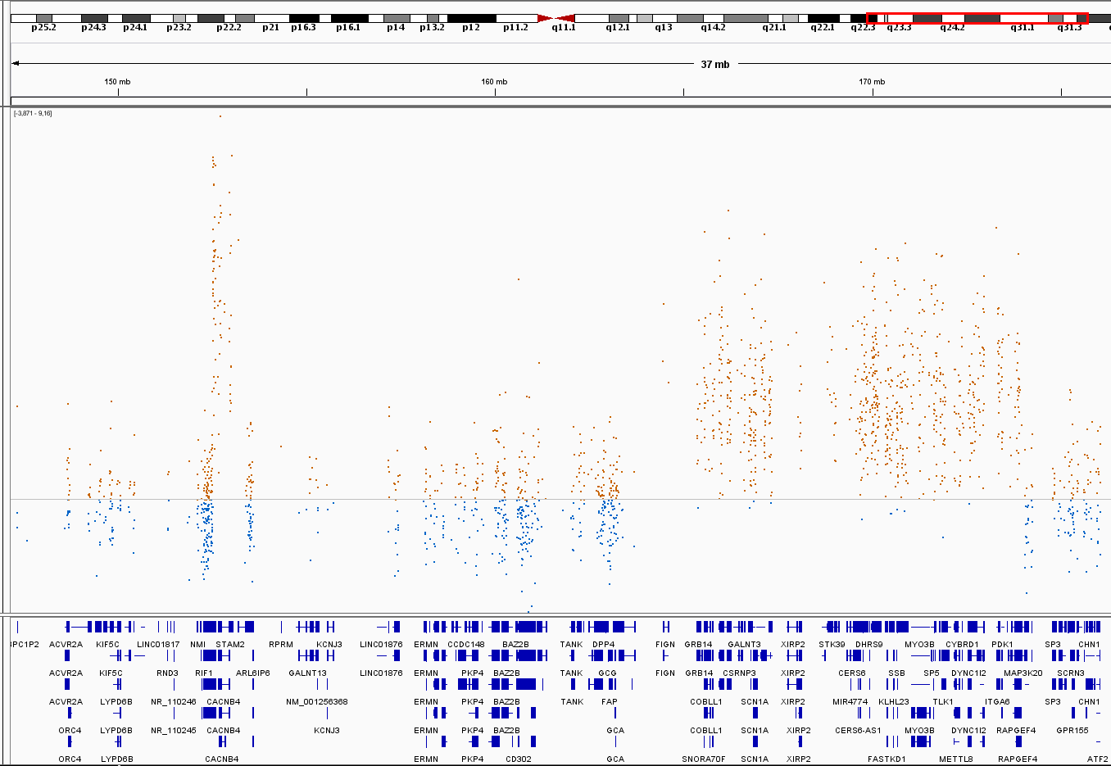
AD9; gain / 2q23.3&2q24.2q31.1 / ~9,4 mb
3 genes; CACNB4, SCN1A, SCN2A

Slide 12
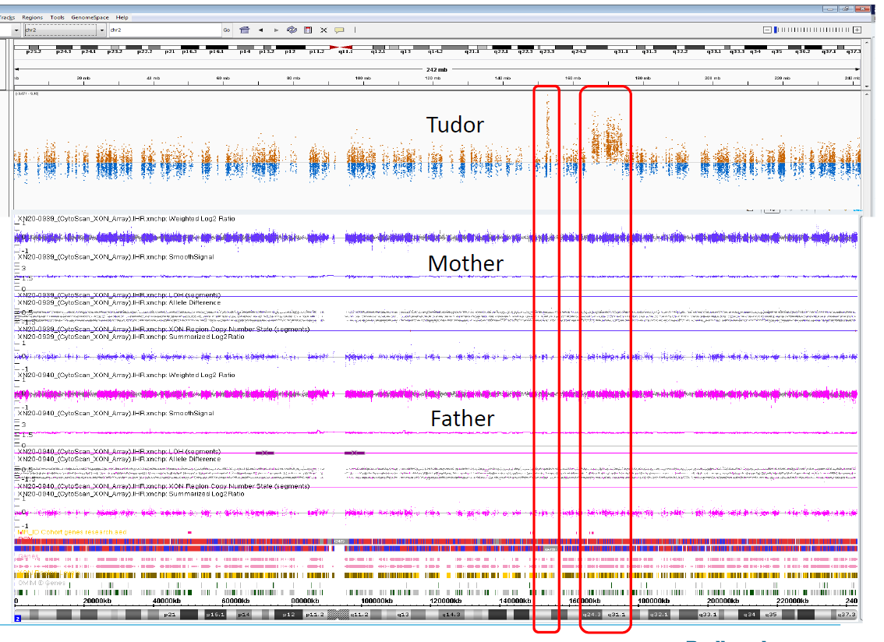
AD9;
Child

Slide 13
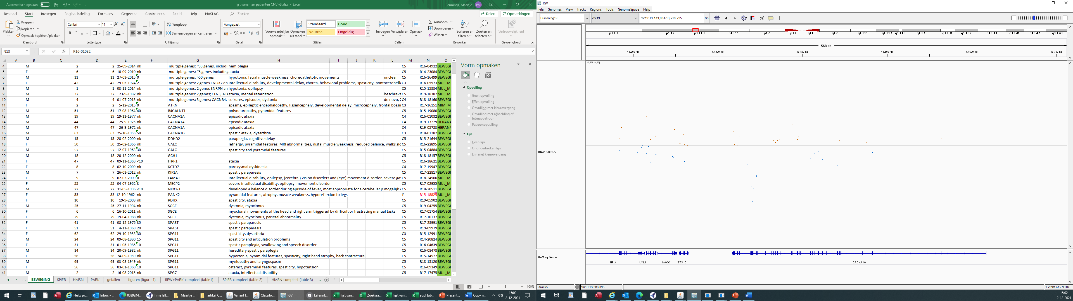
AD10; loss / 19p13.2 / ~11 mb
CACNA1A

Slide 14
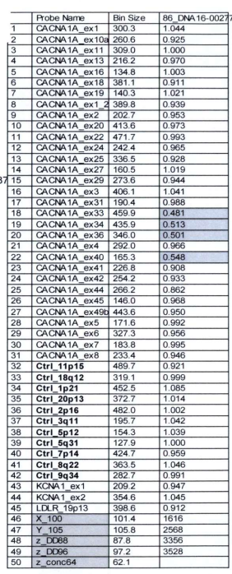

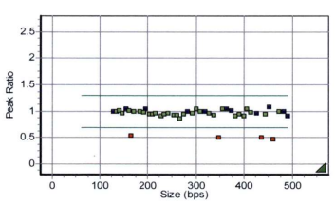
AD10; CACNA1A

Slide 15
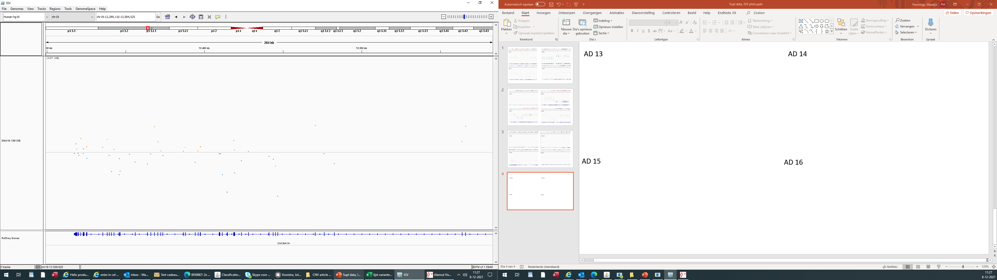
AD11; loss / 19p13.2 / ~11 mb
CACNA1A

Slide 16
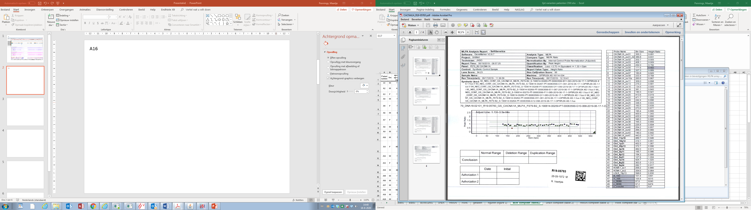
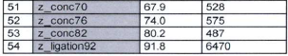
AD11; CACNA1A

Slide 17
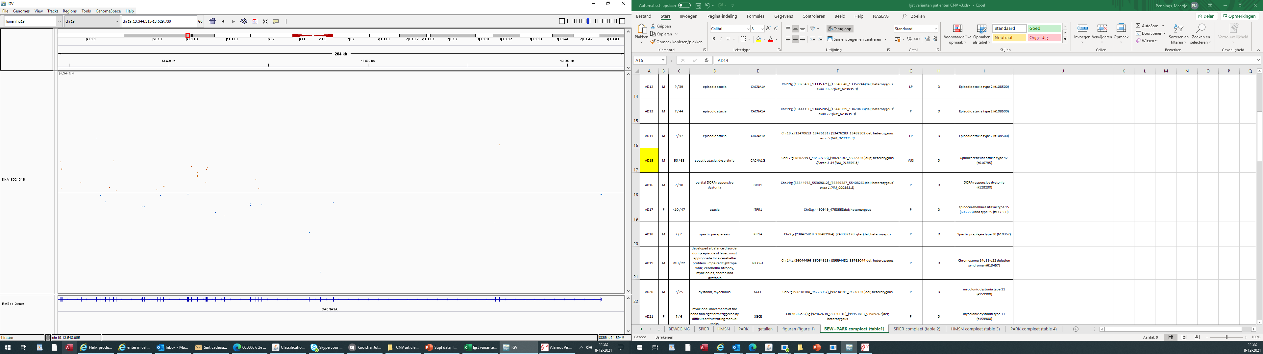
AD12; loss / 19p13.2 / ~5,6 kb
CACNA1A

Slide 18
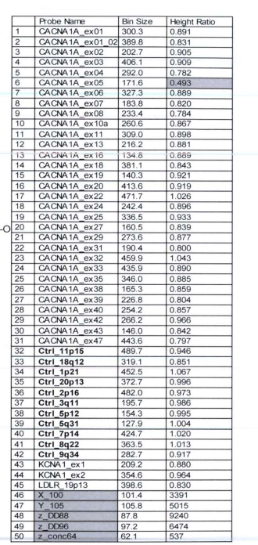

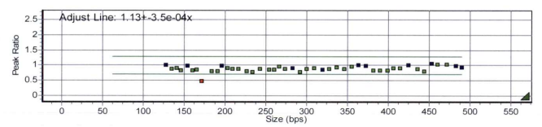
AD12; CACNA1A

Slide 19
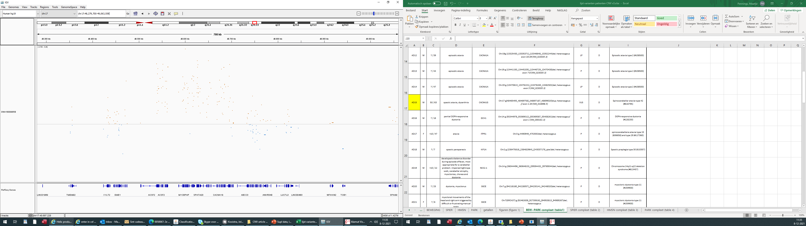
AD13; gain / 17q21.33 / ~227 kb
CACNA1G

Slide 20
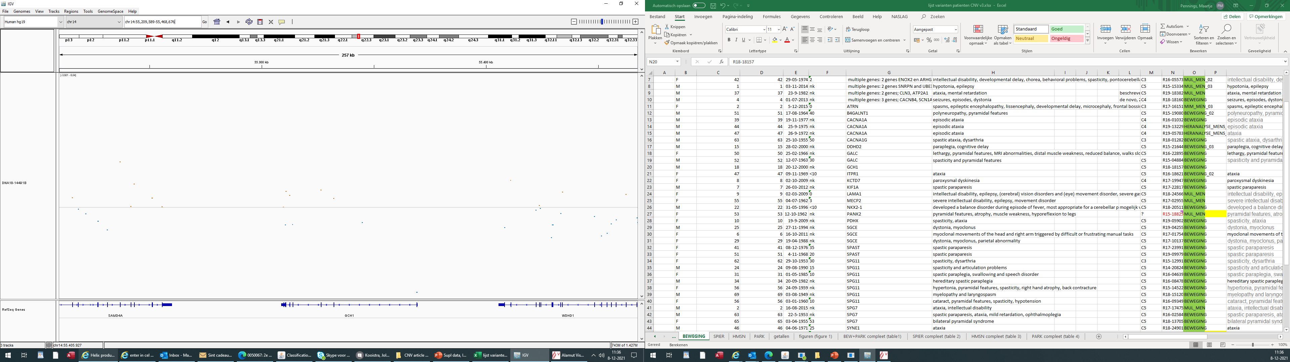
AD14; loss / 14q22.1 / ~375bp GCH1

Slide 21
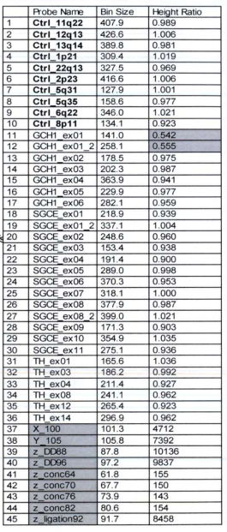
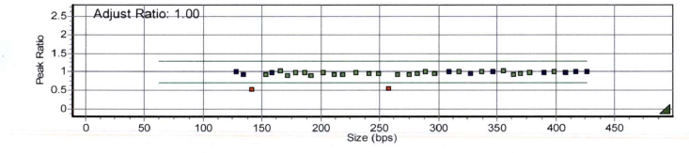
AD14; GCH1

Slide 22
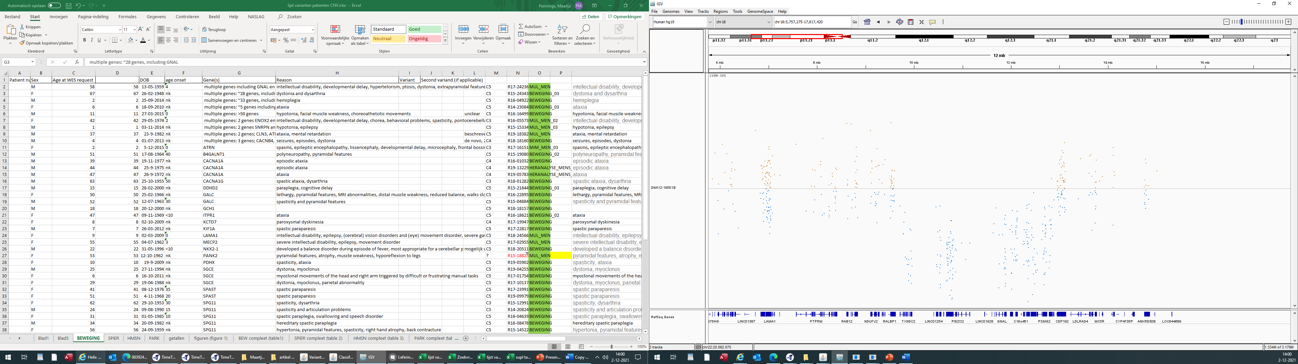
AD15; gain / 18p11.22p11.21 / ~3 mb
GNAL

Slide 23
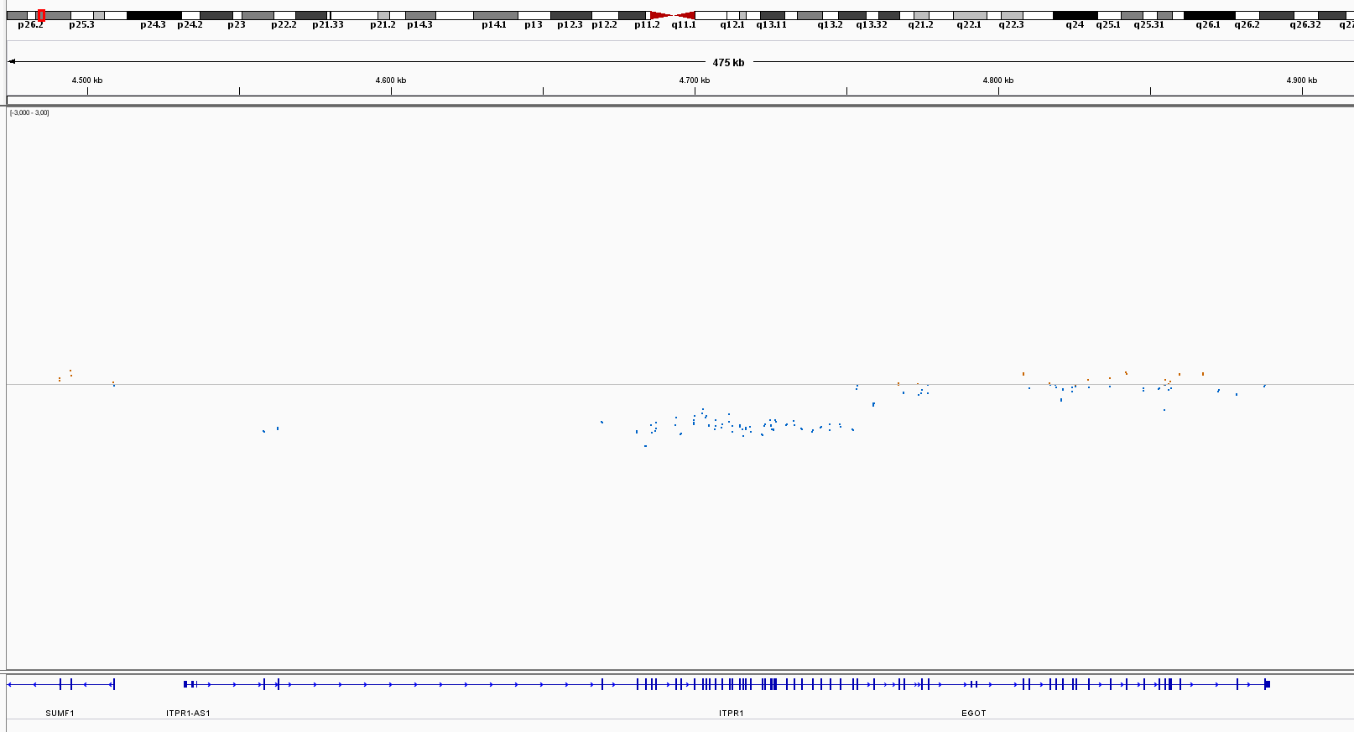
AD16; loss / 3p26~.1 / ~194 kb
ITPR1

Slide 24
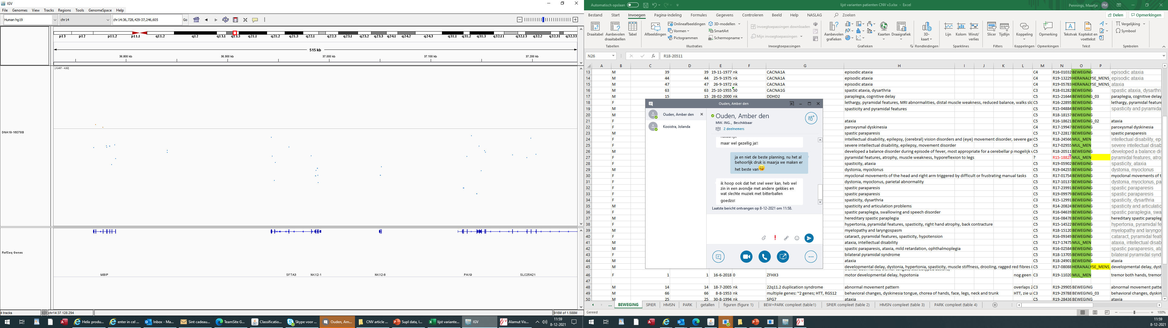
AD17; loss / 14q13.2q21.1 / ~3,5 mb
NKX2-1

Slide 25
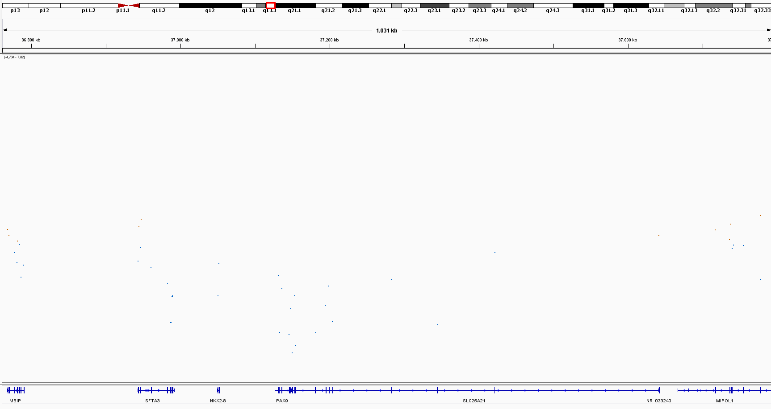
AD18; loss / 14q13.3 / ~361 kb
NKX2-1
NKX2-1

Slide 26
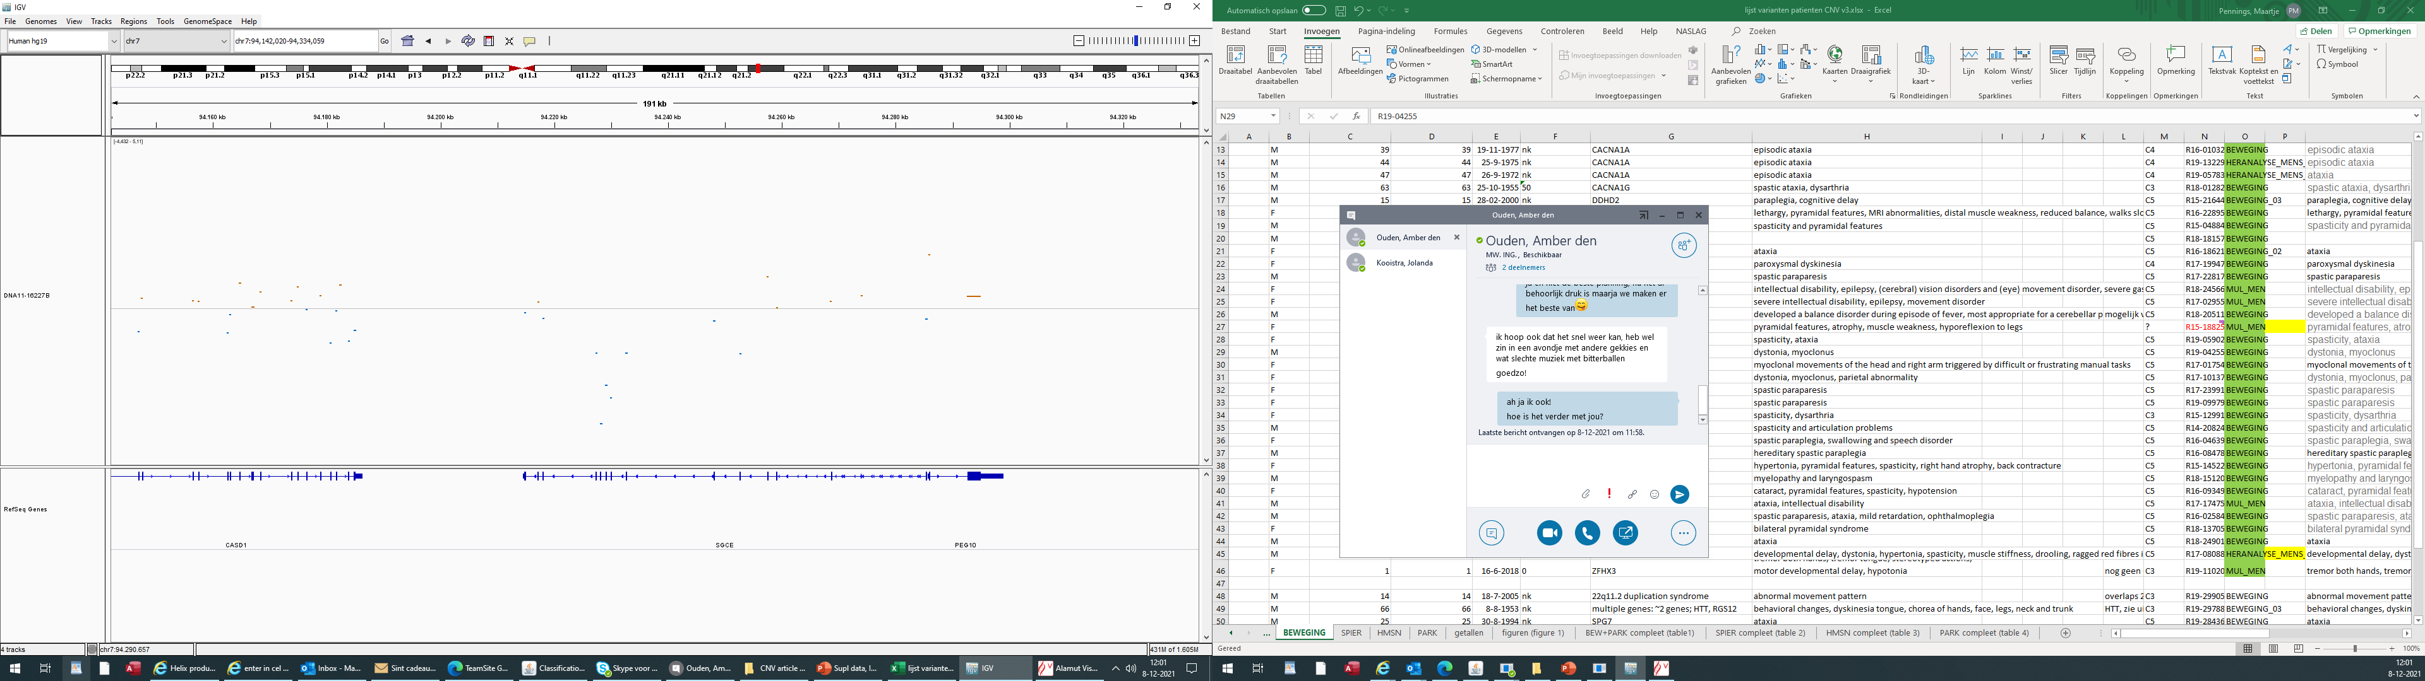
AD19; loss / 7q21.3 / ~2 kb
~SGCE

Slide 27
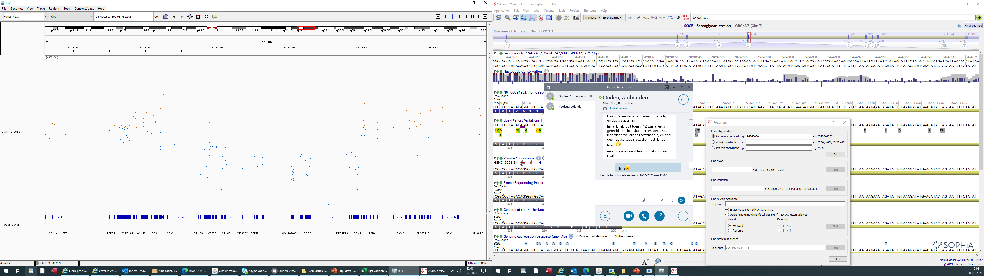
AD20; loss / 7q21.2q21.3 / ~2,2 mb
SGCE

Slide 28
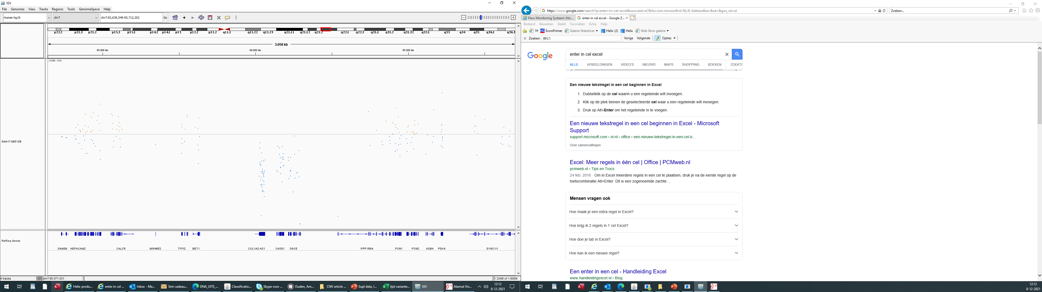
AD21; loss / 7q21.3 / ~516 kb
SGCE

Slide 29
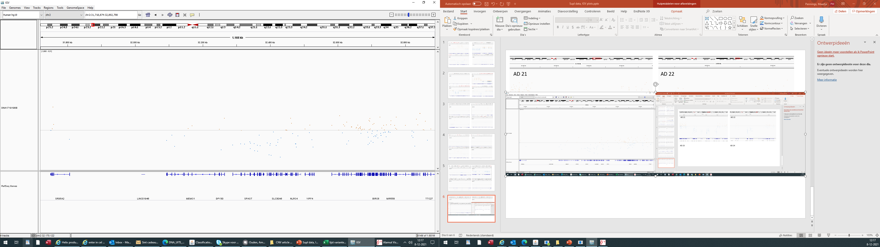
AD22; loss / 2p22.3 / ~160 kb
SPAST

Slide 30
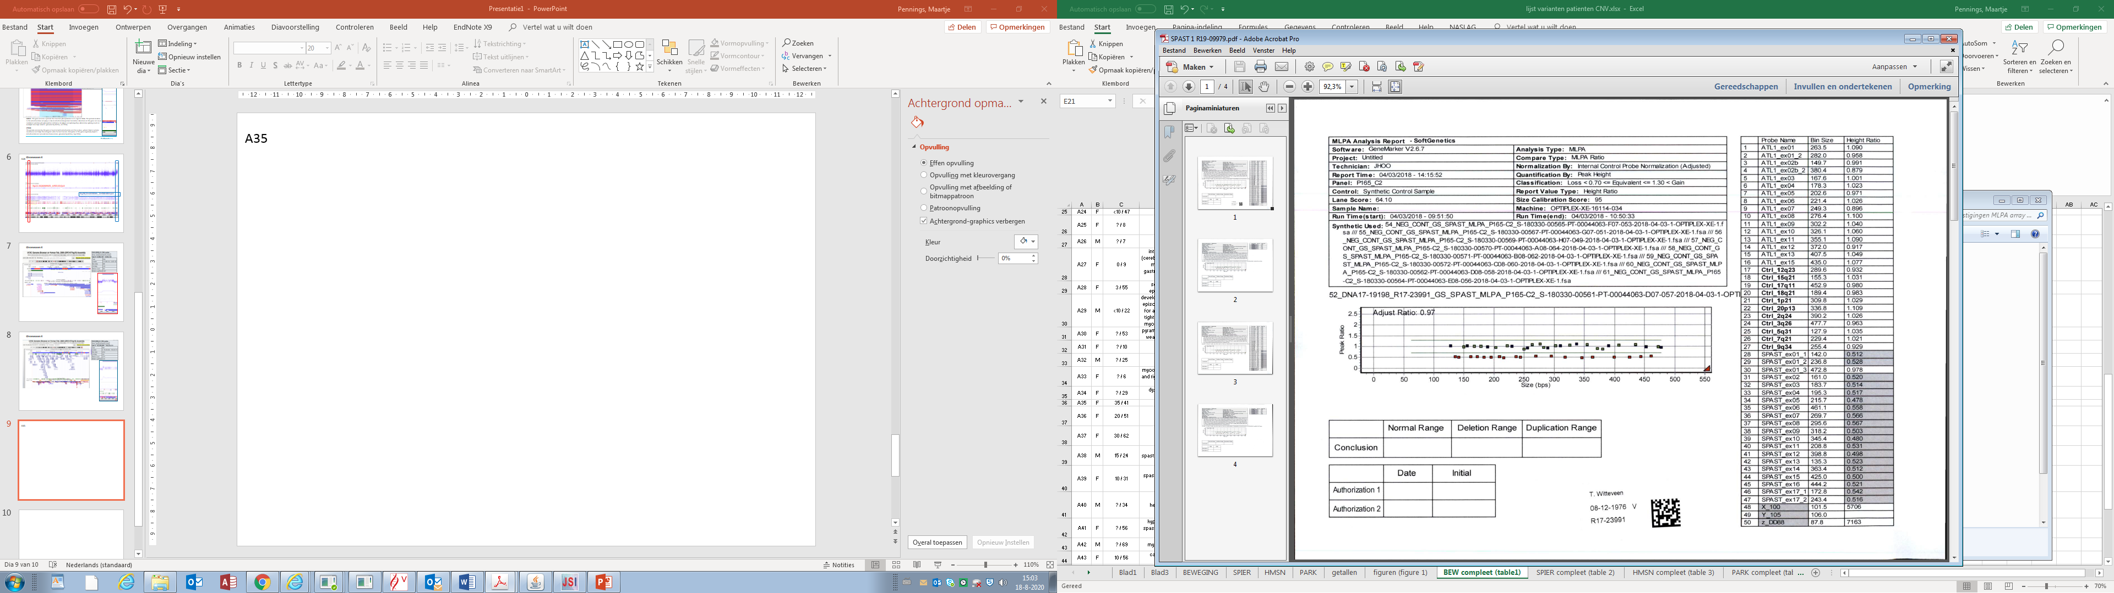
AD22; SPAST deletion

Slide 31
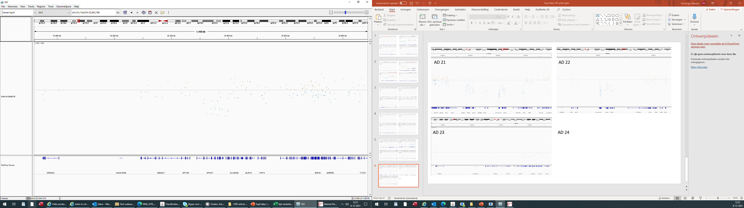
AD23; loss / 2p22.3 / ~88,005bp
SPAST

Slide 32
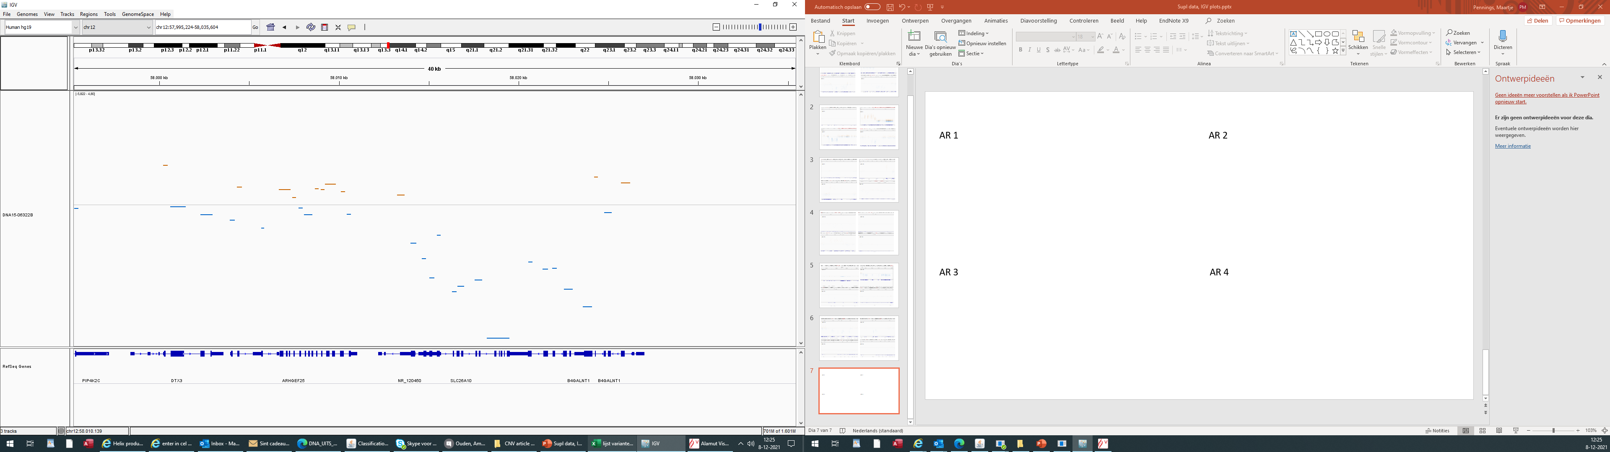
AR1; loss / 12q13.3 / ~10 kb
B4GALNT1

Slide 33
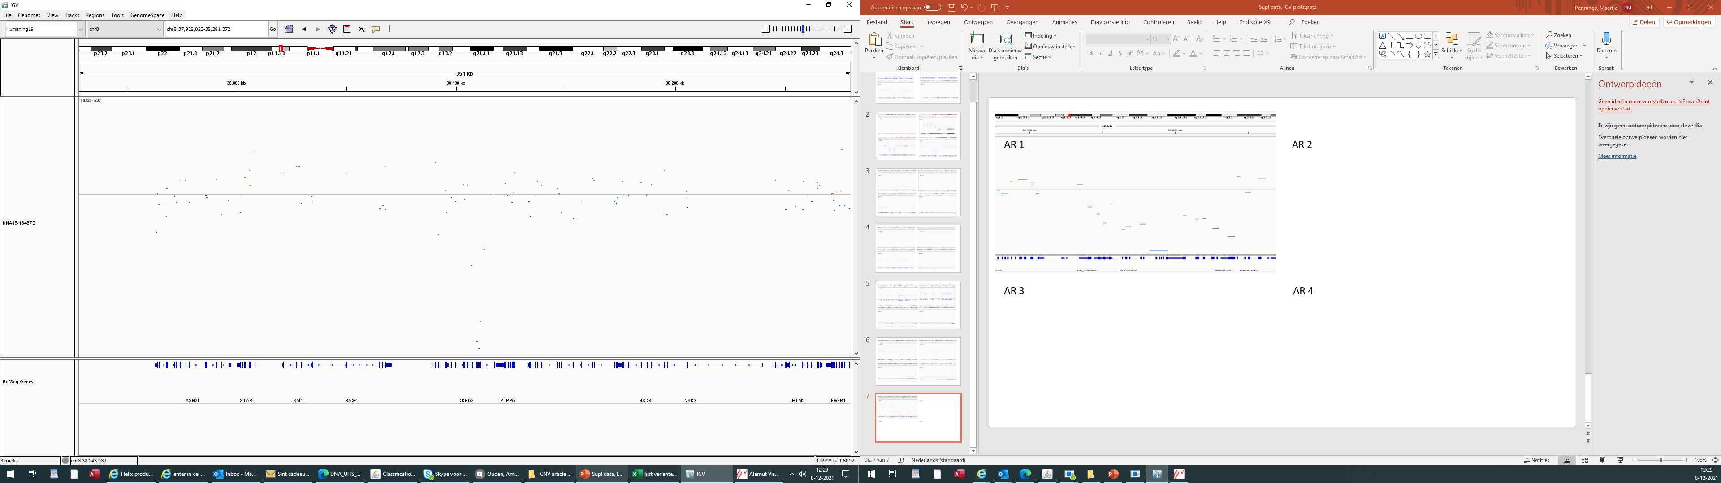
AR2; loss / 8p11.23 / ~5,7 kb
DDHD2

Slide 34
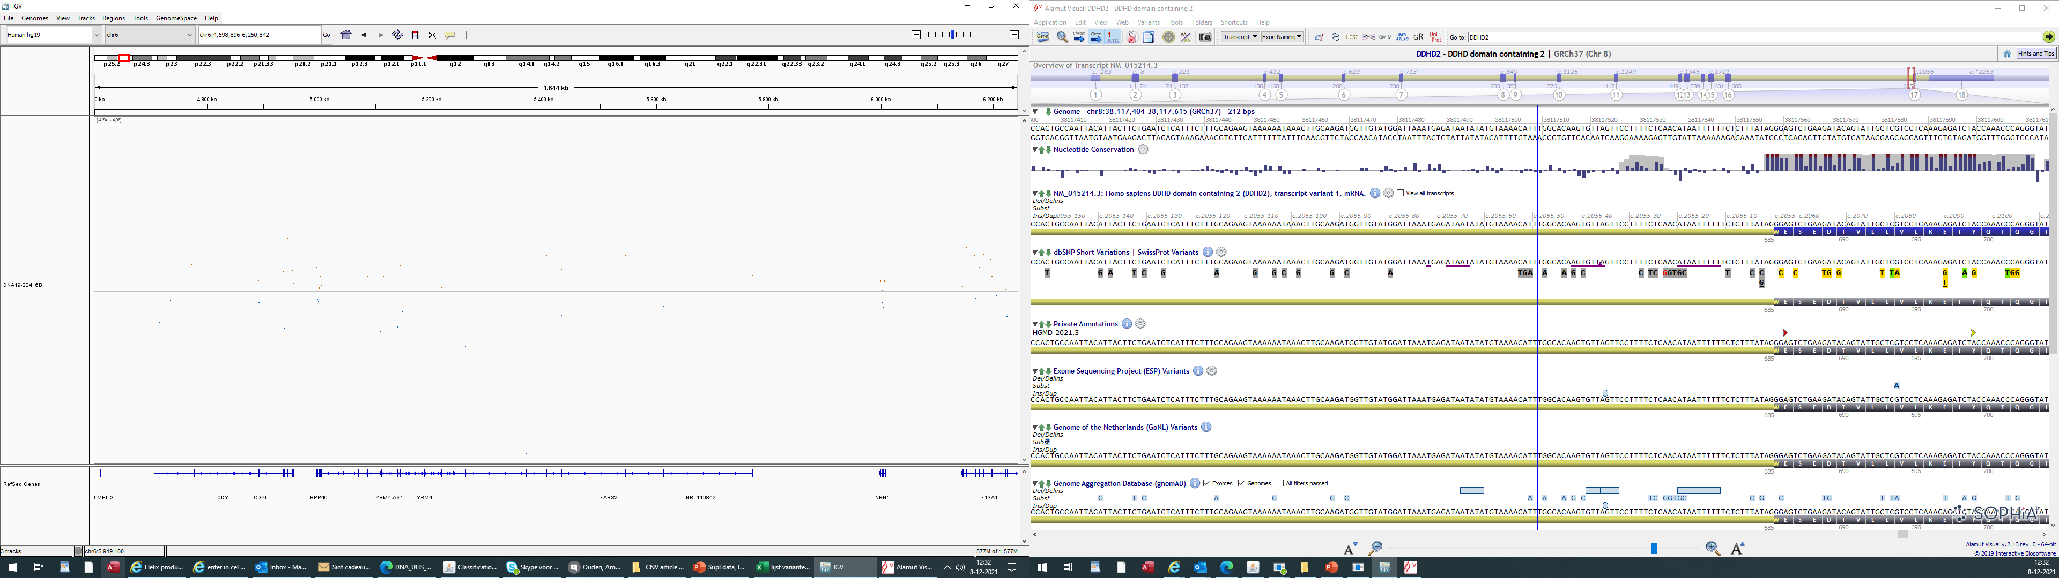
AR3; loss / 6p25.1 / ~670bp
FARS2

Slide 35
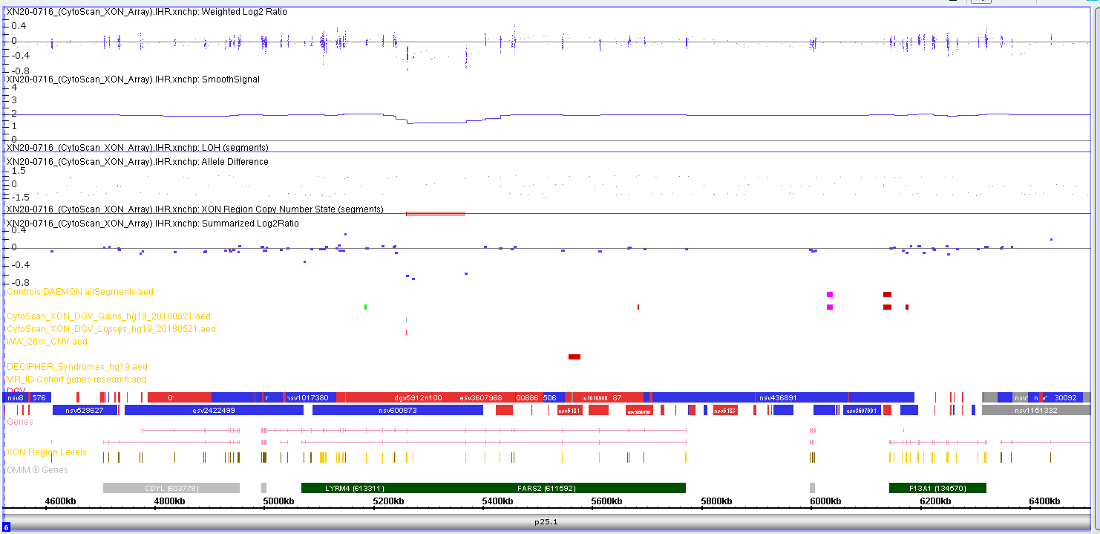
AR3; FARS2 deletion

Slide 36
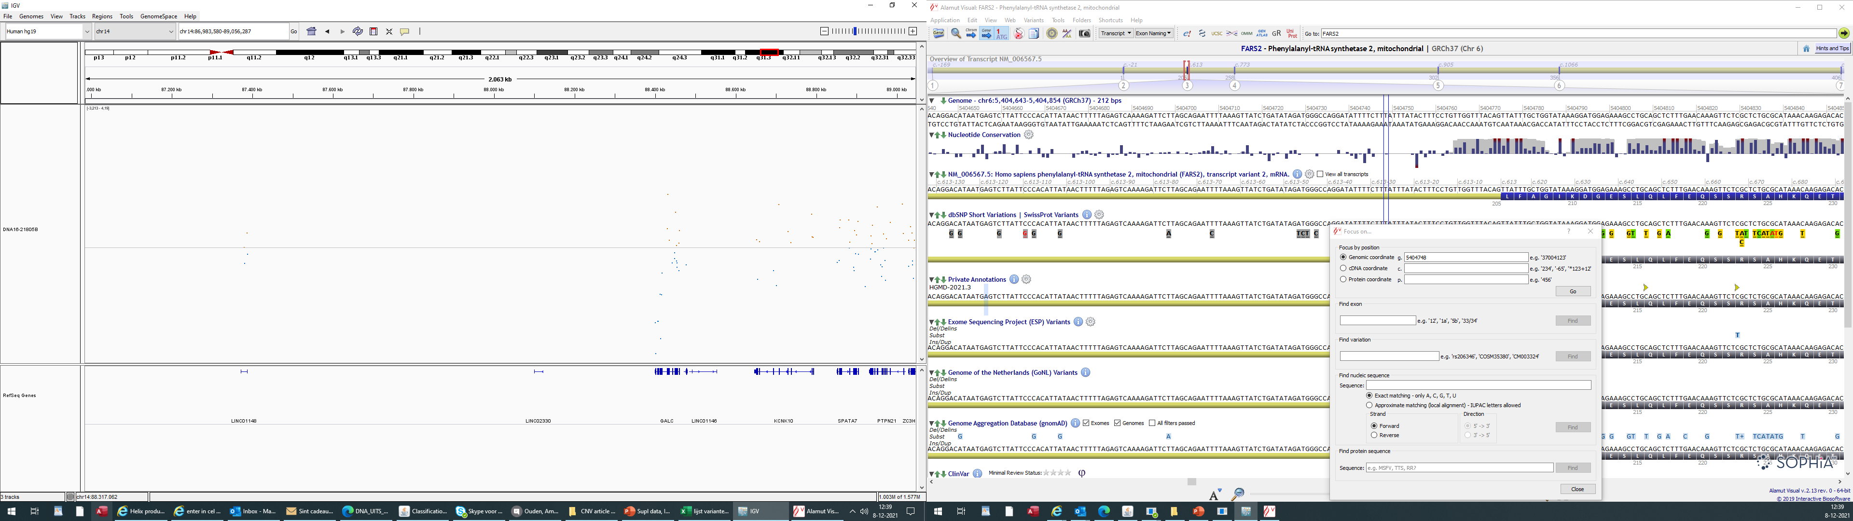
AR4; loss / 14q31.3 / ~15 kb
GALC

Slide 37
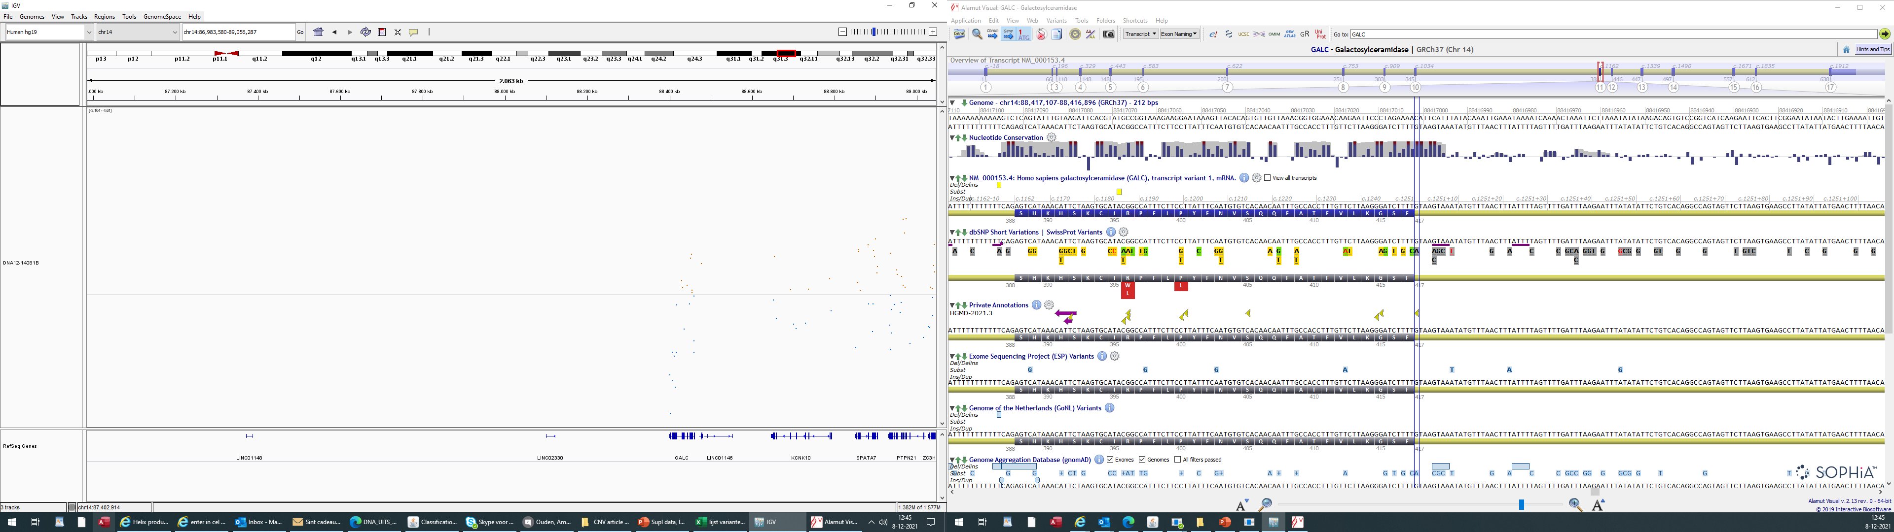
AR5; loss / 14q31.3 / ~16 kb
GALC

Slide 38
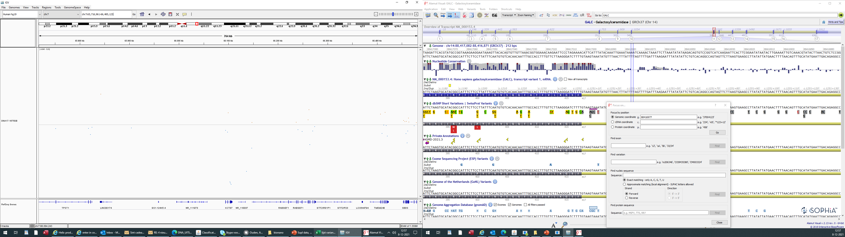
AR6; loss / 7q11.21 / ~4,9 kb
KCTD7

Slide 39
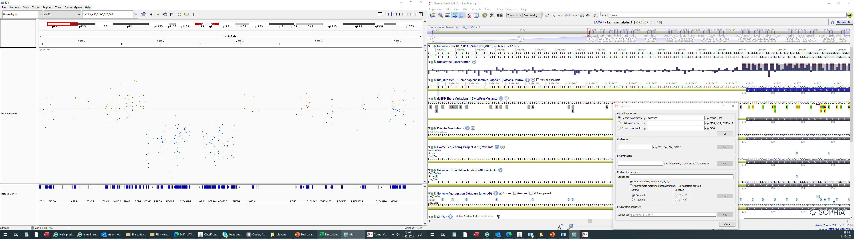
AR7; loss / 20p13 / ~1,1 mb
PANK2

Slide 40
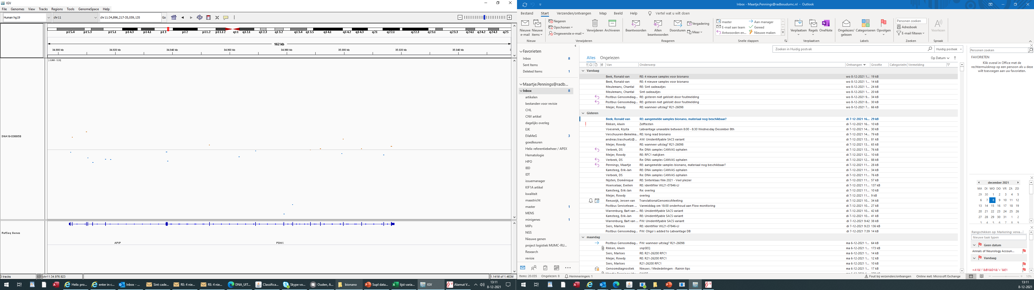
AR8; loss / 11p13 / ~3,1 kb
PDHX

Slide 41
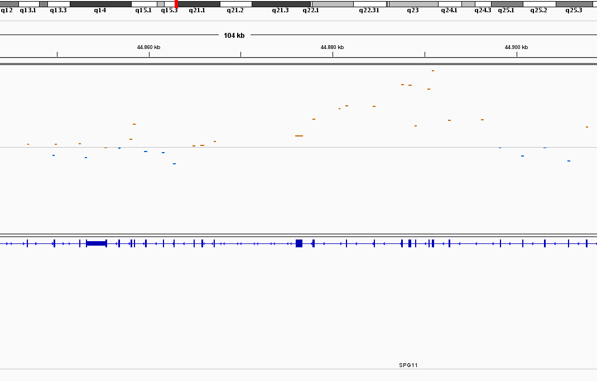
AR9; gain / 15q21.1 / ~18,5 kb
SPG11

Slide 42
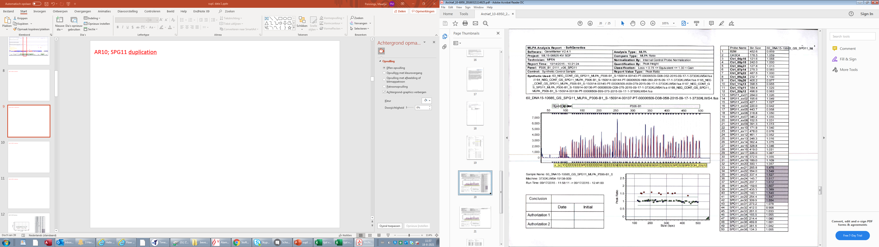
AR9; SPG11 duplication

Slide 43
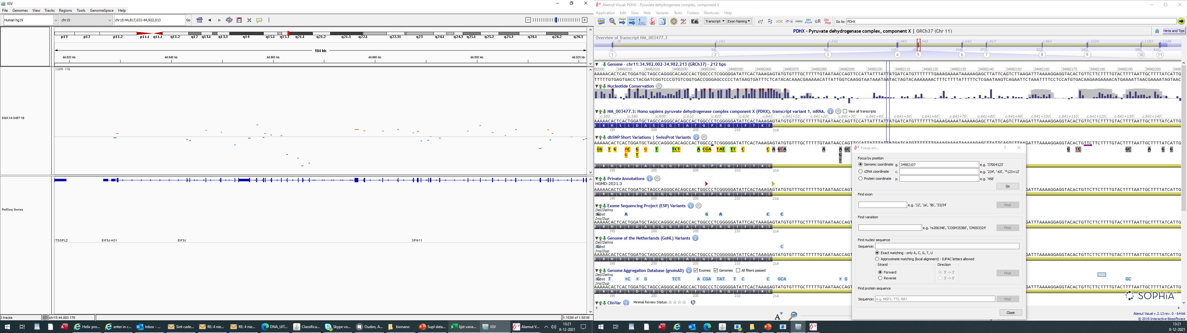
AR10 ; loss / 15q21.1 / ~4,5 kb
SPG11

Slide 44
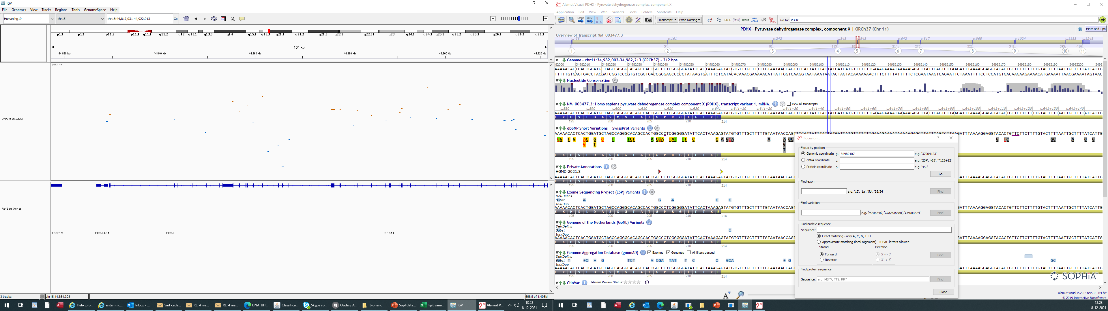
AR11; loss / 15q21.1 / ~4,6 kb
SPG11

Slide 45
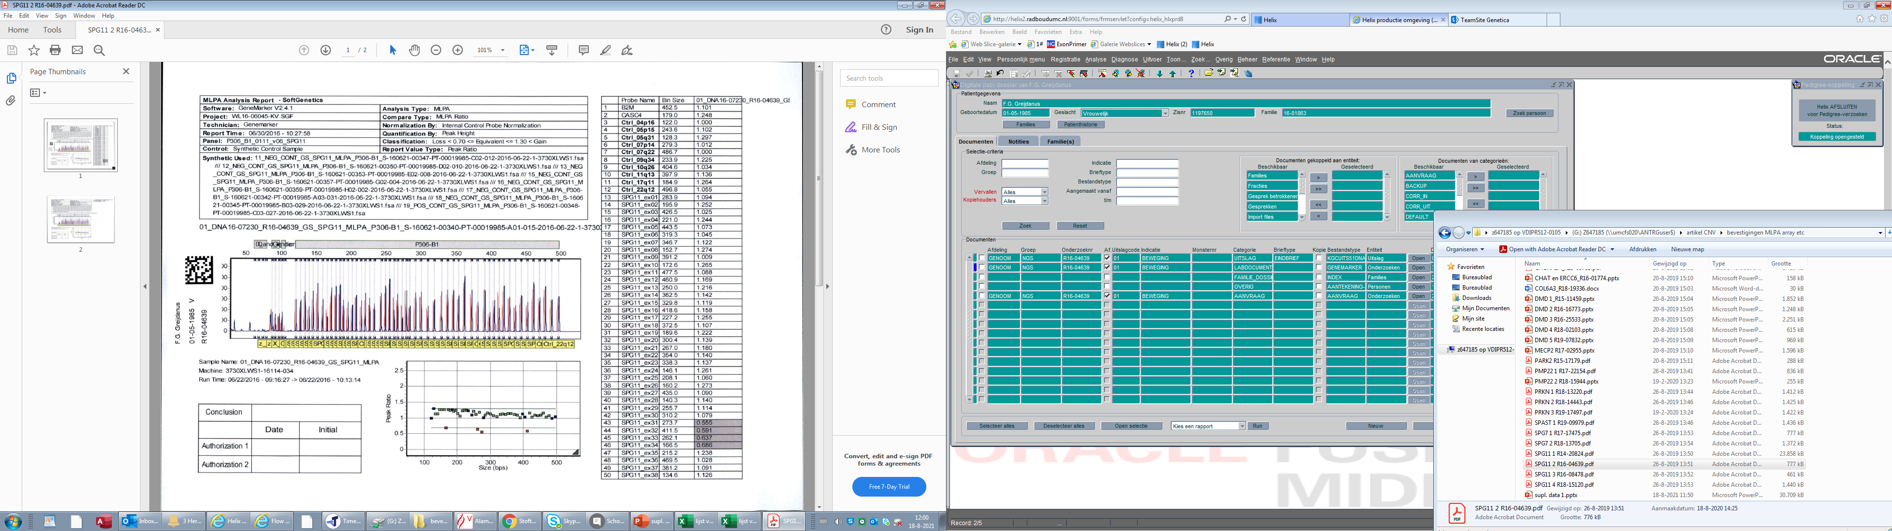
AR11; SPG11 deletion

Slide 46
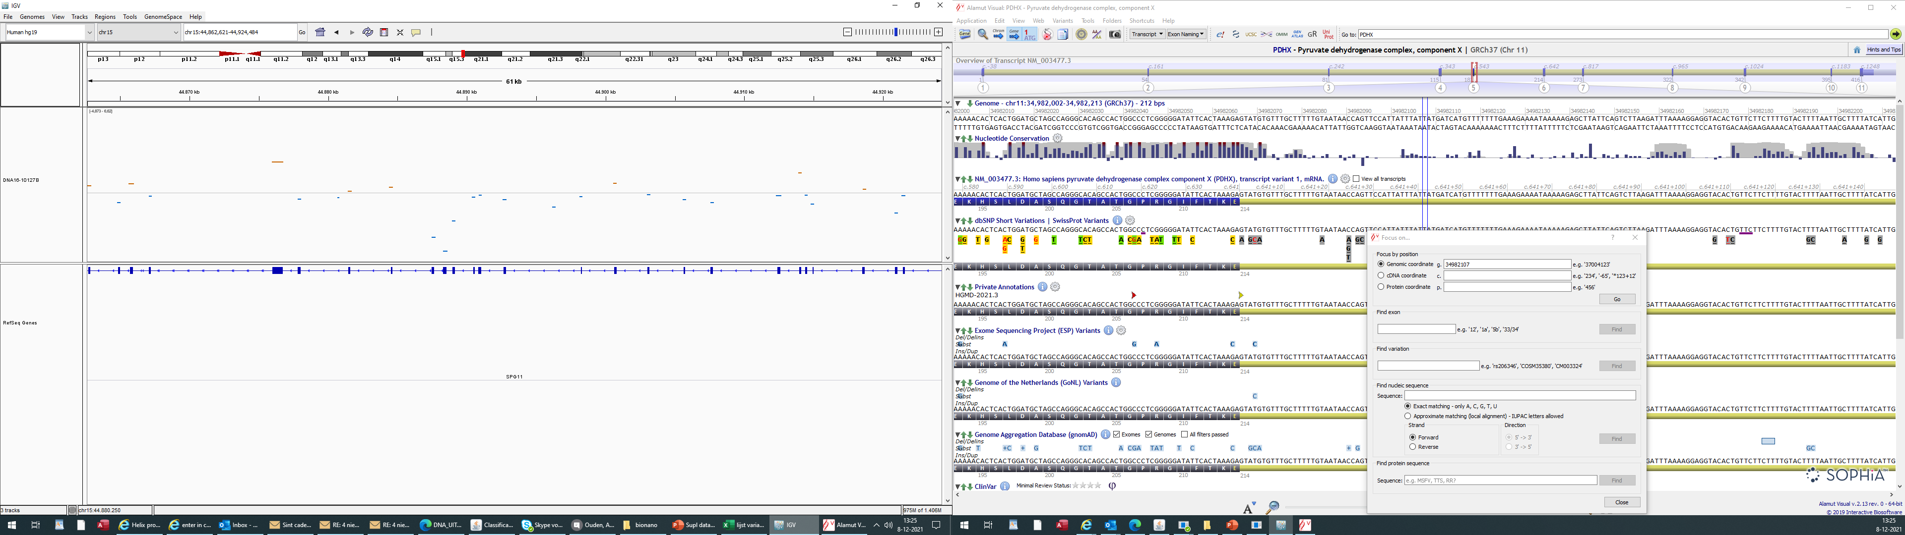
AR12; loss / 15q21.1 / ~1,6 kb
SPG11

Slide 47

AR12; SPG11 deletion

Slide 48

AR13; loss / 15q21.1 / ~4,6 kb
SPG11

Slide 49

AR14; loss / 15q21.1 / ~4,6 kb
SPG11

Slide 50

AR15; loss / 15q21.1 / ~4,6 kb SPG11

Slide 51

AR16; loss / 16q24.3 / ~25 kb
SPG7

Slide 52

AR16; SPG7 deletion

Slide 53

AR17; loss / 16q24.3 / ~25 kb
SPG7

Slide 54

AR18; loss / 16q24.3 / ~1,4 kb
SPG7

Slide 55

AR18; SPG7 deletion

Slide 56

AR19; loss / 16q24.3 / ~200bp
SPG7

Slide 57

AR19; SPG7 deletion

Slide 58

AR20; loss/ 6q25.2 / ~4,8 kb
SYNE1

Slide 59

AR21; loss / 22q11.21 / ~20 kb
TANGO2

Slide 60

AR22; loss / 6q26 / ~228 kb
PRKN

Slide 61


AR22; PRKN deletion

Slide 62

AR23; loss / 6q26 / ~81 kb
PRKN

Slide 63


AR23; PRKN deletion

Slide 64

AR24; gain / 6q26 / ~230bp
PRKN

Slide 65

AR24; PRKN deletion

Slide 66

AR25; loss 6q26 / ~61,6 kb
PRKN

Slide 67

AR25; PRKN deletion

Slide 68

AR26; loss / 6q26 / ~300bp
PRKN

Slide 69

AR26; PRKN deletion

Slide 70

AR27; loss / 6q26 / ~240bp PRKN

Slide 71


AR27; PRKN deletion

Slide 72
Muscle Disorders Patients (B)

Slide 73

BD1; gain / 22q11.21 / ~2,5 mb
22q11.2 duplication

Slide 74


BD1; 22q11.2 duplication
index (CNV in WES) and parents (array)
index
mother
father

Slide 75

BD2; loss / 22q11.21 / ~2,6 mb
22q11.2 deletion

Slide 76

BD3; gain / 16p13.11 / ~1,3 mb
16p13.11 duplication

Slide 77

BD4; loss / 18p11.31 / ~506 kb
7 genes ;including SMCHD1 (partially)

Slide 78

BD5; loss / 15q15.1 / ~8 kb
CAPN3

Slide 79

BD6; loss / 2q37.3 / ~8 kb
COL6A3

Slide 80

BD6; COL6A3 duplication
index
mother
father
MQ

Slide 81

BD7; gain / 2q37.3 / ~2 kb
COL6A3

Slide 82

BD8; gain / 17p12 / ~1,3 mb
PMP22

Slide 83

BR1; loss / 10q11.22q11.23 / ~4,2 mb
multiple genes including CHAT, OGDHL and ERCC6

Slide 84

BR2; loss / 17q25.3 / ~230bp
GAA

Slide 85

BR3; gain / 22q12.3 / ~63 kb
LARGE1

Slide 86

BR4; loss / 2q23.3 / ~115 kb
NEB

Slide 87

BR5; loss / 13q13.12 / ~125bp
SGCG

Slide 88

BR5; SGCG deletion

Slide 89

BR6; loss / 2q31.2 / ~47 kb
TTN

Slide 90

BR7; gain / 2q31.2 / ~44 kb
TTN

Slide 91


BR7; TTN duplication
Primers: TGATTTCATTTATTTGTGGTGATGTGT
AGCAGCAACTTCCCCTTTCC
Set 1
Set 2
Patient
Patient
Patient
Patient
NEG1
NEG2
MQ
NEG2
NEG1
MQ

Slide 92

BX1; loss / Xq28 / ~237 kb
3 genes; MTM1, MTMR1, and CD99L2

Slide 93

BX2; loss / Xp21.1 / ~287 kb
DMD

Slide 94

BX3; loss / Xp21.2 / ~206 kb
DMD

Slide 95

BX3; DMD deletion(1/2)

Slide 96



BX3; DMD deletion(2/2)

Slide 97

BX4; loss / Xp21.1 / ~93 kb
DMD

Slide 98


BX4; DMD deletion (1/2)
X chromosome

Slide 99


BX4; DMD deletion (2/2)
X chromosome

Slide 100

BX5; gain / Xp21.1 / ~44 kb and ~0,5 mb
DMD

Slide 101

BX6; loss / Xp21.1 / ~0,5 mb
DMD

Slide 102

BX6; DMD deletion (1/3)
Chromosome X

Slide 103


BX6; DMD deletion (2/3)
Chromosome X
CNV in exome data
DMD gene

Slide 104



BX6; DMD deletion (3/3)

Slide 105

BX7; loss / Xp21.1 / ~148 kb
DMD

Slide 106




BX7; DMD deletion
Chromosome X
son
mother

Slide 107

BX8 ; loss / Xp21.1 / ~0,5 mb
DMD

Slide 108
Neuropathies Patients (C)

Slide 109

CD1; gain / 2p13.2 / ~608 kb
multiple genes including DCTN1

Slide 110

CD2; loss / 17p12 / ~1,3 mb
PMP22

Slide 111

CD3; loss / 17p12 / ~1,3 mb
PMP22

Slide 112

CD4; gain / 17p12 / ~1,3 mb
PMP22

Slide 113

CD5; gain / 17p12 / ~1,3 mb
PMP22

Slide 114

CD6; gain / 17p12 / ~1,3 mb
PMP22

Slide 115

CD7; gain / 17p12 / ~1,3 mb
PMP22
CD 8

Slide 116

CD8; gain / 17p12 / ~1,3 mb
PMP22

Slide 117

CD8; PMP22 duplication

Slide 118

CD9; gain / 17p12 / ~1,3 mb
PMP22

Slide 119

CD10; gain / 17p12 / ~1,3 mb
PMP22

Slide 120

CD11; gain / 17p12 / ~1,3 mb
PMP22

Slide 121

CD12; gain / 17p12 / ~1,3 mb
PMP22

Slide 122

CD13; gain / 17p12 / ~1,3 mb
PMP22

Slide 123

CD13; PMP22 duplication (1/2)
Chromosome 17

Slide 124



CD13; PMP22 duplication (2/2)

Slide 125

CD14; gain / 17p12 / ~1,3 mb
PMP22

Slide 126

CR1; loss / 6p25.1 / ~328 kb
FARS2

