Slide 1
Vinavirales (former PM2-like group)
79
HGV-1
100
20
PM2 MCP 2017 marine metagenome gene 13 CEPX01414995 10026
70
B PV Phycisphaeraceae bacterium NQV32911
99
91
B PV Sedimentisphaerales bacterium MBN1360960
82
B Pr Halothiobacillaceae bacterium HER34048
B PV Phycisphaerae bacterium NLZ06667
PM2 MCP 2017 marine sediment metagenome gene 10 LAZR01002459 10745
85
100
B PV Planctomycetes bacterium OHB60882
84
92
PM2 MCP 2017 B PV Planctomyc bacterium OHB60882 MHYD01000052 10767
29
B_PV, B_Pr
B PV Opitutus MBA3849344
59
B PV Opitutaceae bacterium MBC7367169
6
B PV Verrucomicrobia bacterium PYJ83067
96
86
B PV Opitutaceae bacterium EIP96806
99
52
B PV Opitutaceae bacterium AHF94460
96
B PV Geminisphaera colitermitum WP 157837245
B PV Coraliomargarita sinensis WP 110130629
43
B PV Opitutaceae bacterium MBW7895156
20
100
HGV-2
81
98
B Pr Thioclava dalianensis WP 143081740
93
PM2 MCP 2017 B Pr Thioclava dalianensis SFN65155 FOVB01000008 122389
94
B Pr Rhodobacteraceae bacterium MBI1220137
B Pr Rhodobacterales bacterium PIE10513
99
97
B Pr Pseudohalocynthiibacter aestuariivivens WP 165192248
B Pr Roseicyclus MBO6603851
99
100
B Pr Thalassospira MBO6807246
PM2 MCP 2017 B Pr Thalassospira KZD05164 LPXL01000015 300147
100
B Pr Kiloniella spongiae WP 047763393
87
PM2 MCP 2017 B Pr Kiloniella spongiae KLN61312 LAQL01000004 260778
B Pr Micavibrio aeruginosavorus PZO86538
99
88
HGV-3
100
B Pr Magnetovibrio blakemorei WP 069959156
PM2 MCP 2017 B Pr Magnetovibrio blakemorei OEJ64654 MCGG01000067 79558
97
B Pr Terasakiella WP 135077682
84
B Pr Rhodospirillaceae bacterium MBB59029
76
0
B Pr Kiloniella majae WP 085908074
PM2 MCP 2017 B Pr Kiloniella majae WP 085908074
99
Pseudoalteromonas phage PM2 etc
59
90
Vibrio phage etc
91
93
B_Pr
0.2
HGV stands for human gut Vinavirales
trees and the alignments used for tree construction are here:
https://ftp.ncbi.nih.gov/pub/yutinn/Vinavirales_2022/trees/

Slide 2
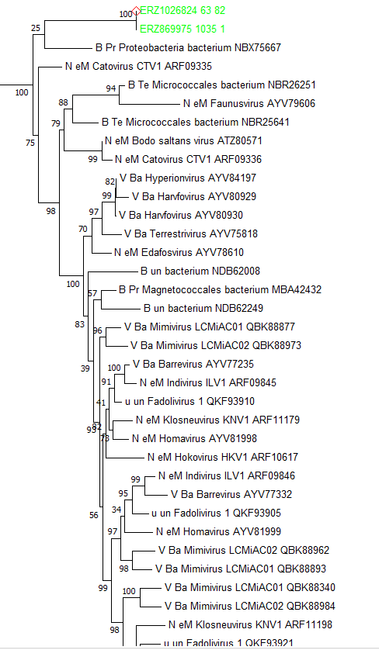
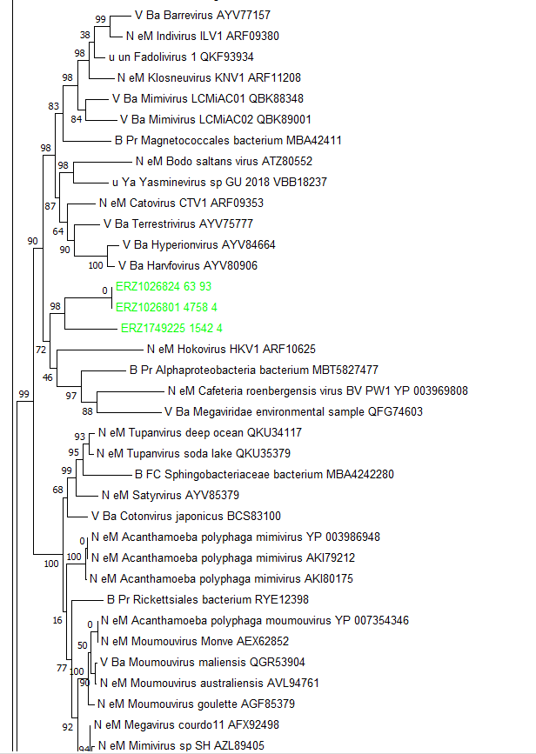
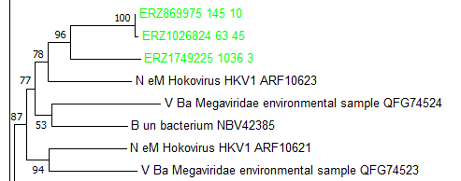
Nucleocytoviricota- Klosneuvirinae
NCLDV_MCP tree, subtrees containing HGM MCPs are shown
NCLDV_A1
NCLDV_A2
NCLDV_A3

Slide 3
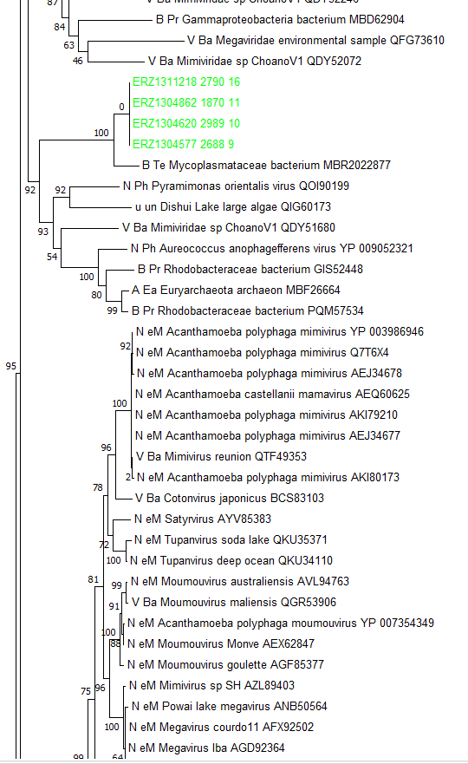
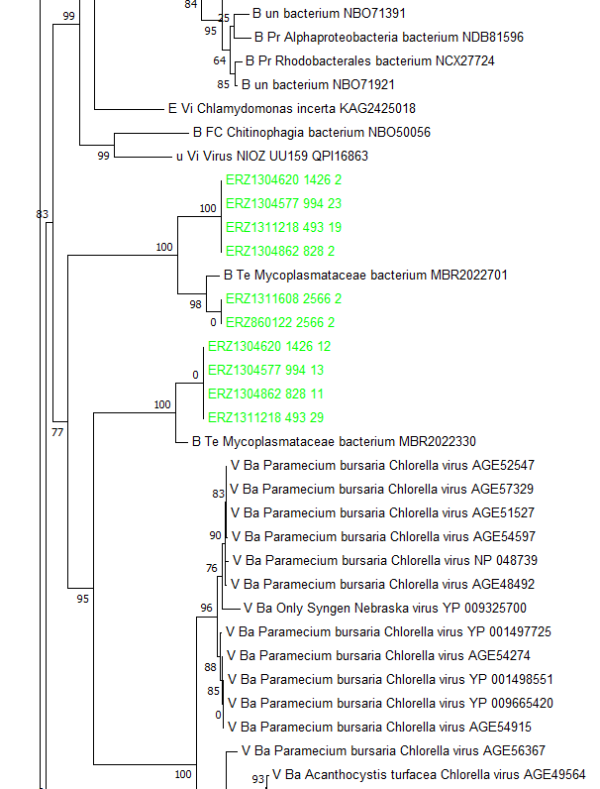
Nucleocytoviricota Phycodnaviridae
NCLDV_B
(ruminant gut metagenome - sheep)
NCLDV_C1
(gut metagenome)
NCLDV_D
NCLDV_C2
(gut metagenome)

Slide 4
Virophages
86
virophages (Mavirus, Sputnik, OLV, YSLV)
85
B Ba Candidatus Dependentiae RTL06738
100
B Ba Candidatus Dependentiae RTL06737
B PV Planctomycetaceae bacterium MAV34271
77
B Pr Rhodospirillales bacterium HIN76173
99
B Pr Gammaproteobacteria bacterium HIO76485
100
B Ba Candidatus Poribacteria HIA67088
0
ERZ1304421 2169 1
viro_A
ERZ919573 23775 9
100
ERZ913512 1301 9
ERZ918291 72395 3
0
ERZ827181 2981 3
viro_B
0
ERZ857629 7791 6
100
ERZ918241 106594 2
99
99
V Ba Adintovirus DAD57247
viro_C
92
V Ba Adintovirus DAD55538
0
ERZ1688035 1451 11
MCP Gut AUXO016736138
100
MCP Gut AUXO011975871
90
0
u un Sheep rumen MELD virus DAC81710
MCP Gut AUXO014937588
98
100
B FC Paludibacteraceae bacterium MBP5421534
MCP Gut AUXO014598981
94
A Ea Methanobrevibacter MBO7209396
65
B FC Paludibacteraceae bacterium MBO4531767
96
u un Bovine rumen MELD virus DAC81502
98
88
MCP Gut AUXO017923253
MCP Gut AUXO012213446
100
A Ea Methanobrevibacter MBO7713100
0.50
4
MCP Gut AUXO014440522

Slide 5
‘fish_PLV’ group
ERZ1754015 74 5
83
ERZ1749270 64 7
ERZ1749929 182 5
80
ERZ1753579 41 4
ERZ1749224 121 4
ERZ1753755 190 3
100
ERZ1749941 32 7
ERZ1753246 59 5
97
ERZ920947 6264 3
ERZ1749594 151 4
99
24
E Op Pimephales promelas KAG1925880
E Op Triplophysa tibetana KAA0701651
5
99
V Ba Pimephales minnow adintovirus DAC81398
E Op Carassius auratus XP 026105673
B Pr Candidatus Enterovibrio WP 150149504
100
E Op Thalassophryne amazonica XP 034019525
25
11
E Op Scophthalmus maximus KAF0029442
29
37
E Op Simochromis diagramma XP 039887838
E Op Oryzias melastigma XP 024117193
89
91
E Op Lucifuga dentata KAF7650868
24
71
V Ba Larimichthys croaker adintovirus DAC81312
100
E Op Takifugu flavidus TWW54006
E Op Takifugu flavidus TWW77441
E Op Gasterosteus aculeatus XP 040024525
V Ba Astyanax tetra cavefish adintovirus DAC81255
E Op Colossoma macropomum XP 036417034
100
63
E Op Colossoma macropomum XP 036416489
E Op Colossoma macropomum XP 036421416
99
E Op Erpetoichthys calabaricus XP 028646145
E Op Polypterus senegalus XP 039597116
99
32
E Op Xenopus tropicalis XP 031757214
100
E Op Xenopus laevis XP 041420041
99
E Op Bufo bufo XP 040263300
E Op Xenopus tropicalis XP 031749718
99
E Op Erpetoichthys calabaricus XP 028647707
99
E Op Erpetoichthys calabaricus XP 028646286
100
100
E Op Lepisosteus oculatus XP 015200282
E Op Lepisosteus oculatus XP 006630736
99
E Op Chelonoidis abingdonii XP 032638418
16
94
V Ba Terrapene box turtle adintovirus DAC80297
9
98
E Op Gavialis gangeticus XP 019379375
E Op Alligator mississippiensis XP 014449290
89
E Op Paroedura picta GCF56325
98
E Op Paroedura picta GCF60098
E Op Geotrypetes seraphini XP 033788773
34
99
E Op Chrysemys picta XP 042702048
E Op Gopherus evgoodei XP 030395305
94
E Op Sceloporus undulatus XP 042300550
97
E Op Python bivittatus XP 015745936
99
99
E Op Thamnophis elegans XP 032091720
E Op Thamnophis sirtalis XP 013928795
0.10

Slide 6
‘Bam’ group
92
93
Bacillus phages Wip1, AP50
2017 B Te Exiguobacterium antarcticum WP 026829758
0
ERZ914449 88250 21
98
100
ERZ1742613 2111 4
100
V Ba Tectiviridae DAI59056
76
99
ERZ914926 12076 26
ERZ989851 57377 13
2017 B Te Clostridium OFU26266 LWPF01000172 8527
54
98
B Te Oscillospiraceae bacterium MBR4870275
Bam_A
96
B Te Clostridia bacterium MBQ7289035
3
ERZ914744 40342 10
73
B Te Oscillospiraceae bacterium MBE7054407
47
V Ba Tectiviridae DAG98324
100
V Ba Tectiviridae sp cthzn51 DAD73633
2017 BAC RED KX984131 8754
79
94
92
B Ba candidate division MBT9175187
2017 B en uncultured bacterium APG79844 KX984138 2997
89
B Te Brevibacillus antibioticus WP 137033716
21
2017 B Te Brevibacillus EJL42505 AKKB01000094 13935
98
V Ba Thermus phage phiKo AYJ74688
93
E Op Wuchereria bancrofti VDM09665
Bam_B
100
ERZ1304317 5267 3
66
89
2017 B Te Sulfobacillus thermosulfidooxidans WP 020374112
B Te Sulfobacillus WP 103374636
100
B Te Sulfobacillus benefaciens PSR33025
71
B Te Sulfobacillus acidophilus AEJ41352
65
B Te Sulfobacillus WP 169101821
2017 B en uncultured bacterium APG79854
31
2017 Alicyclobacillus NZ BCQV01000066 11264
85
2017 Alicyclobacillus JXBW01000023 42929
99
2017 B Te Alicyclobacillus acidoterrestris WP 021297460
Toil group
0.20

Slide 7
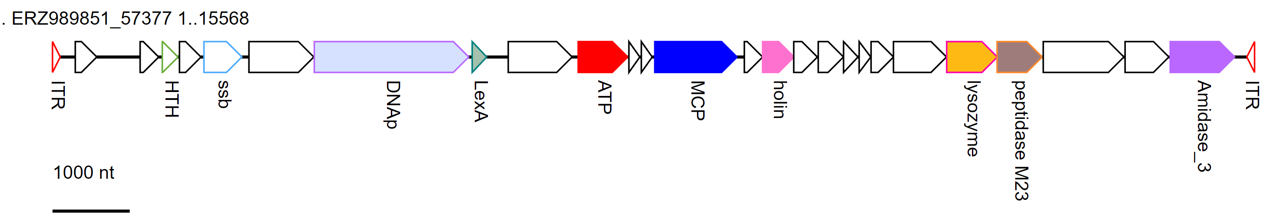
‘Bam’ group, representative genome

