Slide 1
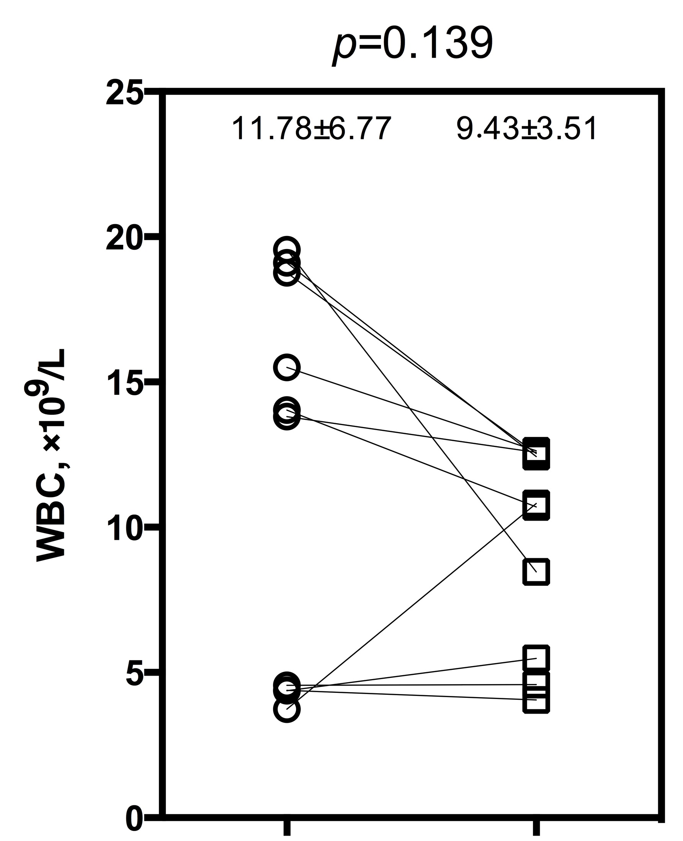
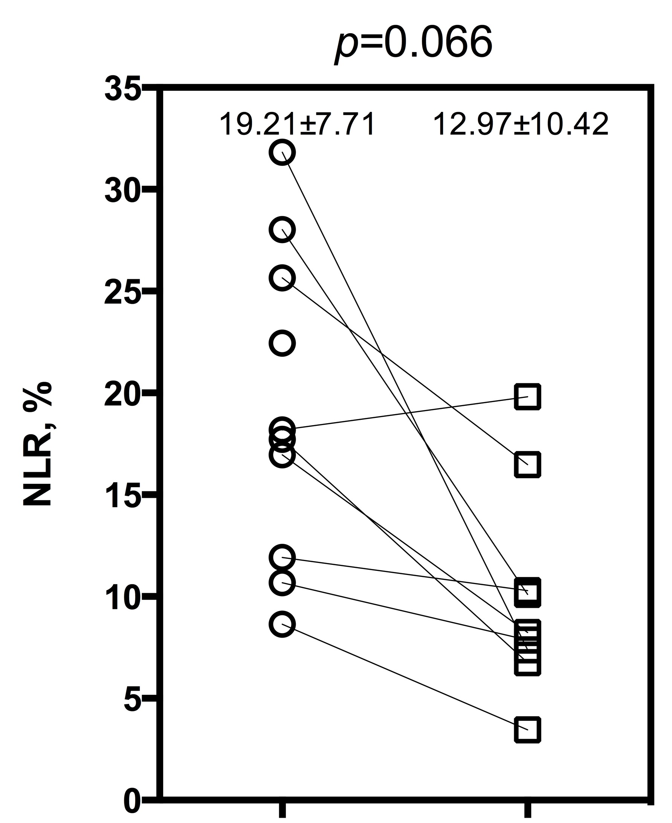
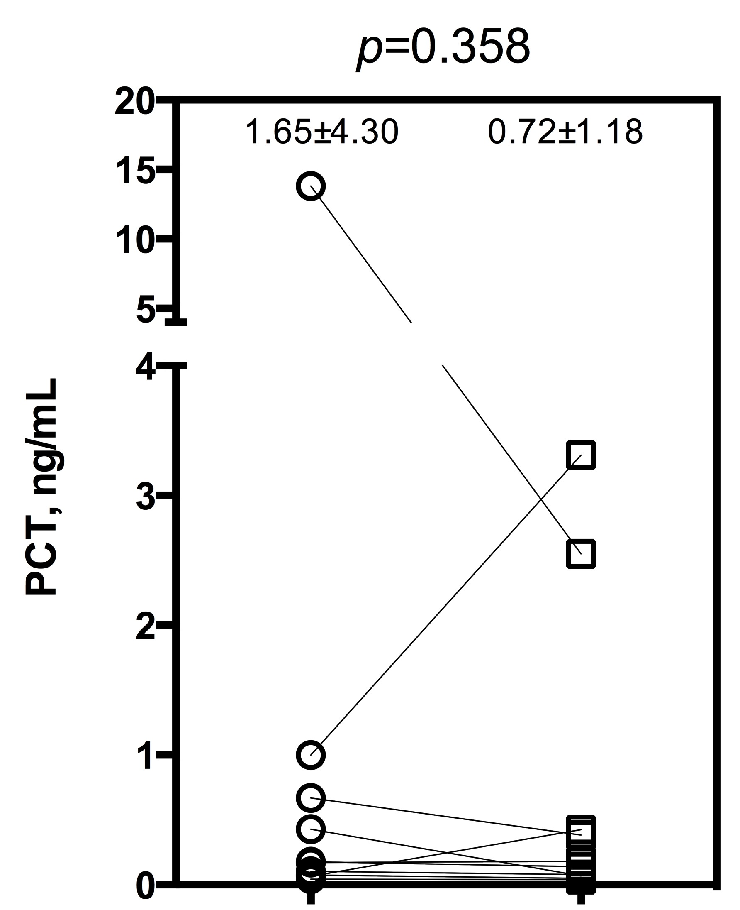
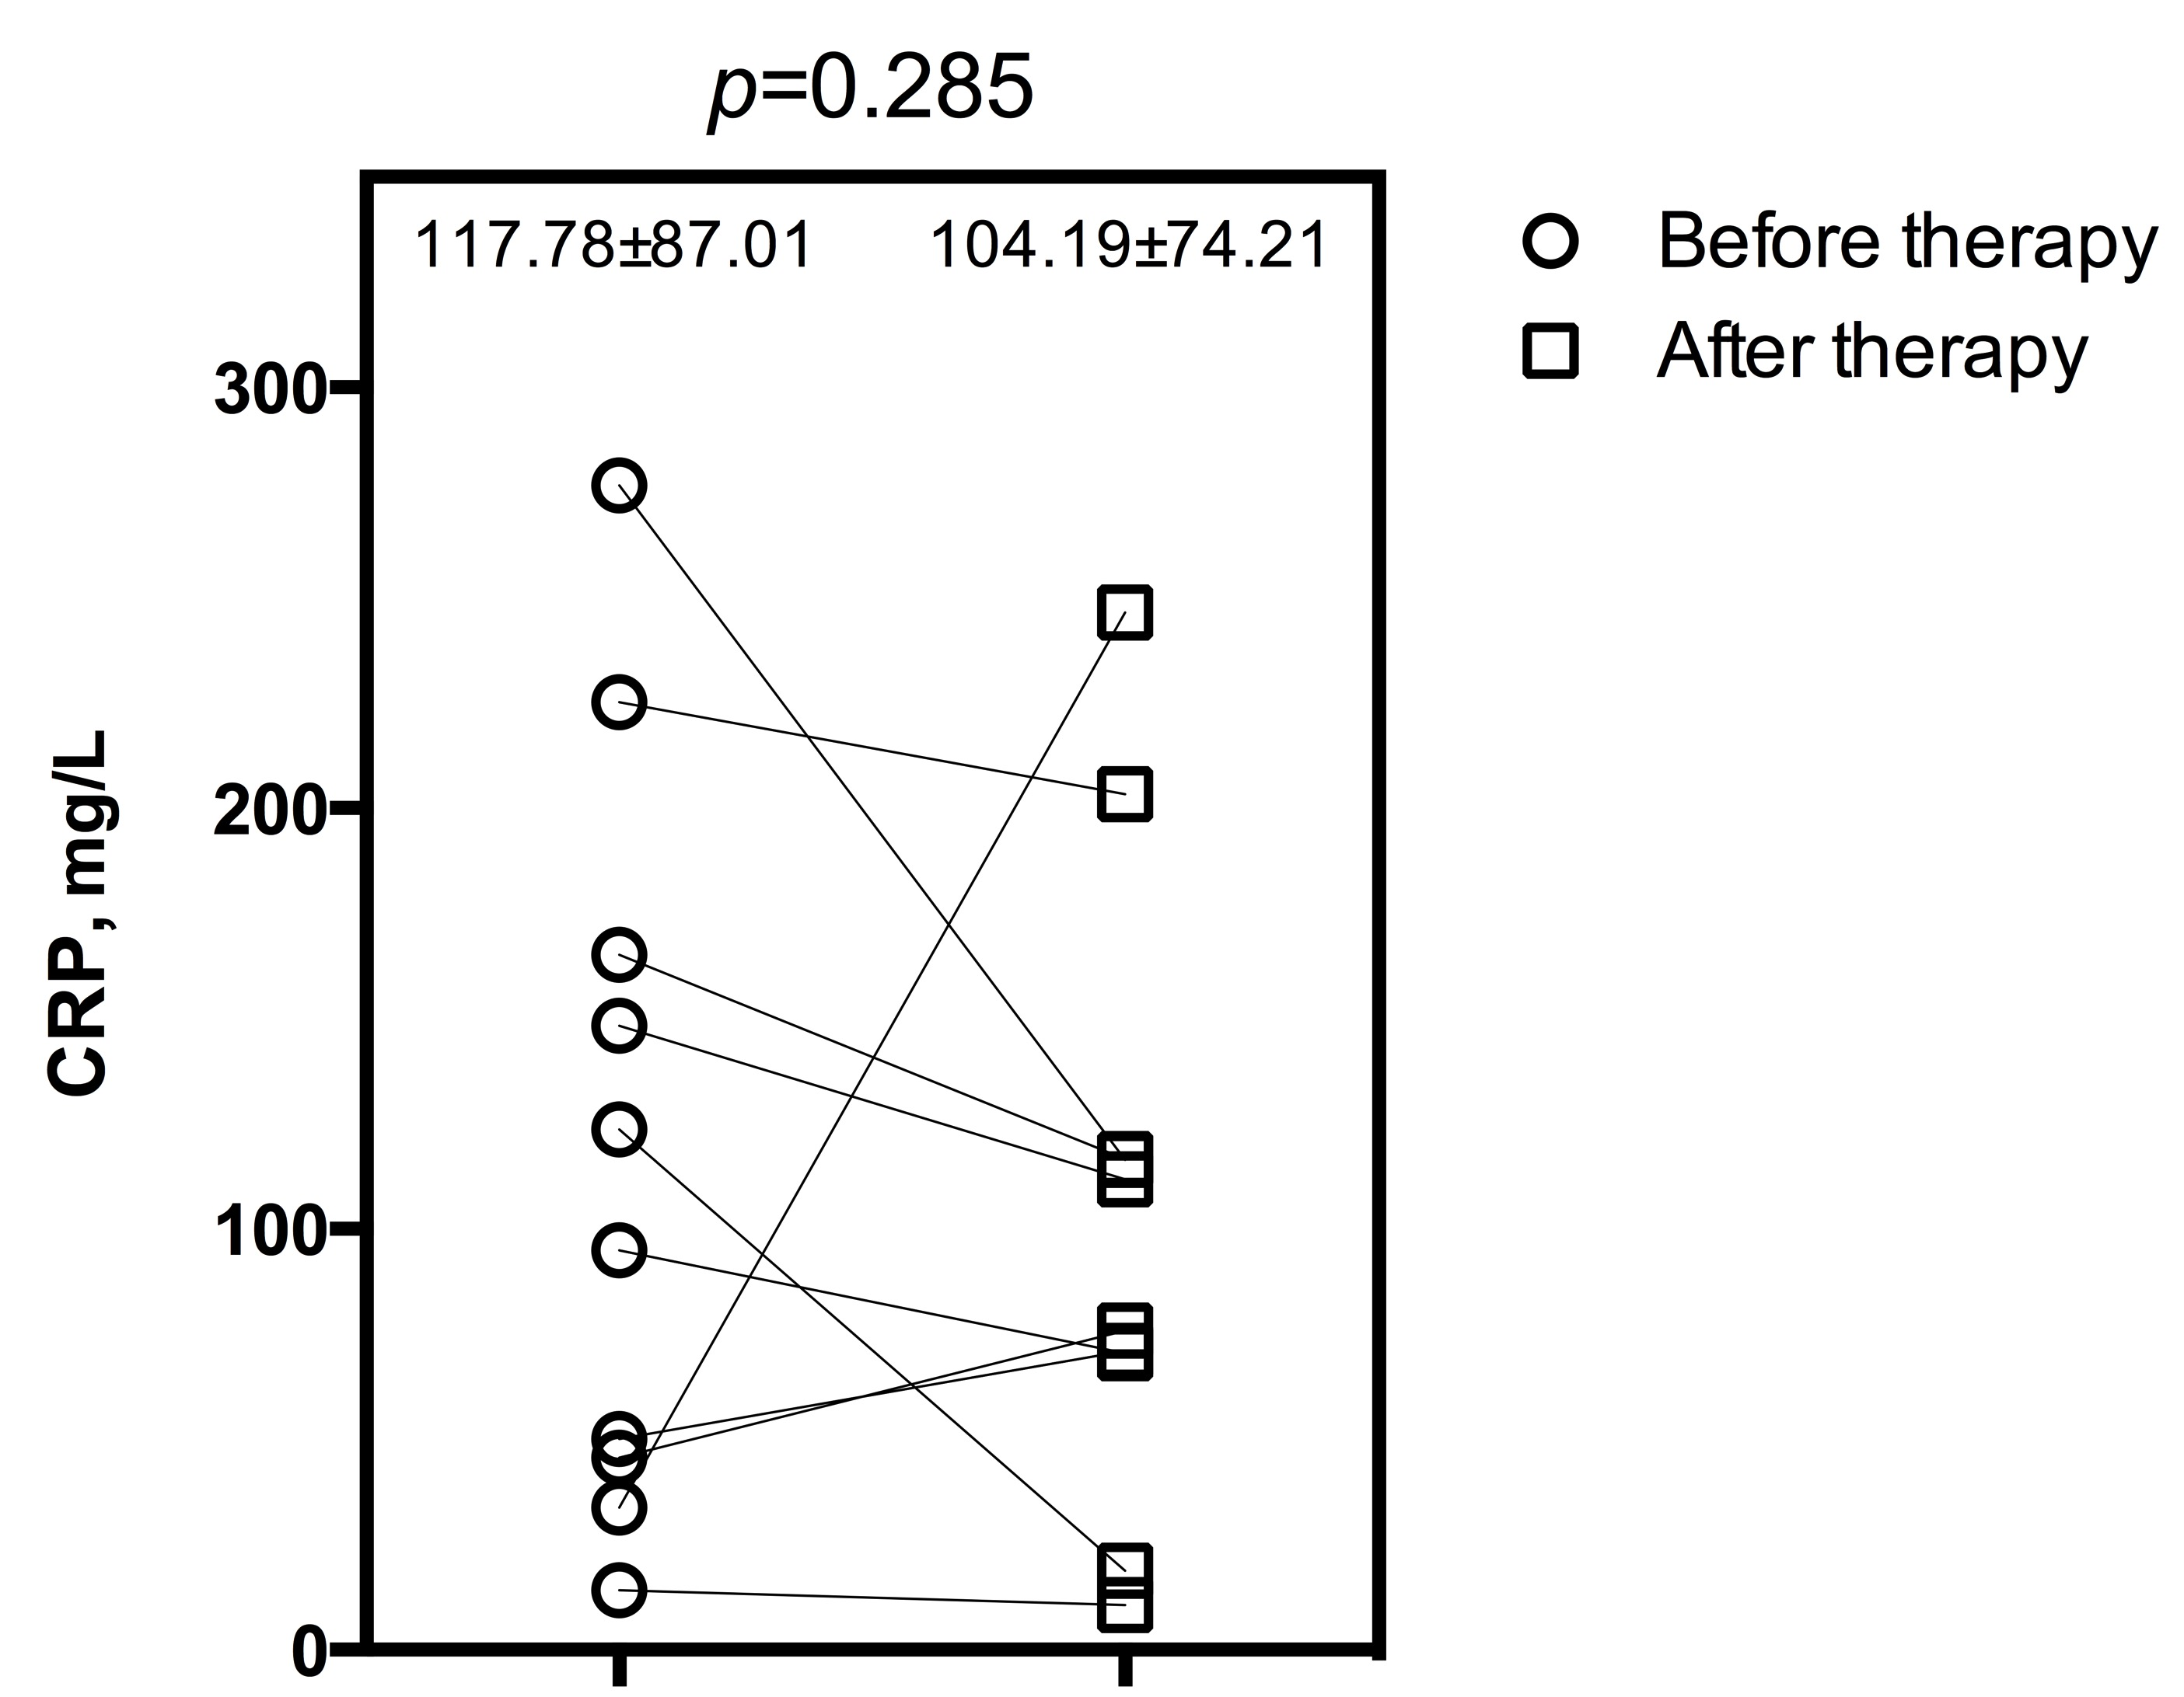
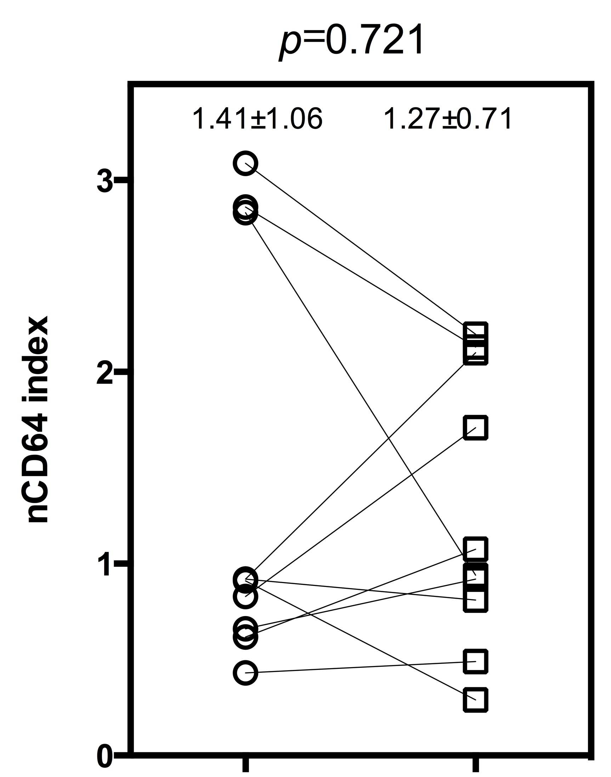
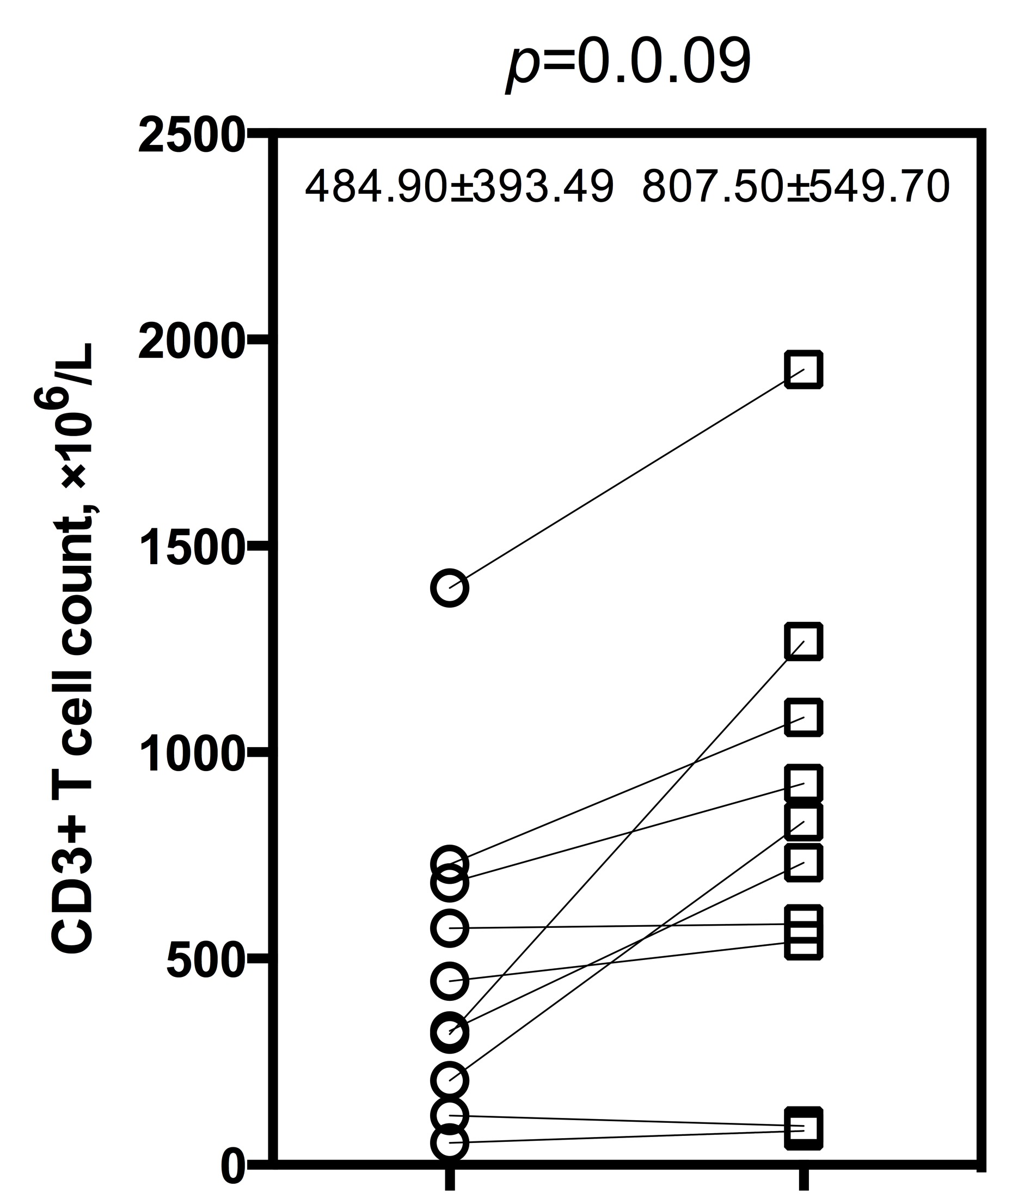
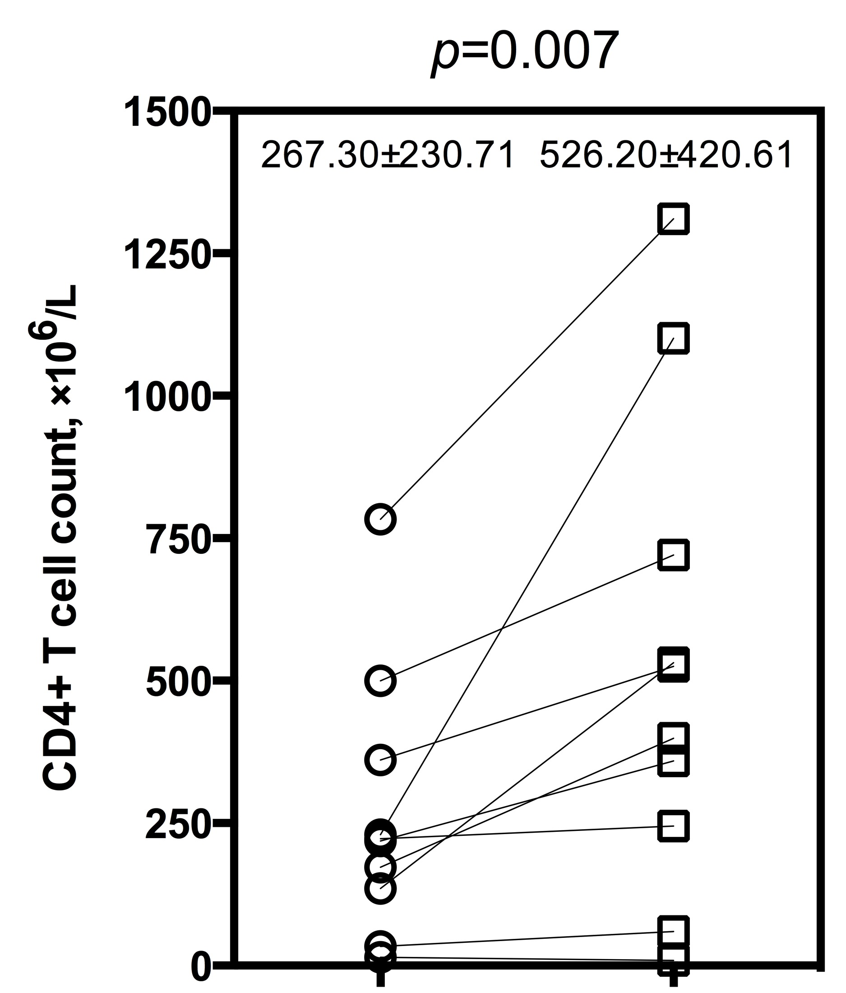
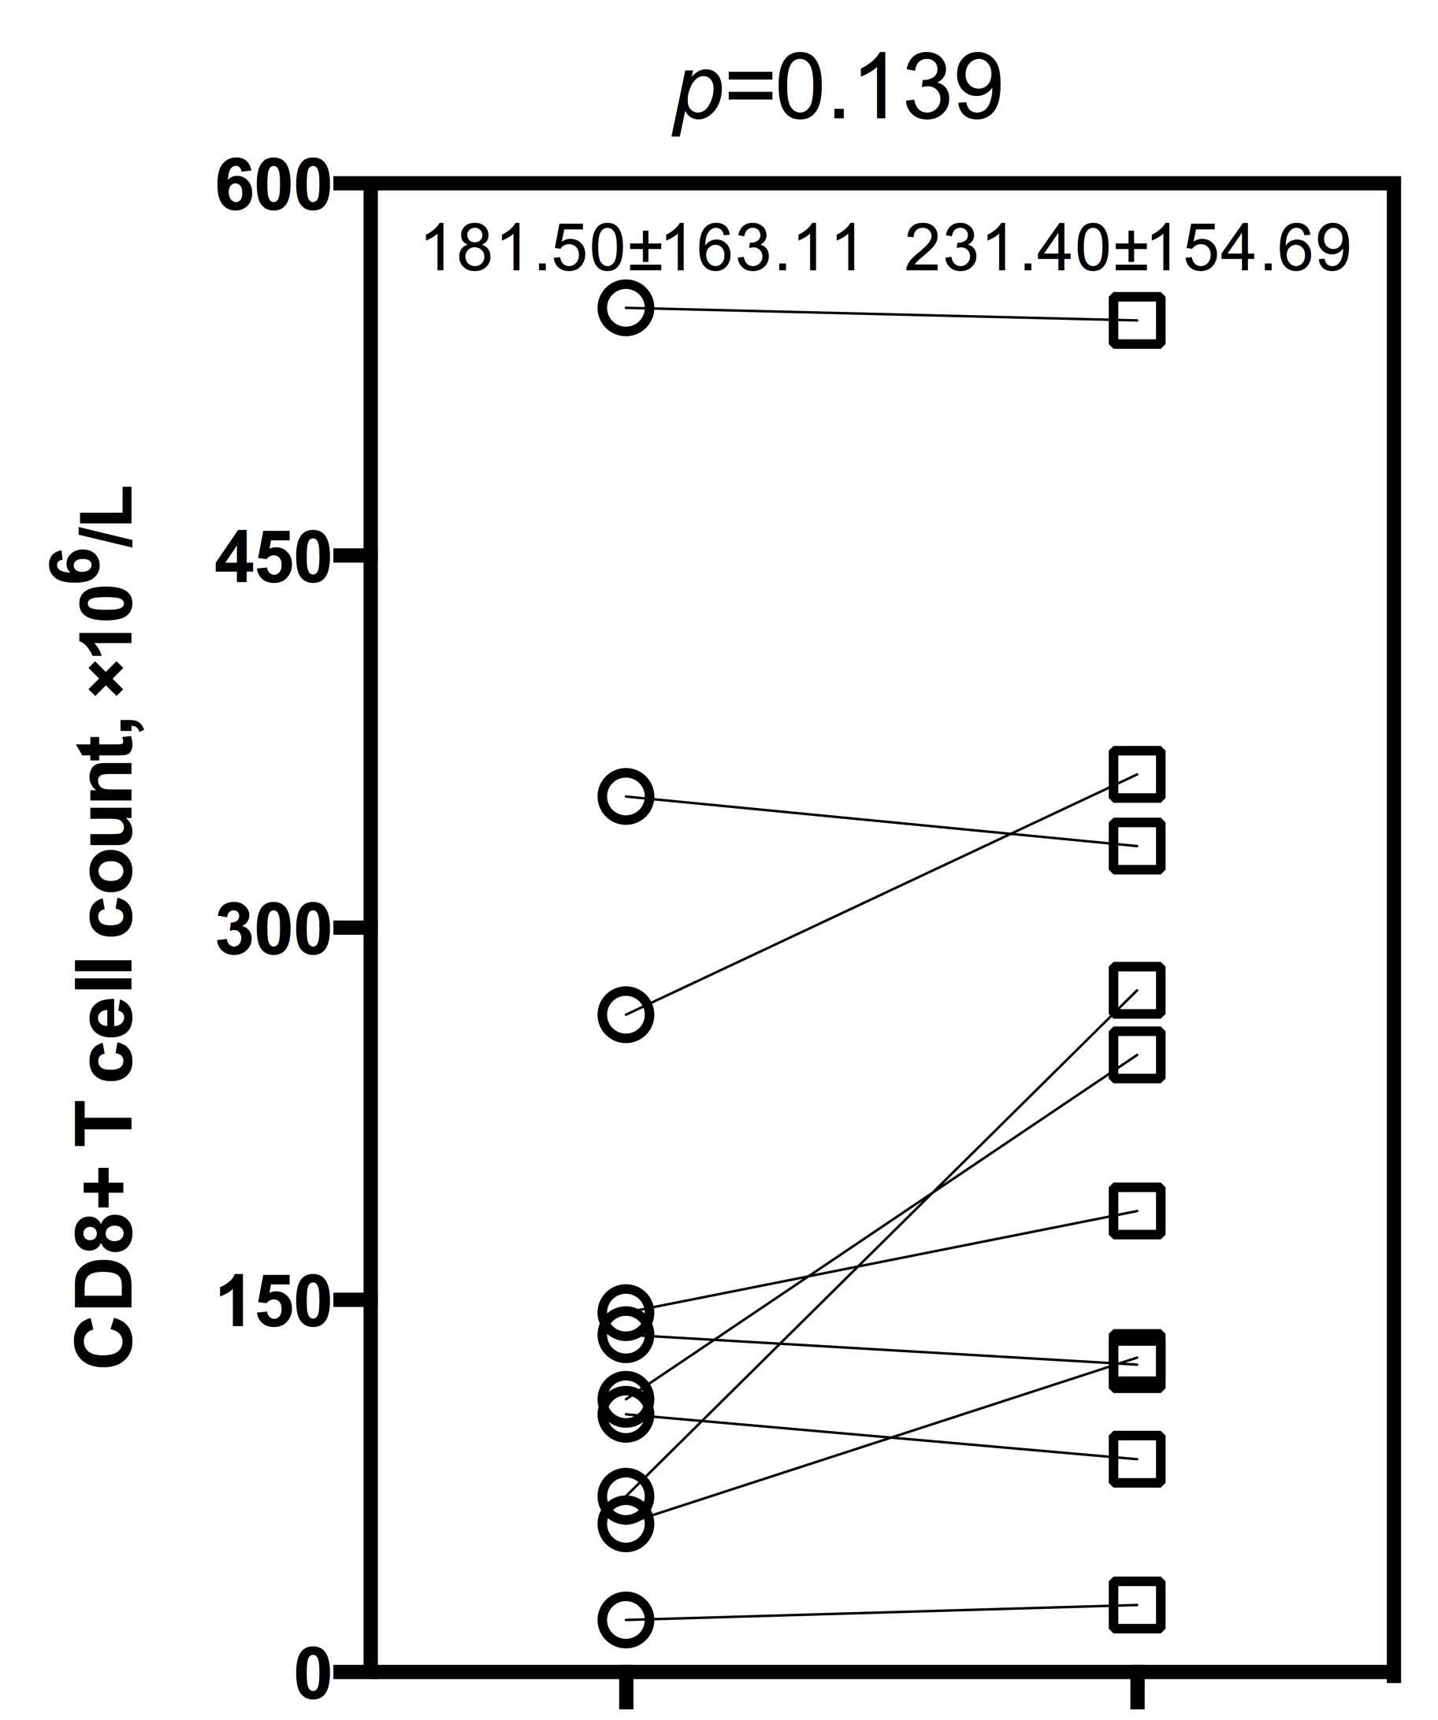
(A)
(B)
(C)
(D)
(E)
(F)
(G)
(H)
Notes:
Supplementary Figure 1 Comparison of indicators in patients with negative bacterial culture before and after receiving effective antibiotic therapy.
WBC= white blood cell count; NLR= neutrophil to lymphocyte ratio; PCT= procalcitonin; CRP= C-reactive protein; nCD64 index= neutrophil CD64 index. Data in (A-H) were analyzed by the Wilcoxon signed ranks test, and expressed as mean ± SD.

