Slide 1
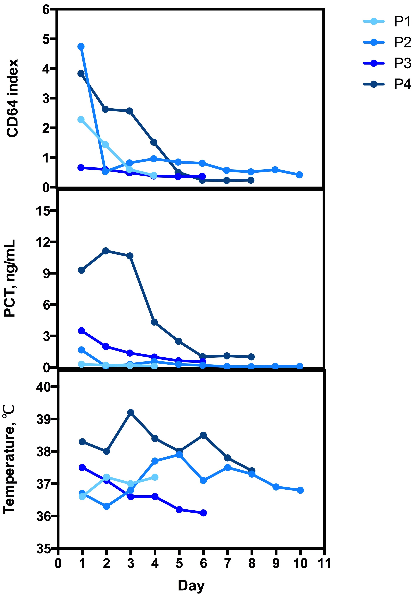
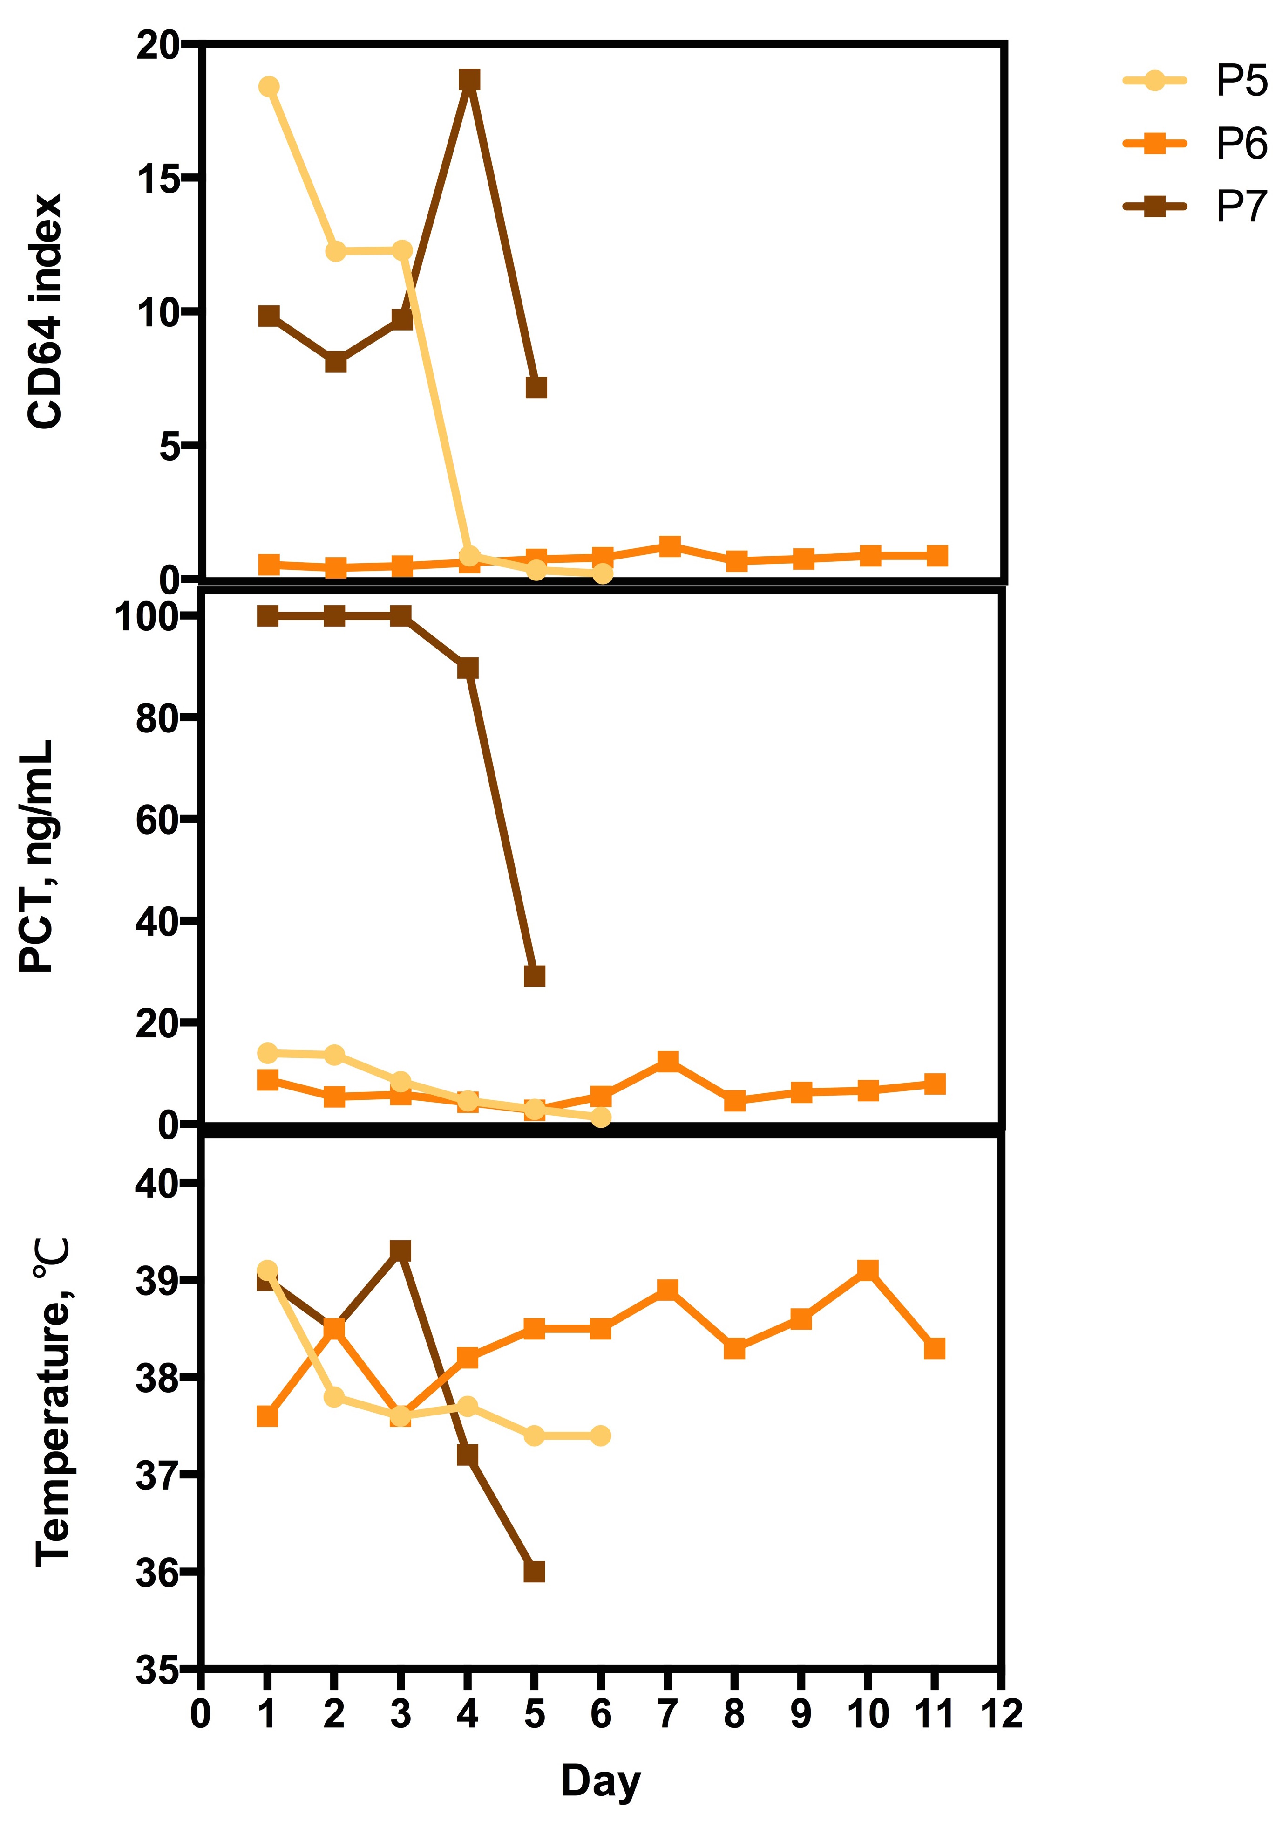
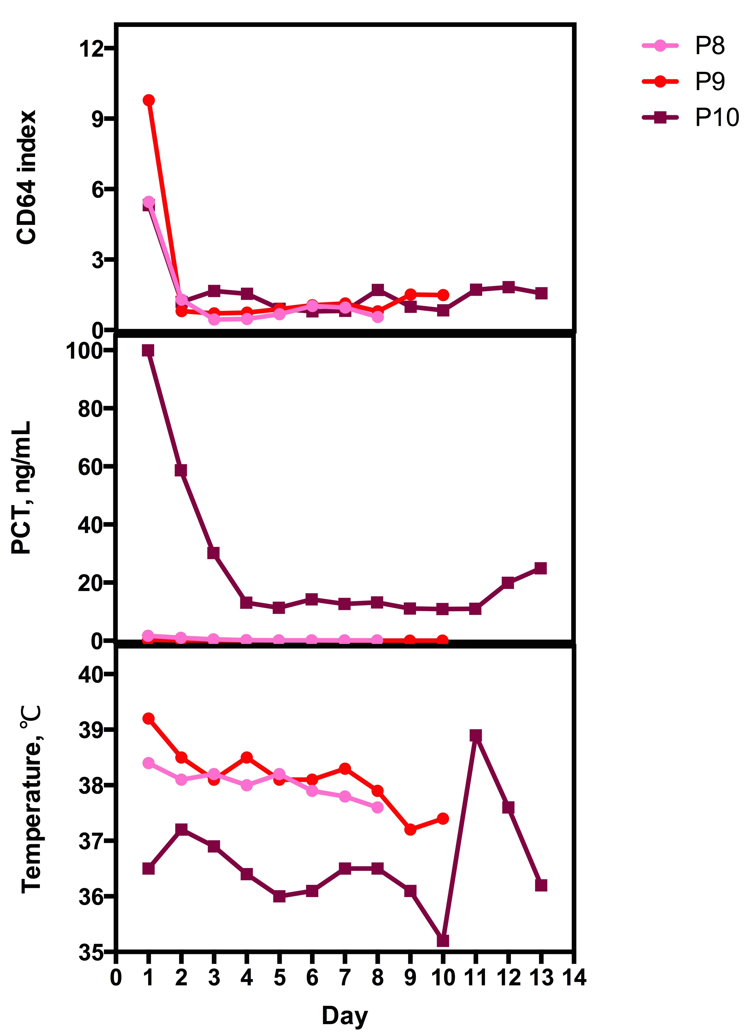
(A)
(B)
(C)
Notes:
Supplementary Figure 2 The daily alteration of the nCD64 index, PCT, and temperature in infected patients.
(A) P1-P4, patient No.1 to No.4: Patients with respiratory tract infection. Infections were effectively controlled by antibiotic therapy, and discharged eventually;
(B) P5-P7, patient No.5 to No.7: Patients with blood infection. Antibiotic therapy was effective in P5, but ineffective in P6-P7. P5 was discharged, but P6 and P7 died.
(C) P8-P10, patient No.8 to No.10: patients with both blood and respiratory tract infection. Antibiotic therapy was effective in P8-P9, but ineffective in P10. P8-P9 were discharged, but P10 died.

