Slide 1
Statistical raw data of epidemiology and survival analysis of femoral head necrosis
Zhao gang, Liu Yujie, Li Zhongli, Li Chunbao

Slide 2
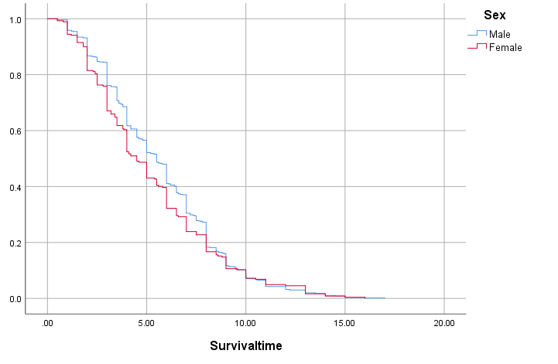
Figure 1 Analysis of gender survival years

Slide 3
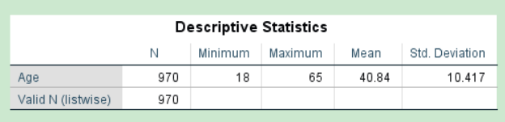
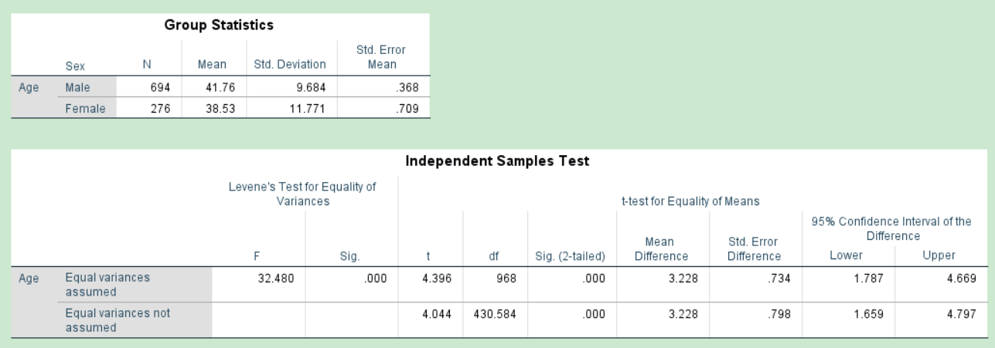
Sex and ages

Slide 4
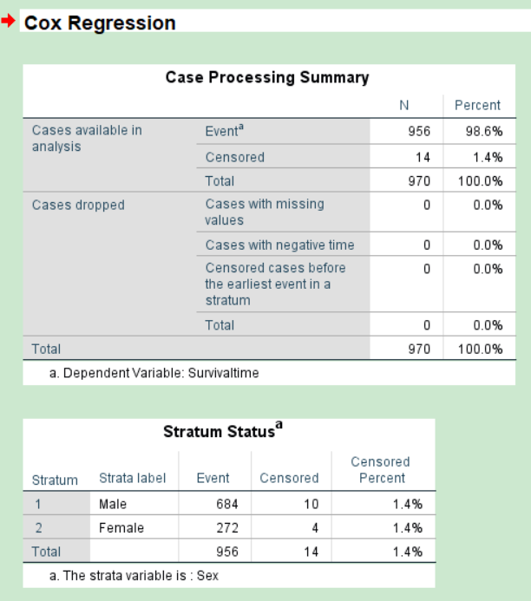
Gender life span

Slide 5
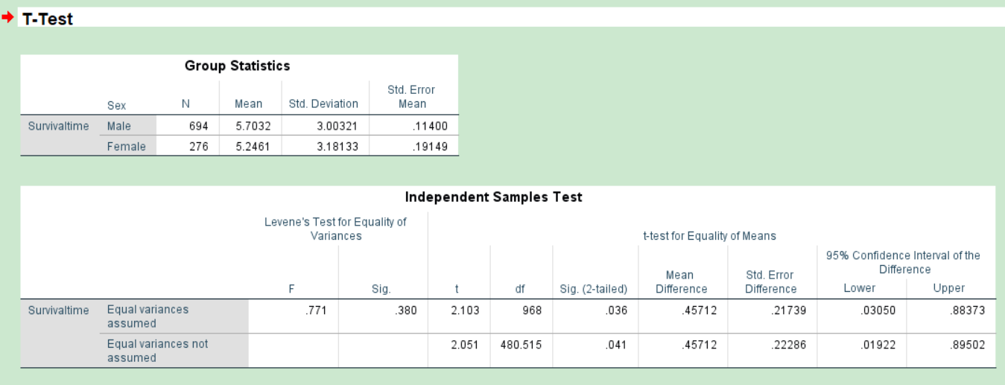
Gender life span

Slide 6
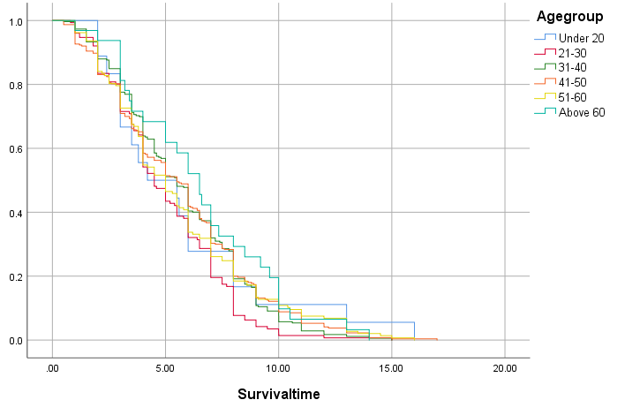
Figure 2 age stratified survival analysis

Slide 7
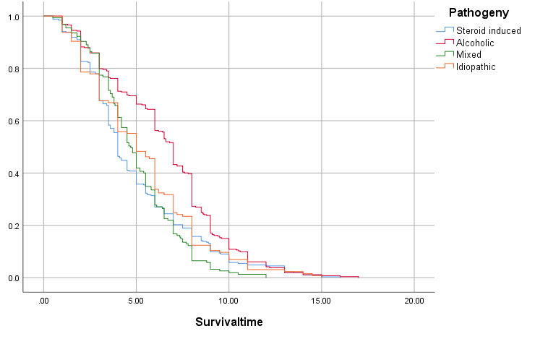
Figure 3 Analysis of stratified survival of etiology

Slide 8
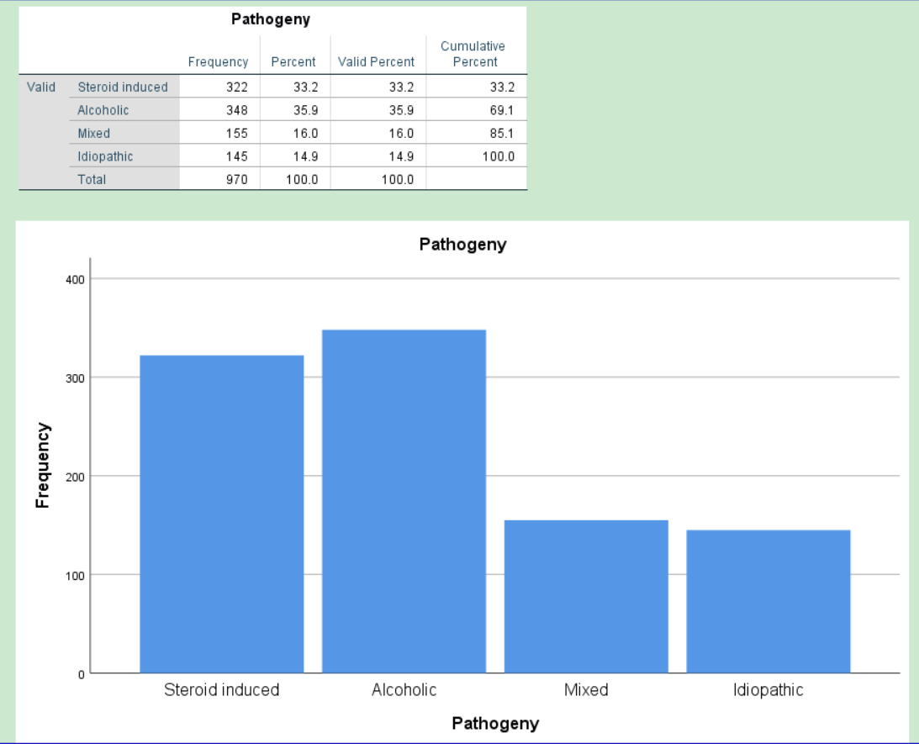
Total cases of etiological classification

Slide 9
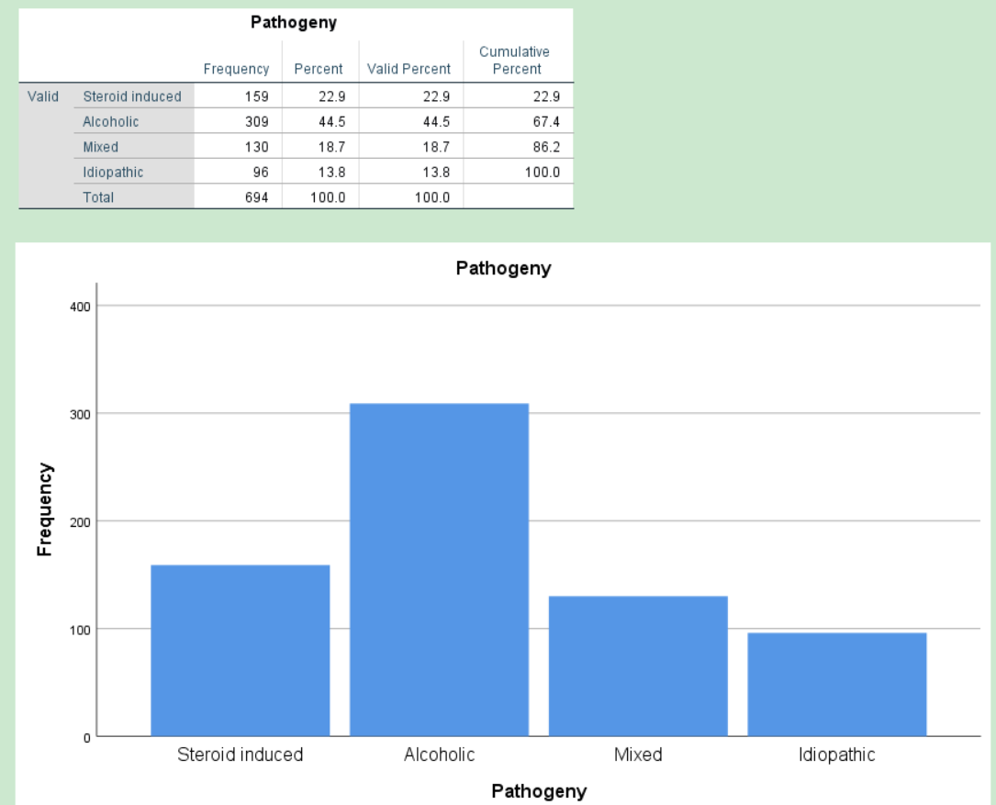
Etiological classification number of male cases

Slide 10
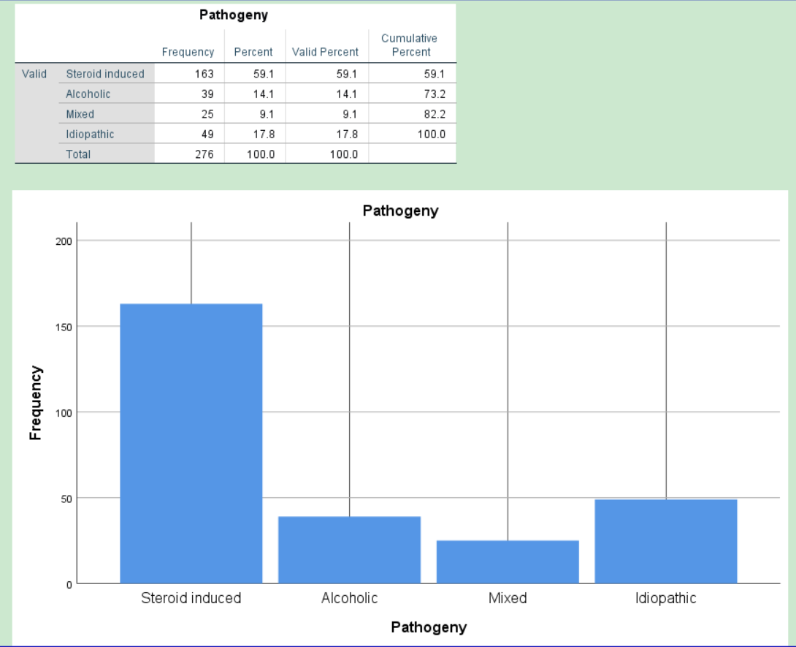
Etiological classification number of female cases

Slide 11
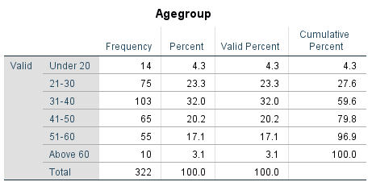
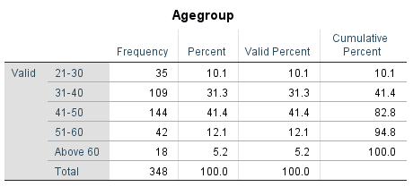
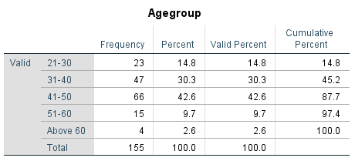
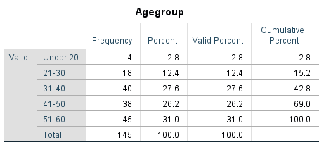
Stratified by etiology and age
hormone
alcohol
mixed
Idiopathic

Slide 12
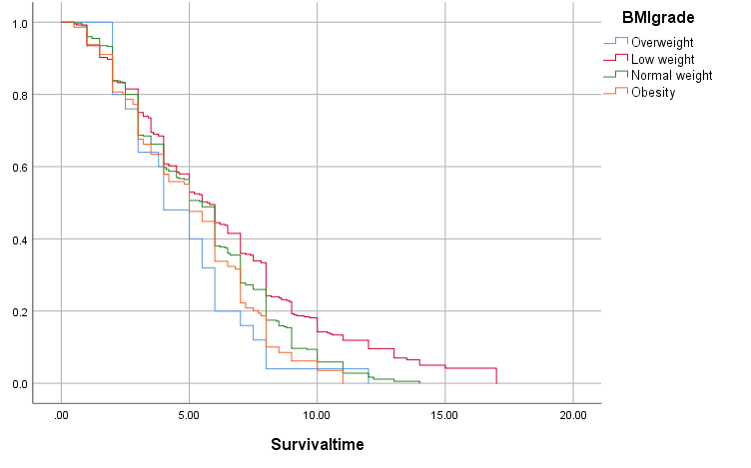
BMI

Slide 13
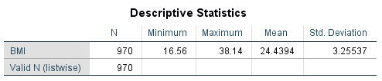
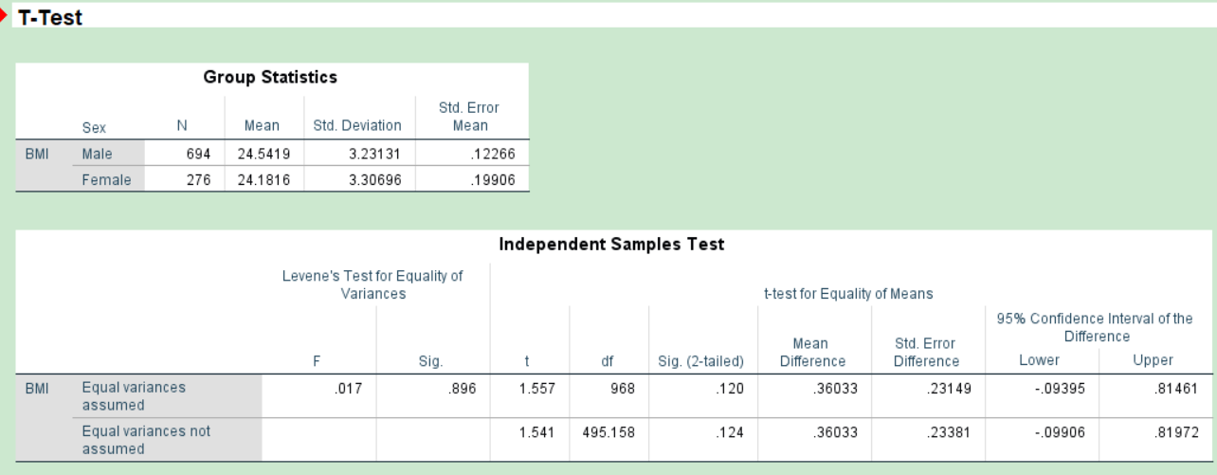
BMI

Slide 14
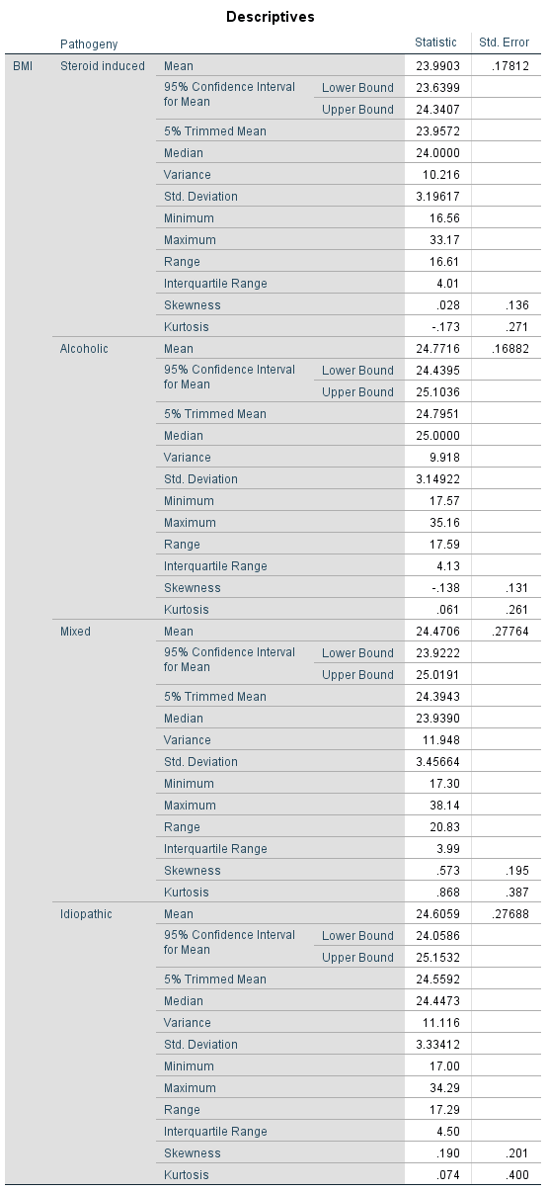

Slide 15
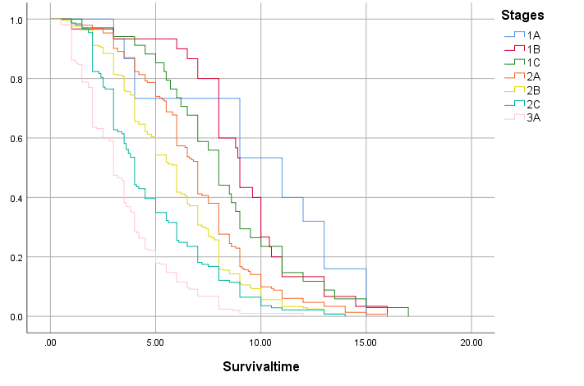
Figure 5 Arco stage survival analysis

Slide 16
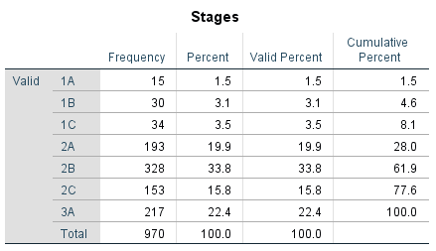
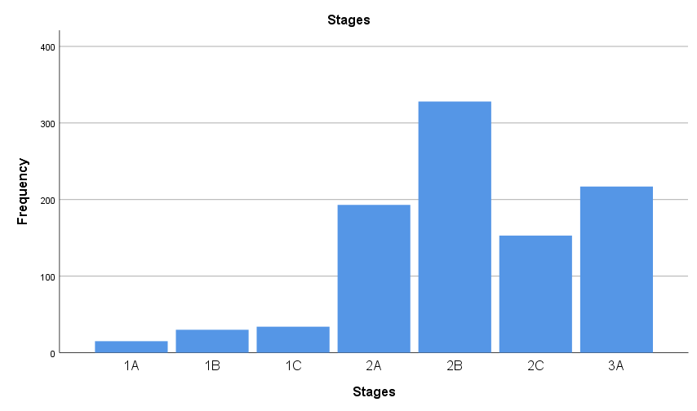
Total number of Arco staging cases

Slide 17
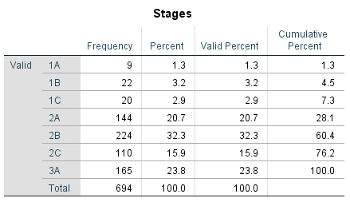

ARCO stage male cases female cases

Slide 18
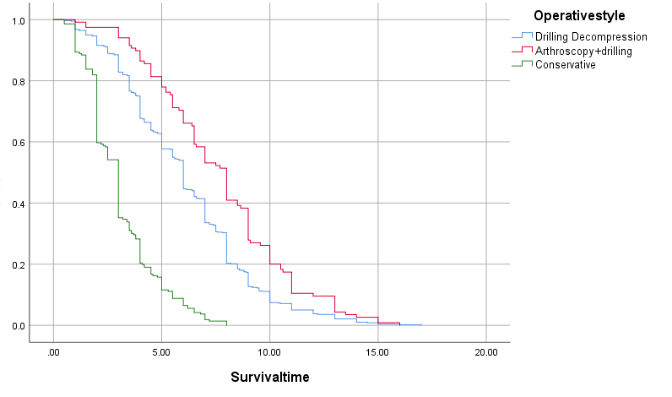
Operative survival analysis

Slide 19
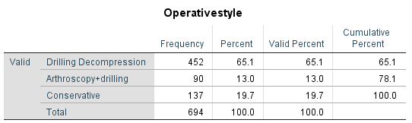
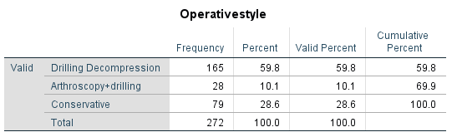
male
female

Slide 20

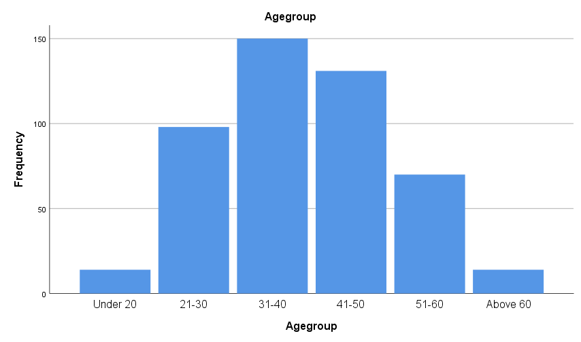
Age stratified survival analysis considering hormone use alone

Slide 21
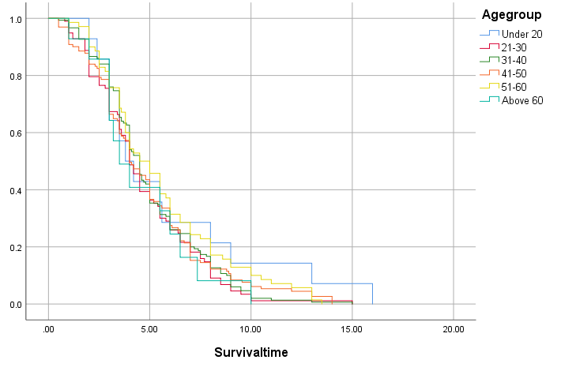
Figure 6 age stratified survival analysis considering hormone use alone

Slide 22
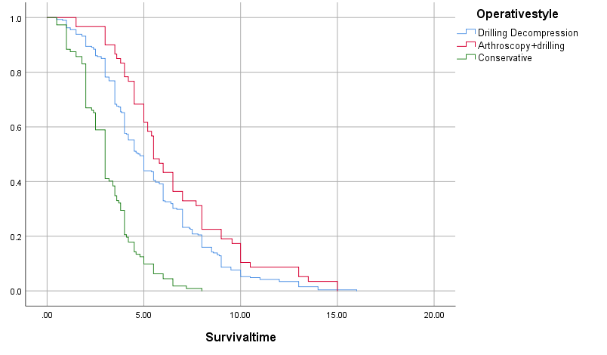
Analysis of operative survival considering hormone use alone

Slide 23
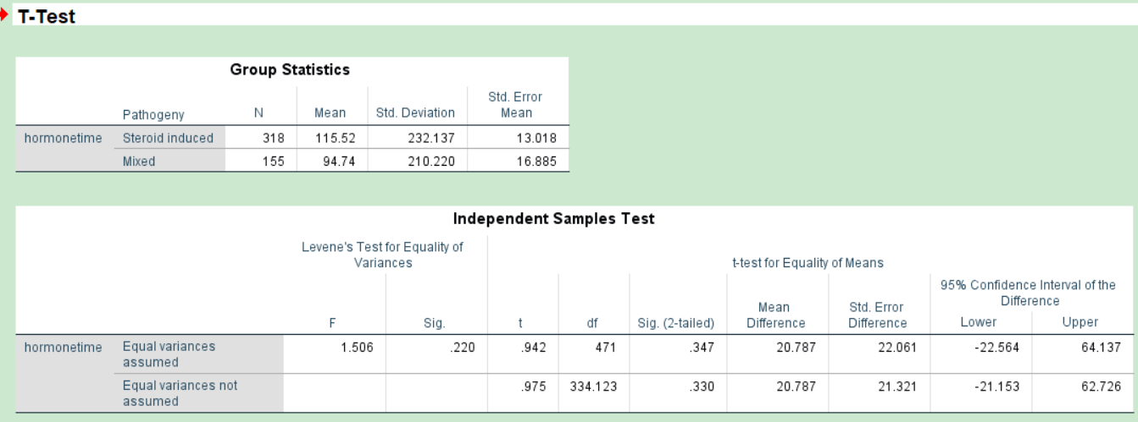
Hormone use time

Slide 24

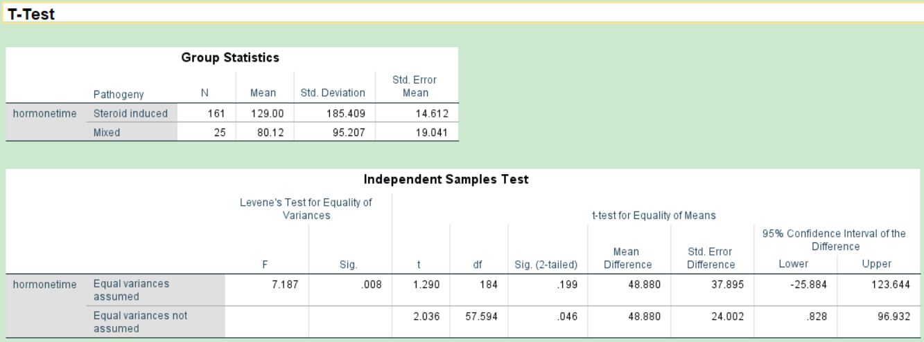
Consider hormonal factors alone
Time of hormone use for men and women
Table 6 Analysis of hormone administration time

Slide 25
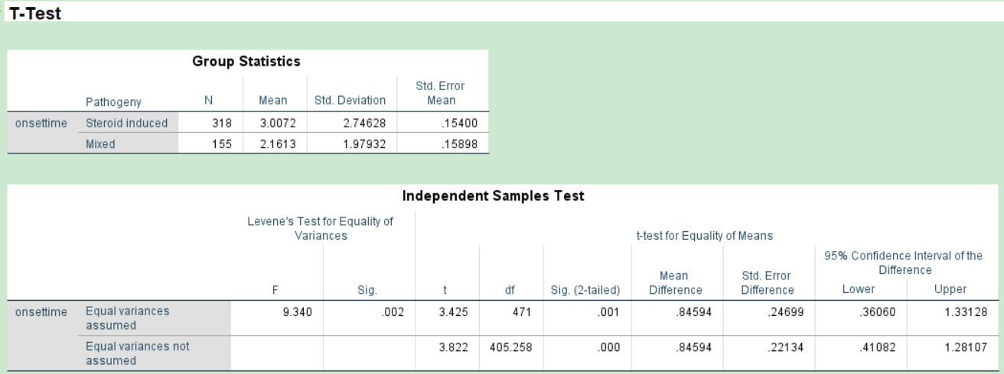
Consider hormonal factors alone
Hormonal onset time

Slide 26
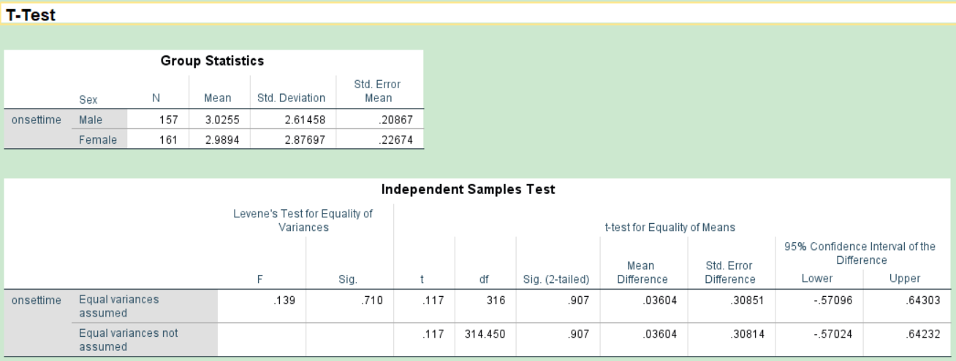
Onset time Steroid induced necrosis

Slide 27
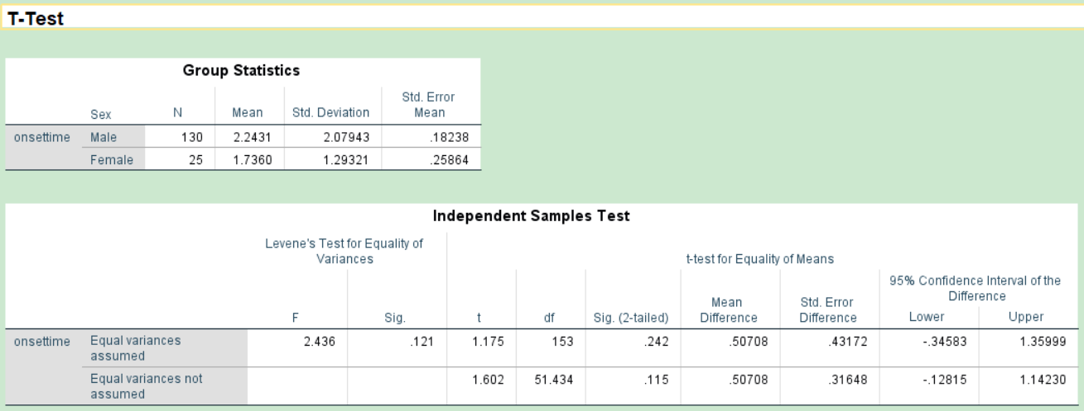
Onset time Mixed necrosis

Slide 28
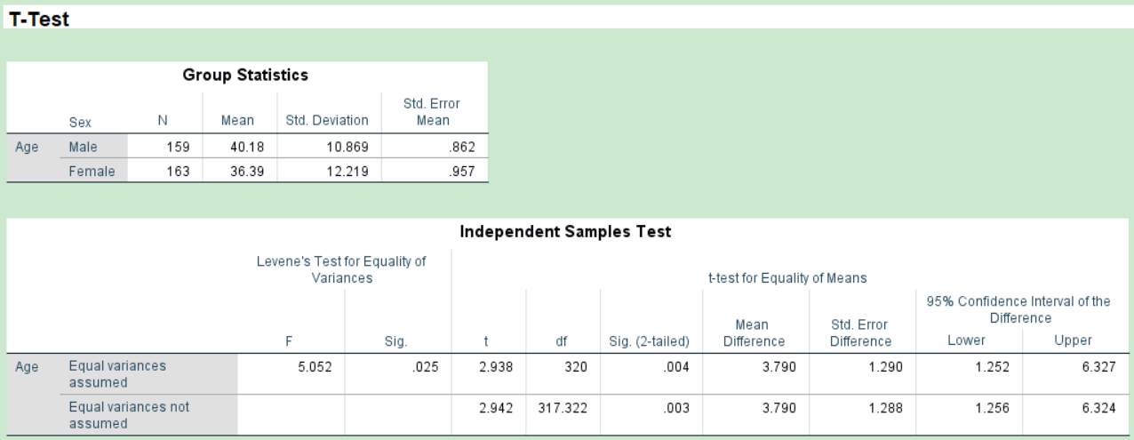
Steroid induced necrosis Age analysis

Slide 29
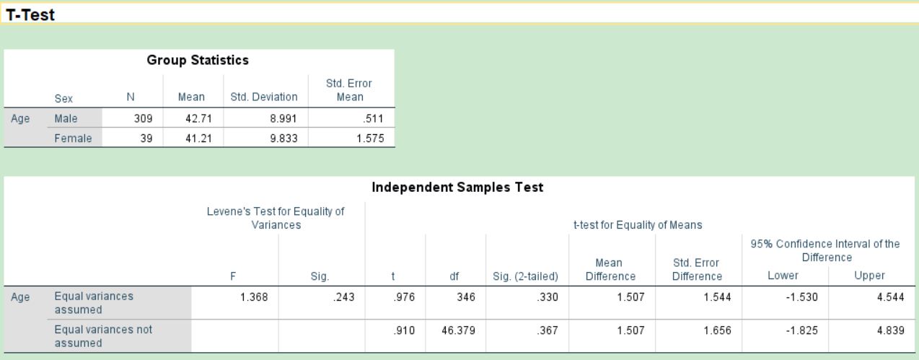
Alcoholic necrosis Age analysis

Slide 30
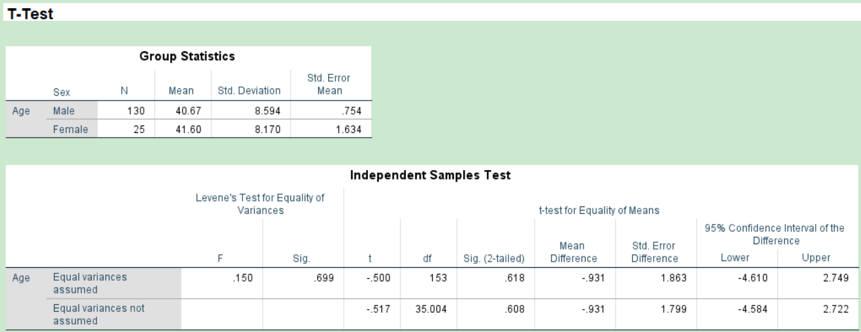
Mixed necrosis Age analysis

Slide 31

Idiopathic necrosis Age analysis of men and women

Slide 32
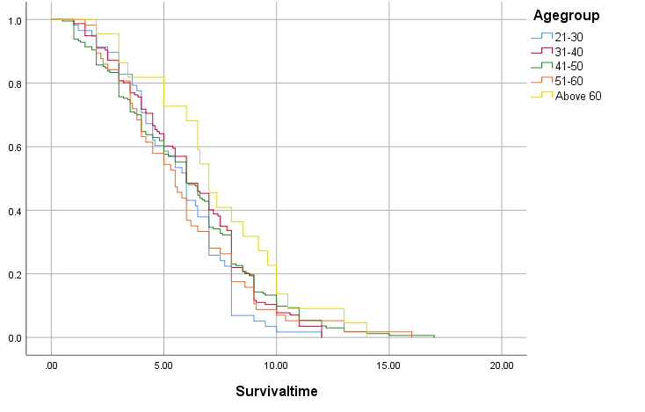
Figure 7 Age-stratified survival analysis considering alcohol alone

Slide 33
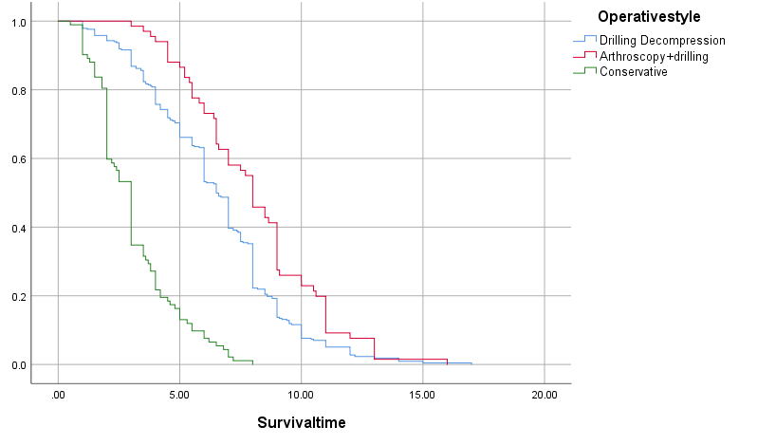
Surgical survival analysis considering alcohol alone

Slide 34
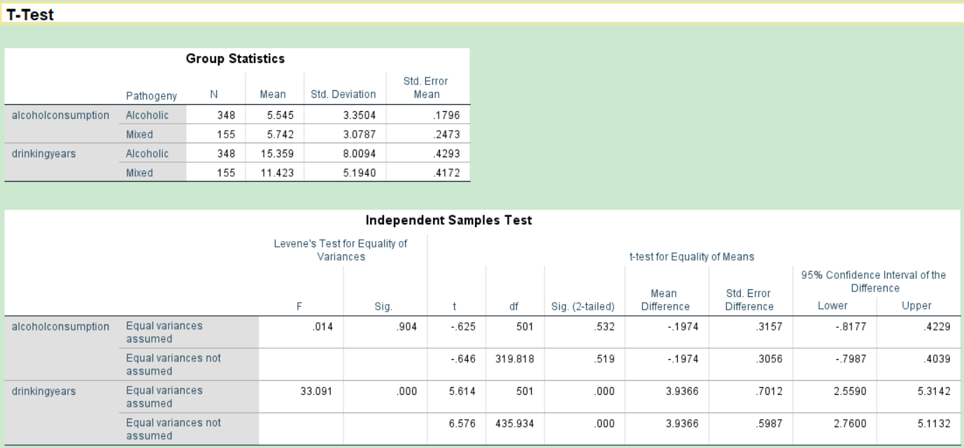
Table 8 Considers the alcohol factor separately
Daily alcohol intake
Drinking years

Slide 35
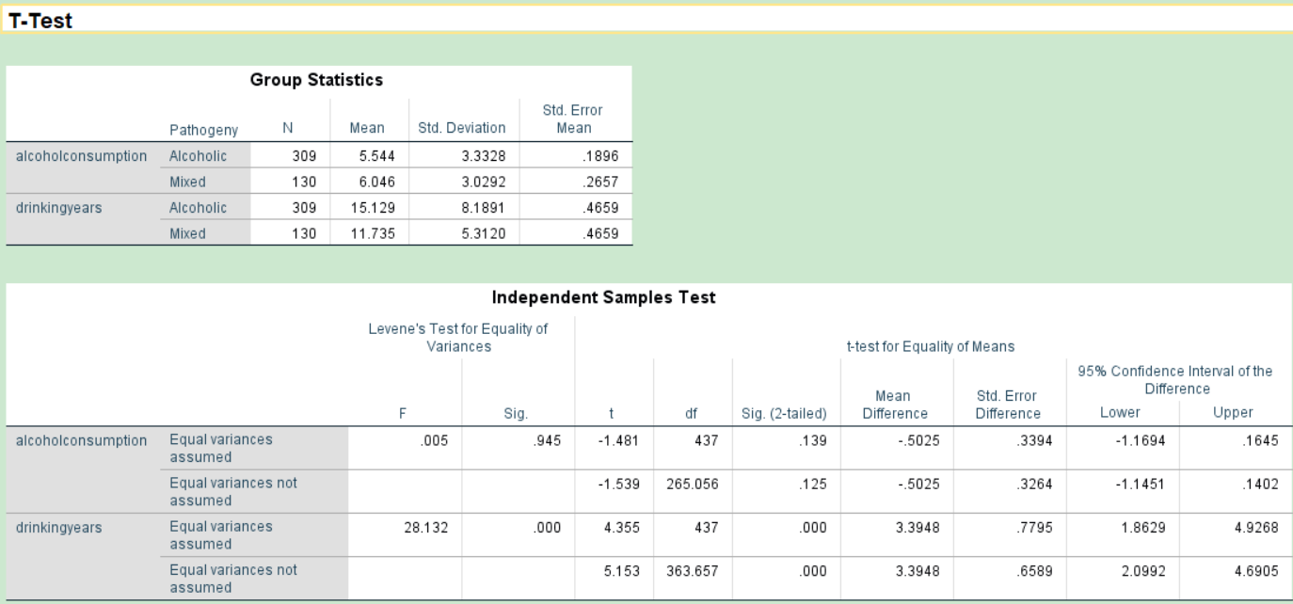
Table 8 Considers the alcohol factor separately
Daily alcohol intake
Drinking years Male

Slide 36
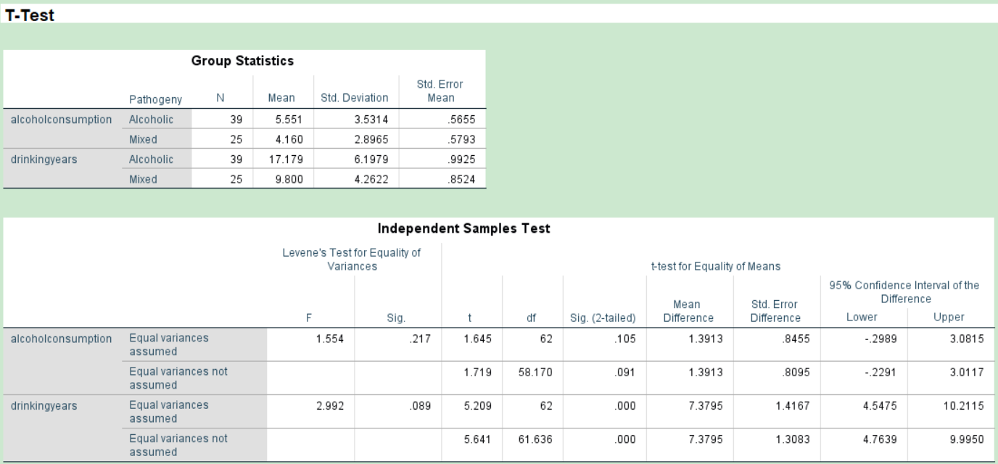
Table 8 Considers the alcohol factor separately
Daily alcohol intake
Drinking years Female

Slide 37
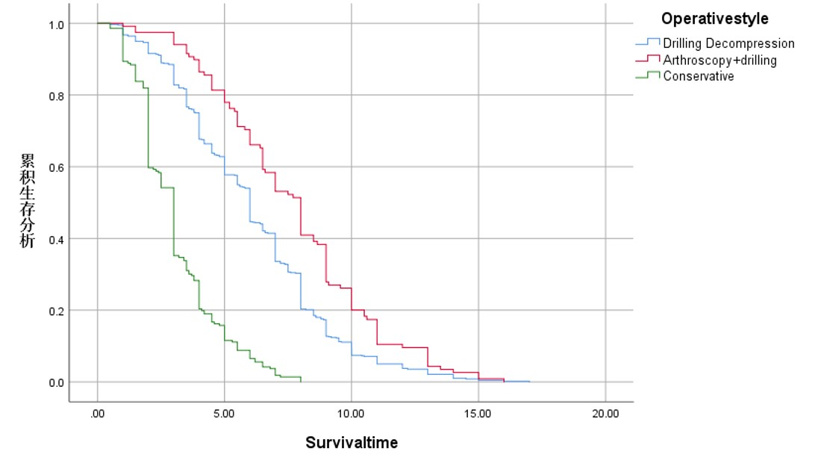
Overall ONFH by surgical survival analysis

Slide 38
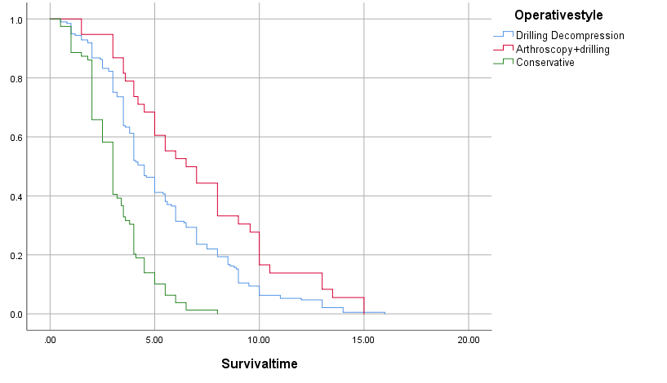
Mixed ONFH by surgical survival analysis

Slide 39
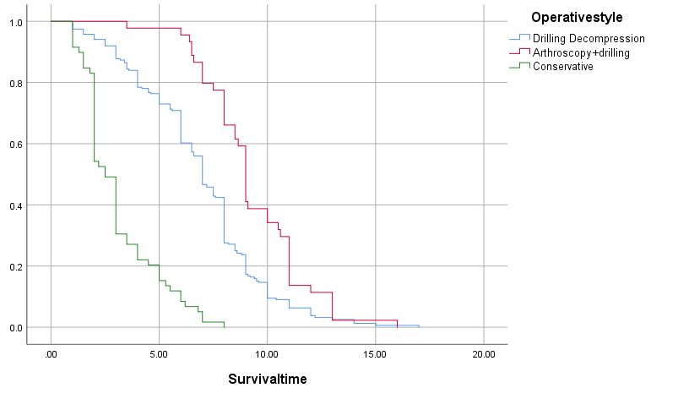
Alcoholic ONFH is analyzed by surgical survival

Slide 40
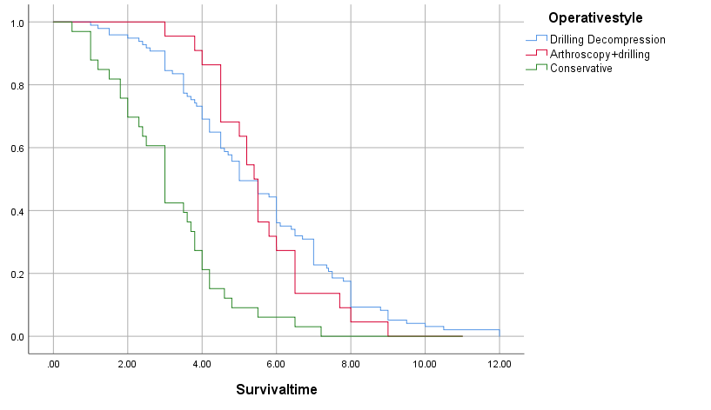
Steroid induced ONFH is analyzed for survival by surgical procedure

Slide 41
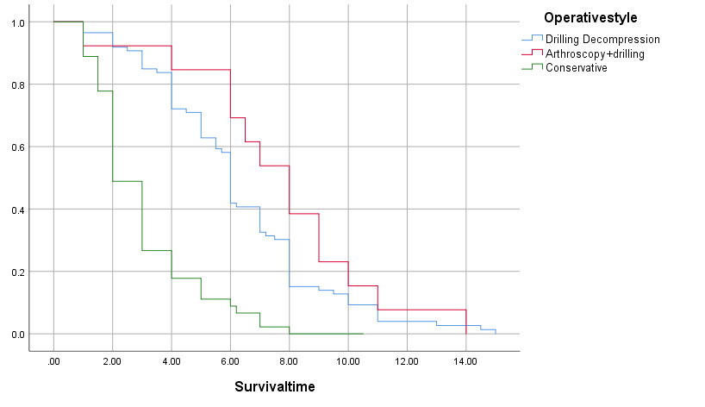
Idiopathic ONFH is analyzed by surgical survival

