Slide 1
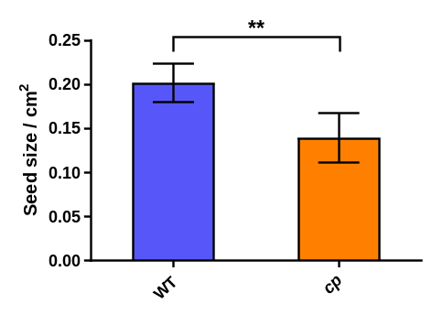
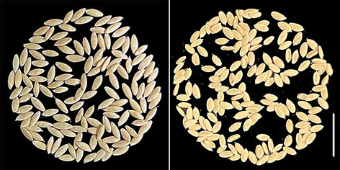
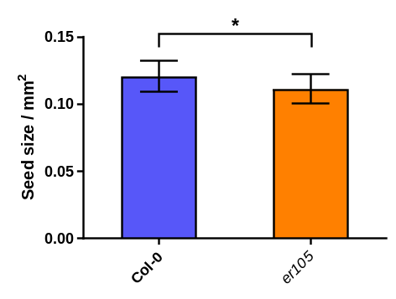
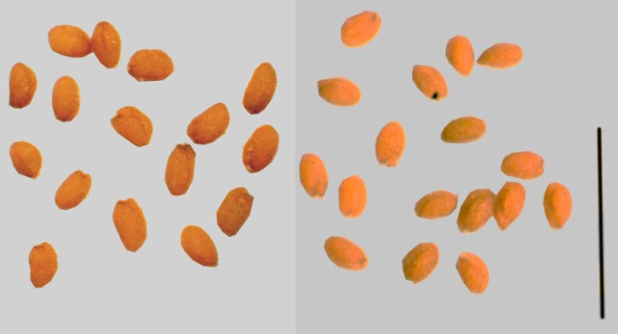
A1
A2
A3
Fig. S1. Seed size in cucumber and Arabidopsis. a The seeds are in smaller size and a bit of wizened, but good for germination in WI7201. a1 seeds from WI7200; a2 seeds from WI7200. Bar = 2 cm. a3 ** indicates statistically significant differences in t tests at P <0.01.
(b) The seeds from er105 are slightly smaller than Col-0. b1 seeds from Col-0; b2 seeds from er105. Bar = 2 mm. a3 and b3 Seed size in cucumber and Arabidopsis. Error bar represents mean ± SD. **P < 0.01, *P<0.05 (Student’s t-test)
B1
B2
B3

Slide 2
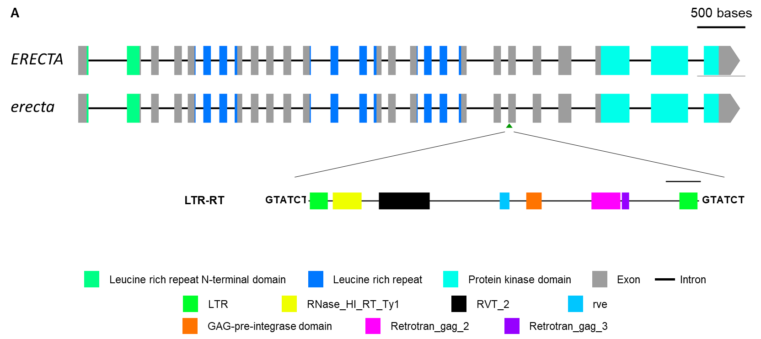
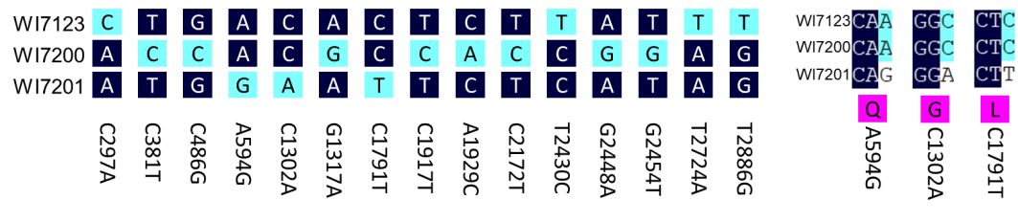
A
B
C
WT
Signal peptide
LRR N terminal
LRR
cp
Kinase
Fig. S2. Structure of CsER in WT and mutant. There are 27 exons in the predicted CsER gene. a In the mutant there is a LTR-RT insertion in the 22nd exon. The LTR-RT has all the domains that are required for active transposition. b There are 15 SNPS among WI7123, WI7200 and WI7201, of which three are unique in WI7201 mutant but all of them are synonymous SNPS. c The conserved domains were not altered by the deletion in neither WT and cp mutant.

Slide 3
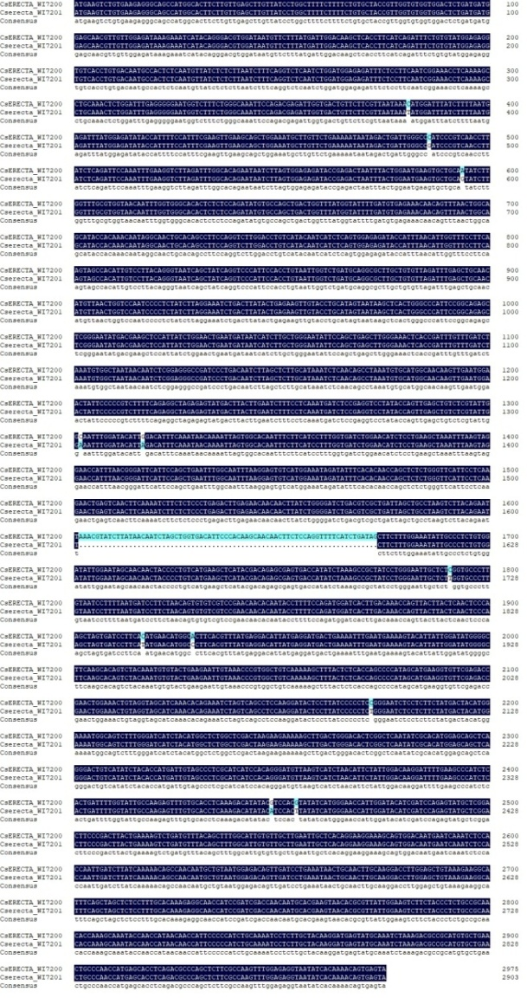
Fig. S3. CDS alignment between WI7200 and WI7201. There were 11 SNPs and one deletion of 72-bp in the mutant. The 11 SNPs were either non-synonymous or not unique in the mutant.

Slide 4
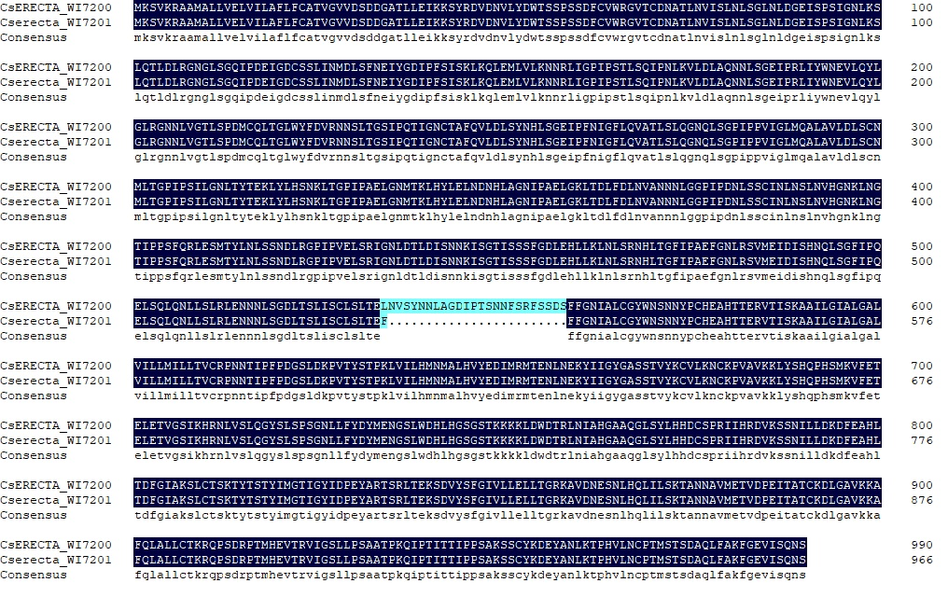
Fig. S4. Alignment of protein sequences between WI7200 and WI7201. There are a deletion of 24 and one substitution amino acids in the mutant. The conserved domains are underlined. Red: Leucine rich repeat (LRR); Green: Protein kinase.
Leucine rich repeat
Protein kinase domain

Slide 5
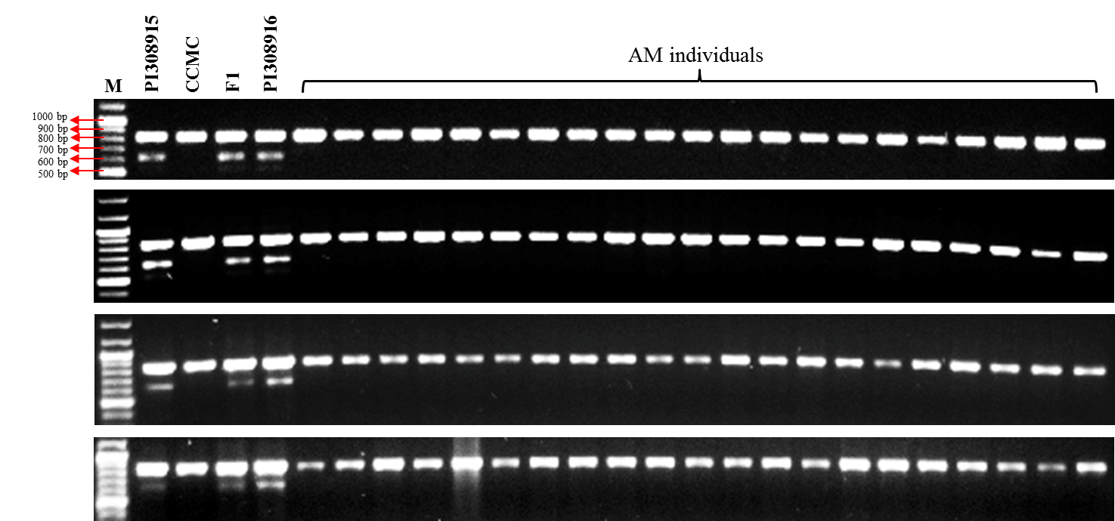
Fig. S5. Alleles at the Cp locus among representative cucumber accessions. The mutant allele only presents in F₁, PI 308915 (WI7201), PI 308916 (WI7202) and WI7201 x WI7123 (CCMC) F1.

Slide 6
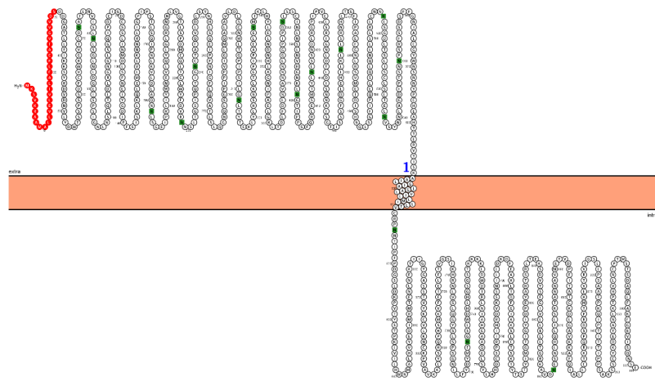
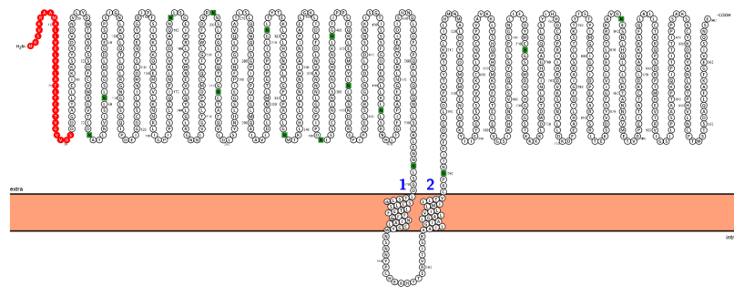
Fig. S6. Predicted topological structures of ERECTA protein on cell membrane in WT and mutant. a The WT ERECTA protein has one trans-membrane structure with one extra-cellular LRR domain and one intra-cellular kinase domain while b the mutated ERECTA protein potentially has two trans-membrane structures to re-locate the intra-cellular kinase to the outside of the cell membrane.
A
N-glyco motif
signal peptide
Extra-cellular
Intra-cellular
N-glyco motif
signal peptide
B
Extra-cellular
Intra-cellular

Slide 7
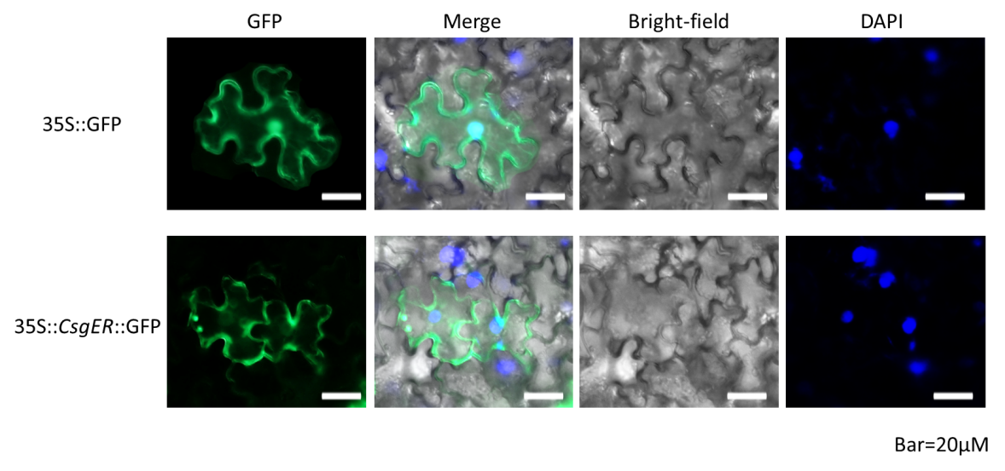
Fig. S7. Subcellular localization of CsER in tobacco leaf. CsER is located on cytomembrane. CK vector 35S::eGFP was used as the positive control. Scale bars = 20 μm. 4′,6-diamidino-2-phenylindole (DAPI) was used to indicate the cell nucleuses.

Slide 8
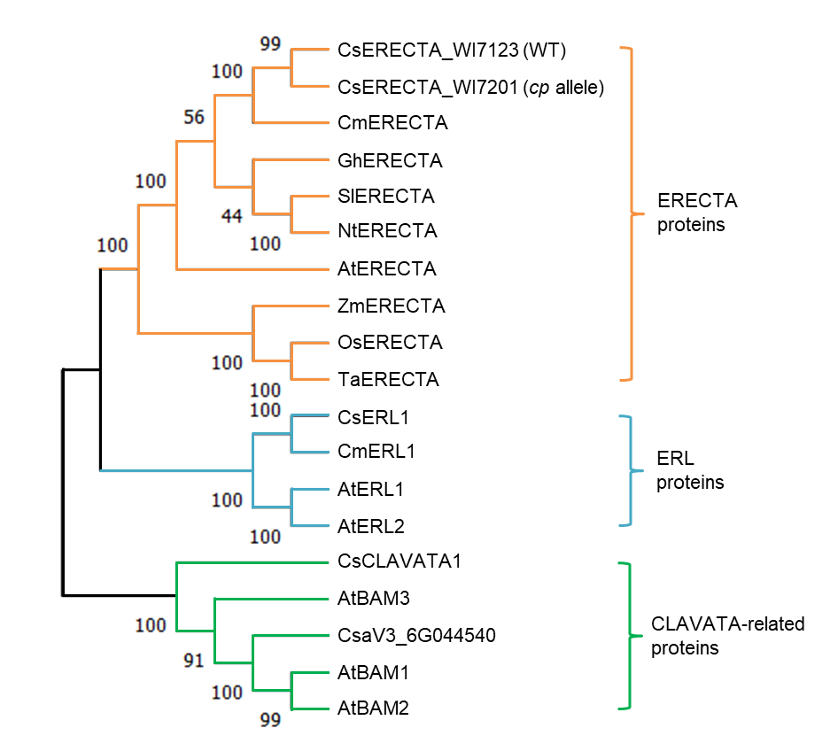
Fig. S8. Phylogeny of ER protein family members and CLAVATA-related proteins. All the ER proteins among 9 species were clustered while the ERL proteins were clustered in another branch, indicating the ER protein may have unique functions among species. The CLAVATA-related proteins are used as outliers. The numbers (in percentages) at each node indicate the probability that the node is supported.

Slide 9
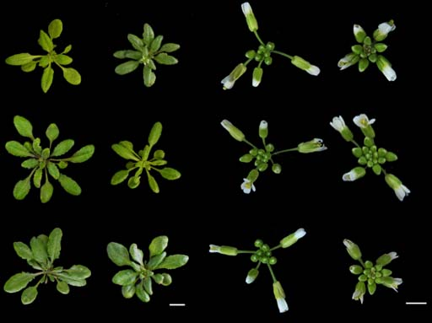
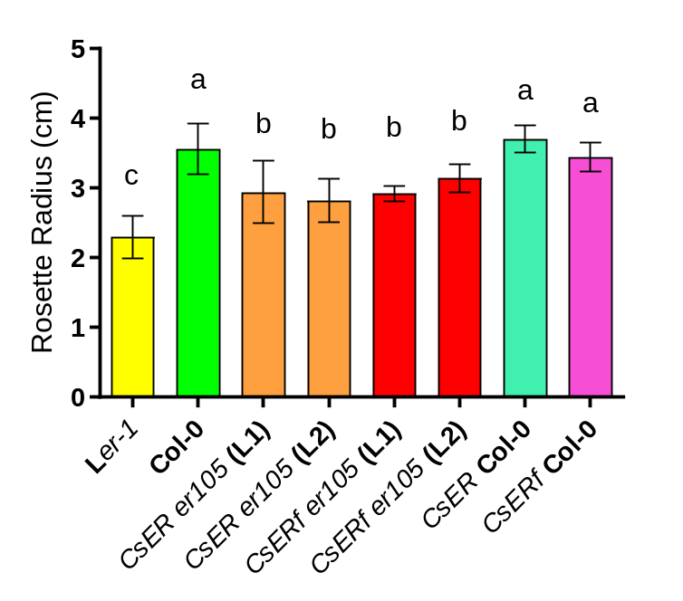
A
B
Col-0
er105
Col-0
er105
Col-0 CsER
er105 CsER
Col-0 CsER
er105 CsER
Col-0 CsERf
er105 CsERf
Col-0 CsERf
er105 CsERf
Fig. S9. CsERECTA (CsER) can partially restore the rosette radius and the short pedicel in Arabidopsis mutant er105. a Rosette radius of Col-0, er105 (controls) and the complementary CsER transgenic lines. b Inflorescences of Col-0, er105, and the complementary CsER transgenic lines. Bar =1 cm. c Rosette radius (cm) of different lines. The lower-case letters above the bars indicate statistically significant differences of expression level in t tests at P <0.05.

Slide 10
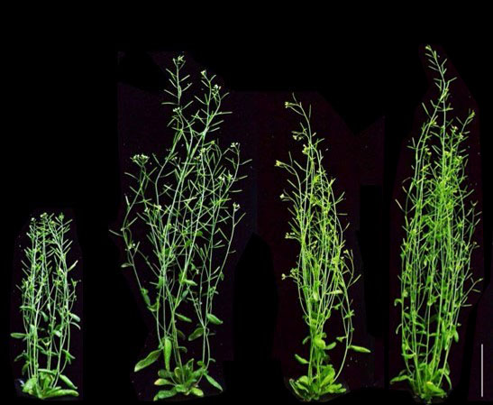
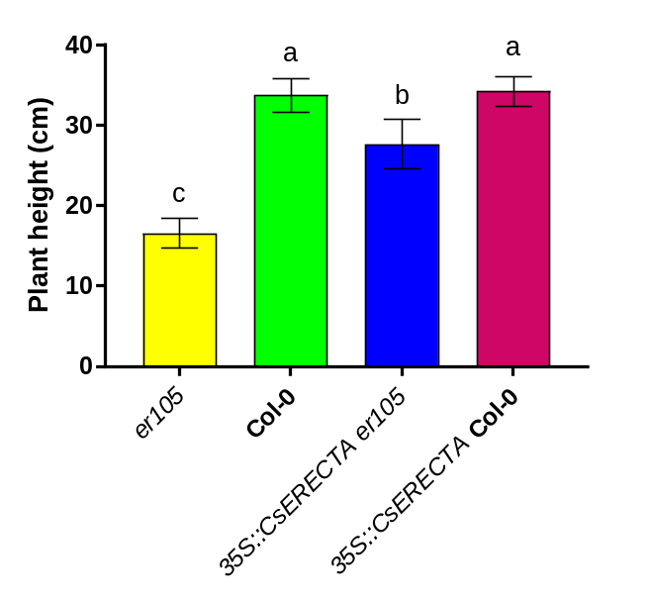
A
B
Fig. S10. Ectopic expression of CsERECTA in Arabidopsis mutant. a er105. 35S::CsERECTA plants could partially recover the er105 phenotype as the native promoter of CsERECTA does a, bar = 5 cm. Plant height of different lines b. The lower-case letters above the bars indicate statistically significant differences of expression level in t tests at P <0.05.

Slide 11
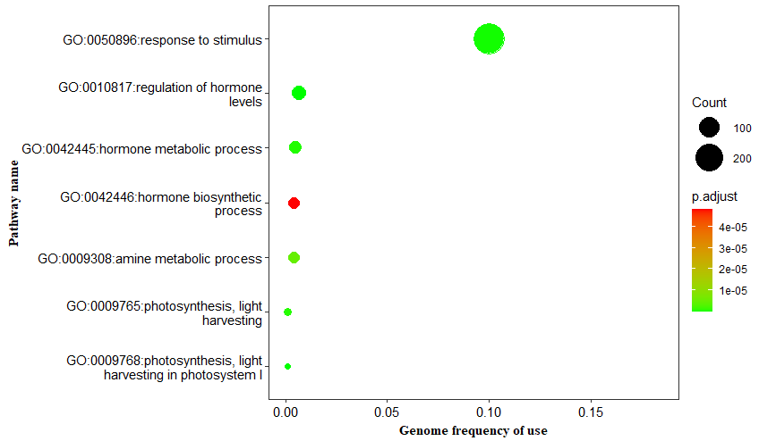
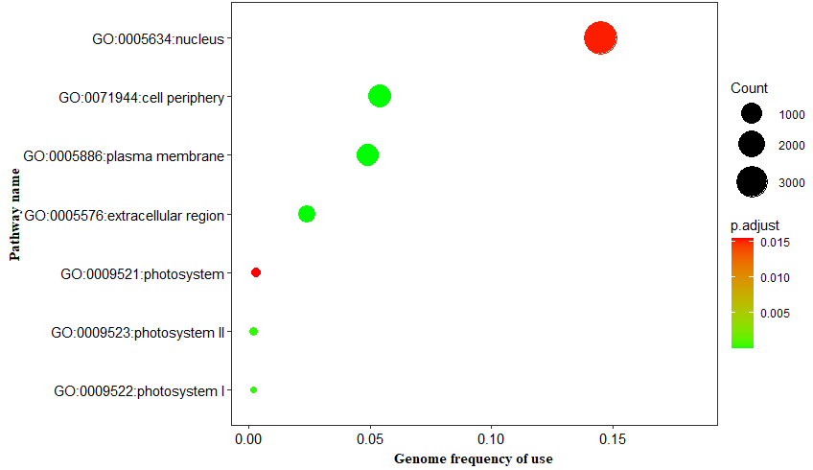
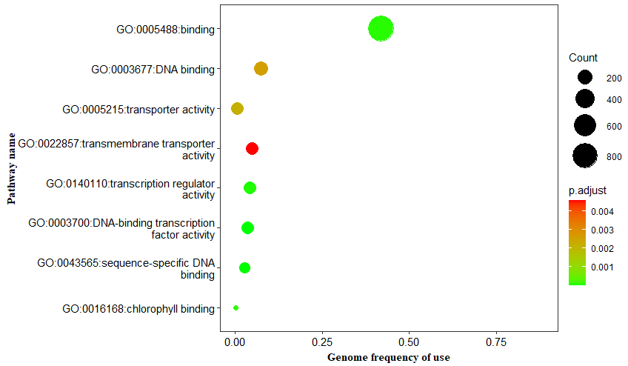
Biological process
Cellular component
A
B
Molecular function
C
Fig. S11. GO enrichment of the 1795 DEGs for biological process (BP), cellular component (CC) and molecular function (MF).

Slide 12
Cytokinin biosynthesis./signaling
B
Auxin biosynthesis/signaling
A
Log2 (Fold Change)
3
CsaV3_1G004350
CsaV3_5G028620
CsaV3_4G027450
CsaV3_1G036890
CsaV3_4G006770
CsaV3_5G020230
CsaV3_6G013960
CsaV3_3G034000
CsaV3_2G015870
CsaV3_4G026200
CsaV3_1G040980
CsaV3_6G050280
CsaV3_2G013230
CsaV3_2G004120
CsaV3_2G013210
CsaV3_3G046370
CsaV3_6G013600
CsaV3_1G013410
CsaV3_3G015720
1.21
1.15
0.94
-0.82
-0.51
-0.63
-0.63
0.64
-0.98
0.77
-0.91
-0.62
-0.69
1.72
2.92
1.09
1.05
-1.14
1.49
Auxin efflux carrier component
Auxin efflux carrier component
Auxin efflux carrier family protein
Auxin response factor
Auxin response factor
Auxin response factor
Auxin response factor
Auxin transporter-like protein
Auxin transporter-like protein
Auxin transporter-like protein
auxin-binding protein ABP19a-like
Auxin-repressed protein
Auxin-responsive protein
Auxin-responsive protein
Auxin-responsive protein
Auxin-responsive protein
auxin-responsive protein SAUR71
auxin-responsive protein SAUR72-like
auxin-responsive protein SAUR-like
CsaV3_3G041310
CsaV3_3G008110
CsaV3_3G028050
CsaV3_3G028080
CsaV3_6G051200
CsaV3_6G006470
CsaV3_4G000140
CsaV3_4G034710
CsaV3_2G030100
CsaV3_6G045120
CsaV3_4G035020
CsaV3_4G026490
CsaV3_1G004160
CsaV3_5G027140
CsaV3_3G035820
CsaV3_3G045750
CsaV3_6G012720
CsaV3_6G013990
CsaV3_6G039600
CsaV3_5G024480
CsaV3_5G028750
CsaV3_5G031940
CsaV3_2G034410
CsaV3_5G000090
-1.06
0.72
-1.00
-0.60
0.90
-0.67
-0.57
1.40
-0.61
-1.75
-0.86
-0.82
-0.54
0.67
-1.37
-2.61
-1.27
-1.74
-0.85
-1.49
-1.04
-1.07
-1.36
-1.46
cyclic dof factor 2
cyclic nucleotide-gated ion channel 1
Cyclic nucleotide-gated ion channel 1
cyclic nucleotide-gated ion channel 1-like
cyclic phosphodiesterase-like
Cyclin
Cyclin d protein
cyclin-D3-3-like
cyclin-D4-1-like
cyclin-D4-1-like isoform X1
cyclin-D5-2-like
cyclin-dependent kinase 11B-like
cyclin-dependent kinase D-3-like
cyclin-dependent protein kinase inhibitor SMR3
Cytokinin riboside 5'-monophosphate phosphoribohydrolase
Cytokinin riboside 5'-monophosphate phosphoribohydrolase
Cytokinin riboside 5'-monophosphate phosphoribohydrolase
Cytokinin riboside 5'-monophosphate phosphoribohydrolase
Cytokinin riboside 5'-monophosphate phosphoribohydrolase
Two-component response regulator
Two-component response regulator
Two-component response regulator
Two-component response regulator-like APRR2
two-component response regulator-like APRR5
-3
C
Photosynthesis
CsaV3_1G002410
CsaV3_1G005600
CsaV3_1G032510
CsaV3_3G005950
CsaV3_4G026100
CsaV3_5G030270
CsaV3_6G013800
CsaV3_6G051520
CsaV3_6G051530
CsaV3_5G025740
CsaV3_5G039350
CsaV3_6G005340
CsaV3_7G002620
1.56
-2.54
1.15
1.30
0.80
1.18
0.81
1.07
1.51
0.53
0.59
0.51
0.63
Chlorophyll a-b binding protein, chloroplastic
Chlorophyll a-b binding protein, chloroplastic
Chlorophyll a-b binding protein, chloroplastic
Chlorophyll a-b binding protein, chloroplastic
Chlorophyll a-b binding protein, chloroplastic
Chlorophyll a-b binding protein, chloroplastic
Chlorophyll a-b binding protein, chloroplastic
Chlorophyll a-b binding protein, chloroplastic
Chlorophyll a-b binding protein, chloroplastic
Chlorophyll a-b binding protein, chloroplastic
Chlorophyll a-b binding protein, chloroplastic
Chlorophyll a-b binding protein, chloroplastic
Chlorophyll a-b binding protein, chloroplastic
Fig. S12. Representative differential expressed genes (DEGs) in the SAM transcriptomes in the mutant vs in the WT in a cytokinin and cell cycle transition, b auxin/IAA biosynthesis/signaling pathway, and c the photosynthesis.

Slide 13
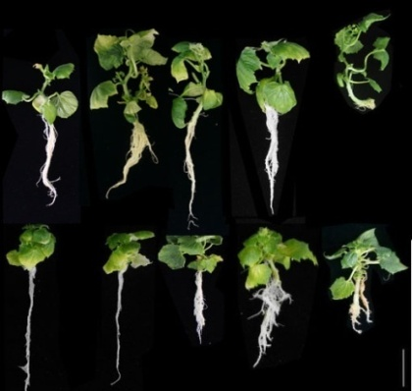
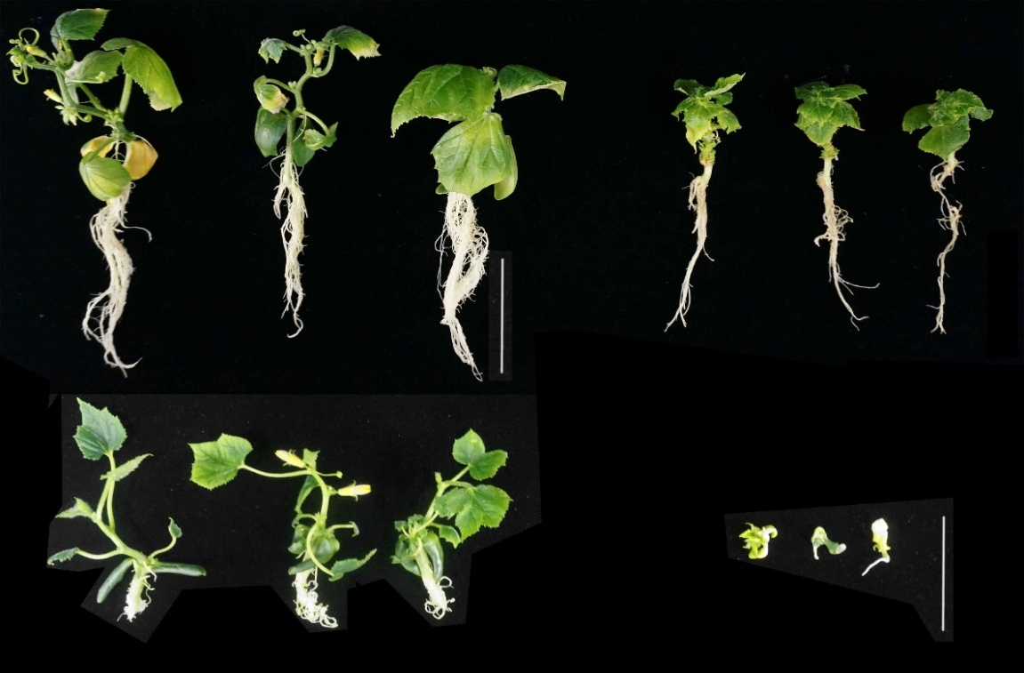
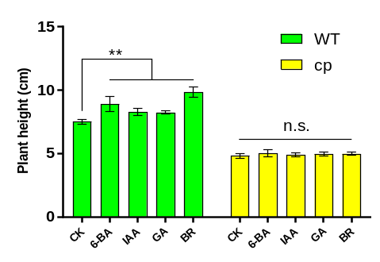
A
C
*
*
B
D
Fig. S13. Effect of hormone treatments in WT and mutant plants. a Appearances of plants of WT and the mutant grown on MS media supplemented with four hormones at different treatments: IAA (0.1 µM), 6-BA (0.1mg/L), GA3 (10 µM) and epi-BR (low: 0.01 µM and high: 5 µM). Data were collected at 21 days after germination。The red stars indicated branch development by 6-BA treatment. Bar = 5 cm. b All the treated WT plants were significantly higher than the control, while no different in plant heights among the treatments and the control (mutant). *: Significant differences in t tests at P <0.05. n.s.: not significant. c Appearances of WT and mutant plants without hormone treatments. d High-level BR results in severe developmental defect in the cp mutants.

Slide 14
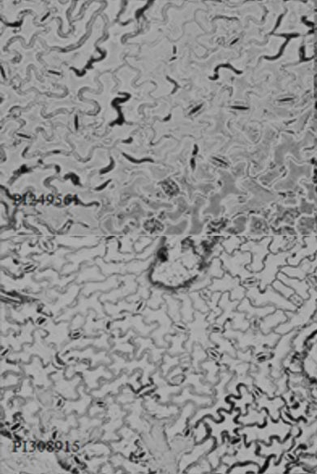
A
Fig. S14. The cp mutant had more stomata than the WT. a WI7200 (WT). b WI7201. Bar = 50 μm. The red stars indicated stomata.
*
*
*
*
*
*
*
*
*
*
*
*
WI 7200
B
B
*
*
*
*
*
*
*
*
*
*
*
*
*
*
*
*
*
*
*
*
*
*
*
*
*
*
*
*
*
*
*
*
*
*
*
*
*
*
*
*
*
*
*
*
*
*
*
*
*
*
WI 7201
*
*
*
*
*
*
*

