Slide 1
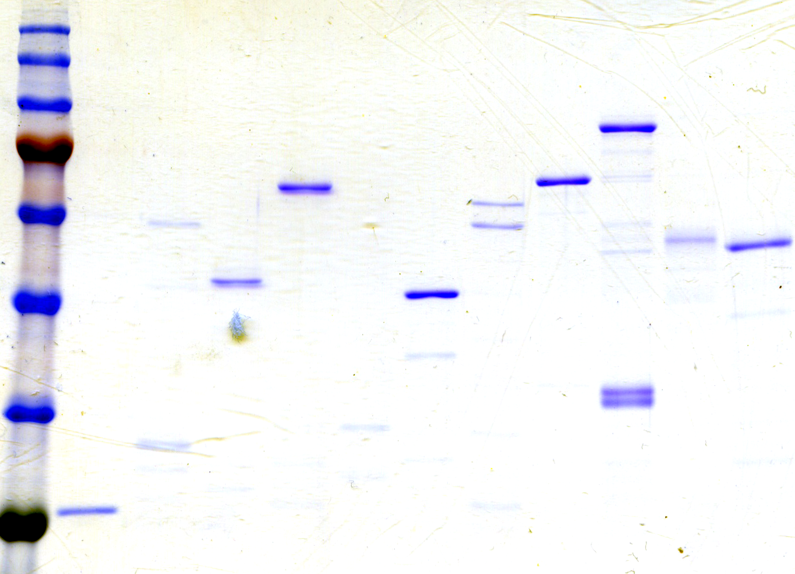
SDS-PAGE of purified proteins
MMP1-GST
CBX1-GST
ECSCR-GST
BRAT1-GST
NEMF-GST
WDR1-GST
KIF20B-GST
CBX5-GST
FH-GST
ALDOA-GST
GST
100 kDa-
75 kDa-
63 kDa-
48 kDa-
35 kDa-
28 kDa-
Candidate antigenic proteins proteins were separated through SDS-PAGE and stained with Coomassie Blue.
Notes:
Purified proteins were resolved and separated by SDS-PAGE and then either directly stained with Coomassie Blue

Slide 2
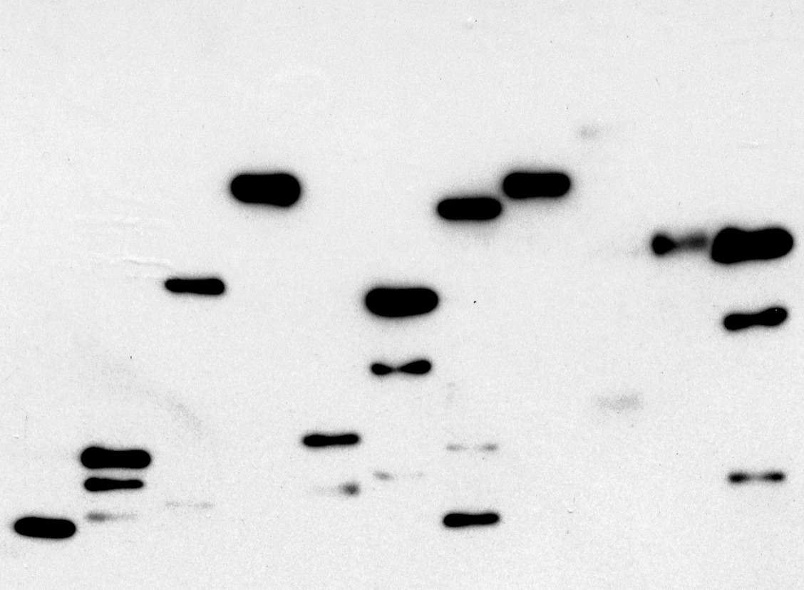
Western blotting using goat anti-GST antibody
CBX1-GST
MMP1-GST
ECSCR-GST
BRAT1-GST
NEMF-GST
WDR1-GST
CBX5-GST
KIF20B-GST
ALDOA-GST
FH-GST
GST
100 kDa-
75 kDa-
63 kDa-
48 kDa-
35 kDa-
28 kDa-
Almost all of the Coomassie-stained bands were recognized by anti-GST antibody, indicating that they were GST fusion proteins and the respective degradation products.
Notes:
Western blot analysis showed all recombinant GST fusion proteins can be detected at expected size (The molecular weight of the largest product was similar to that predicted by sequencing analysis).

