Slide 1
uncropped gel or blot
anti-p-AKT
anti-CXCR4
anti-AKT
anti-GAPDH
anti-p-mTOR
anti-mTOR

Slide 2
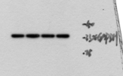
uncropped gel or blot
anti-p-AKT
anti-CXCR4
anti-AKT
anti-GAPDH
anti-p-mTOR
anti-mTOR

