Slide 1
Full Western Blots
670nm Photobiomodulation Modulates Bioenergetics And Oxidative Stress, Decreasing Inflammatory Mediator Production In An In Vitro Model Of Diabetic Retinopathy
Hannah J. Nonarath²*, Alexandria E. Hall¹*, Gopika SenthilKumar³, Betsy Abroe¹, Janis T. Eells¹ and Elizabeth S. Liedhegner^{1#}

Slide 2
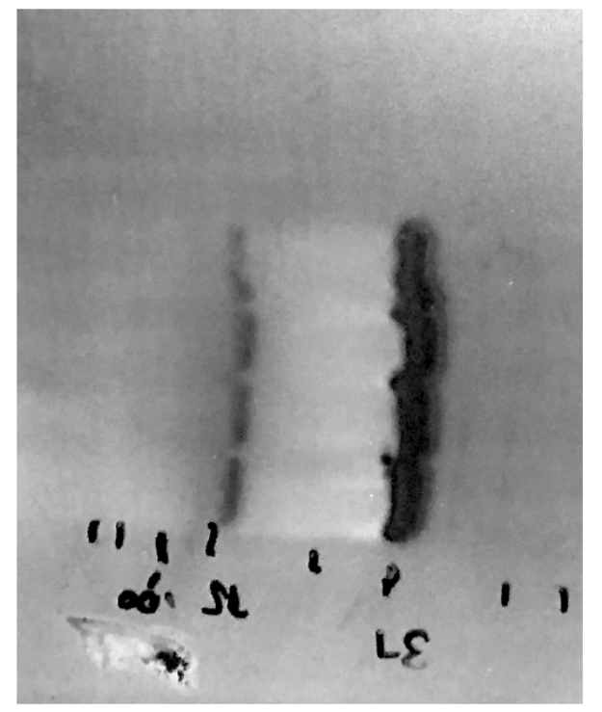
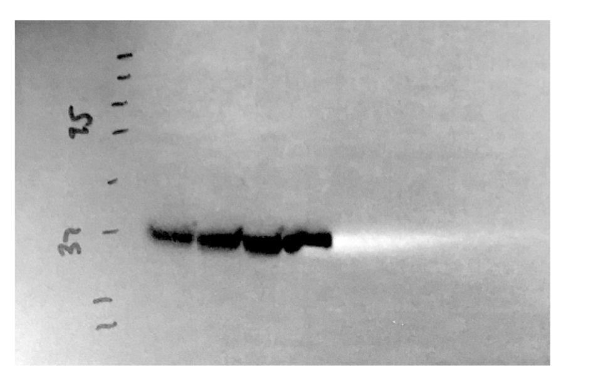
(A)
Normal glucose 670nm
Normal glucose sham
High glucose sham
High glucose 670nm
ICAM
Figure S1: Full length western blot image for ICAM and GAPDH. Cropped image is seen in Figure 4. (A): ICAM reactivity shown as ladder, normal glucose sham, normal glucose 670nm light, high glucose sham, high glucose 670nm light. (B) GAPDH reactivity shown as ladder, normal glucose sham, normal glucose 670nm light, high glucose sham, high glucose 670nm light. Arrow denotes band of interest.
(B)
GAPDH

Slide 3
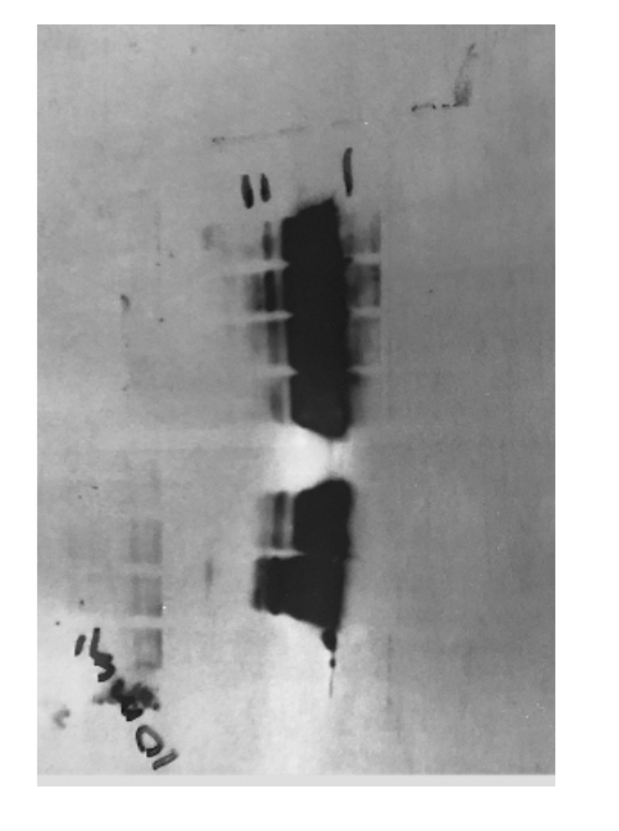
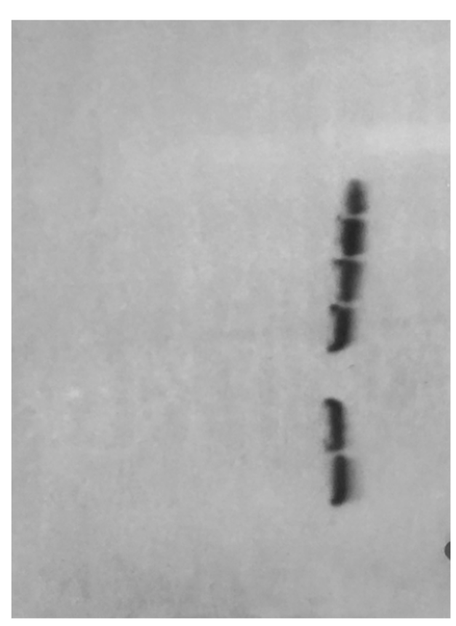
(A) ICAM
Heart tissue, positive control
(B) GAPDH
High glucose sham
Normal glucose 670nm
Heart tissue, positive control
Normal glucose sham
High glucose 670nm
Normal glucose 670nm
Normal glucose sham
High glucose sham
High glucose 670nm
Heart tissue, positive control
Figure S2: Full length western blot image for ICAM and GAPDH. Cropped image is seen in Figure 4. (A): ICAM reactivity shown as positive control (heart tissue, mouse), positive control (heart tissue, mouse), empty well, normal glucose sham, normal glucose 670nm light, high glucose sham, high glucose 670nm light, ladder. (B) GAPDH reactivity shown as positive control (heart tissue, mouse), positive control (heart tissue, mouse), empty well, normal glucose sham, normal glucose 670nm light, high glucose sham, high glucose 670nm light, ladder. Arrow denotes band of interest.

Slide 4
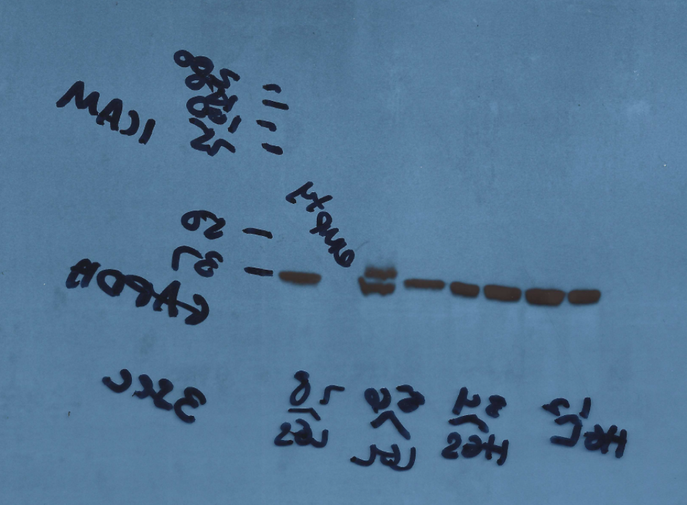
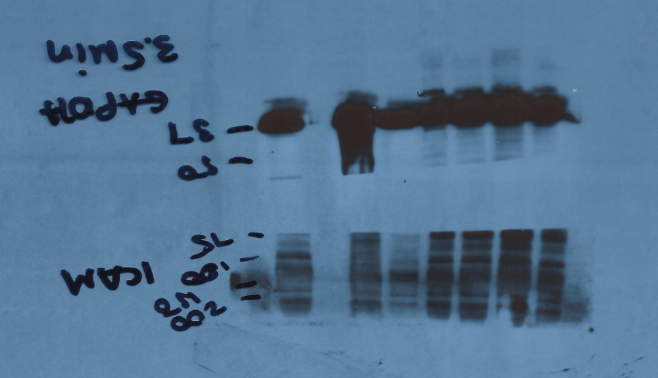
(B)
(A)
Key:
HGL=high glucose, 670nm
HGS=high glucose, sham
LGL=low glucose, 670nm
LGS=low glucose, sham
Figure S3: Full length western blot image for ICAM and GAPDH. Cropped image is seen in Figure 4. (A): ICAM reactivity shown as high glucose 670nm light, high glucose 670nm light, high glucose sham, high glucose sham, normal glucose 670nm light, normal glucose 670nm light, empty, normal glucose sham, ladder. (B) GAPDH reactivity shown as high glucose 670nm light, high glucose 670nm light, high glucose sham, high glucose sham, normal glucose 670nm light, normal glucose 670nm light, empty, normal glucose sham, ladder. Each sample represents a single replicate (i.e. 2 independent replicates of high glucose 670 nm). Arrow denotes band of interest.

