Slide 1
Visual Patient
Intensive Care
Computer-based multicenter study

Slide 2
Instructions
Thank you very much for participating in this study!
Main topic of our study group: new ways of presenting medical information
  Improving perception
  Improving situational awareness for possible changes
Technique for vital sign presentation: “Visual Patient"
  animated virtual model of the monitored patient
Aim

Slide 3
Instructions
Study: Comparison of two ways of displaying vital signs
  “Visual patient” vs. “conventional monitor”
1. Teachingvideo «Visual Patient»
2. Example «conventional monitor»
3. One by one: 10 monitor slides (15 seconds each)
  5x conventional design
  5x “Visual Patient"
Task: Try to remember as many vital signs and installations as possible
Please answer the questions on the iPad after each example

Slide 4
Instructions
Please answer the general questions on the iPad

Slide 5
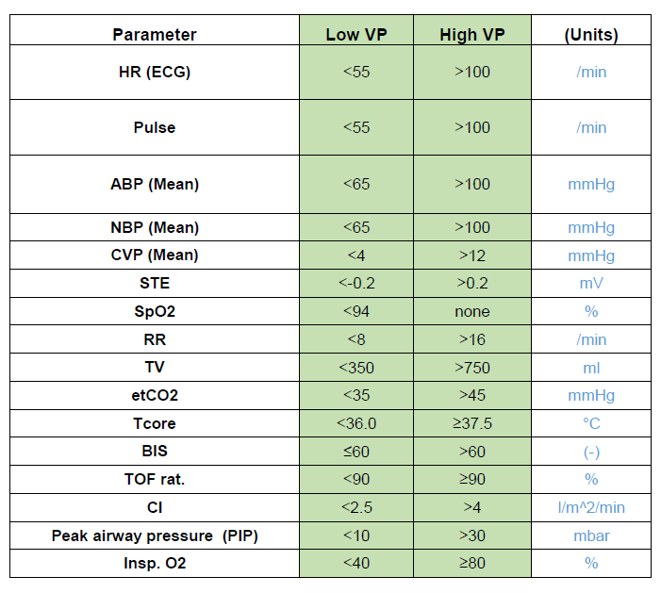
Instructions
Table with the defined limit values

Slide 6
Introduction
Teachingvideo «Visual patient»

Slide 7
Introduction
Example «conventional monitor»

Slide 8
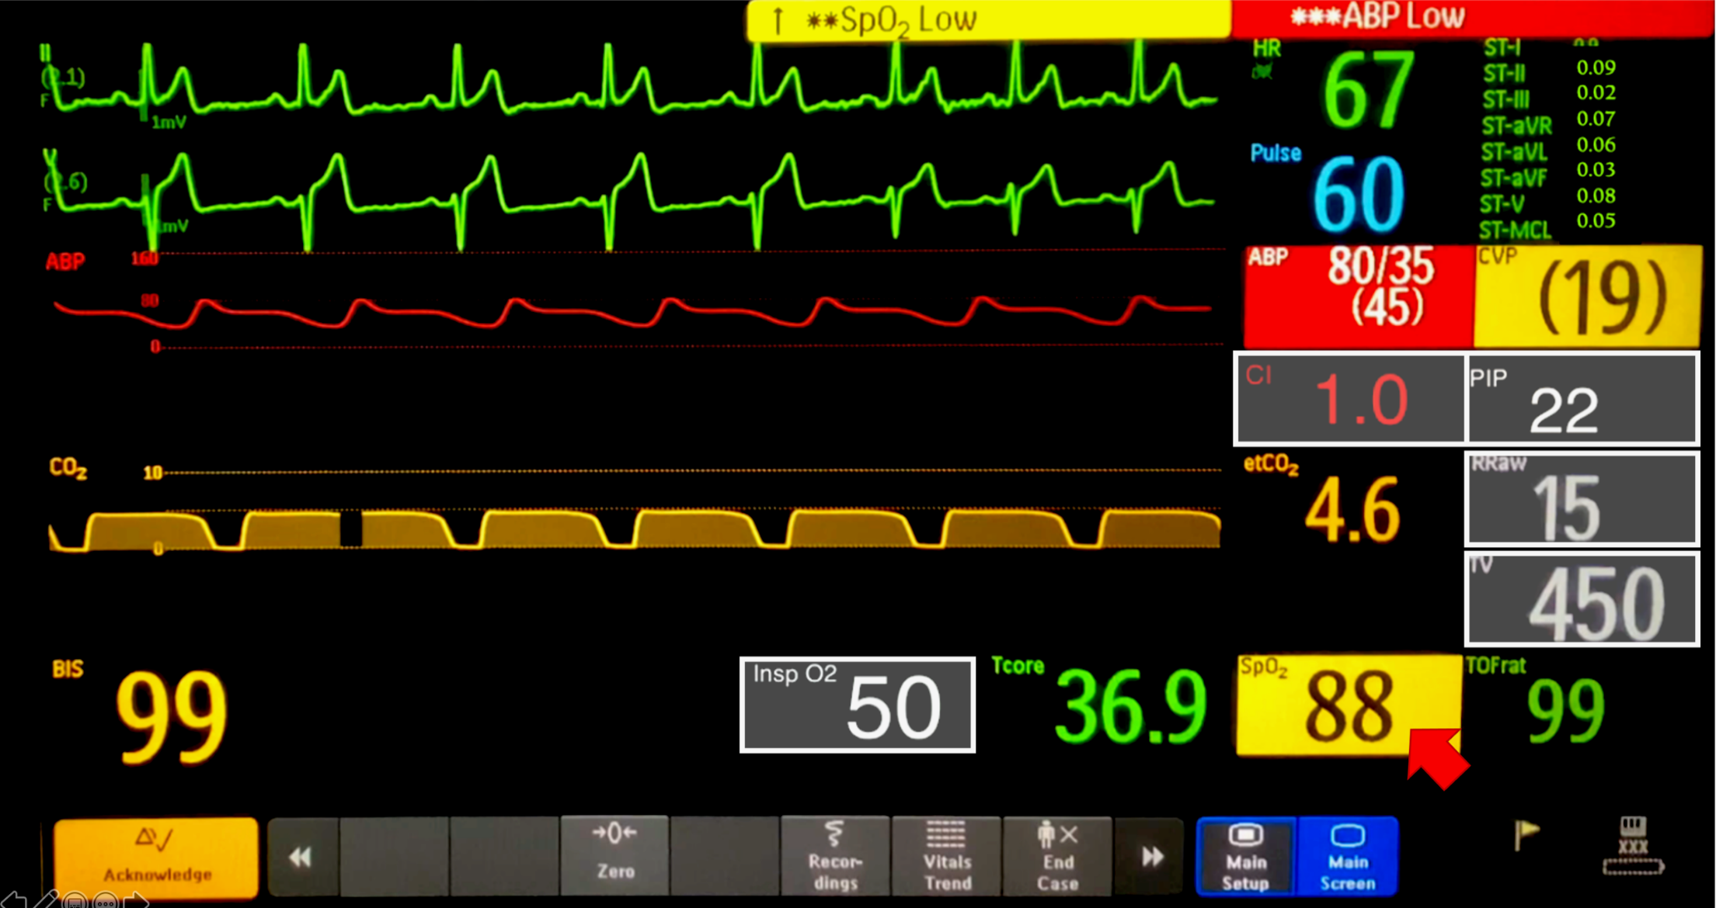


3.8
30
40
60
80
Peripheral venous line
Peripheral venous line
Central venous line
Arterial line
Tube
Urinary catheter
Brain-activity sensor

Slide 9
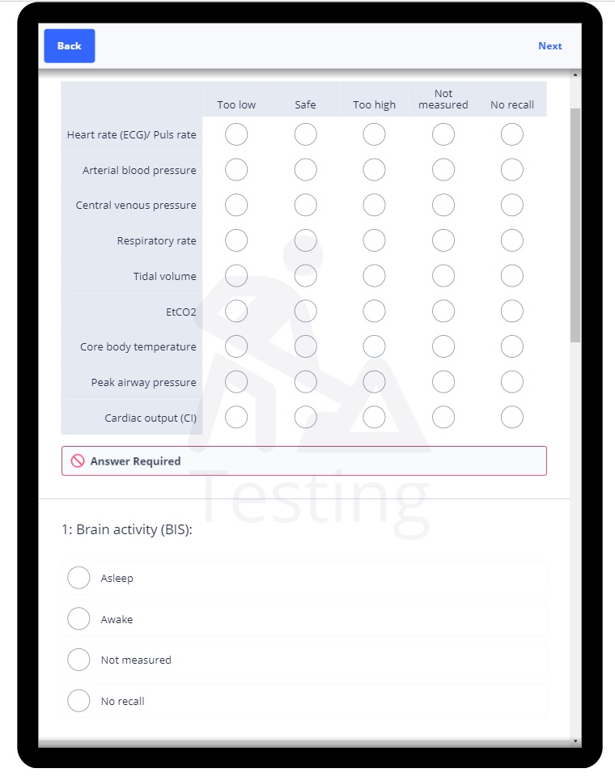
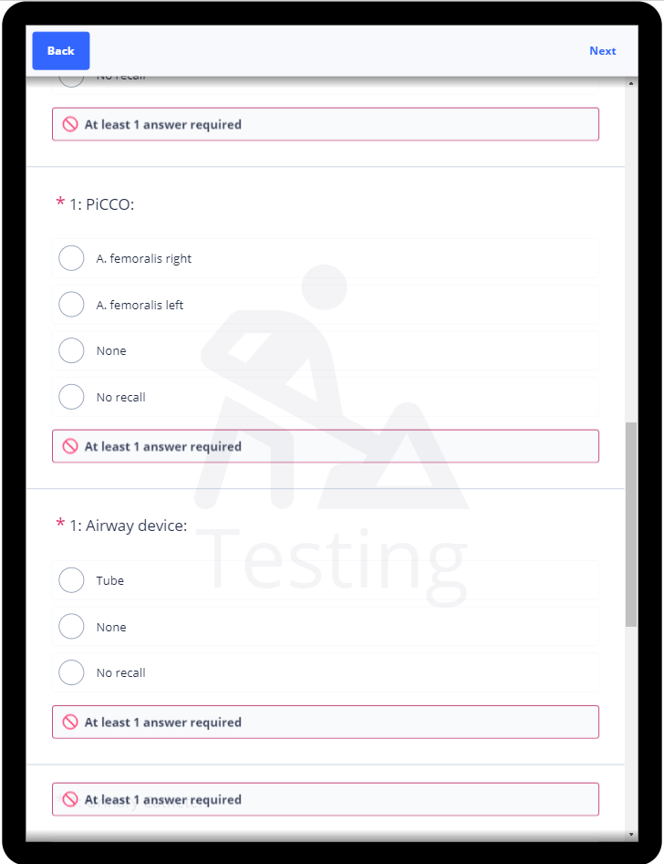
Survey

Slide 10
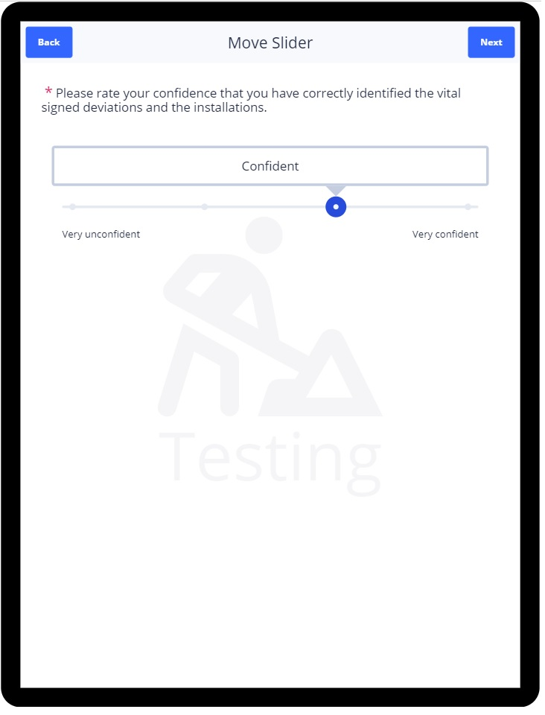
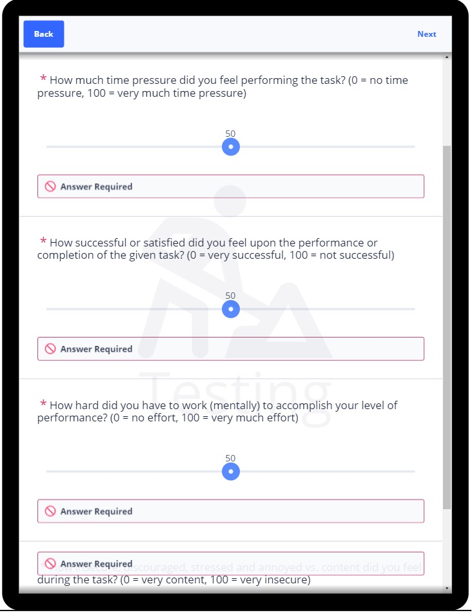
Survey

Slide 11
Case 1

Slide 12








VP1

