Slide 1
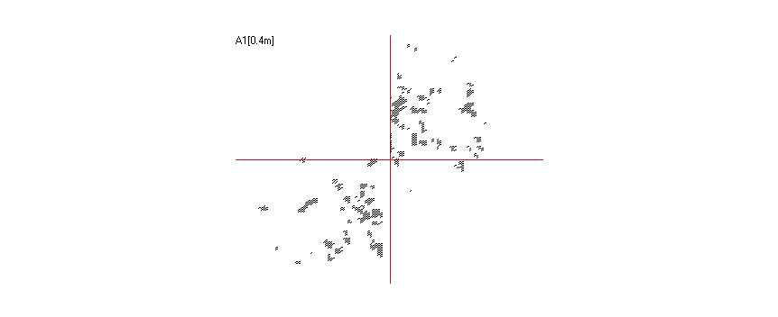
Movie S1
Day 3 (N2)

Slide 2
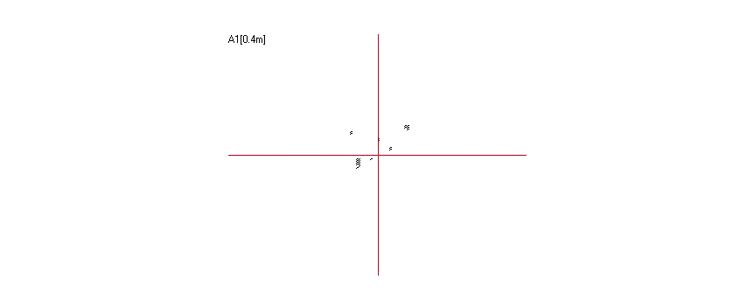
Movie S2
Day 3 (UA196)

Slide 3
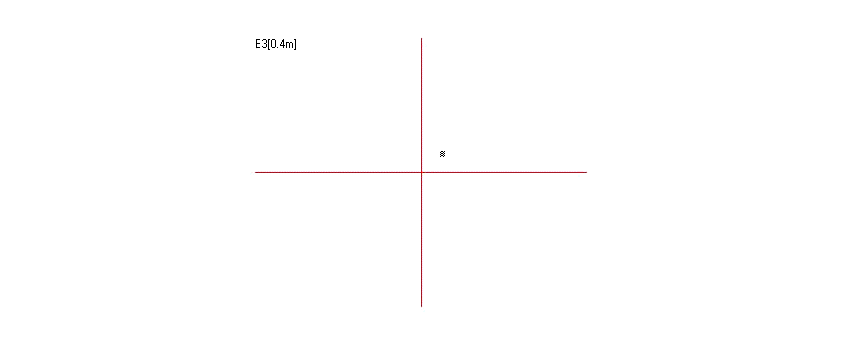
Movie S3
Day 3 (UA196 + 50 μM NS163)

Slide 4
Movie S4
Day 3 (UA196 + 50 μM NS132)

Slide 5
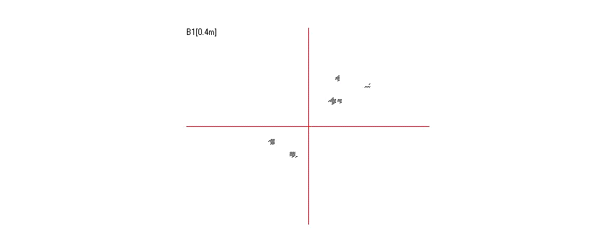
Movie S5
Day 10 (N2)

Slide 6
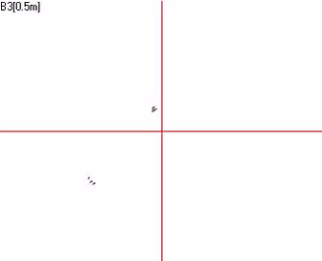
Movie S6
Day 10 (UA196)

Slide 7
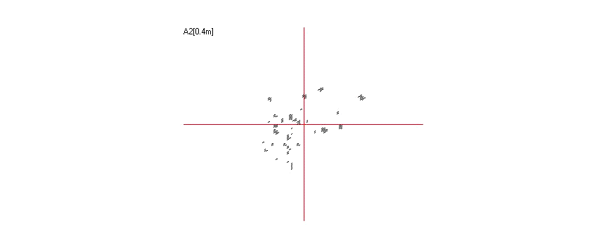
Movie S7
Day 10 (UA196 + 50 μM NS163)

Slide 8
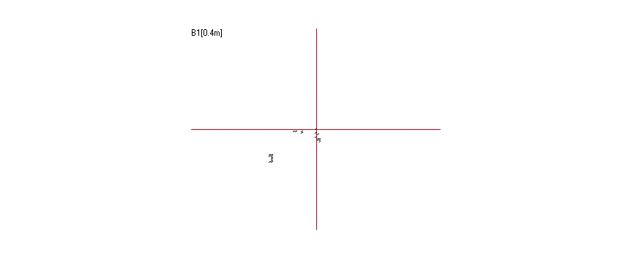
Movie S8
Day 10 (UA196 + 50 μM NS132)

