Slide 1
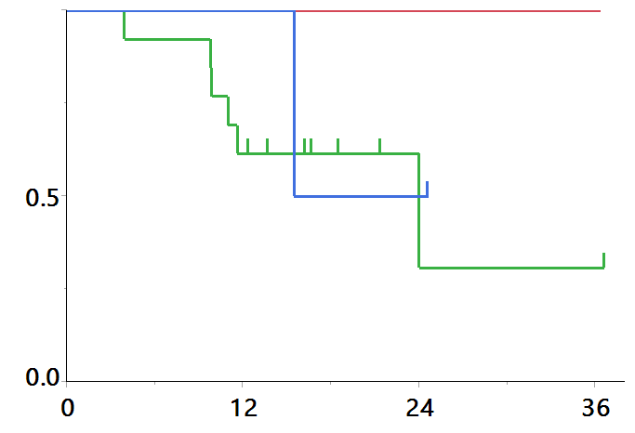
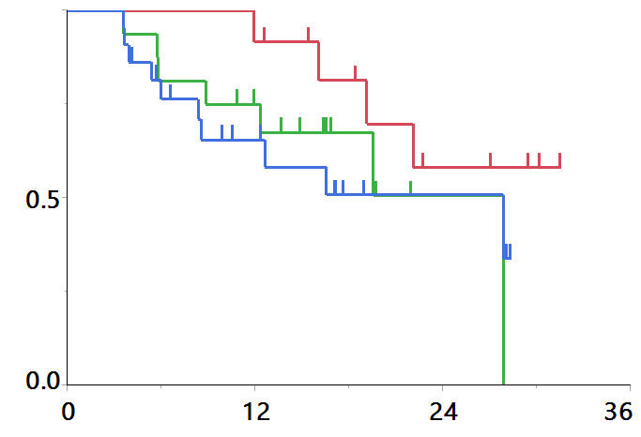
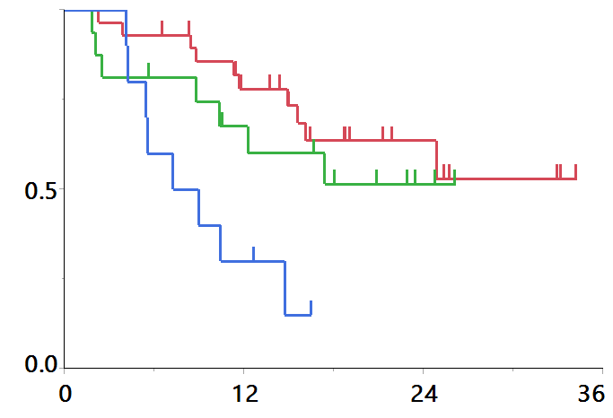
Supplementary Figure 4 K-M for OS divided by PD-L1 status
a
b
months
months
PTI index | N | Median OS | HR
Low | 5 | NR | 1
Intermediate | 13 | 24.0 | 1.54 (0.48-5.50)
High | 3 | NR | 2.21(0.30-11.2)
P=0.17 by Log-rank test
PTI index | N | Median OS | HR
Low | 14 | NR | 1
Intermediate | 17 | 27.9 | 2.95 (1.07-8.69)
High | 22 | 27.8 | 2.36 (0.94-6.43)
P=0.24 by Log-rank test
c
months
PTI index | N | Median OS | HR
Low | 29 | NR | 1
Intermediate | 16 | NR | 1.14 (0..48-2.54)
High | 11 | 8.1 | 4.49 (0.98-15.5)
P<0.01 by Log-rank test

