Slide 1
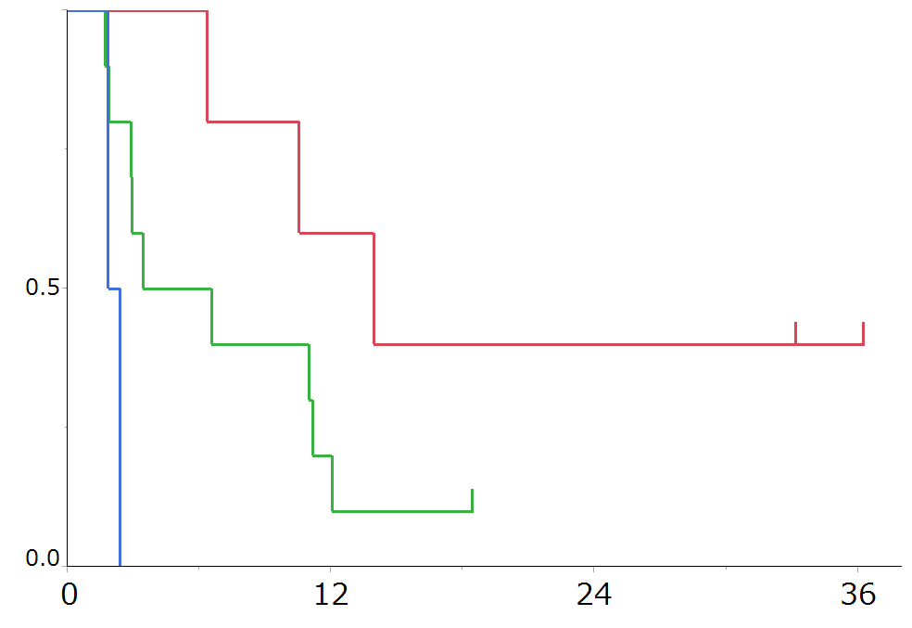
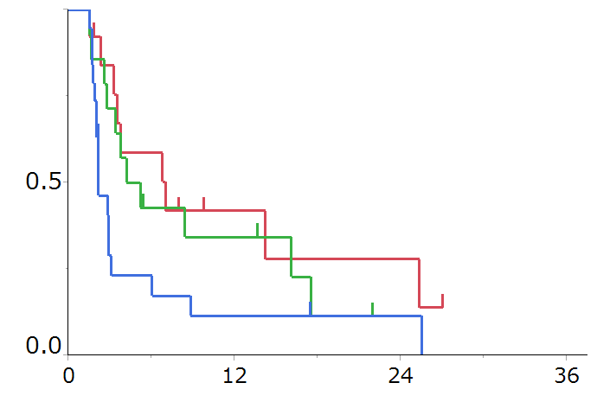
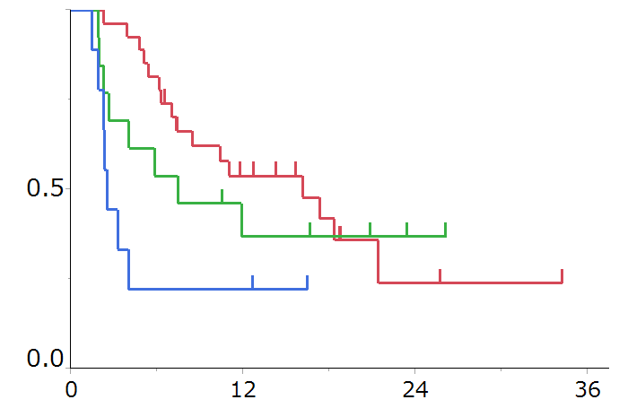
Supplementary Figure 3 K-M for PFS divided by PD-L1 status
a
b
months
months
PTI index | N | Median PFS | HR
Low | 5 | 13.9 | 1
Intermediate | 10 | 5.0 | 2.85 (0.82-13.1)
High | 2 | 2.1 | 21.6 (2.06-248.2)
P<0.01 by Log-rank test
PTI index | N | Median PFS | HR
Low | 13 | 7.0 | 1
Intermediate | 14 | 4.7 | 1.28 (0.52-3.20)
High | 19 | 2.1 | 2.38 (1.07-5.65)
P=0.07 by Log-rank test
c
months
PTI index | N | Median PFS | HR
Low | 27 | 16.1 | 1
Intermediate | 13 | 7.4 | 1.26 (0.51-2.88)
High | 9 | 2.5 | 3.24 (1.22-7.82)
P=0.03 by Log-rank test
Notes:
6w未満にPD除外

