Slide 1
Fi S1: Classification of breeding sites according to the container material. The percentage show the proportion of each type of material according to the Health district. Values in brackets indicate the number of breeding sites in each district

Slide 2
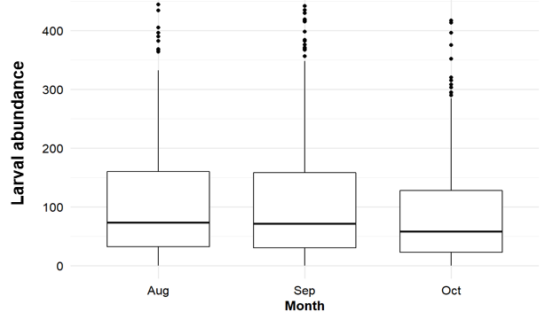
Fig. S2: Graph of Aedes aegypti mosquito larval abundance according to collection period: Aug (August), Sep (September) and Oct (October).

Slide 3
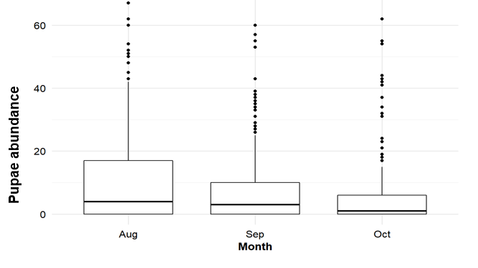
Fig. S3: Graph of pupal abundance according to collection period. Aug (August), Sep (September) and Oct (October).

