Slide 1
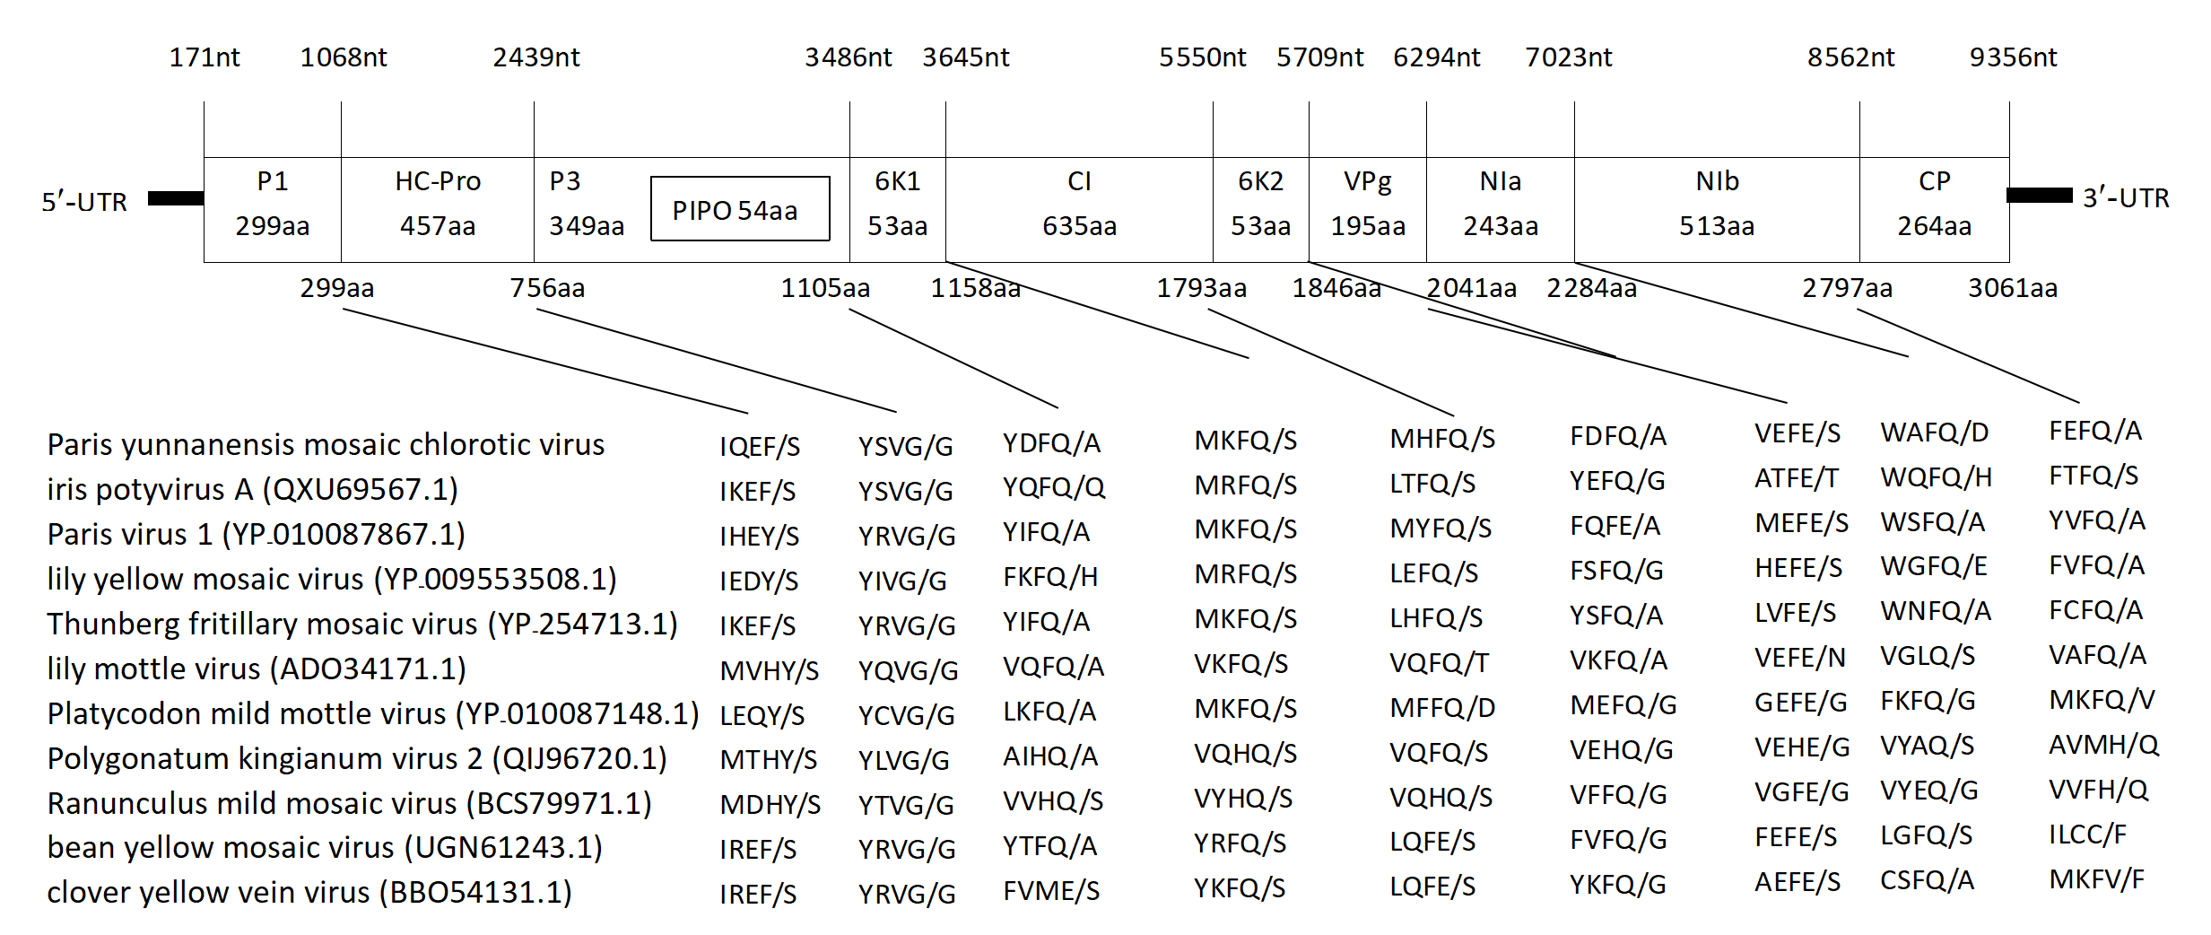
Supplementary figure 1. Genome organization of PyMCV. The cleavage sites for generation of 10 mature proteins were predicted by comparative analysis of PyMCV with some other potyviruses. The shaded part “ / ” is the proteolytic cleavage site in each protein. The 5’- and 3’- untranslated regions (UTR) are represented by a bold black line. The putative protein PIPO identified within P3 protein is indicated by a small black rectangle. The putative protein cleavage sites in the polyprotein and the length of amino acids of each protein is indicated in each small box. The numbers above and below the genome indicate the genomic positions of nucleotides and amino acids respectively

Slide 2
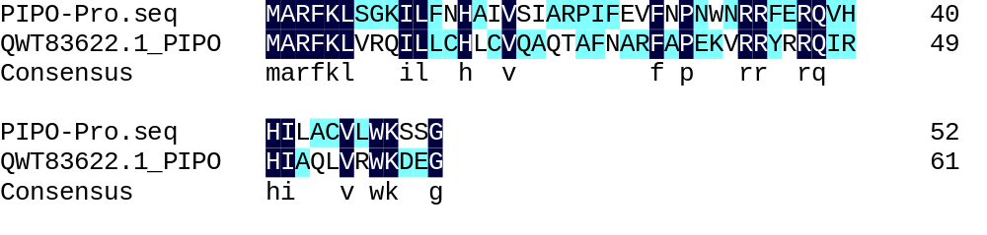
Supplementary figure 2. Comparison of structural domain of P3N-PIPO between PyMCV and beet mosaic virus (QWT83622.1)

Slide 3
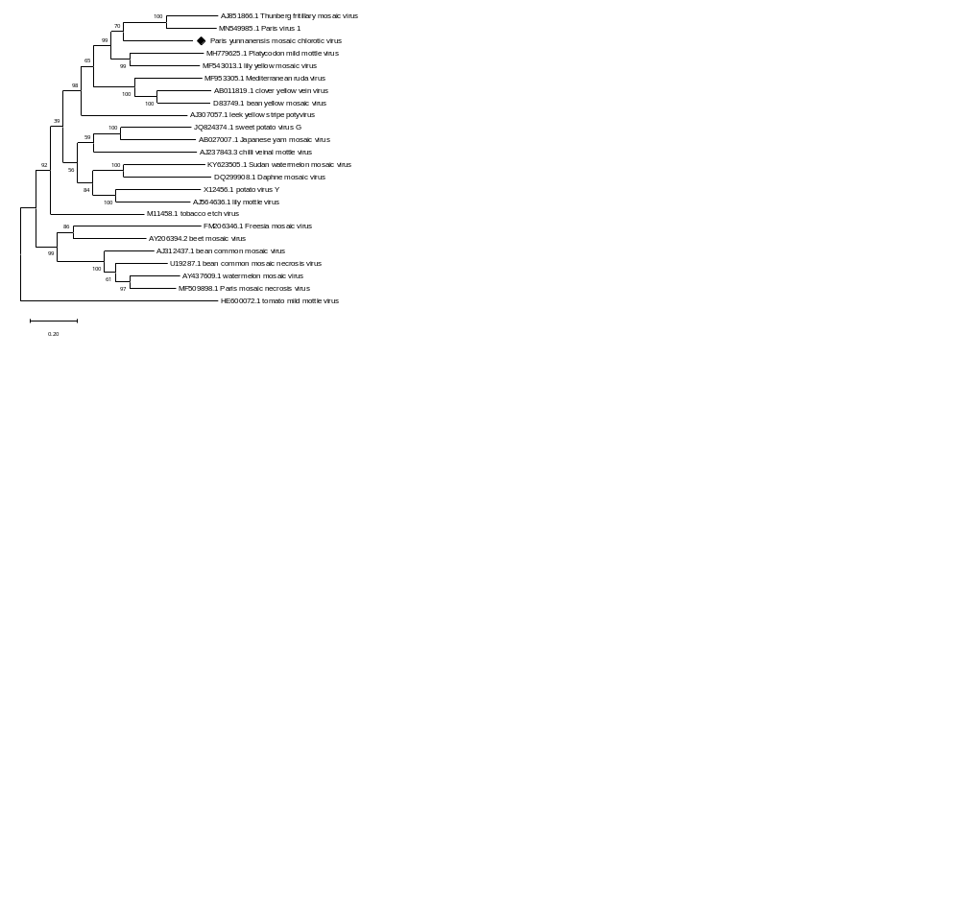
Supplementary figure 3. Phylogenetic analysis of Paris yunnanensis mosaic chlorotic virus (PyMCV) and other members of the genus Potyvirus based on complete sequences. Viral genome sequences were downloaded from GenBank

Slide 4
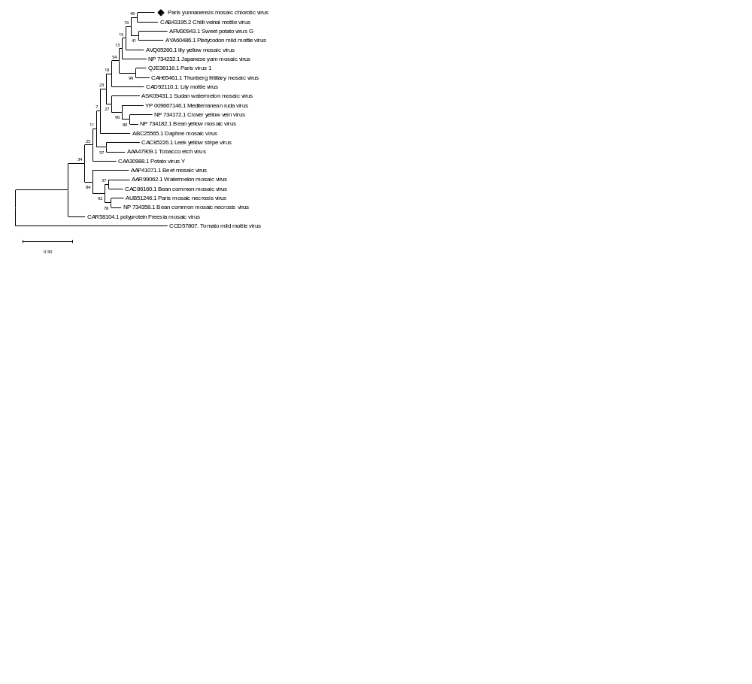
Supplementary figure 4. Phylogenetic analysis of Paris yunnanensis mosaic chlorotic virus (PyMCV) and other members of the genus Potyvirus based on coat protein aa sequences. Viral genome sequences were downloaded from GenBank

Slide 5
Supplementary table 1. Comparison of PyMCV-encoded mature proteins with other potyviruses
Putative Mature Proteins | Amino acid | Virus | Nucleotide | Virus
P1 | 26.96% | iris potyvirus A | 46.20% | iris potyirus A
HC-Pro | 54.27% | tulip breaking virus | 57.20% | leek yellow stripe virus
P3 | 39.94% | lily yellow mosaic virus | 53.70% | lily yellow mosaic virus
6K1 | 56.60% | tulip breaking virus | 57.90% | tulip breaking virus
CI | 67.56% | Paris virus 1 | 63.90% | Thunberg fritillary mosaic virus
6K2 | 58.49% | Lettuce Italian necrotic virus | 57.90% | Thunberg fritillary mosaic virus
VPg | 68.85% | tulip breaking virus | 42.50% | tulip breaking virus
NIa | 62.96% | Thunberg fritillary mosaic virus | 57.10% | Dioscorea mosaic virus
NIb | 72.20% | lily mottle virus | 61.70% | beet mosaic virus
CP | 73.11% | chilli veinal mottle virus | 60.60% | Plum pox virus

Slide 6
Supplementary table 2. Comparison of complete genome sequences between PyMCV and other potyvirus
Scientific Name | Identity
Thunberg fritillary mosaic virus (AJ851866.1) | 59.60%
plum pox virus (OK562676.1) | 57.80%
clover yellow vein virus (MT631721.1) | 56.90%
sweet potato virus G (KF790759.1) | 56.80%
sweet potato latent virus (MK778800.1) | 56.70%
leek yellow stripe virus (JQ899450.1) | 56.40%
lettuce mosaic virus (KJ161186.1) | 56.00%
wild tomato mosaic virus (MT793717.1) | 55.90%
Japanese yam mosaic virus (KJ789139.1) | 55.70%
turnip mosaic virus (AB701737.1) | 55.70%
konjac mosaic virus (MK770338.1) | 55.40%
sugarcane mosaic virus (KR108213.1) | 54.90%
beet mosaic virus (AY206394.2) | 54.70%
Freesia mosaic virus (GU214748.1) | 54.70%
Telosma mosaic virus (DQ851493.1) | 54.30%
Hardenbergia mosaic virus (KJ152153.1) | 54.20%

Slide 7
Supplementary table 3. Comparison of polyprotein aa sequences between PyMCV and other potyvirus
Scientific Name | Identity
iris potyvirus A (QXU69567.1) | 57.90%
lily yellow mosaic virus (YP 009553508.1) | 57.10%
Paris virus 1 (YP 010087867.1) | 57.00%
Thunberg fritillary mosaic virus (YP 254713.1) | 56.10%
Platycodon mild mottle virus (YP 010087148.1) | 53.70%
lily mottle virus (UBF41691.1) | 53.40%
Polygonatum kingianum virus 2 (QIJ96720.1) | 52.90%
bean yellow mosaic virus (UGN61243.1) | 52.60%
clover yellow vein virus (BBO54131.1) | 52.50%
Ranunculus mild mosaic virus (BCS79971.1) | 52.30%
Mediterranean ruda virus (YP 009666832.1) | 52.10%
white lupin mosaic virus (ABG33691.1) | 51.90%
leek yellow stripe virus (QED45151.1) | 51.80%
Polygonatum kingianum virus 5 (QVN46485.1) | 51.80%

