Slide 1
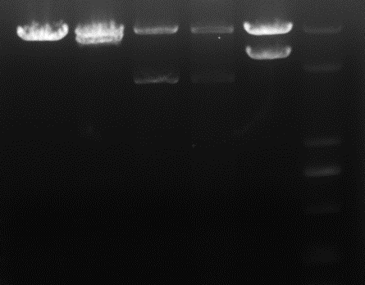
1 2 3 4 5 Marker
3000bp
2000bp
1000bp
Fig. S1 Four candidate DNA vaccines were successfully constructed. Agarose gel electrophoresis of the recombinant plasmid digested by restriction enzymes. Lane1: pVAXI DNA, Lane2:A39 DNA, Lane3:B37 DNA, Lane4:B31 DNA, Lane5:B21 DNA.

Slide 2
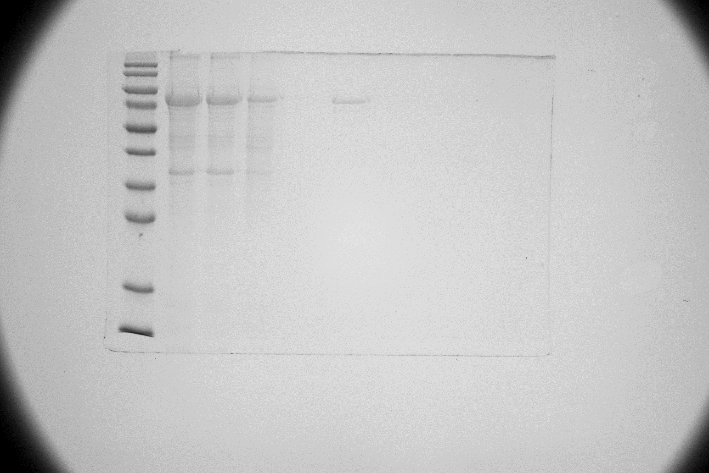
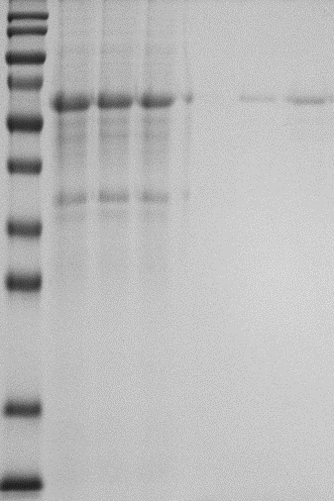
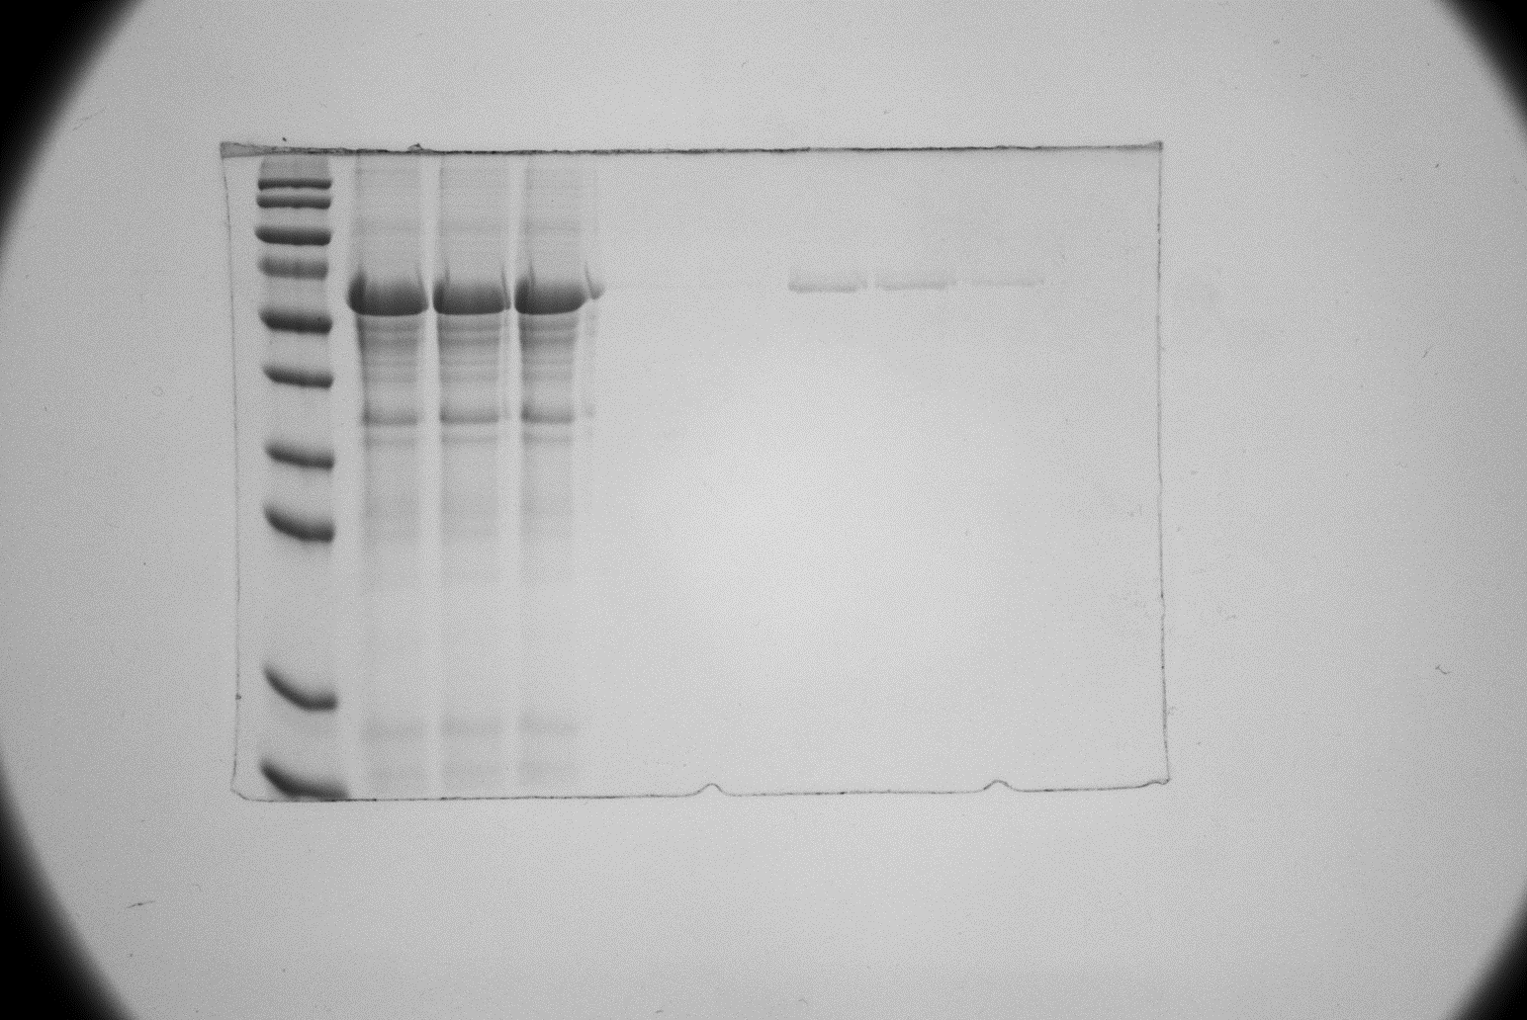
A
B
C
100kD
100kD
100kD
70kD
70kD
70kD
50kD
50kD
50kD
Fig. S2 A39,B31 and B21 antigens were successfully induced in E. coli BL21 by supplementation with 2 mM isopropyl β-d-thiogalactoside (IPTG) for 8 h. (A) The lane selected in the red box is the purified A39 protein. (B) The lane selected in the red box is the purified B31 protein. (C) The lane selected in the red box is the purified B21 protein.

Slide 3
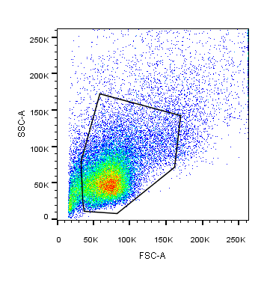
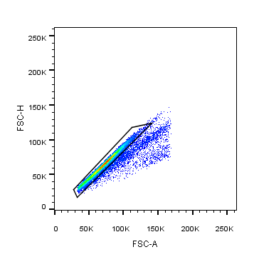
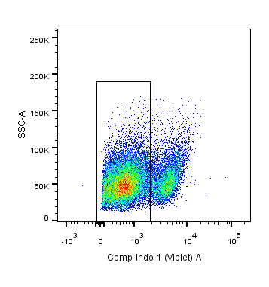
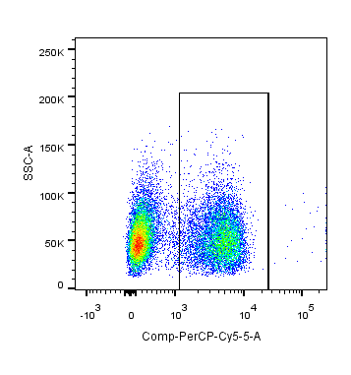
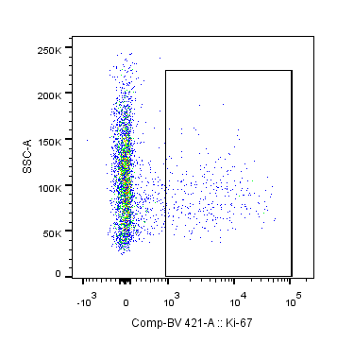
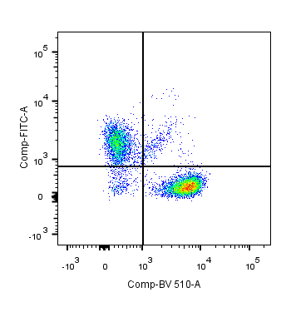
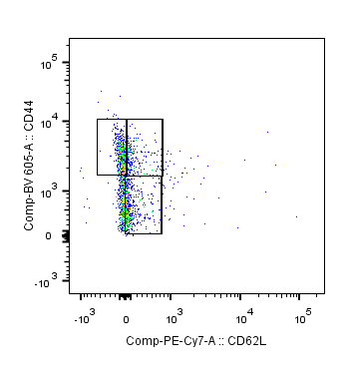
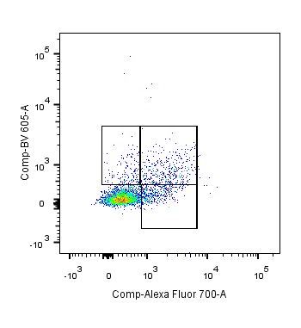
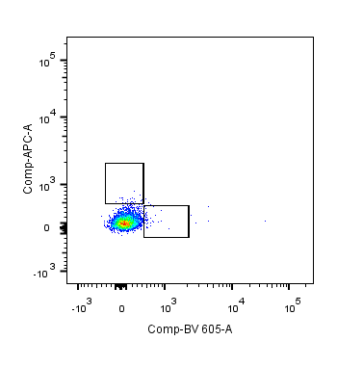
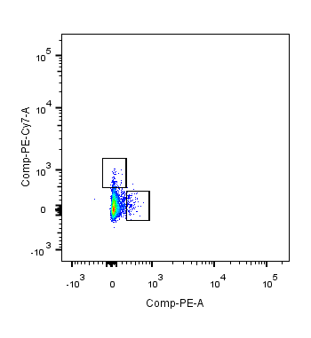
Lymphocyte
Single cell
Live cell
CD3
SSC-A
FSC-H
SSC-A
SSC-A
Single cell
FSC-A
FSC-A
Live/Dead
PerCP-Cy5.5-CD3
In CD3 GATE
In CD3 GATE
In CD4/CD8 GATE
In CD8 GATE
T_{EM}
T_{CM}
SSC-A
FITC-CD8
BV605-CD44
BV605-IFN-γ
T_{Naive}
BV421-Ki-67
BV510-CD4
PE-cy7-CD62L
AF700-CD107a
In CD4 GATE
In CD4 GATE
PE-cy7-CD154
APC-IL-4
PE-IL-17A
BV605-IFN-γ
Fig. S3 The gating strategy of T-cell subsets in splenic lymphocytes was analyzed by flow cytometry. Lymphocytes isolated from the spleens of treated mice were stained with anti-CD3, anti-CD4, anti-CD8, anti-IFN-γ, anti-IL-4, anti-IL-17A, anti-CD154 and anti-CD107a to assess the response to multifunctional cellular immunity, with additional analysis of memory T cell profiles with anti-CD44 and anti-CD62L.

Slide 4
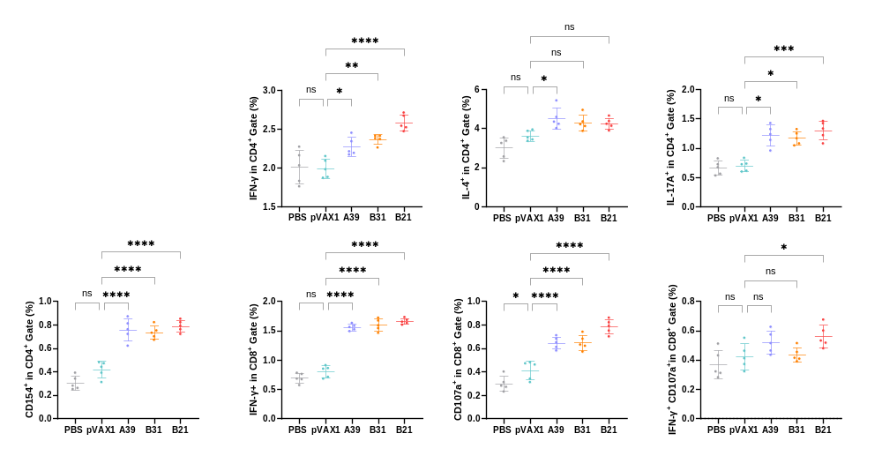
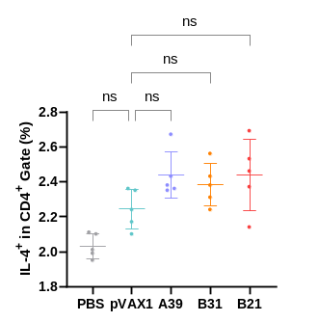
A
B
C
D
E
F
G
H
Fig. S4 The frequency of T-cell subsets in splenocytes was assessed by flow cytometry. Four weeks after immunization, spleen lymphocytes isolated from vaccine and control mice were stimulated in vitro with the fusion protein for 16 hours. Representative dot plots are shown for(A) % CD4+IL-4+ cells in splenocytes after two weeks of immunization (B) % CD4+ IFN-γ+ cells, (C) % CD4⁺IL-4⁺ cells ,(D) % IL-17A⁺cells in CD4⁺ T cell subset, (E) % CD154⁺cells in CD4⁺ T cell subset, (F) % IFN-γ⁺ cells in CD8+ T cell subset, (G) % CD107a⁺ cells in CD8⁺ T cell subset, (H) % IFN-γ⁺CD107a⁺cells in CD8⁺ T cell subset. Data were shown as mean± SD, n=5. Statistical analyses were performed by the method of one-way ANOVA (*, P< 0.05, **, P< 0.01, ***, P< 0.001, ****, P< 0.0001).

