Slide 1
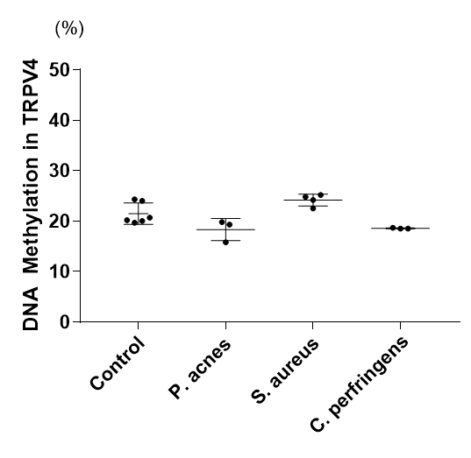
Supplemental Fig. 1

Slide 2
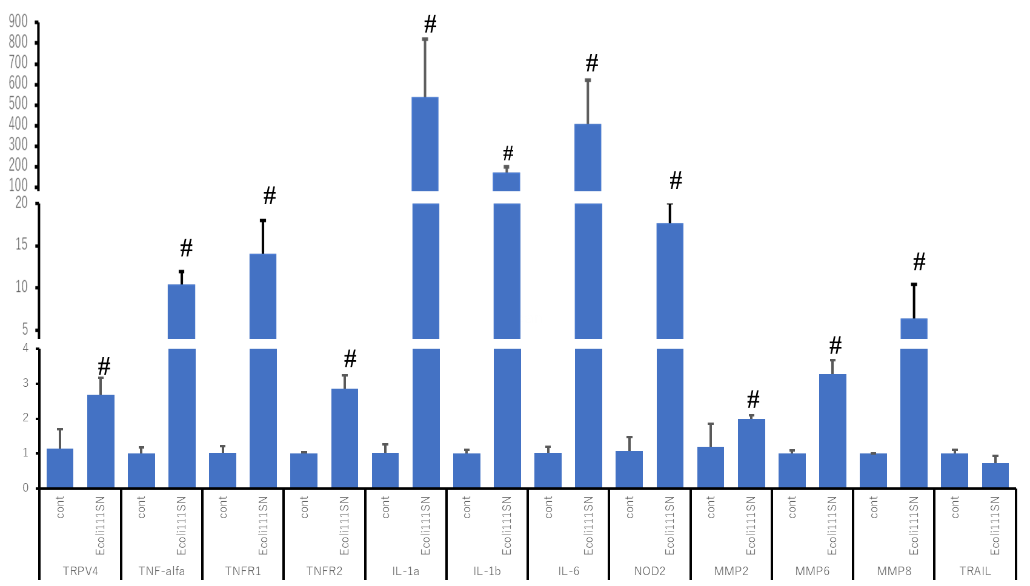
Supplemental Fig. 2
mRNA expression/β-actin

Slide 3
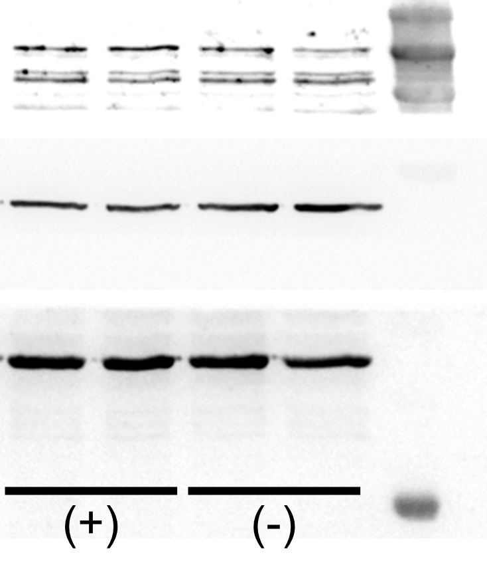
TRPV4
Supplemental Fig. 3
TNF-αR2
β-actin
SN

Slide 4
Supplemental Fig. 4
#
TRPV4 /β-actin

