Slide 1
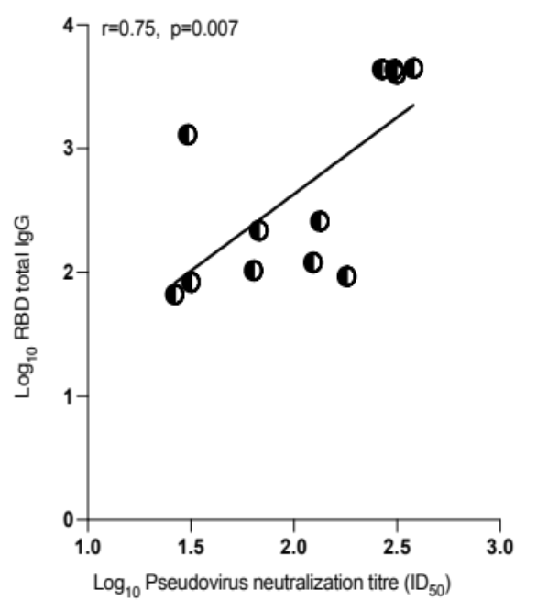
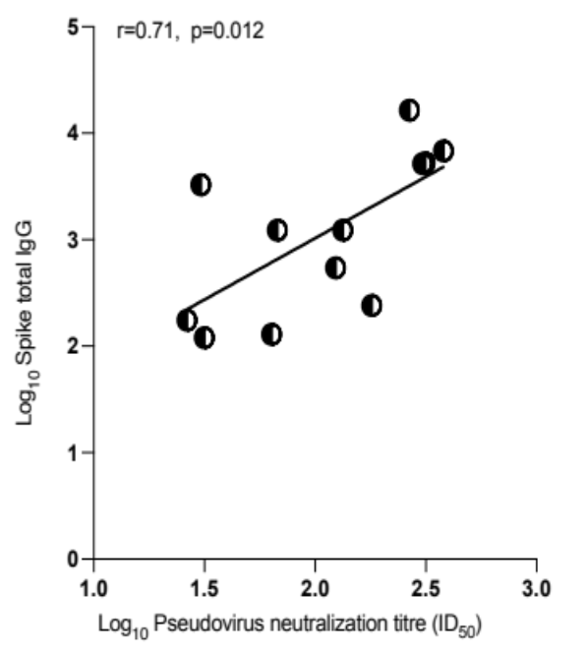
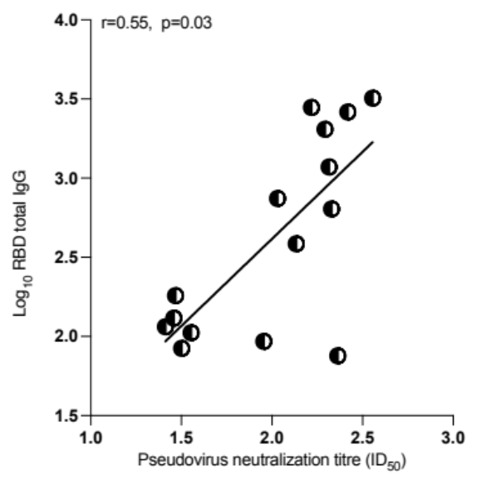
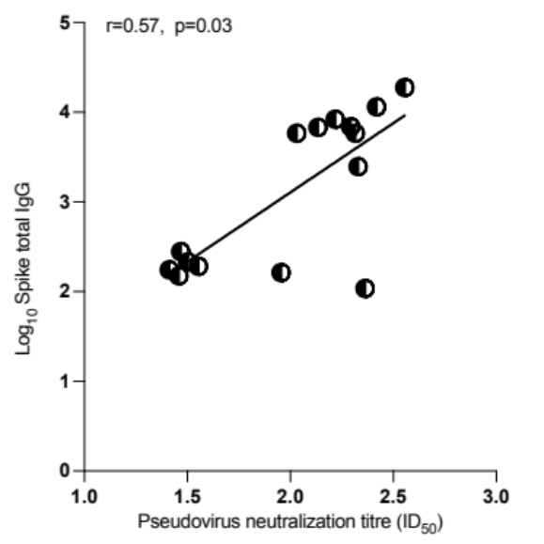
a
b
Supplementary Figure 1a: Spearman correlation between binding and neutralizing antibodies prior to vaccination in Nigerian participants. Correlation between anti-spike full length and receptor binding domain (RBD) IgG binding antibody responses and neutralization by sera against SARS-CoV-2 in a spike lentiviral pseudotyping assay expressing wild-type spike (D614G) ns=not significant. These data include only 11 individuals with ID50>20 at baseline and who were Anti-N antibody negative. ID50 is expressed as log_{10.} b. Spearman correlation between binding and neutralizing antibodies prior to vaccination in Ghanaian participants. Correlation between anti-spike full length and receptor binding domain (RBD) IgG binding antibody responses and neutralization by sera against SARS-CoV-2 in a spike lentiviral pseudotyping assay expressing wild-type spike (D614G) ns=not significant. These data include only 15 individuals with ID50>20 at baseline and who were Anti-N antibody negative. ID50 is expressed as log₁₀

Slide 2
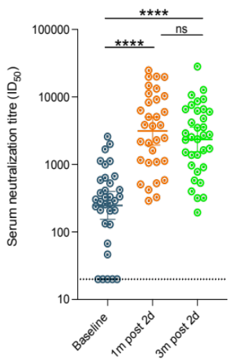
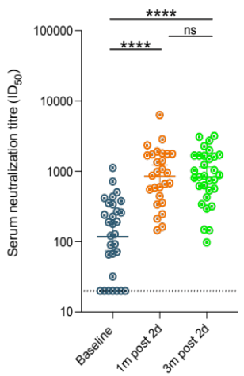
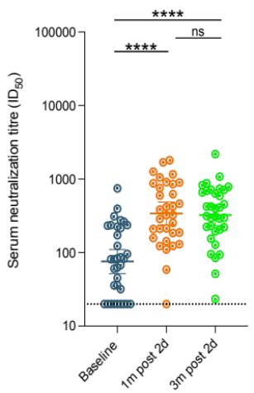
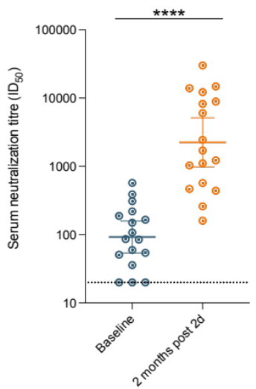
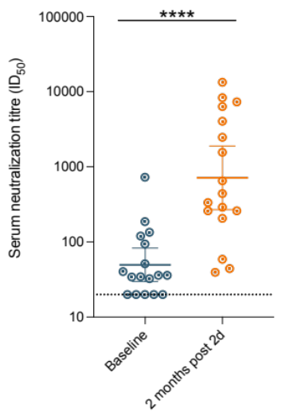
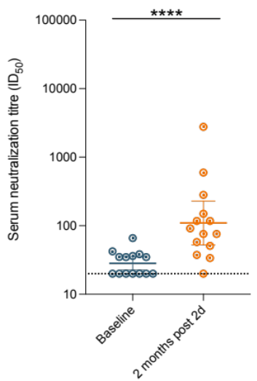
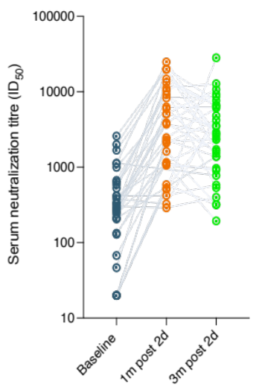
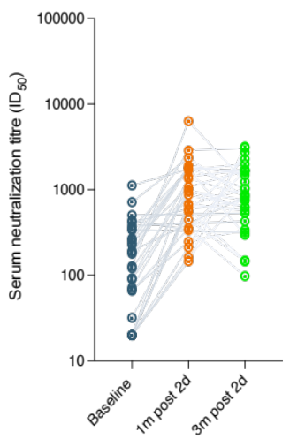
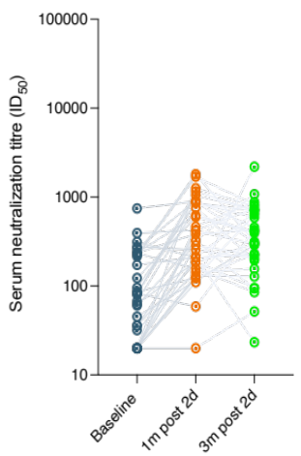
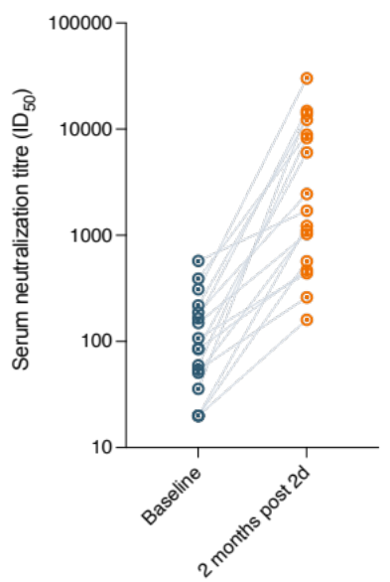
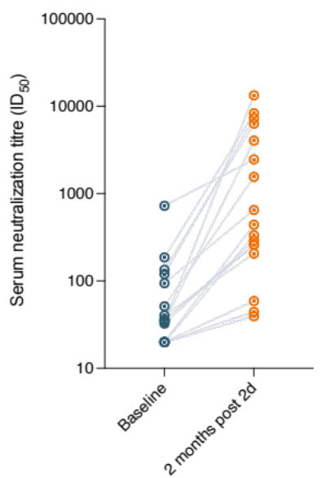
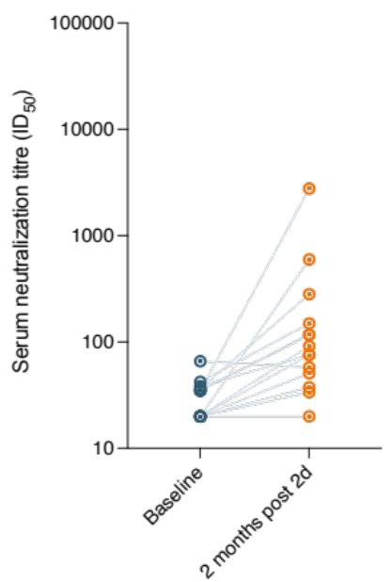
a
Wu-1 D614G
Delta
Omicron BA.1
b
c
d
Supplementary Figure 2: SARS-CoV-2 neutralization by sera from AZD1222 vaccinated individuals who were positive for N antibodies during follow up. Serum neutralization of pseudovirus after two doses of vaccine against pseudotyped virus (PV) expressing wild-type spike protein (D614G), delta and omicron variants of concerns from (n=34) participants at baseline (prior to first dose vaccination), 1m (1 month) after second dose vaccination and 3m (3 months) after vaccination and had ≥1 timepoint where anti-N IgG was positive on study from the Nigerian cohort (Supplementary Figure 2a and 2c) and from the Ghanaian cohort (n=17) [(Supplementary Figure 2b and 2d). Data are representative of two independent experiments comprising of two technical replicates. Data shown as geometric mean titre (GMT) with 95% confidence interval. *P<0.05; ****P<0.0001; ns=not significant.

Slide 3
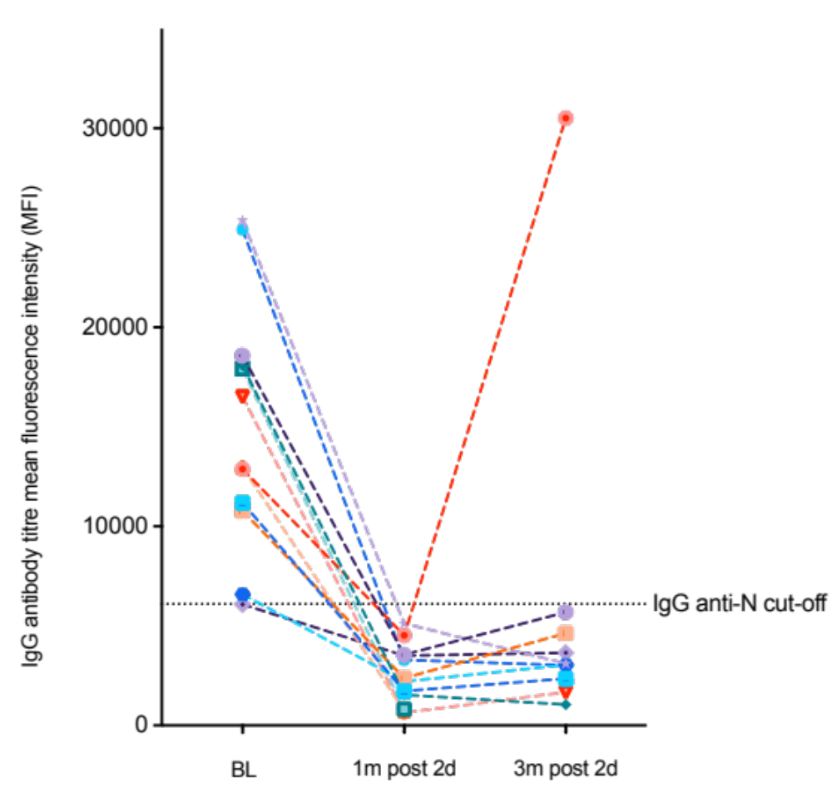
Supplementary Figure 3: Kinetics of SARS-COV-2 total IgG anti-N antibodies in individuals positive for N at baseline from the Nigerian cohort. Note in orange one participant with SARS-COV-2 reinfection following evidence of positive IgG anti-N at baseline; negative IgG anti-N at 1 month after second dose and positive IgG anti-N 3 months post-second dose.

Slide 4
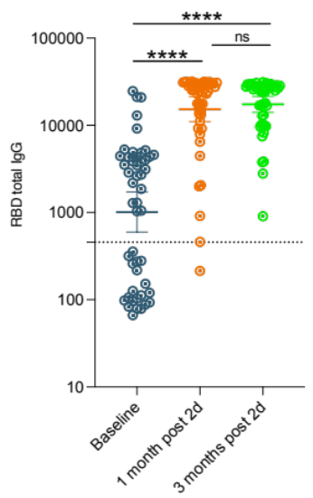
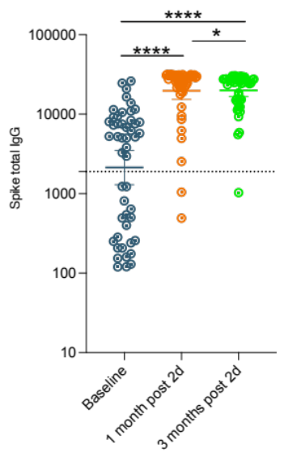
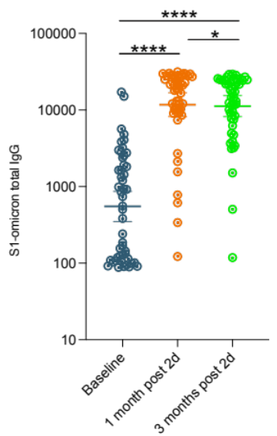
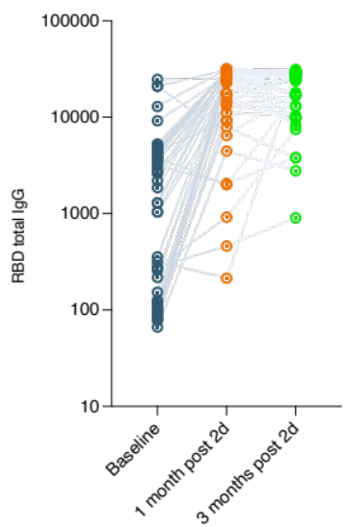
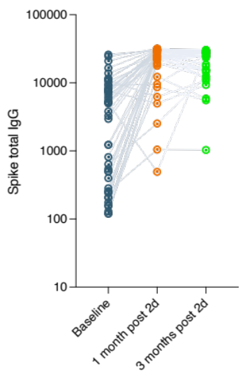
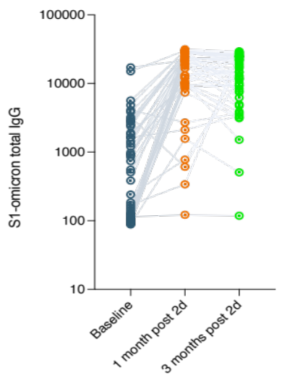
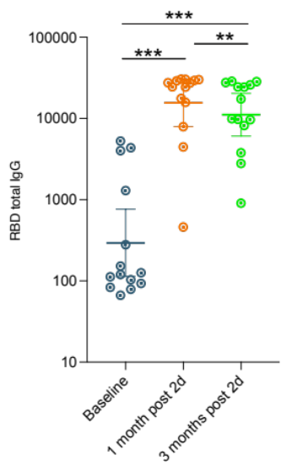
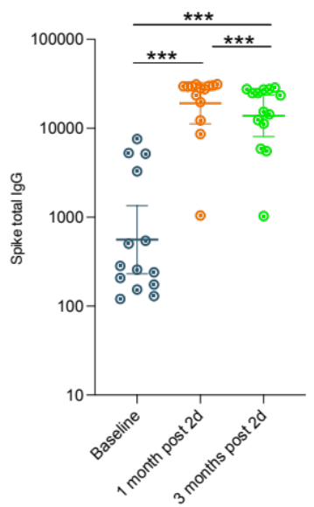
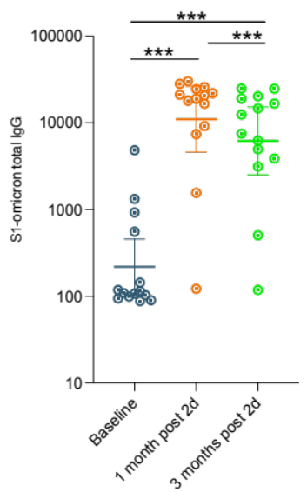
a
b
Supplementary Figure 4: SARS-CoV-2 plasma binding antibodies against Wu-1 RBD and Spike S1 and Omicron BA.1 S1 from AZD1222 vaccinated individuals with 3 months follow up. a) Participants at baseline (prior to first dose vaccination), 1m (1 month) after second dose vaccination and 3m (3 months) after vaccination and had ≥1 timepoint where anti-N IgG was positive on study (N=39). b) Plasma binding antibodies (n=15) participants at baseline (prior to 1st dose vaccination), 1m (1 month) after 2nd dose vaccination and 3m (3 months) after vaccination in participants who were anti-N IgG negative throughout study period. Data are representative of two independent experiments comprising of two technical replicates. Data shown as mean fluorescence intensity (MFI) with 95% confidence interval. *p<0.05; **p<0.01, ***P<0.001, ****p<0.0001; ns=not significant.

Slide 5
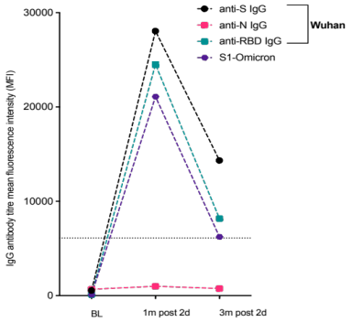
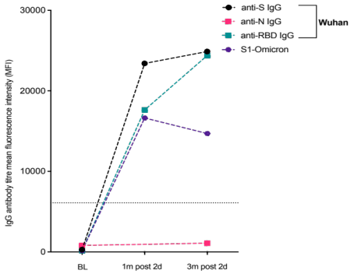
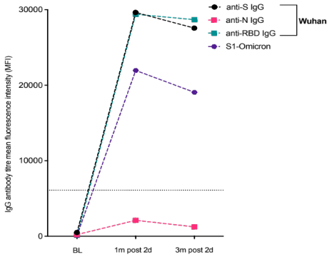
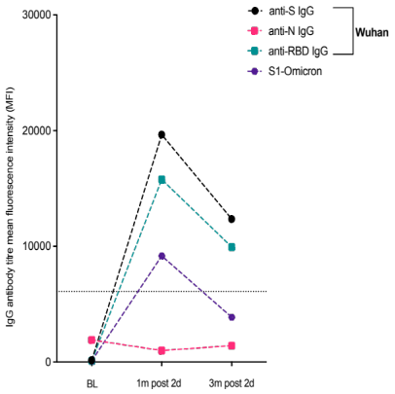
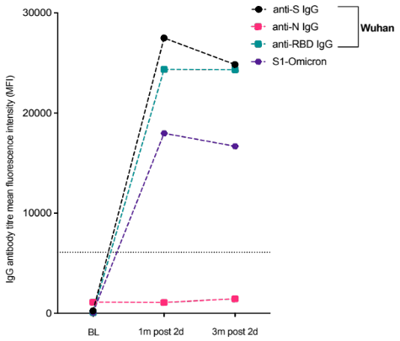
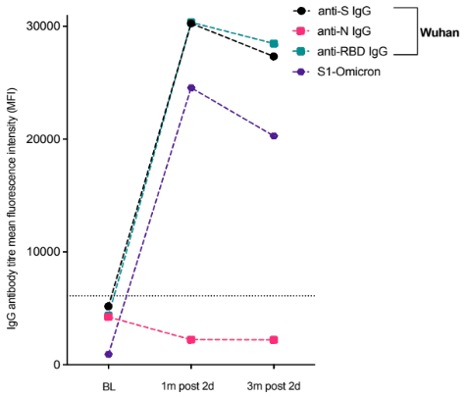
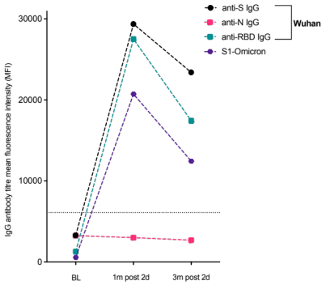
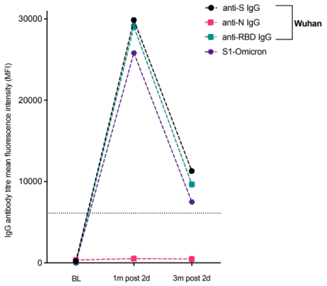
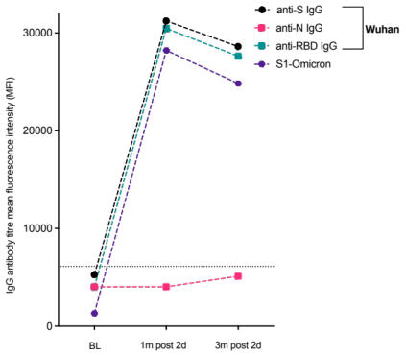
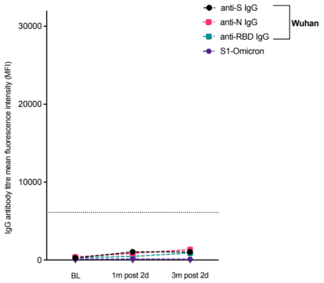
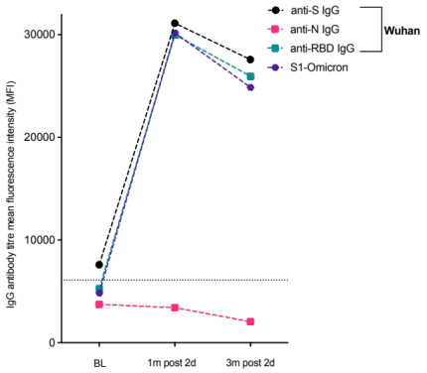
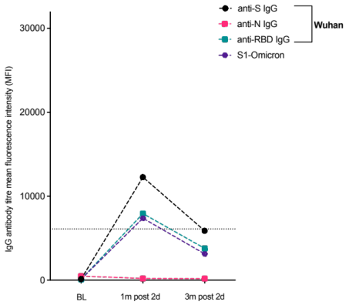
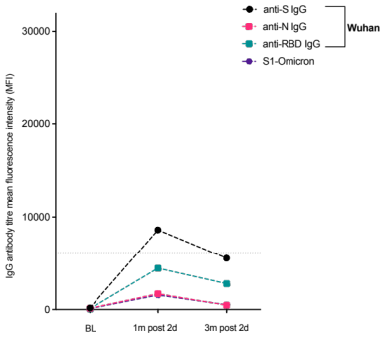
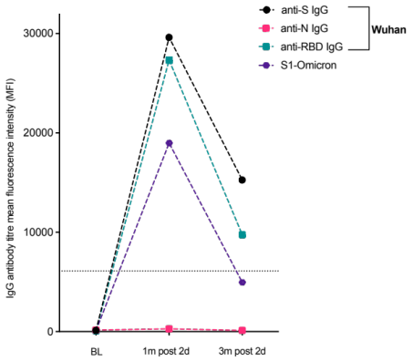
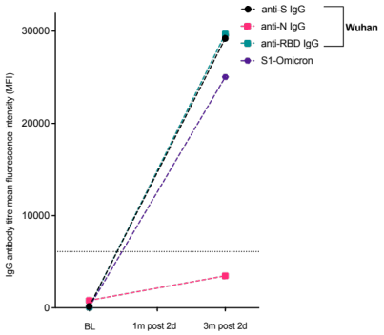
a
b
c
d
e
f
g
h
i
j
k
l
m
n
o
Supplementary Figure 5: Kinetics of anti-SARS-COV-2 IgG binding antibodies to Wuhan-1 and Omicron in eight participants with no evidence of infection throughout study duration from the Nigerian cohort (a-o), at baseline, 1 month after second dose and 3 months post-second dose. Binding antibodies to Wu-1 and Omicron BA.1 are shown. One subject (o) did not have sufficient sample volume available for testing at 1 month after second dose.

Slide 6
 | Follow-up | Follow-up
 | Lagos cohort |  |  | Kumasi cohort
 | All | N-Ab +ve at baseline | N- Ab -ve at baseline | All | N-Ab +ve at baseline | N- Ab -ve at baseline
Characteristic
Total number, n (%) | 49 (100) | 25 (51) | 24 (49) | 45 (100) | 13 (29) | 32 (71)
Age, median years (IQR) | 39 (31, 46) | 37 (31,44) | 40 (30, 49) | 24 (22, 29) | 25 (22, 50) | 24 (22, 27)
Male gender, n (%) | 23 (47) | 11 (44) | 12 (50) | 18 (40) | 6 (33) | 12 (67)
Serum ID50 (GMT, 95 % CI) ª
Baseline | 145 (95, 224) | 431 (297, 627) | 47 (29, 75) | 57 (40, 79) | 106 (55, 201) | 45 (30, 66)
1 month post 2nd dose | 2579 (1689, 3938) | 4674 (2738, 7981) | 1423 (786, 2577) | 1049 (588, 1871) | 2128 (822, 5513) | 773 (366, 1636)
3 months post 2nd dose | 1695 (1112, 2584) | 2217 (1365, 3600) | 1267 (612, 2620)
Table 1: Baseline characteristics of study participants in longitudinal vaccine response study stratified by IgG anti-N status. ª Serum Geometric mean titre (GMT) against Wuhan-614G wild type virus in a. Lagos, Nigeria and b. Kumasi, Ghana.

