Slide 1
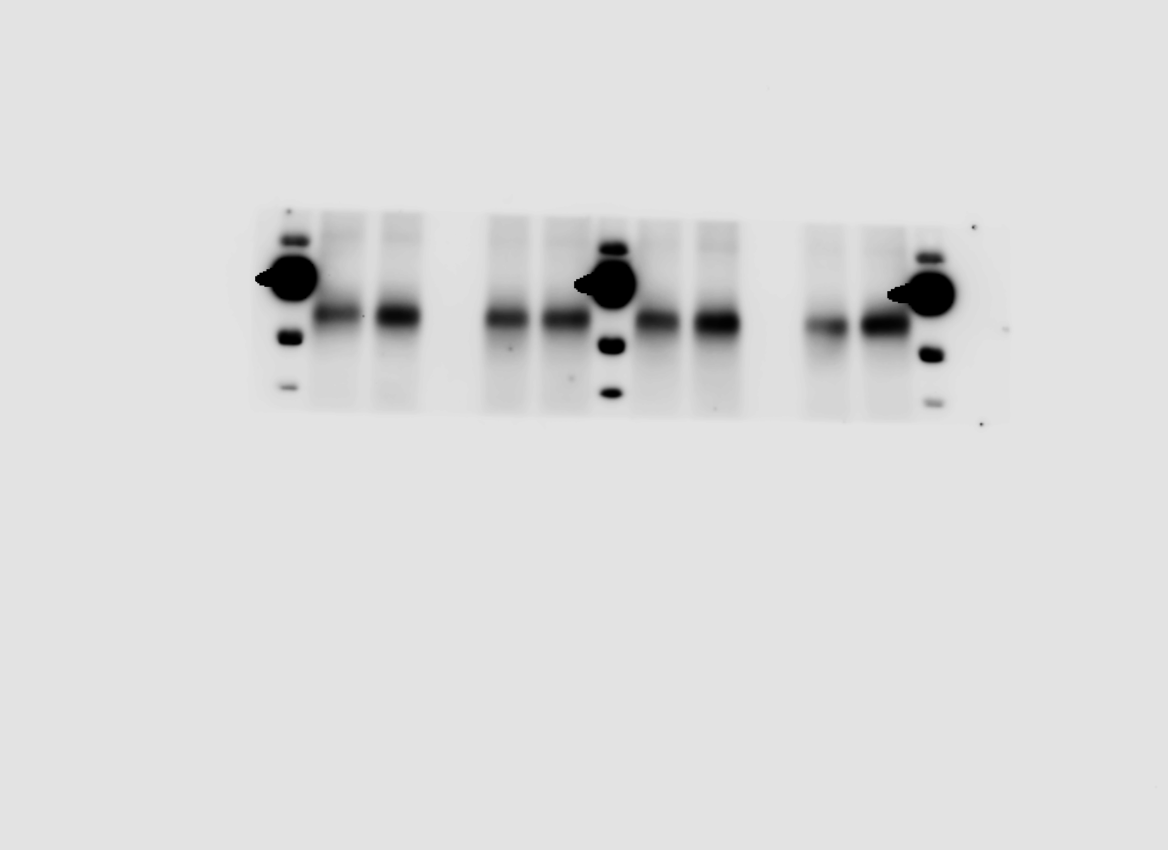
Figure 6A
P-AMPK
Apoe^{-/-} Card9^{+/+}
Apoe^{-/-} Card9^{-/-}
-
oxLDL
-
oxLDL
100kD
100kD
70kD
70kD
55kD
55kD
40kD
40kD

Slide 2
Figure 6A
AMPK
Apoe^{-/-} Card9^{+/+}
Apoe^{-/-} Card9^{-/-}
-
oxLDL
-
oxLDL
100kD
100kD
70kD
70kD
55kD
55kD
40kD
40kD

Slide 3
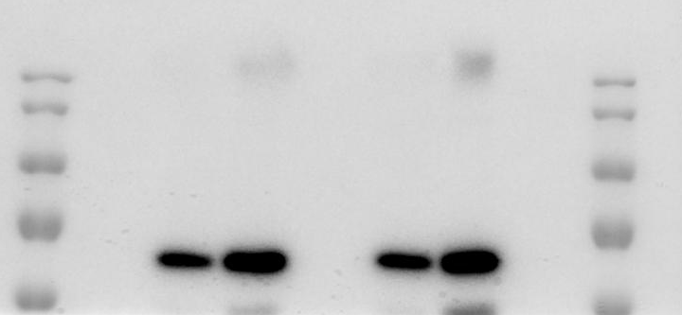
Figure 6A
P62
Apoe^{-/-} Card9^{+/+}
Apoe^{-/-} Card9^{-/-}
-
oxLDL
-
oxLDL
170kD
170kD
130kD
130kD
100kD
100kD
70kD
70kD
55kD
55kD

Slide 4
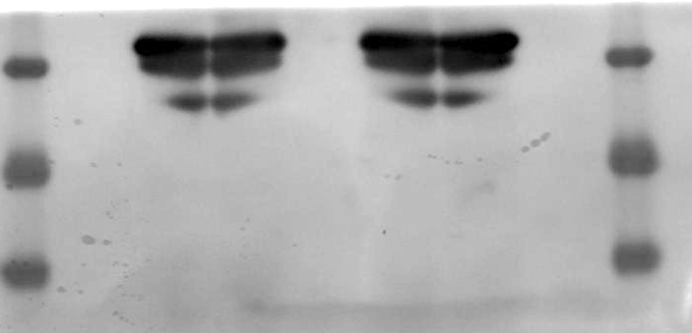
Figure 6A
β-actin
Apoe^{-/-} Card9^{+/+}
Apoe^{-/-} Card9^{-/-}
-
oxLDL
-
oxLDL
40kD
40kD
35kD
35kD
25kD
25kD

Slide 5
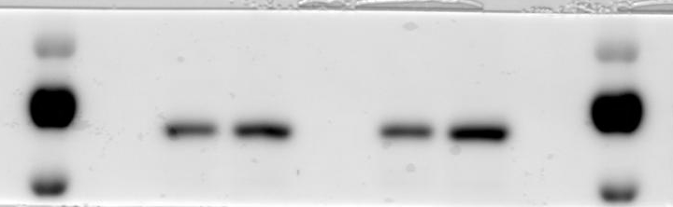
Figure 7A
p-AMPK
CD36^{-/-} Card9^{+/+}
CD36^{-/-} Card9^{-/-}
-
oxLDL
-
oxLDL
100kD
100kD
70kD
70kD
55kD
55kD

Slide 6
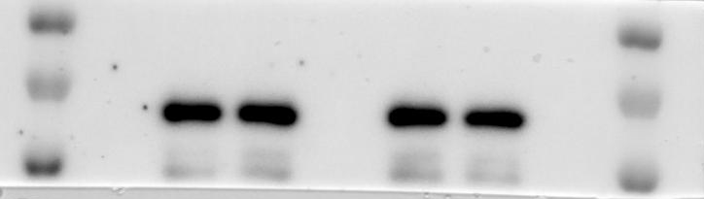
Figure 7A
AMPK
CD36^{-/-} Card9^{+/+}
CD36^{-/-} Card9^{-/-}
-
oxLDL
-
oxLDL
100kD
100kD
70kD
70kD
55kD
55kD

Slide 7
Supplementary figure 7
CHOP
Apoe^{-/-} Card9^{+/+}
Apoe^{-/-} Card9^{-/-}
-
oxLDL
-
oxLDL
35kD
35kD
25kD
25kD
15kD
15kD

Slide 8
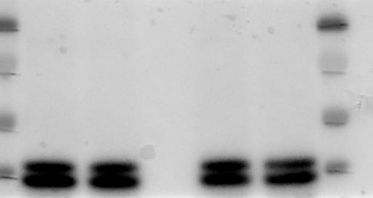
Supplementary figure 7
b-actin
Apoe^{-/-} Card9^{+/+}
Apoe^{-/-} Card9^{-/-}
-
oxLDL
-
oxLDL
100kD
100kD
70kD
70kD
55kD
55kD
40kD
40kD

Slide 9
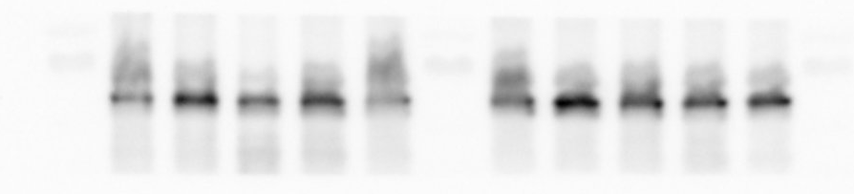
Supplementary figure 7
P-Beclin-1
Apoe^{-/-} Card9^{+/+}
Apoe^{-/-} Card9^{-/-}
-
oxLDL
-
oxLDL
100kD
100kD
70kD
70kD
55kD
55kD
40kD
40kD

Slide 10
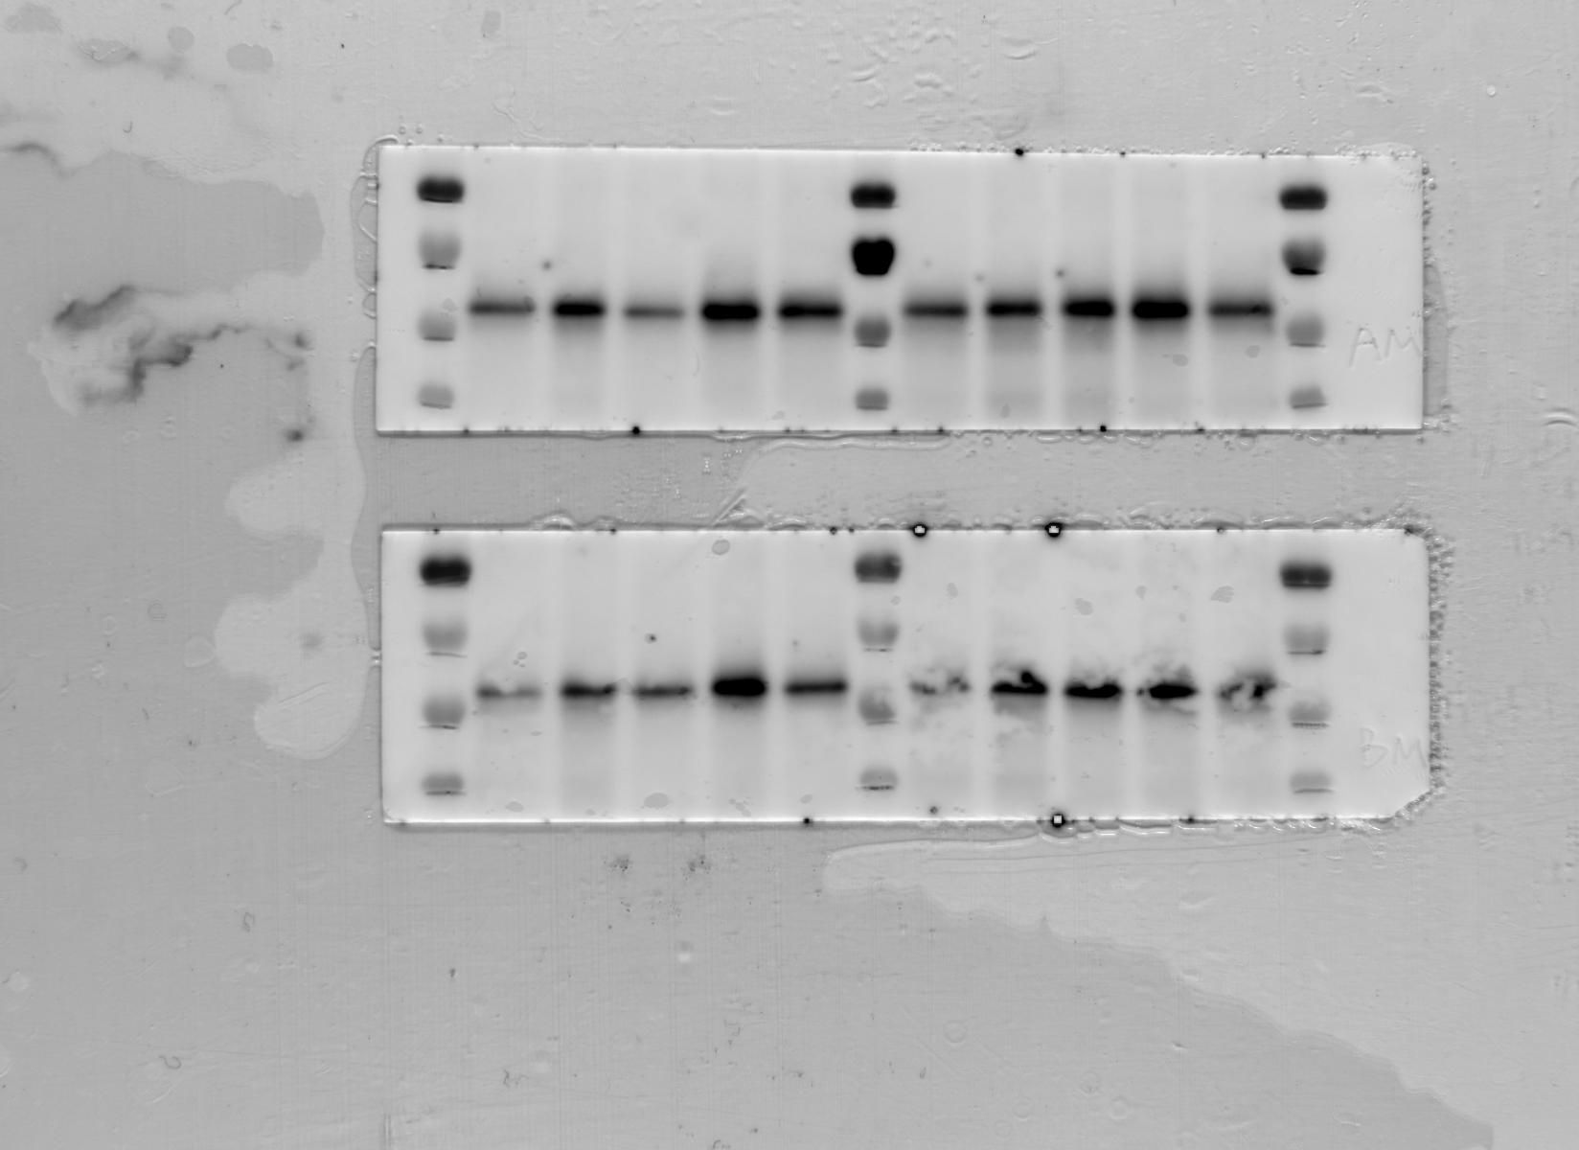
Supplementary figure 7
Beclin-1
Apoe^{-/-} Card9^{+/+}
Apoe^{-/-} Card9^{-/-}
-
oxLDL
-
oxLDL
100kD
100kD
70kD
70kD
55kD
55kD
40kD
40kD

Slide 11
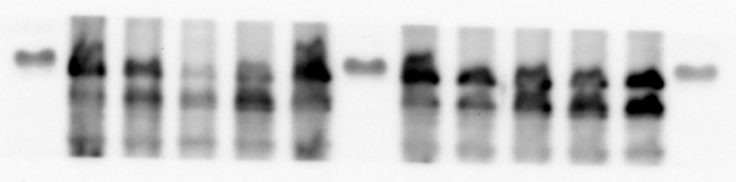
Supplementary figure 7
P-LKB1
Apoe^{-/-} Card9^{+/+}
Apoe^{-/-} Card9^{-/-}
-
oxLDL
-
oxLDL
100kD
100kD
70kD
70kD
55kD
55kD
40kD
40kD

Slide 12
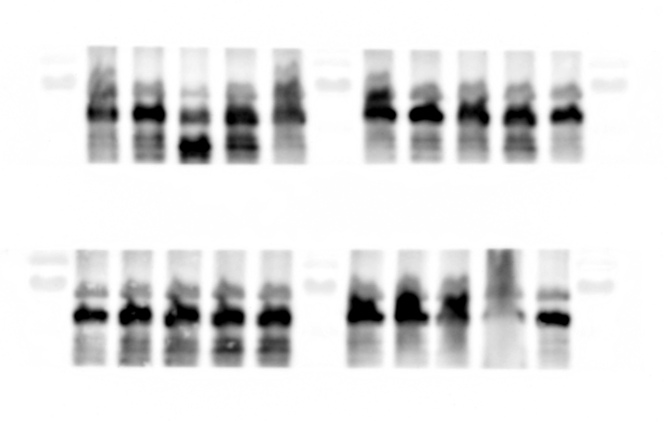
Supplementary figure 7
LKB1
Apoe^{-/-} Card9^{+/+}
Apoe^{-/-} Card9^{-/-}
-
oxLDL
-
oxLDL
100kD
100kD
70kD
70kD
55kD
55kD
40kD
40kD

